Slide 1

#DHSS24
Digital innovation in primary care
Dr Minal Bakhai
Dr Karl Bennett
Director of Primary Care Transformation, NHS England
Senior Partner, Oakley Health Group
Dr Chris Stanley
Dr Shanker Vijayadeva
GP, Haxby Group Practice
GP lead, Digital Transformation – Primary Care (London Region), NHS England

Slide 2
Digital Innovation in Primary Care
Dr Minal Bakhai
GP and National Director of Primary Care and Community Transformation and Improvement, NHS England
19th July 2024

Slide 3
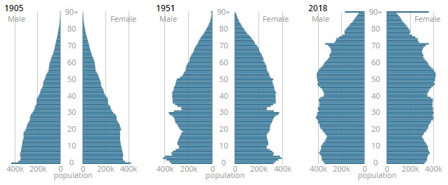
The population has changed considerably over the last 100 years

Slide 4
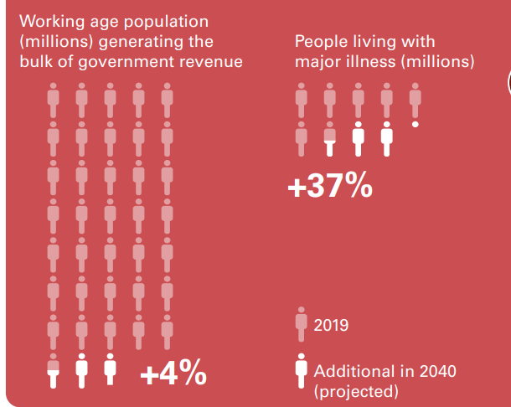
Growing pressures to fund care for a growing population with high health and care needs over the next 15 years
REAL Centre Health in 2040: projected patterns of illness in England, Health Foundation 2024

Slide 5

Modern General Practice (MGP) is a response to demand pressures and the strategic route to integrated neighbourhood working
Traditional general practice
Modern general practice
(reactive care)
Advanced Modern General Practice (with population health)
Integrated neighbourhood working
(proactive care)
‘8am rush’ and ‘call back tomorrow’
One size fits all approach
Inefficient and unfair allocation of capacity “first come first served”
Avoidable GP appointments – allocated based on patient preference not clinical need
GP centric model not multi-disciplinary team
Inefficient workflow
Limited use and understanding of data to plan activity around demand patterns
Widening healthcare inequalities; the demand-capacity gap is unequally distributed
The benefits are cumulative:
Improved patient experience of access
Improved staff working conditions
Better alignment of existing capacity with need
  Improved safety
  Improved equity
  Improved continuity of care
  Improved productivity, reduced avoidable appointments
  Improved co-ordination of care
  Improved resilience
  Released time for proactive care
  Reduced failure demand (UEC and unplanned hospital admissions)

Slide 6
Modern general practice is a generational shift in ways of working.
It consists of 5 key elements
Objectives
Improve patient experience of access and allocation, improve staff working environment, better align existing capacity with need
Building capability to sustain improvement
Goals
See all expressed demand
Understand all expressed need
Support safer more equitable allocation of capacity based on need and optimise existing capacity
Make full use of a multi-disciplinary team
Practice workflow
tasks or stages
Contact
Single workflow to assess need, prioritise and better align existing capacity with need
Improvement
Phone
Collect information
Structured information captured into single workflow
Filter
to separate admin tasks OR request additional information / photo from patient
Assess needs, prioritise & update patient
Assess patient need and urgency. Identify next steps (considering continuity of care). Then signpost, refer, book or resolve and advise patient of next step within the working day.
Consult
Face to face, phone or video with multi-disciplinary practice and PCN team
Improvement Capabilities
Capabilities and shared learning to continue change
Online
Care navigate: Signpost, refer or book according to protocol
Walk in
Clinical triage: Resolve or book for consultation
Patient experience
Patient choice of channels. All open during core hours to ensure parity.
Online patient information and self-serve and self-referral.
Admin request resolved or directed to team.
Care navigated or signposted to community pharmacy and other primary, community and VCSE services.
Request resolved via digital message / phone.
Patient has consultation with multi-disciplinary team within practice / PCN.
Consultation booked with multi-disciplinary team.
Consultation booked with multi-disciplinary team.
Updated May 2024

Slide 7
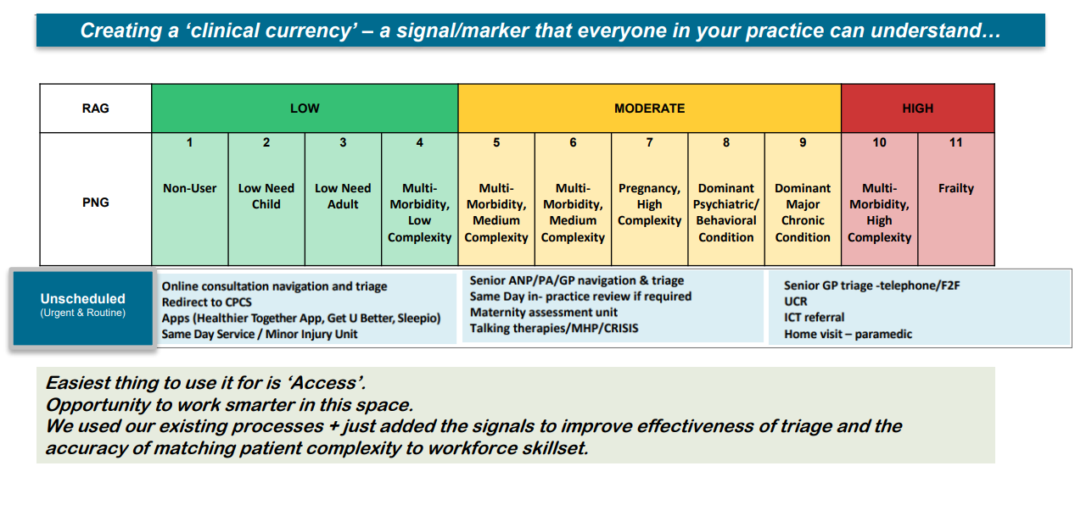
Advanced Modern General Practice uses a population health approach

Slide 8
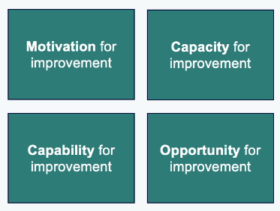
A National General Practice Improvement Programme to support implementation of Modern General Practice: context and improvement quality drives activities, outcomes and benefits
Practice context
Evidence based content
Rigor of improvement cycle
What good looks like; evidenced outcomes and benefits
Improvement approaches for specific improvements (online journeys or care navigation and clinical triage models)
Using highly usable and accessible digital tools effectively
Systematic approach to
Defining goals
Understanding the problem (with data)
Possibilities
Priorities
Measures of success
Specialist skills + expertise
Practice vs PCN working
Delivery capability (prior experience of working as a team in a structured way)
Stakeholder engagement and alignment
Completion
Review and iterate
Drive the size and likelihood of improvement being achieved and sustained

Slide 9
We are on a multi-year journey
Embedding a holistic model of primary care improvement that is evidence based, systematic, focused, aligned and sustained
#OneTeam approach
Importance of partnerships
Alignment of system priorities, enablers, levers and partnerships to accelerate change at scale
Research and evaluation
Evidence based content and quality standards
Practical support and knowledge sharing
Digital usability and accessibility standards and product benchmarking
Strengthened ICB transformation and improvement model and infrastructure
Local primary care transformation leaders, peer communities and inclusion of patient voices

Slide 10
Opportunities
Spread and scale of innovation and improvement is complex
We have a significant opportunity to transform quality of care, productivity, patient and staff experience by enabling ICBs to prioritise, lead and support primary care transformation
How do we collectively strengthen the approach:
  To ensure primary care is involved in shaping transformation priorities
  To ensure priorities align with staff and patient needs
  To enable locally led transformation and improvement
  To ensure primary care is embedded in a system wide response to support the spread and scale of innovation and improvement

Slide 11
Implementing the new General Practice Access Model
(An experience)
Dr Karl Bennett
Senior Partner
Oakley Health Group

Slide 12

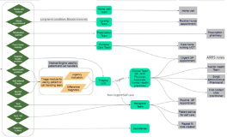

How a practice can organise itself
Clinical and Social campaigns
Community news and services
Service updates
Clinical / Corporate Management (e.g. rota planning)
Social media
Website
Community workflows and pathways
R
A
G
Emis
Emis XA
Connected Care
NHS App
Analytics
Online consultation
RAG
Phone
Email
Walk in
Case finding
e.g. frailty
e.g. LTC clusters
Clinical Admin
Co-ordinated recalls and interventions
ICT
Notes:
To demonstrate processes common to practices regardless of size and structure
Consider this as a small part of overall system activity and therefore the impact of other providers on our ability to provide care

Slide 13
Challenges
We’ve all moved on
Fear of change
Workload
Secondary care pressures
Rising costs vs funding
Staff recruitment and retention
Politics, media and social media
Notes:
OC data helps us to see a predictable pattern of demand
Impact of practice closure for training
Increasing demand before Easter, tailing off during the week after the public holiday. Impact felt due to staff holidays.

Slide 14
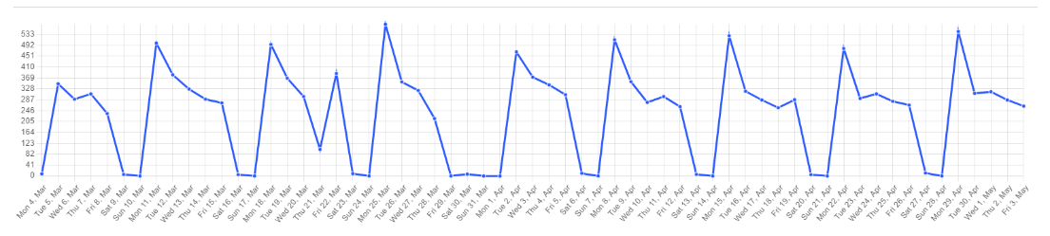
…and the D Word…
Notes:
OC data helps us to see a predictable pattern of demand
Impact of practice closure for training
Increasing demand before Easter, tailing off during the week after the public holiday. Impact felt due to staff holidays.

Slide 15
Everything is interlinked
Patient facing
Patient / population engagement
Front door
Staff management
Pathways
- Admin
- Clinical
Notes:
To highlight impact of proactive care on capacity to provide reactive care

Slide 16

Even simpler…
Proactive
Reactive
Self care

Slide 17
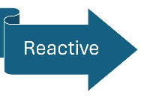
Our wish list for OC
Patient facing
Front door
Pathways
- Admin
- Clinical
Accessible for patients
Captures sufficient structured information to enable care navigation process
Flexible design
Compatible with Emis
Integral to our own system
Compatible with NHS app and website
Supports effective and equitable allocation of clinical skills and time
Helps us prioritise continuity of care for those who need it most
Website
NHS App
Online consultation
Phone
Email
Walk in
Notes:
There is no single perfect solution

Slide 18





What we aimed for

Slide 19



What we didn’t want

Slide 20
Choice of OC tool
Patient facing
Patient / population engagement
Front door
Staff management
Pathways
- Admin
- Clinical
Understand patients’ perspective
Meeting patient needs
GP surgery needs from OC: consider short and medium term
Advanced functions and integration
Website
NHS App
Online consultation
Phone
Email
Walk in
Take time over this critical step

Slide 21
Patient requests workflow
Admin request
Admin team
complete action
Minor Illness Clinic
Advice
Self care or signpost / refer
Clinical request
Patient care navigator
Phone / message
i.e. complete without booking
Own GP
(or buddy group if absent)
Help hub GP
Book phone appointment
Teams e.g. BP, mental health, MSK, women’s health, pharmacy etc.
Book F2F appointment

Slide 22
Patient experience
Improved telephone access
Negatives about the system – “Why can’t I see a doctor?”
Positives – praising efficiency, access and ability to consult remotely
Some frustration with having to use the online service
Some encountering difficulties with access

Slide 23
Staff feedback
For some clinicians, a sense of control and feeling that patient management is more thorough
Ability to prioritise cases
Helps structure care
Collaborative approach
Varying levels of confidence with remote management
Hasn’t solved capacity problems
More training needed

Slide 24
Cycle of development
  Increased efficiency
  Collaborative
  Adaptable
  Work in parallel
  Reducing risks
  Reliable user feedback
Plan and requirements
Analysis and design
Implementation
Testing
Evaluation and review
Notes:
To emphasise for all staff to understand this process improving collaboration and support

Slide 25
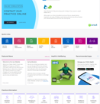
Relentless promotion and support
  Social media
  PPG
  Drop-in sessions for support with OC
  Constant drip-drip approach
  Whole team approach with support for staff
Website
NHS App
Online consultation
Self care
Phone callback
Email
Walk in

Slide 26
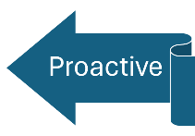

The many needs for monitoring
PROVIDERS
CONDITIONS
Chronic disease management (QOF)
Community Mental Health
Acute NHS Trust
Chronic disease management (non QOF)
General Practice
Primary Care Hubs
Shared care medication monitoring e.g. DMARDs,
?Private Providers
Stand alone monitoring e.g. post bariatric surgery

Slide 27
Planning proactive care
Recall by birth month or complete within a few months
Prioritise more complex patients
Automate whenever possible
Aggregate activity into as fewer contacts as possible
Match patient types to suitable staff
Group consultations (e.g. prediabetics, lipid management, respiratory reviews)

Slide 28
Summary
Online consultation is integral to a whole practice approach
Reactive and proactive care both need to be developed to maximise efficiency and release capacity
Patient and staff experiences and involvement are vital
Continuing cycle of development
Better to feel more in control of change
Capacity remains an issue

Slide 29
Working with Industry
Chris Stanley
GP @ Haxby Group

Slide 30


Commercial Partnerships
Notes:
When working with commercial partners sometimes we give a narrative of them being on the ‘dark side’.
However my experience is not this but we just need to mindful how we approach these partnerships in order to stay true to our values.
Even more than this I think the NHS requires the expertise, innovation and resources that private enterprise requires.
We may not often think of GP partnerships as private enterprises but there is not a black line that defines NHS and commercial

Slide 31
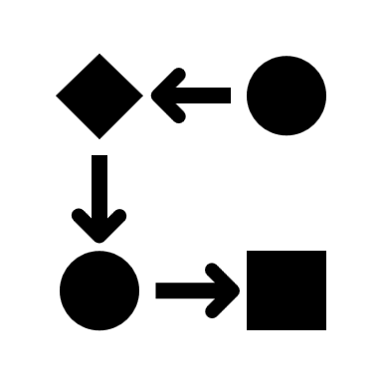



WBLL
Notes:
Is everyone familiar with WGLL framework, this is my version and its what bad looks like.
2 stories to illustrate my framework. The names and identity of some of the characters have been changed in order to preserve their anonymity (or dignity)
There once was a GP practice that recognised the value of RPA, mainly in their back office function, they were so confident they employed a single person and took out a 12 month licence to run existing back office functions not only for their own practice but several practices, after several months of preparation they were ready to go live, the launch was soft and gradual, teething problems became more like fundamental issues, the person employed solely to run this project left, £35k of RPA software and licensing was left redundant
Digitise a bad pathway
Ignore humans/have a single point of failure
2nd story
Once upon a time a young naïve GP spent several months having exciting positive meetings with a large company over the opportunities their tech company could offer general practice. Process maps were drawn, enough infographics and use cases to sink a ship were created. A few months in and the commercial heads of terms conversations were started. Lets just say the assumptions made on both sides were wide of the mark. I thought their 2 billion euro R&D annual investment might be find a small % to prop up the project, they didn’t and they thought we money
Make assumptions
Leave it to the last minute to talk contracts/money

