Slide 1

#DHSS24
Serving communities though digital services
Chair: Paul Charnley
Tom Micklewright
Co-Chair Digital Blueprinting Steering Committee (NHS England)
clinical lead for digital transformation, Cheshire and Merseyside ICS
Emma Arrowsmith
Katie Heard
digital matron, County Durham and Darlington NHS FT
head of research and data insights, Good things foundation

Slide 2
#DHSS24
Emma Arrowsmith
digital matron, County Durham and Darlington NHS FT

Slide 3
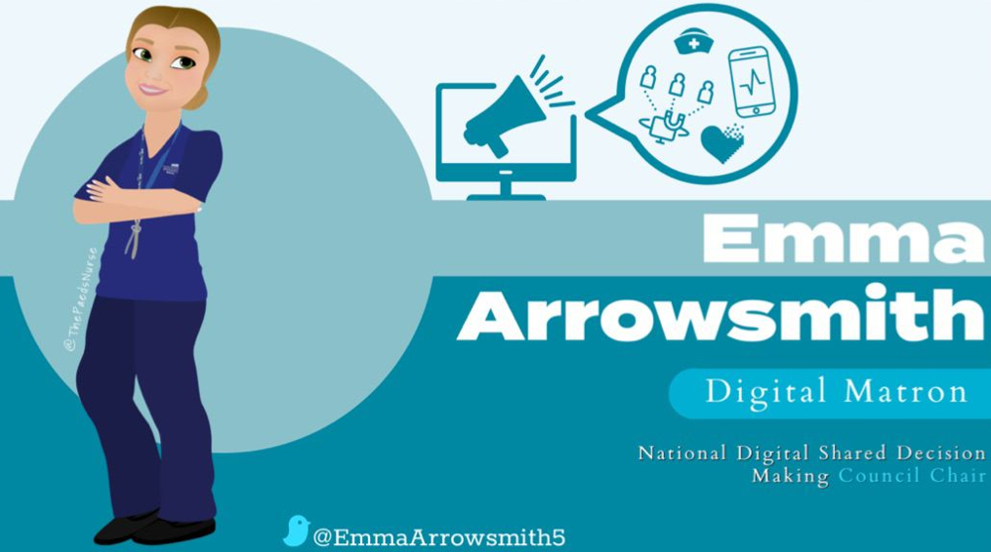
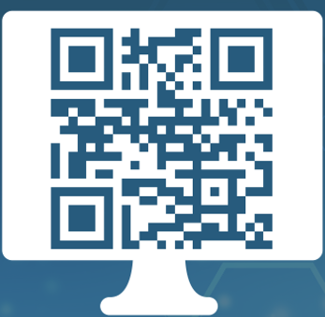

Slide 4
#DHSS24
Tom Micklewright
clinical lead for digital transformation, Cheshire and Merseyside ICS

Slide 5
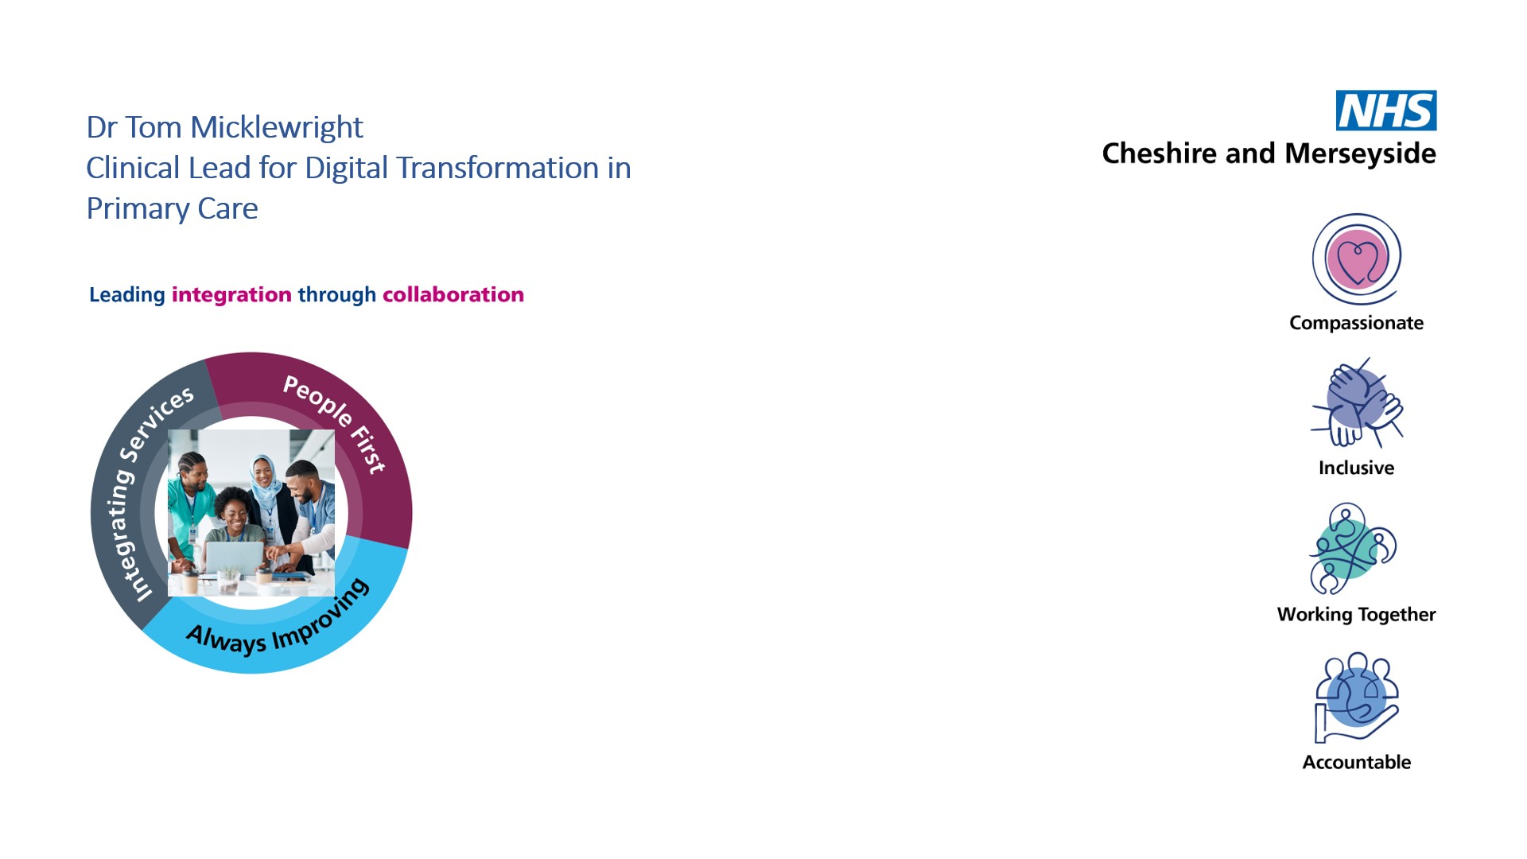
SERVING COMMUNITIES THROUGH DIGITAL SERVICES: HEALTH APPS
Dr Tom Micklewright
Clinical Lead for Digital Transformation in Primary Care,
Cheshire and Merseyside ICB

Slide 6

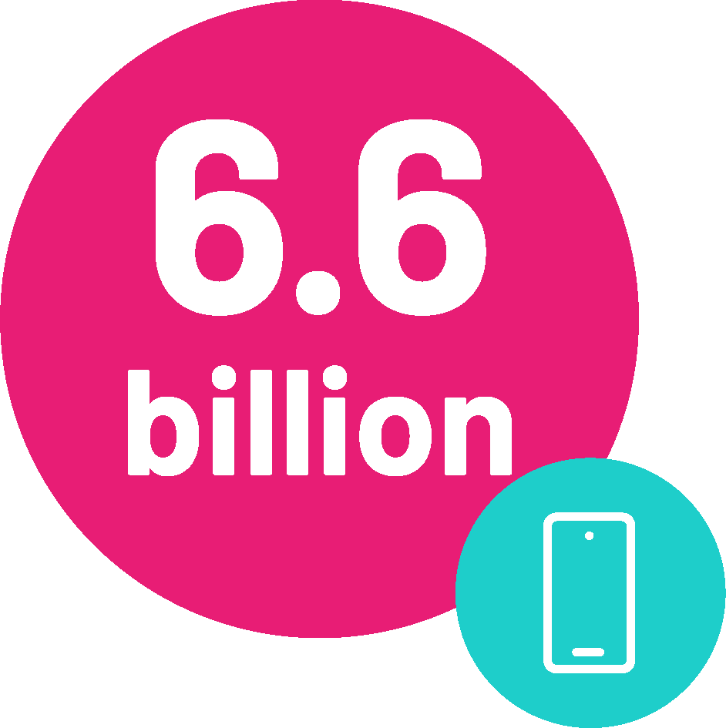
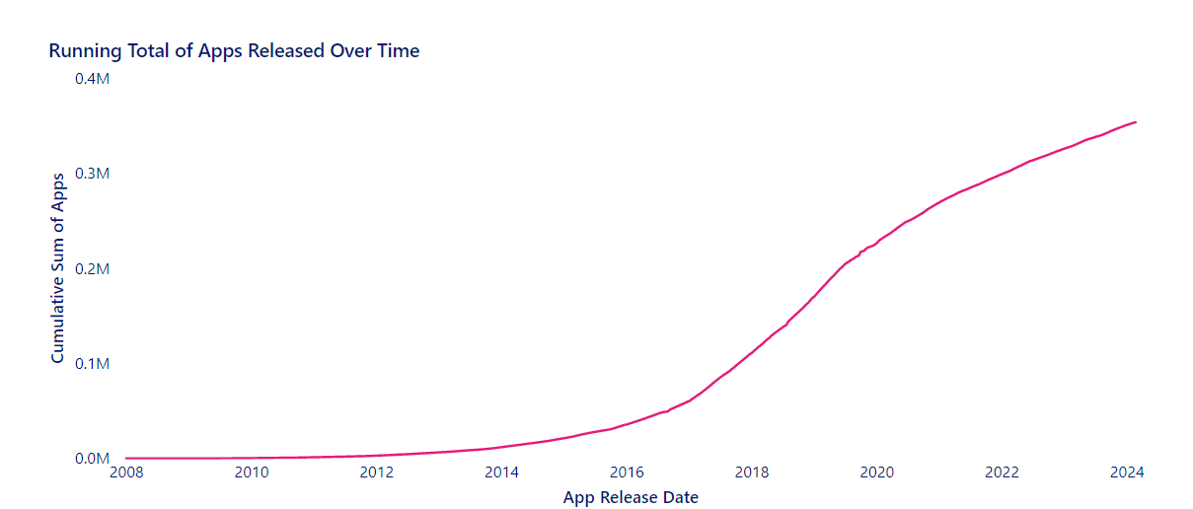

THE DIGITAL OPPORTUNITY
People across the world have a smart phone
That’s more people than
own a toothbrush
Number of Health Apps released over time
6
5m
People download a health app every day.
UK
1
United States
India
3
Mexico
4
93%
of clinicians believe digital technologies can help.
5
Singapore
Brazil
2
350,000
there are 350,000 digital health technologies to choose from.

Slide 7

THE DIGITAL OPPORTUNITY
68% of people agree, or strongly agree, that it is vital we all look at new ways to manage our health, including using high-quality health apps.
This has grown by almost 10% since 2022.
This support is now consistent nationwide.
Age is not a barrier. 60% of people aged over 65 years are digital health advocates.
When asked, 68 out of every 100 people advocate for the use of digital health.

Slide 8
STRATEGIC DELIVERY ROADMAP
 | By March 25 | By March 26 | By March 27
Empowering Patients | Increase number of record views and repeat prescriptions ordered through NHS app Increase uptake of NHS app through partnership working with local colleges, councils and VCFSE organisations Promote uptake of NHS app in community pharmacy Share good practice models and templates for appointment booking and cancellation and two way patient communications through NHS app, and encourage use of this functionality in practices Develop a consistent offer of digital based information and apps for patients, promoting approved sources and apps into general practice and sharing good practice across the system Share good practice in digital self-referral pathways across C&M and encourage adoption | Development of a consistent model of patient record access and repeat prescription ordering across PCNs and then C&M more broadly, encouraging the ‘phasing out’ of local practice portals in favour of NHS app Enhance the digital inclusion heatmap to support on-going targeted NHS app uptake campaigns into the ‘hard to reach’ groups Develop standard model for C&M practices for appointment booking and cancellation and two way communications through NHS app Support integration of approved sources of digital based information and apps into models of care through Clinical Networks and support increased uptake in social prescribing pathways Develop a small number of high impact ‘at scale’ digital self-referral management models for potential widespread adoption | Support implementation of a standard model for appointment booking and cancellation and two way communication with patients through NHS app across C&M, with an initial focus on increasing the uptake of online appt booking for high volume services Promote and support enhancements in NHS app functionality for increased patient benefit Review and update approved sources of digital based information and apps, and commission new approved sources and apps where gaps exist Support implementation of standardised digital self-referral pathways where appropriate and identify other potential pathways that would benefit from a standardised, ‘at scale’ approach
Notes:
Roadmap diagram
Set out high level plans for each year of the strategy
What we need to do
How we will do it
What is will deliver (intended benefits)

Slide 9
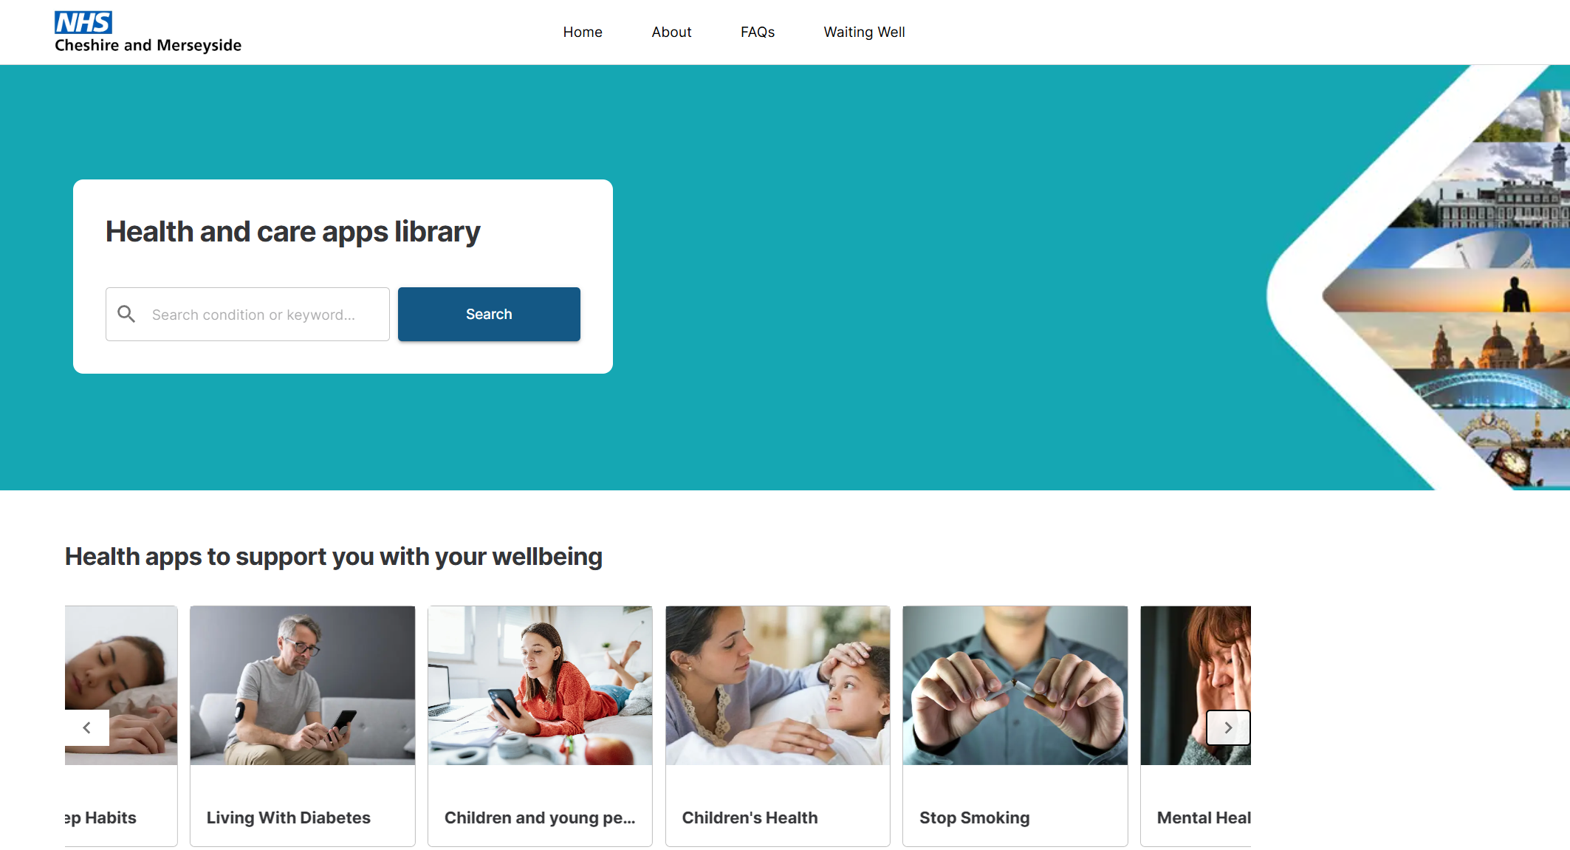
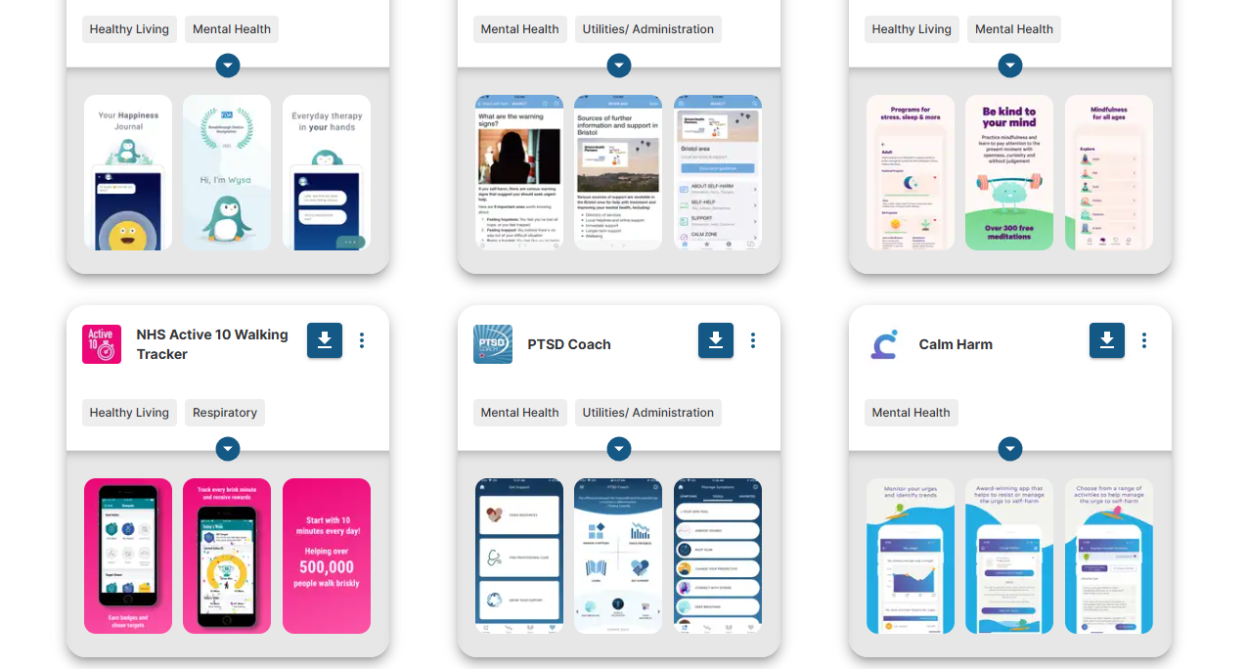
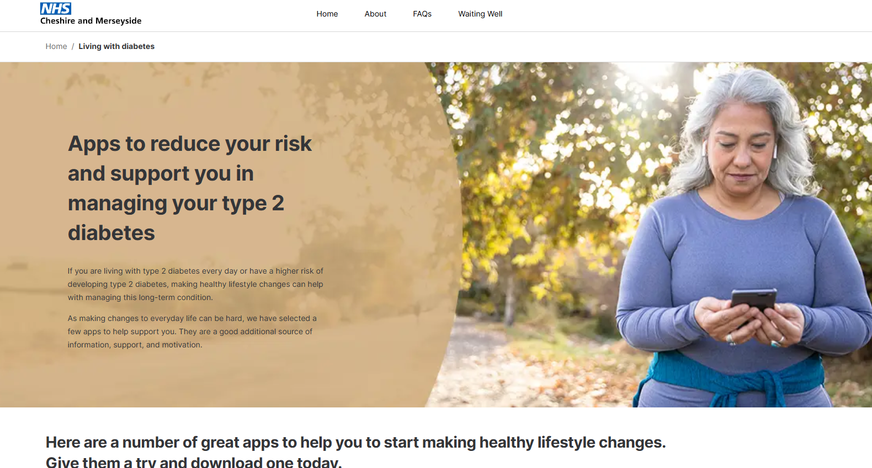
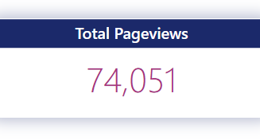
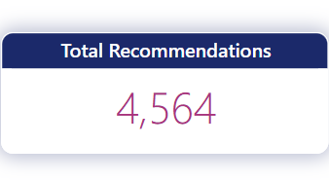
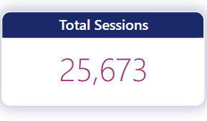
THE C&M HEALTH APP LIBRARY
Data from October 2022 to July 2024

Slide 10
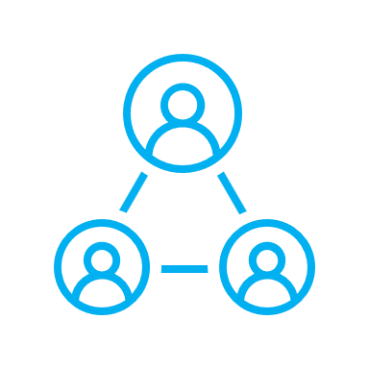

Outcomes and Results
Digital Care Pathways
E-comms
Campaigns
Social
Prescribing
Winter Pressures Campaign
Elective Care Campaign
- 7648 Page visits over 2 months
- 27% download rate
Wellbeing CIC – bespoke digital health formulary.
Team makes ~90 app recommendations per month
Estimated savings £65K per annum
Patients, HF teams, Primary Care.
Redesigned Heart Failure Pathway.
Matching digital tools to unmet patient needs.

Slide 11
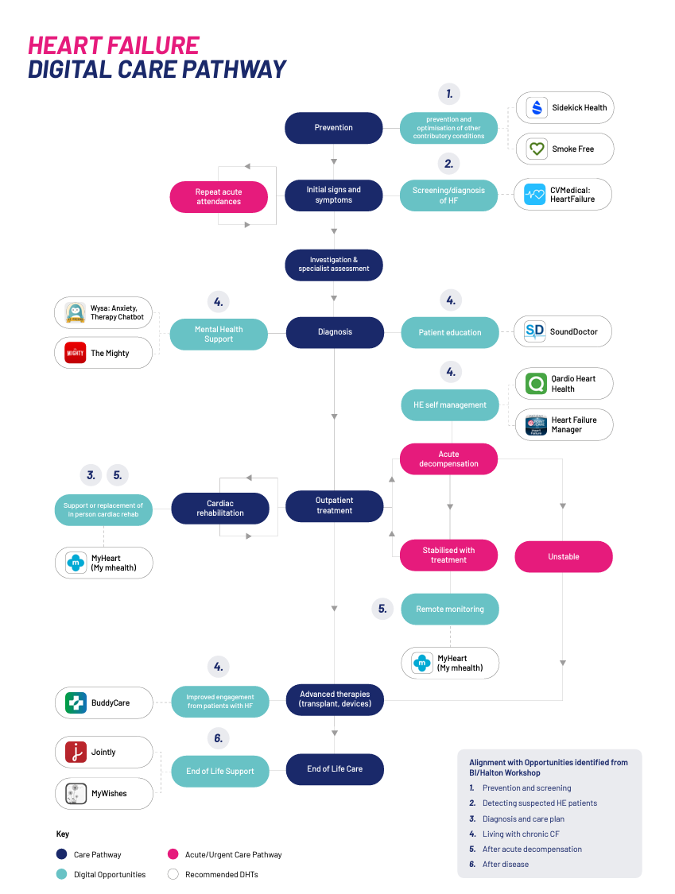


THE C&M HEART FAILURE DIGITAL CARE PATHWAY
This project was led by a deep understanding from heart failure patients and clinicians themselves about their experiences and we collaboratively generated solutions that underpin this new pathway.
I am hopeful that we can improve the experience and outcomes for patients across heart failure pathways, with a view to offering it more widely in other regions

Slide 12
Support for those on mental health wait lists
Using SDE and Apps – unplanned admission avoidance
Digitally Supported Early Discharge
THE DIGITAL FUTURE

Slide 13
#DHSS24
Katie Heard
head of research and data insights, Good things foundation

Slide 14
Serving Communities Through Digital Services
Thinking About
Digital Inclusion
Katie Heard
Head of Research and Data Insights

Slide 15
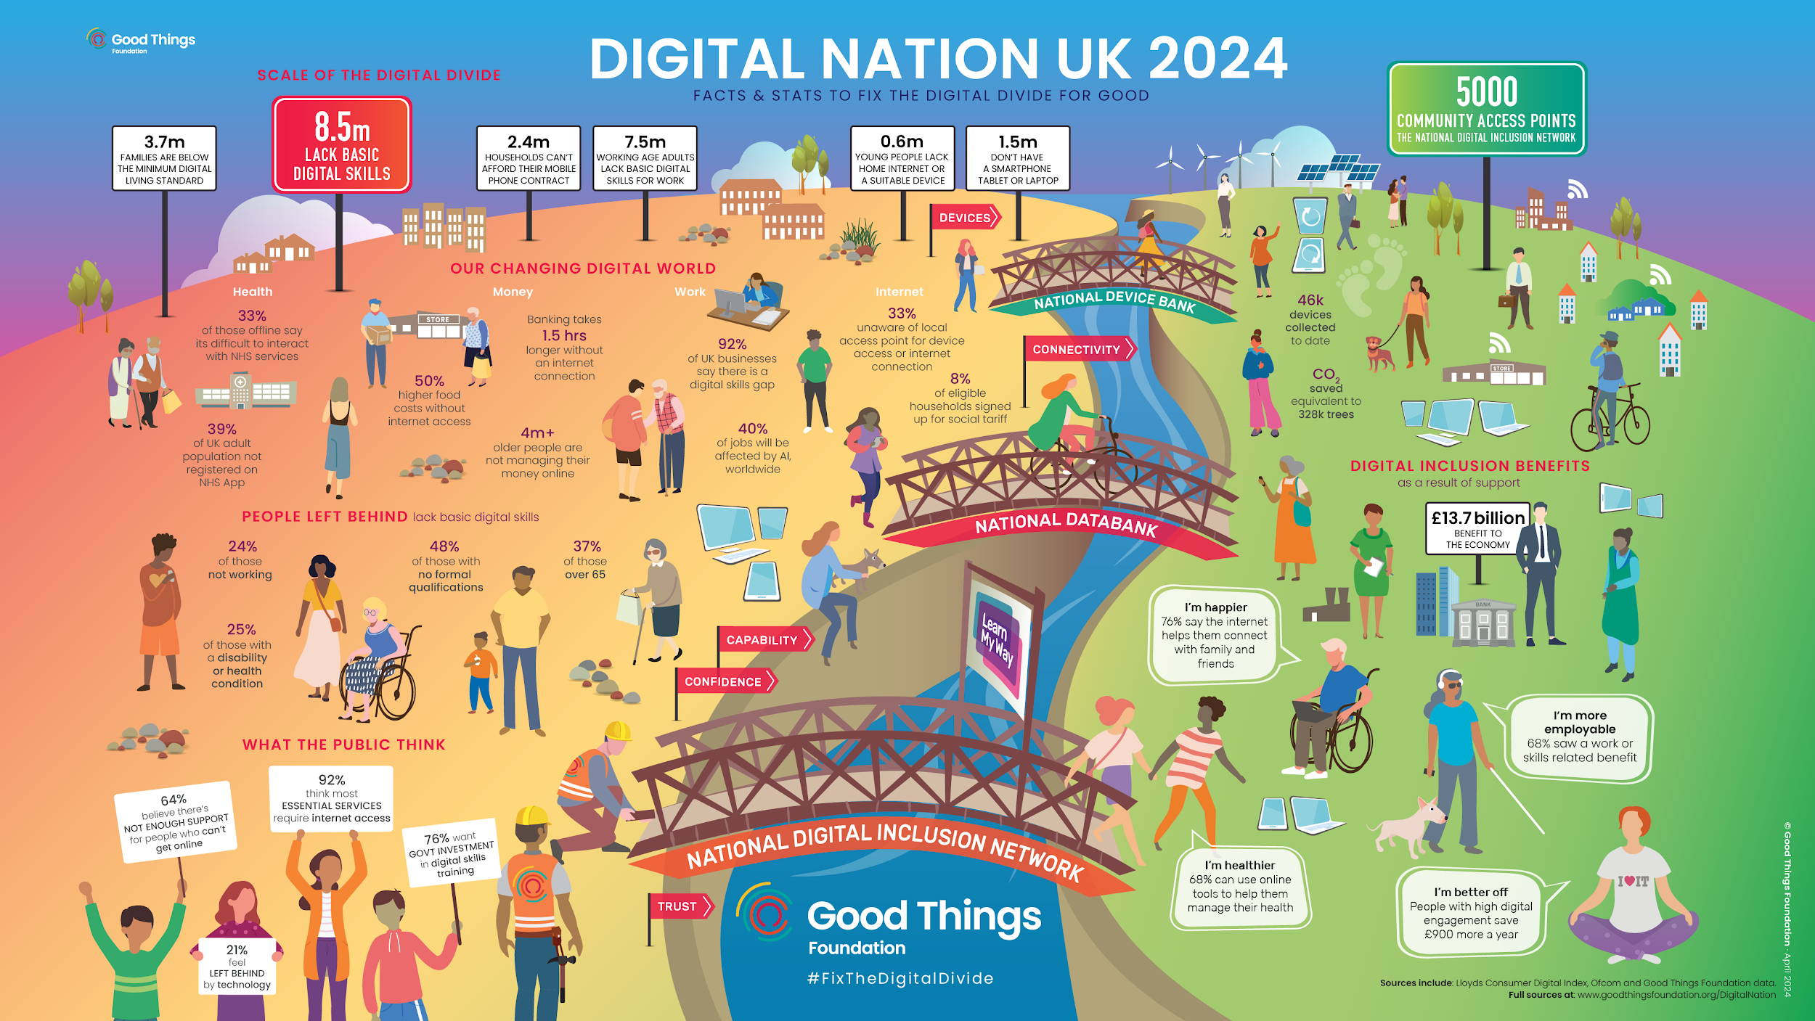

Slide 16
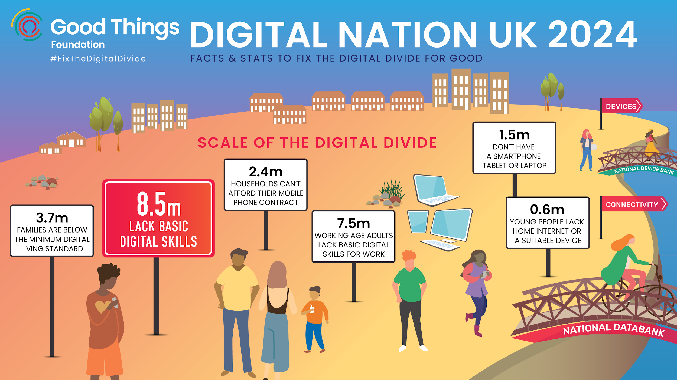

Slide 17
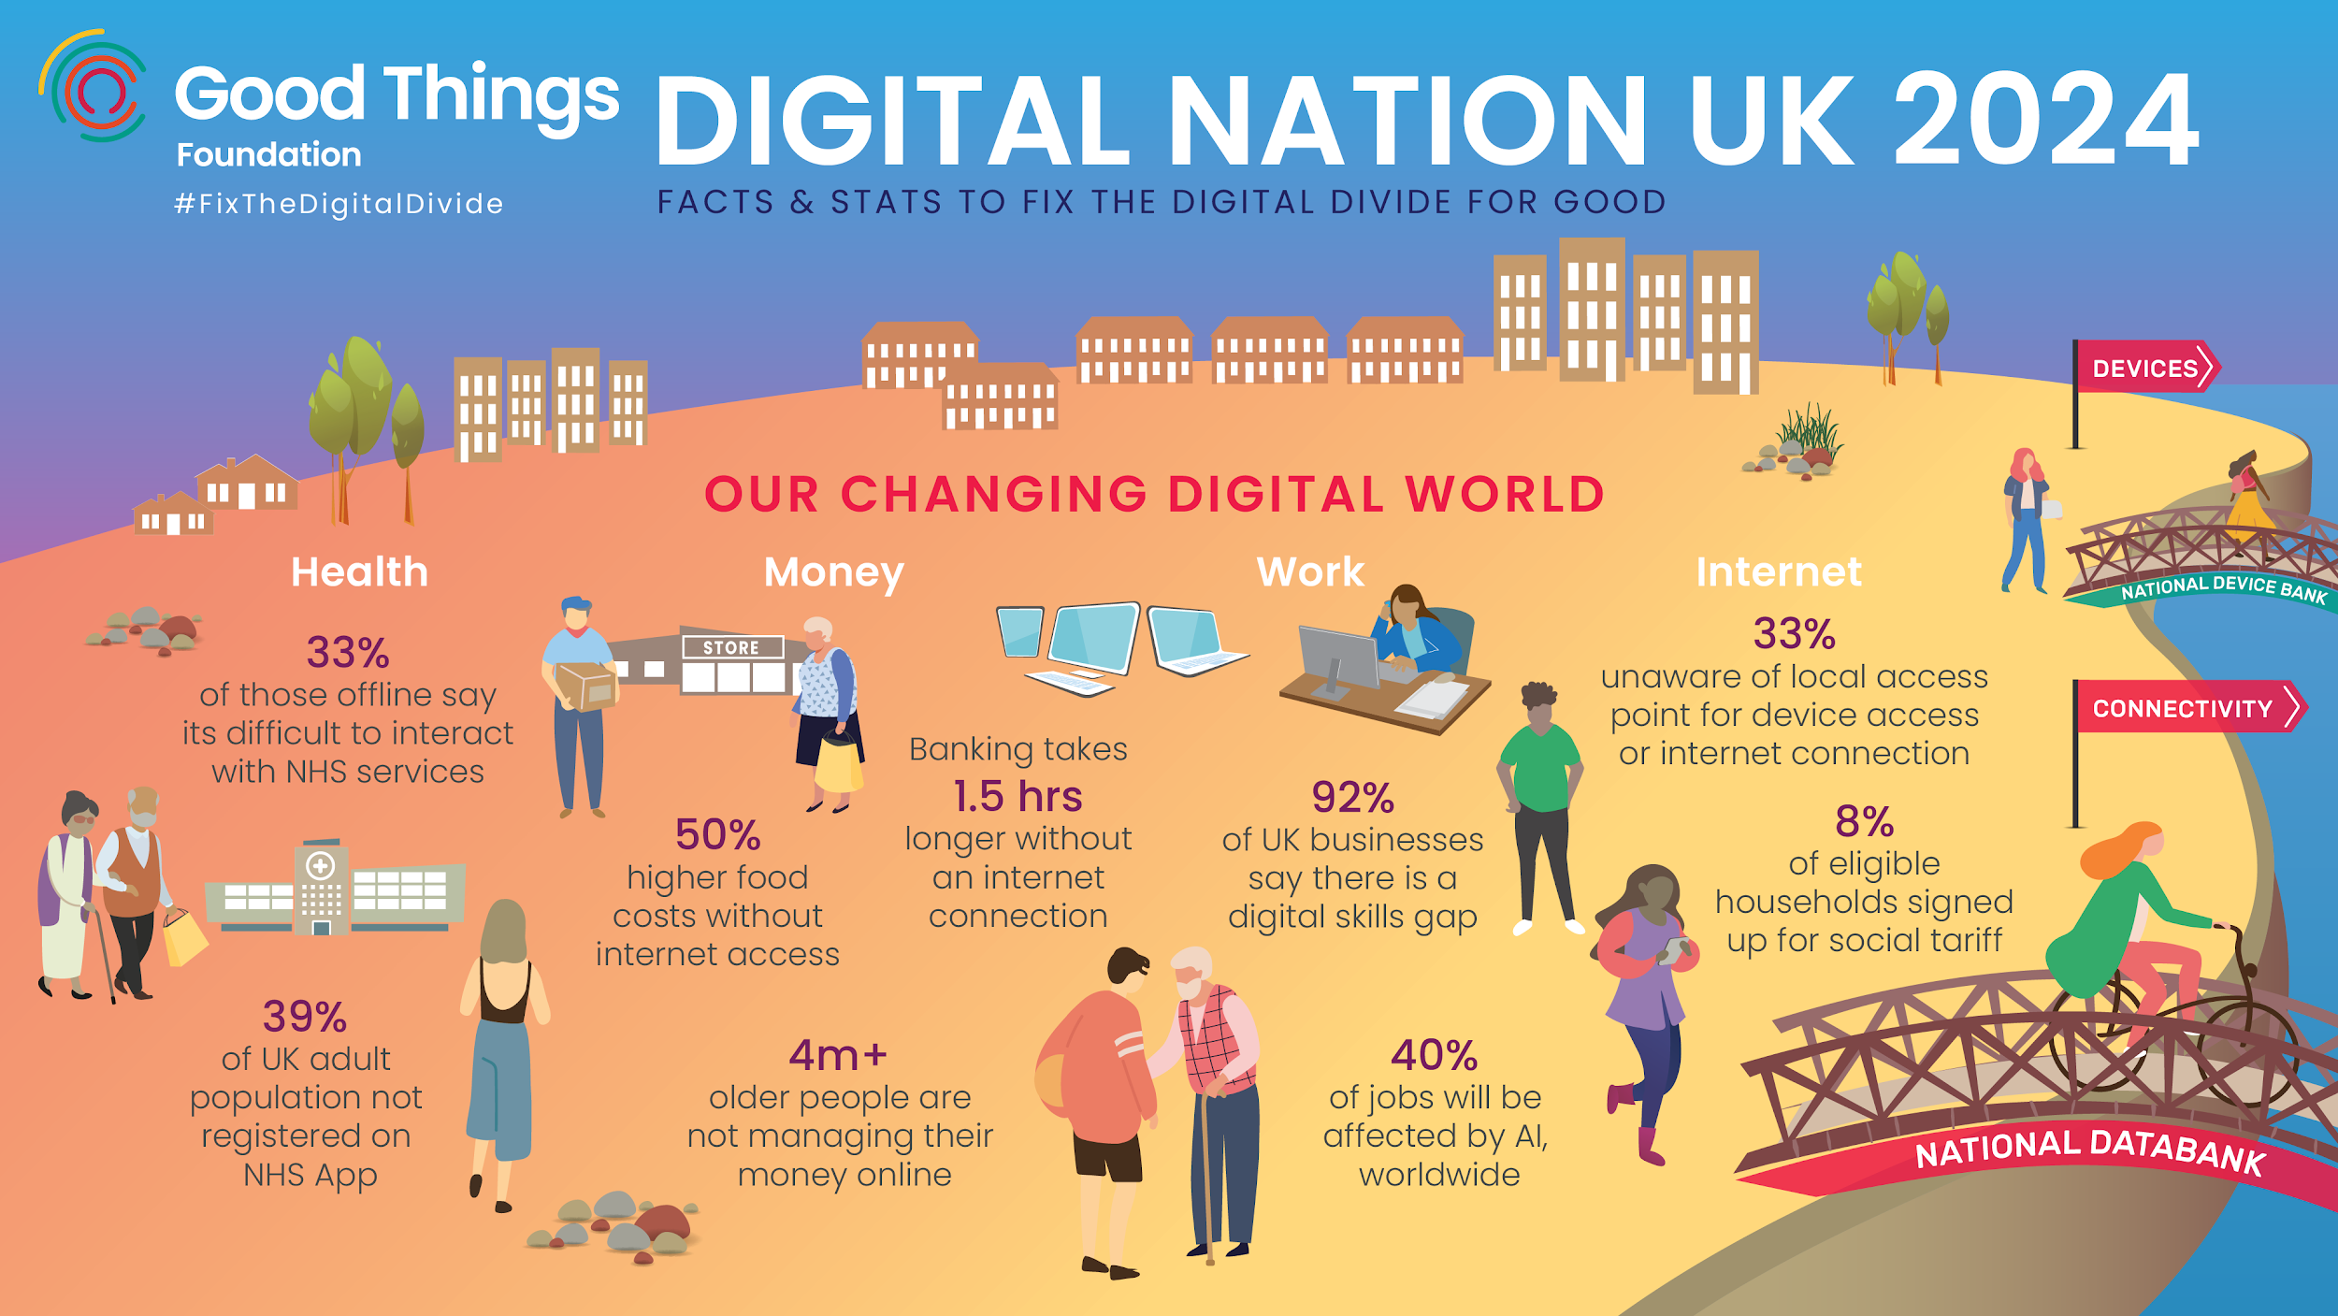

Slide 18
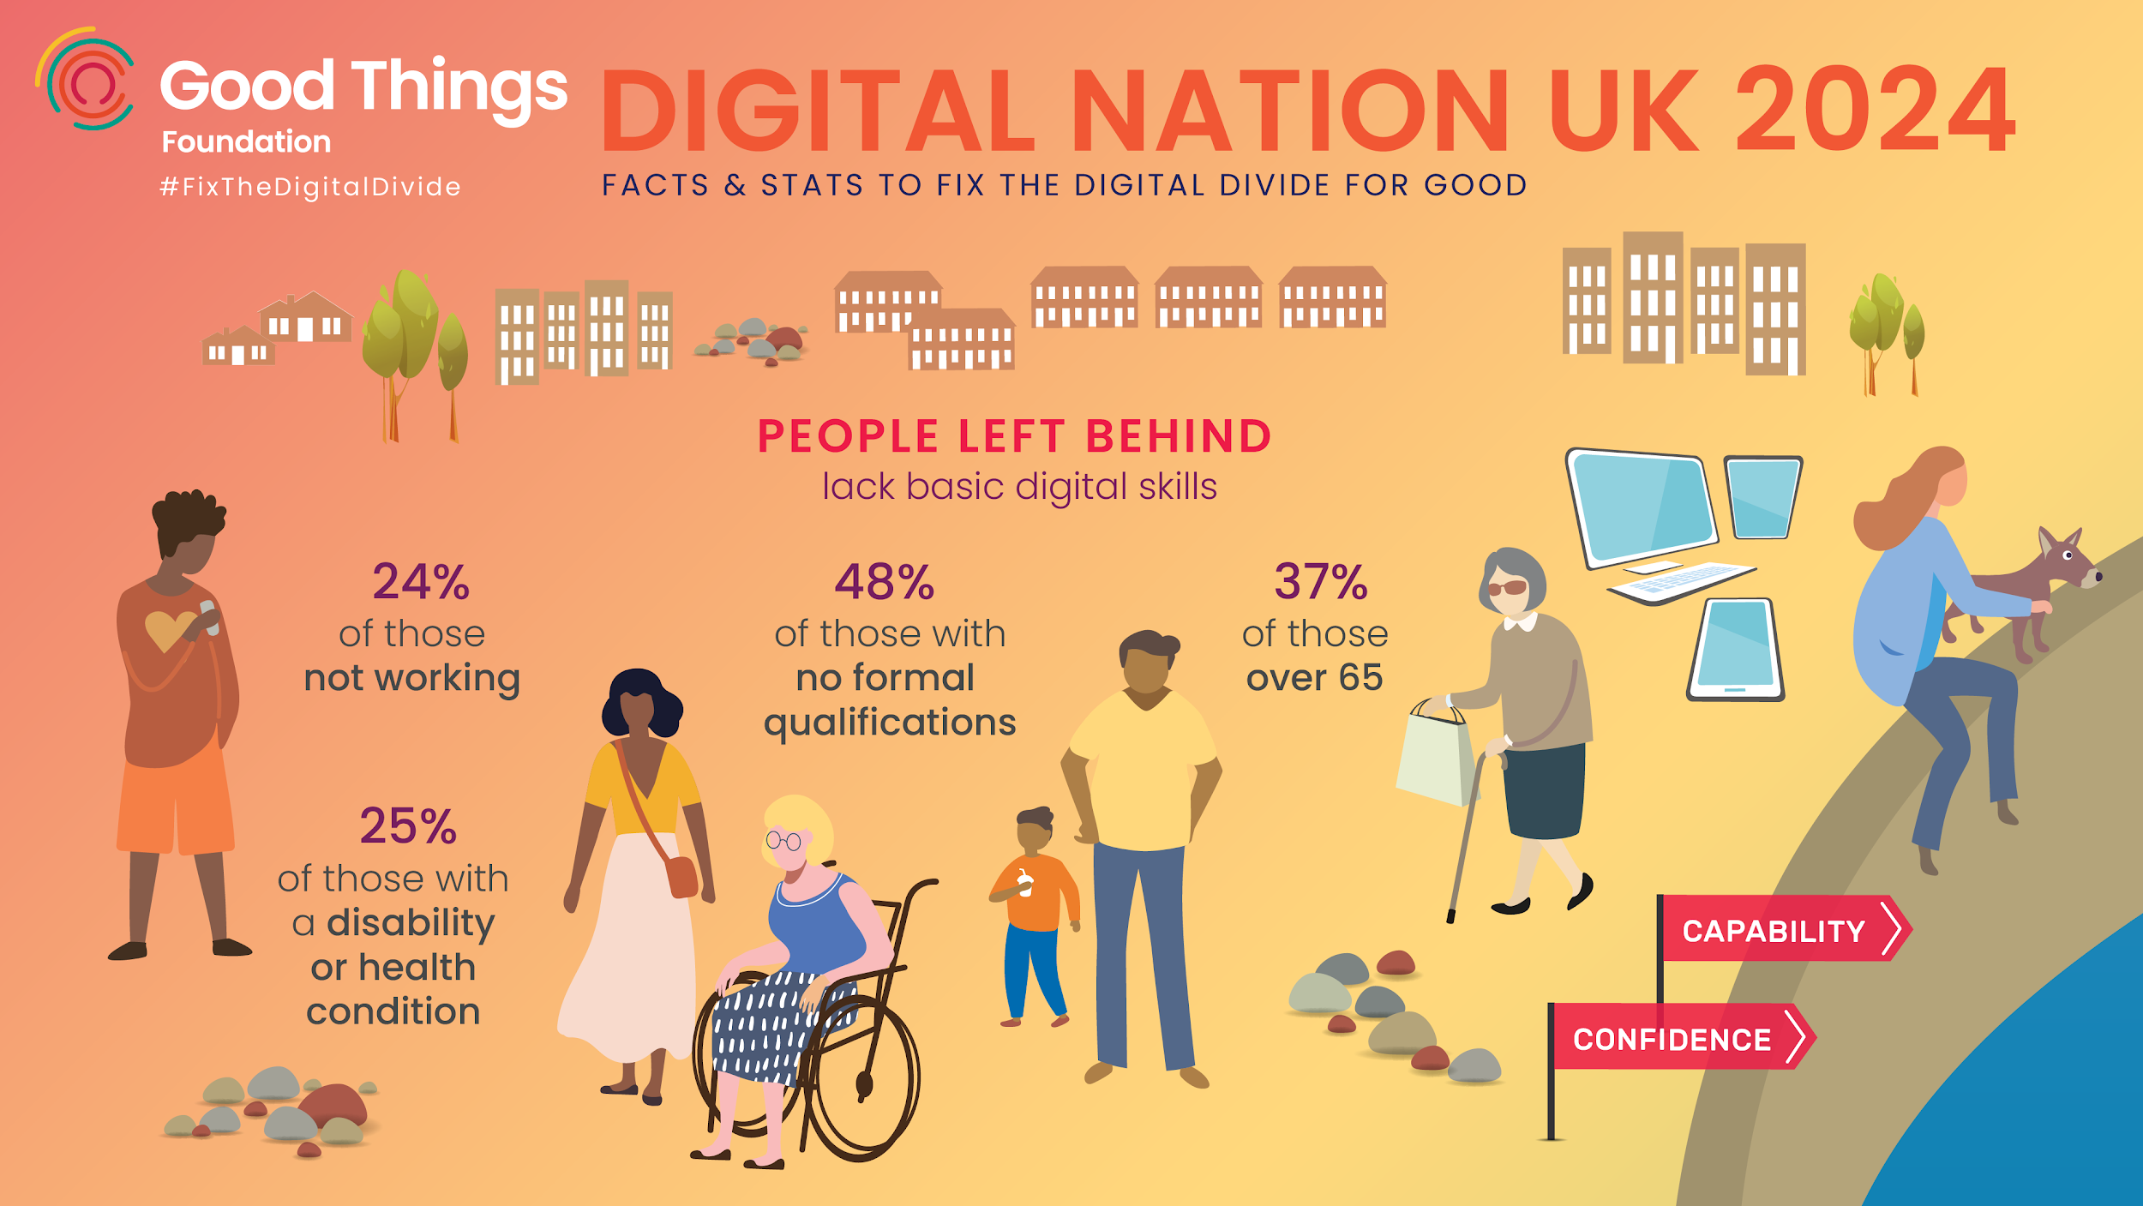

Slide 19
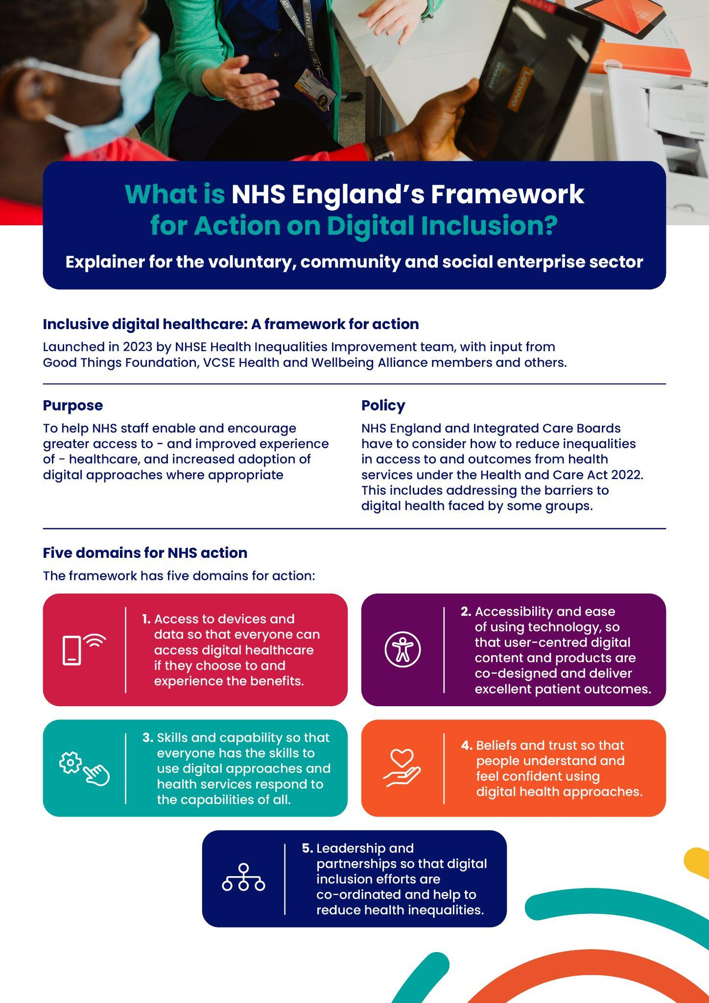
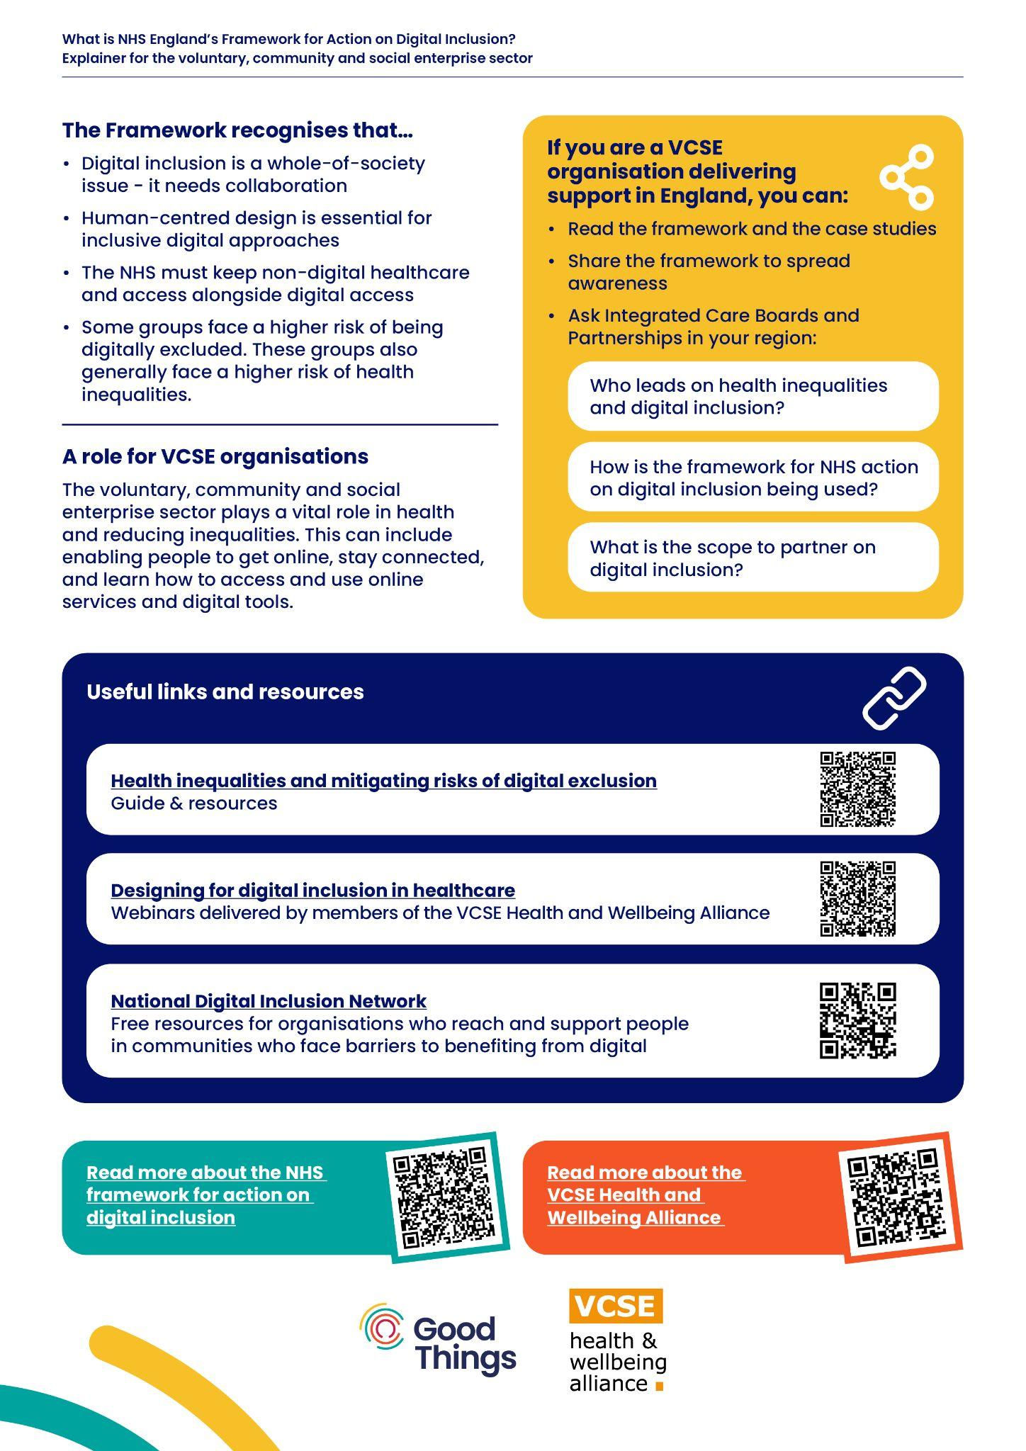
Digital Inclusion - An NHS priority
NHS Operational planning guidance identifies digital exclusion as a priority:
Priority 2: Mitigating against digital exclusion
The Framework for action on digital inclusion is a tool to help NHS staff enable and encourage greater access to and improved experience of healthcare, and increased adoption of digital approaches where appropriate

Slide 20

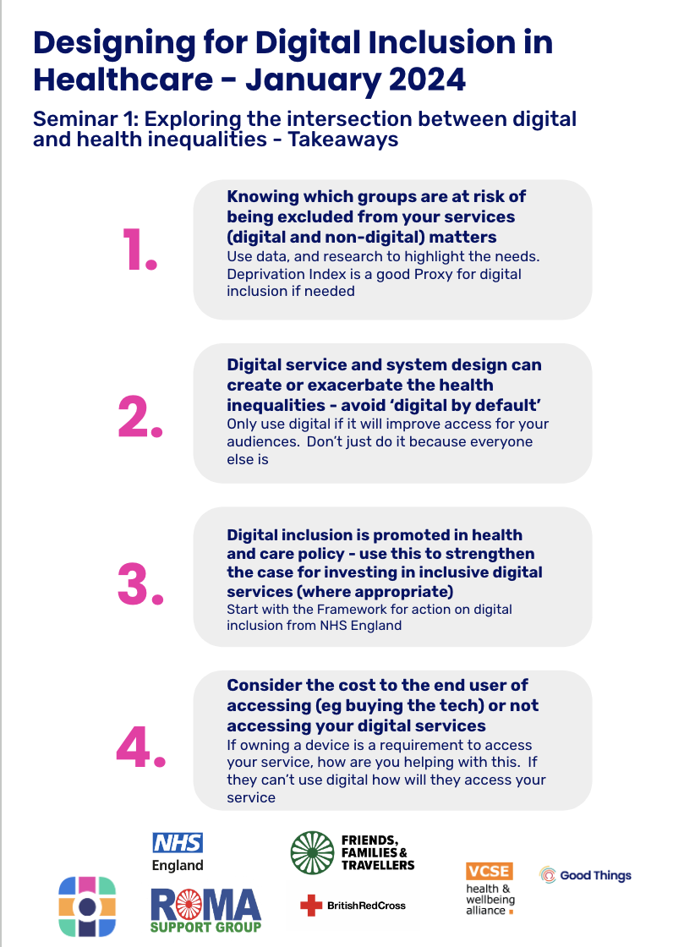
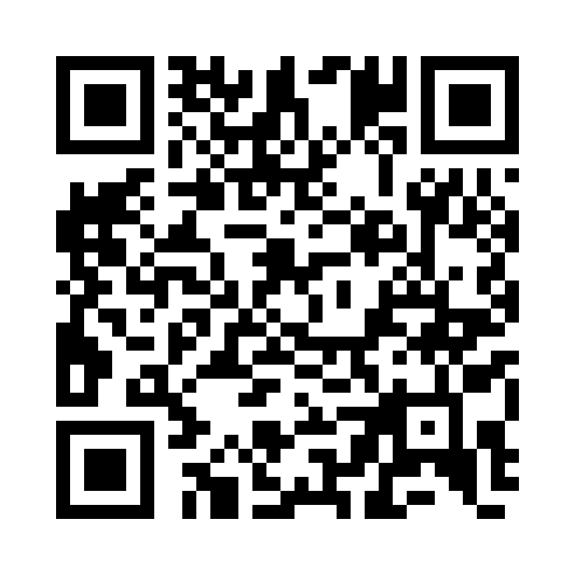

Designing for digital inclusion in healthcare
A seminar series to help you consider populations, barriers and solutions:
Seminar 1 ‘Exploring the intersection between digital and health inequalities’
Seminar 2 ‘Exploring the barriers that exclude people from digital health services, and how to remove them’
Seminar 3 ‘Designing inclusive digital healthcare services
Including lots of examples and case studies

Slide 21


See examples of good practice in primary care
Find out more: https://www.goodthingsfoundation.org/insights/supporting-digital-inclusion-in-general-practice-top-tips/
The challenge
Admin staff based at busy GP practices across the Beeston and Middleton area in Leeds were unsure where to signpost vulnerable patients who required digital and non-digital support around their health needs and had limited time to offer direct support.
The approach
100% Digital Leeds developed a place-based approach to digital inclusion to improve health participation, working with Beeston and Middleton Local Care Partnership to develop a Digital Health Hub Network. Each Digital Health Hub offers accessible spaces for patients at the heart of the local community.
Bevan Health and Wellbeing successfully recruited and trained peer volunteers to increase digital literacy and online use of healthcare for volunteers and patients who were asylum seekers, refugees or who had been affected by homelessness. Of 77 patients who participated in an evaluation, 29% started using online consultation systems or similar website forms to request help from their GP; 26% requested repeat prescriptions online; and a quarter used a video app for GP consultations.

Slide 22
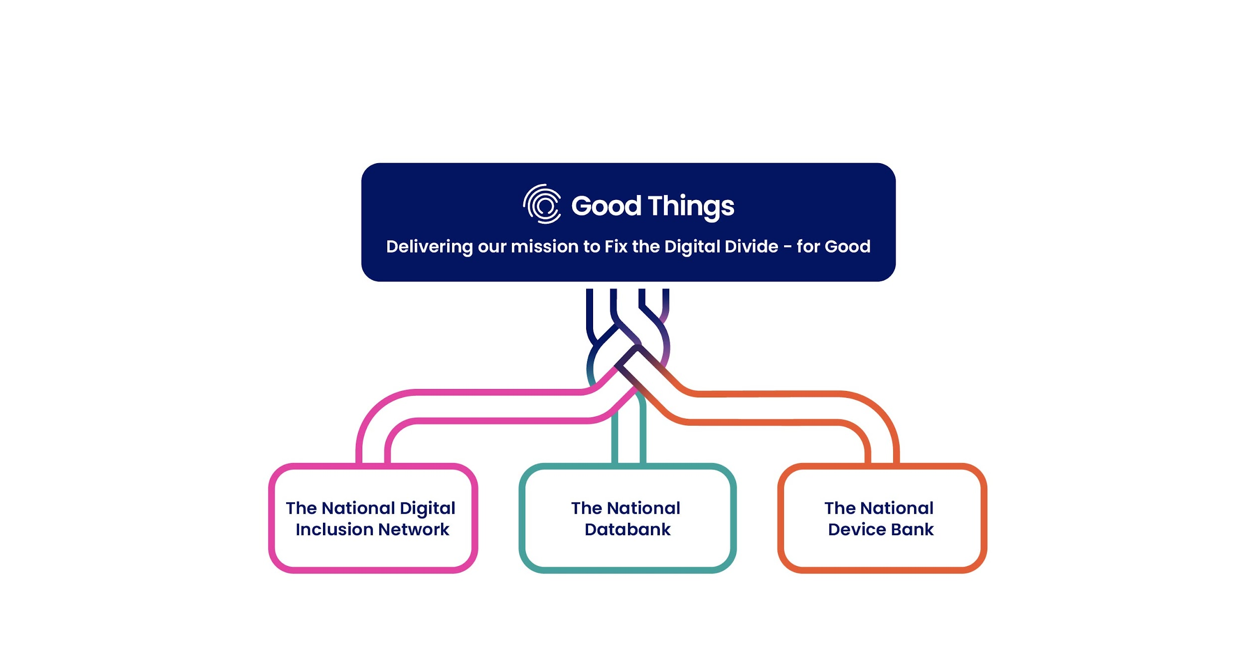
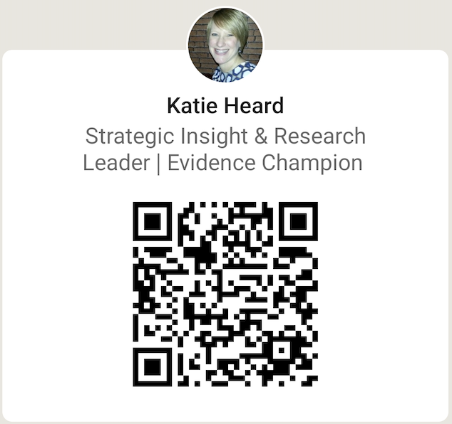
Get in Touch!
Katie Heard, Head of Research and Data Insights
katie.heard@goodthingsfoundation.org

Slide 23
#DHSS24
Serving communities though digital services
Chair: Paul Charnley
Tom Micklewright
Co-Chair Digital Blueprinting Steering Committee (NHS England)
clinical lead for digital transformation, Cheshire and Merseyside ICS
Emma Arrowsmith
Katie Heard
digital matron, County Durham and Darlington NHS FT
head of research and data insights, Good things foundation

