Slide 1

#DHSS24
Peter Coates
David Jobling
Prof Mike Reed
openOutcomes from Cambois to Catalonia
managing director, The Apperta Foundation
digital health specialist
openOutcomes committee chair
Anji Kingman
Steve Wilkinson
clinical outcomes manager, Northumbria Healthcare
project director, staircase13 Ltd

Slide 2







openOutcomes from Cambois to Catalonia
Digital Health Summer Schools
19th July 2024
https://apperta.org
info@apperta.org
https://openoutcomes.apperta.org

Slide 3
Patient Reported Outcome
Measures (PROMS) for MSK
Professor Mike Reed
Northumbria Healthcare NHS Foundation Trust, Consultant Trauma & Orthopaedic Surgeon
https://apperta.org
info@apperta.org
https://openoutcomes.apperta.org

Slide 4
“Most businesses spend around 10-15% of revenue on quality control.”
qualitastech.com 2019
https://apperta.org
info@apperta.org
https://openoutcomes.apperta.org

Slide 5

What are PROMS?
Assess the quality of care delivered to patients from the patient perspective. (NHS England)
Patient-centred clinical care
https://apperta.org
info@apperta.org
https://openoutcomes.apperta.org
Notes:
I wanted to start by giving a background of what PROMs are.
PROMs are standardised, validated questionnaires that are completed by patients to better understand the efficacy of a clinical intervention measured from the patients’ perspective.
In 2011, the government white paper ‘Equity and Excellence: Liberating the NHS’:
Highlighted that they would support clinicians to use PROMs across the NHS therefore recognizing that patients perception of their health and experiences are key to providing excellent patient-centred clinical care

Slide 6
What are PROMS?
Cumberledge 'First do no harm’ - 2020
Guidance from the report is explicit in recommending long term PROMs follow-up for all cases associated with the use of medical devices.
In essence the report calls for an all-specialities PROMs registry, mandating the routine collection of PROMs which is central to medical device safety.
https://apperta.org
info@apperta.org
https://openoutcomes.apperta.org

Slide 7
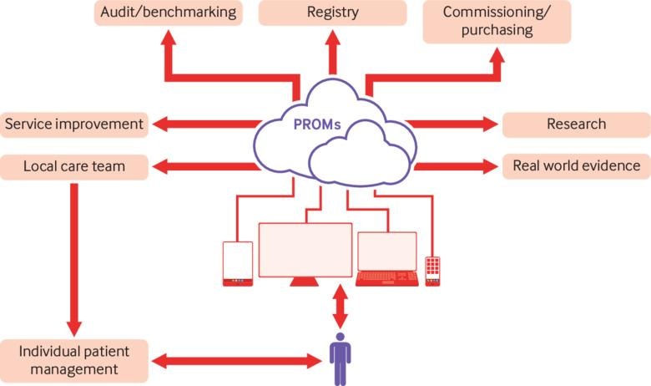
Why use PROMS?
https://apperta.org
info@apperta.org
https://openoutcomes.apperta.org
Notes:
So why use PROMs and What are the benefits to patients
The information gathered from PROMs has a number of uses:
Individual Patient management – Clinics, PIFU and in the waiting well to monitor patients for deterioration or improvement
It can identify triggers for surgery and potentially reduce burden on clinical services by limiting the numbers of
unnecessary or ineffectual procedures therefore reducing risk to patients.
Research – To determine the efficacy of clinical interventions
Quality improvement & Audit - allow comparisons of performance of trusts, thus allowing rewards for positive outcomes in high quality Care.
Overall, put together the PROMs data can be used at different healthcare settings:
local healthcare organisations to assess service provision
Regional Level and in particular the recently forms Integrated Care Boards.
National level to provide evidence of efficacy, standards / benchmarking

Slide 8
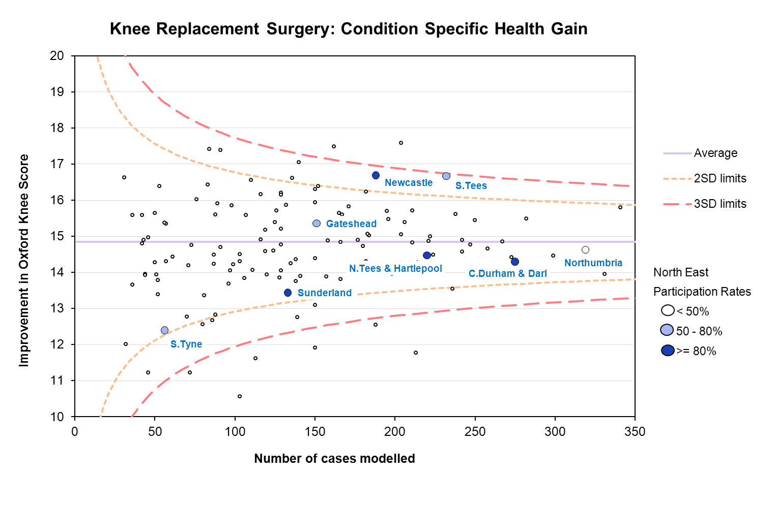

Why use PROMS?
https://apperta.org
info@apperta.org
https://openoutcomes.apperta.org
Notes:
So why use PROMs and What are the benefits to patients
The information gathered from PROMs has a number of uses:
Individual Patient management – Clinics, PIFU and in the waiting well to monitor patients for deterioration or improvement
It can identify triggers for surgery and potentially reduce burden on clinical services by limiting the numbers of
unnecessary or ineffectual procedures therefore reducing risk to patients.
Research – To determine the efficacy of clinical interventions
Quality improvement & Audit - allow comparisons of performance of trusts, thus allowing rewards for positive outcomes in high quality Care.
Overall, put together the PROMs data can be used at different healthcare settings:
local healthcare organisations to assess service provision
Regional Level and in particular the recently forms Integrated Care Boards.
National level to provide evidence of efficacy, standards / benchmarking

Slide 9
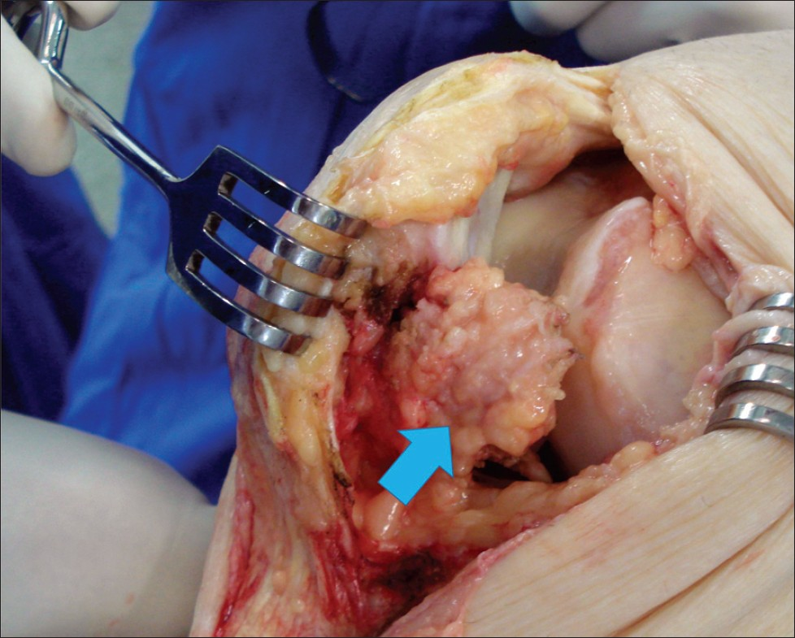
Preserve or Excise the Fat Pad?
https://apperta.org
info@apperta.org
https://openoutcomes.apperta.org
Notes:
So why use PROMs and What are the benefits to patients
The information gathered from PROMs has a number of uses:
Individual Patient management – Clinics, PIFU and in the waiting well to monitor patients for deterioration or improvement
It can identify triggers for surgery and potentially reduce burden on clinical services by limiting the numbers of
unnecessary or ineffectual procedures therefore reducing risk to patients.
Research – To determine the efficacy of clinical interventions
Quality improvement & Audit - allow comparisons of performance of trusts, thus allowing rewards for positive outcomes in high quality Care.
Overall, put together the PROMs data can be used at different healthcare settings:
local healthcare organisations to assess service provision
Regional Level and in particular the recently forms Integrated Care Boards.
National level to provide evidence of efficacy, standards / benchmarking

Slide 10
Background
Removal of the infrapatella fat pad remains controversial
  Blood supply to the patella tendon
  Biomechanics of the knee
  Inflammatory modulator
Vs
Improved access
Visualisation
https://apperta.org
info@apperta.org
https://openoutcomes.apperta.org
Notes:
So why use PROMs and What are the benefits to patients
The information gathered from PROMs has a number of uses:
Individual Patient management – Clinics, PIFU and in the waiting well to monitor patients for deterioration or improvement
It can identify triggers for surgery and potentially reduce burden on clinical services by limiting the numbers of
unnecessary or ineffectual procedures therefore reducing risk to patients.
Research – To determine the efficacy of clinical interventions
Quality improvement & Audit - allow comparisons of performance of trusts, thus allowing rewards for positive outcomes in high quality Care.
Overall, put together the PROMs data can be used at different healthcare settings:
local healthcare organisations to assess service provision
Regional Level and in particular the recently forms Integrated Care Boards.
National level to provide evidence of efficacy, standards / benchmarking

Slide 11
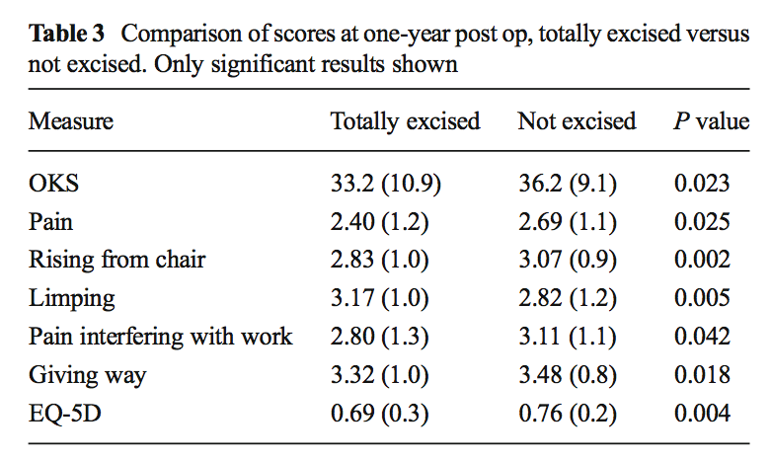
Background
Removal of the infrapatella fat pad during total knee arthroplasty: does it affect patient outcomes?
Robert Moverley | Defer Williams | Nikolaos Bardakos | Richard Field
https://apperta.org
info@apperta.org
https://openoutcomes.apperta.org
Notes:
So why use PROMs and What are the benefits to patients
The information gathered from PROMs has a number of uses:
Individual Patient management – Clinics, PIFU and in the waiting well to monitor patients for deterioration or improvement
It can identify triggers for surgery and potentially reduce burden on clinical services by limiting the numbers of
unnecessary or ineffectual procedures therefore reducing risk to patients.
Research – To determine the efficacy of clinical interventions
Quality improvement & Audit - allow comparisons of performance of trusts, thus allowing rewards for positive outcomes in high quality Care.
Overall, put together the PROMs data can be used at different healthcare settings:
local healthcare organisations to assess service provision
Regional Level and in particular the recently forms Integrated Care Boards.
National level to provide evidence of efficacy, standards / benchmarking

Slide 12
PROMs improvement scores per default infrapatella fat pad practice
 | NUMBER | OKS CHANGE | EQ5D CHANGE
EXCISED | 297 | 15.0 | 0.262
PARTIAL | 178 | 16.6 | 0.295
PRESERVED | 169 | 17.3 | 0.327
https://apperta.org
info@apperta.org
https://openoutcomes.apperta.org
Notes:
So why use PROMs and What are the benefits to patients
The information gathered from PROMs has a number of uses:
Individual Patient management – Clinics, PIFU and in the waiting well to monitor patients for deterioration or improvement
It can identify triggers for surgery and potentially reduce burden on clinical services by limiting the numbers of
unnecessary or ineffectual procedures therefore reducing risk to patients.
Research – To determine the efficacy of clinical interventions
Quality improvement & Audit - allow comparisons of performance of trusts, thus allowing rewards for positive outcomes in high quality Care.
Overall, put together the PROMs data can be used at different healthcare settings:
local healthcare organisations to assess service provision
Regional Level and in particular the recently forms Integrated Care Boards.
National level to provide evidence of efficacy, standards / benchmarking

Slide 13
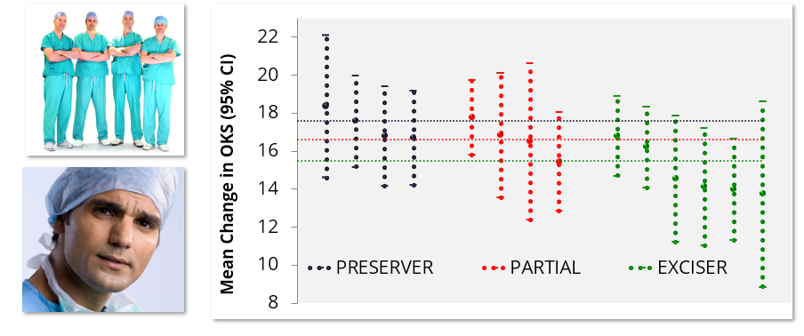
Mean Change in OKS
Mean Change in OKS (95% CI) comparing individual consultant fat pad default practice
https://apperta.org
info@apperta.org
https://openoutcomes.apperta.org
Notes:
So why use PROMs and What are the benefits to patients
The information gathered from PROMs has a number of uses:
Individual Patient management – Clinics, PIFU and in the waiting well to monitor patients for deterioration or improvement
It can identify triggers for surgery and potentially reduce burden on clinical services by limiting the numbers of
unnecessary or ineffectual procedures therefore reducing risk to patients.
Research – To determine the efficacy of clinical interventions
Quality improvement & Audit - allow comparisons of performance of trusts, thus allowing rewards for positive outcomes in high quality Care.
Overall, put together the PROMs data can be used at different healthcare settings:
local healthcare organisations to assess service provision
Regional Level and in particular the recently forms Integrated Care Boards.
National level to provide evidence of efficacy, standards / benchmarking

Slide 14
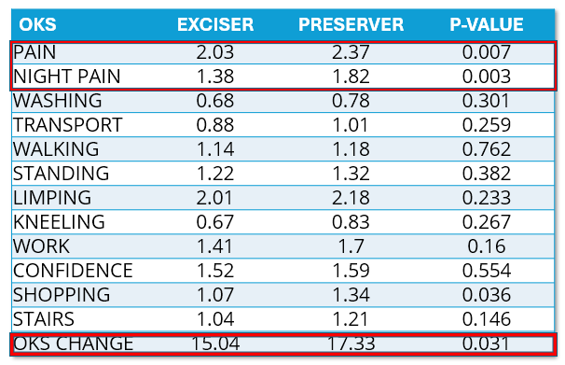
Components of OXFORD KNEE SCORE improvement comparing excisers and preservers
https://apperta.org
info@apperta.org
https://openoutcomes.apperta.org
Notes:
So why use PROMs and What are the benefits to patients
The information gathered from PROMs has a number of uses:
Individual Patient management – Clinics, PIFU and in the waiting well to monitor patients for deterioration or improvement
It can identify triggers for surgery and potentially reduce burden on clinical services by limiting the numbers of
unnecessary or ineffectual procedures therefore reducing risk to patients.
Research – To determine the efficacy of clinical interventions
Quality improvement & Audit - allow comparisons of performance of trusts, thus allowing rewards for positive outcomes in high quality Care.
Overall, put together the PROMs data can be used at different healthcare settings:
local healthcare organisations to assess service provision
Regional Level and in particular the recently forms Integrated Care Boards.
National level to provide evidence of efficacy, standards / benchmarking

Slide 15
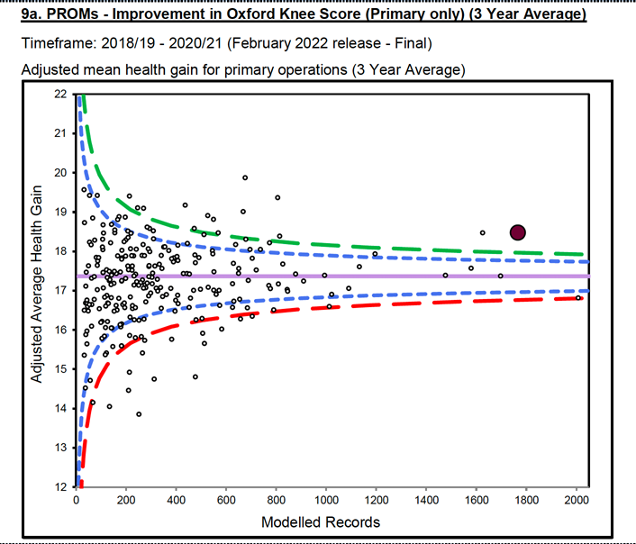
https://apperta.org
info@apperta.org
https://openoutcomes.apperta.org
Notes:
So why use PROMs and What are the benefits to patients
The information gathered from PROMs has a number of uses:
Individual Patient management – Clinics, PIFU and in the waiting well to monitor patients for deterioration or improvement
It can identify triggers for surgery and potentially reduce burden on clinical services by limiting the numbers of
unnecessary or ineffectual procedures therefore reducing risk to patients.
Research – To determine the efficacy of clinical interventions
Quality improvement & Audit - allow comparisons of performance of trusts, thus allowing rewards for positive outcomes in high quality Care.
Overall, put together the PROMs data can be used at different healthcare settings:
local healthcare organisations to assess service provision
Regional Level and in particular the recently forms Integrated Care Boards.
National level to provide evidence of efficacy, standards / benchmarking

Slide 16



Challenges
Clinical
Organisational
Digital/Developer
https://apperta.org
info@apperta.org
https://openoutcomes.apperta.org
Notes:
There are a number of challenges in collecting digital PROMs in healthcare
Clinical challenges
There are no easy or cost effective way to collect, record & analyse PROMs
Majority are done on paper
There a wide variety of PROMS to choose from and there is a lack of standardisation of these PROMs across providers
Unable to benchmark and use at patient level e.g. In clinic setting for individual patient care
Organisational challenges:
Some PROMS options can be costly
Vendor / data lock in / siloed data platforms
Poor Communication with other hospital systems
Lack Flexibility & agility of these proprietary solutions as there may be differing user needs.
Manual data entry & added to different registries leading to duplication of time, effort & cost
Software Developer Challenges
Software developers spend many hours learning clinical requirements rather than focusing on designing good user interfaces and improving user experience.
There are significant technical challenges with Integration with existing EPR / legacy data.
Poor understanding of different PROMs pathways.
The Lack of data standards to help IT systems to talk to each other causes considerable time, effort and money to be wasted trying to connect different applications often without an intuitive solution for the user at the end.

Slide 17






The solution
Collaborative
Open standard
PROMS
https://apperta.org
info@apperta.org
https://openoutcomes.apperta.org
Notes:
To help solve these challenges we have developed openOutcomes
With openoutcomes we can Collectively deliver a best in class solution based on an open standards and open data platform approach
We are doing this through:
Collaborative approach which is Clinically led, designed by its users, coproduced with patients and in partnership with experts
Its based on an internationally recognised Open standards called OpenEHR which forms an essential and critical part of the open data technology approach to the platform making the system interoperable with other IT systems
In addition we are making the source code open so that other healthcare organisations can re-use the code and implement locally.

Slide 18




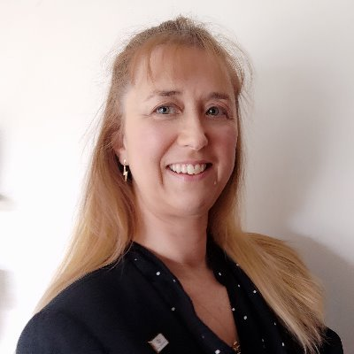

Committee
Professor Mike Reed (Chair) Consultant Orthopaedic Surgeon
Kanthan Theivendran (Clinical Lead)
Consultant Orthopaedic Surgeon
Ajay Malviya
Consultant Orthopaedic Surgeon
Andrew Bateman
Professor in Rehabilitation, Director, NIHR East of England Research Design Service
Anji Kingman
Clinical Outcomes Manager (PROMs)
Roanna Burgess
Consultant MSK Physiotherapist
https://apperta.org
info@apperta.org
https://openoutcomes.apperta.org
Notes:
Key part of our openOutcomes journey was to create a multidisciplinary team lead by clinicians, allied health professionals and Clinical Outcomes manager.
Along with this we have partnered by the Apperta Foundation a not for profit Community Interest Company specialising in open standards and opensource software development in healthcare.
We are also supported by NHS healthcare trusts from Northumbria and Sandwell & West Birmingham representing a cross ICS collaboration and with the support of the National PROMs Network.

Slide 19
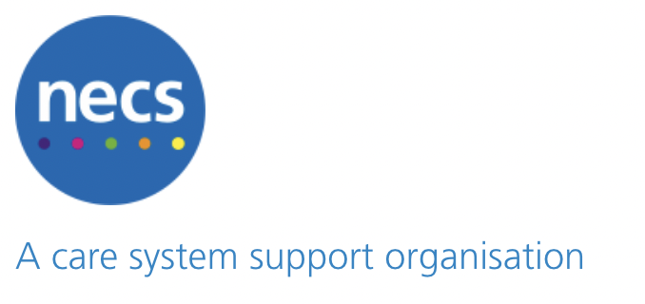

Thank you to our funders
NHS Transformation MSK Adoption Fund
https://apperta.org
info@apperta.org
https://openoutcomes.apperta.org
Notes:
I would like to thank our funders who have supported this project
Including NHS Transformation MSK Adoption fund and the North East care system support organisation

Slide 20
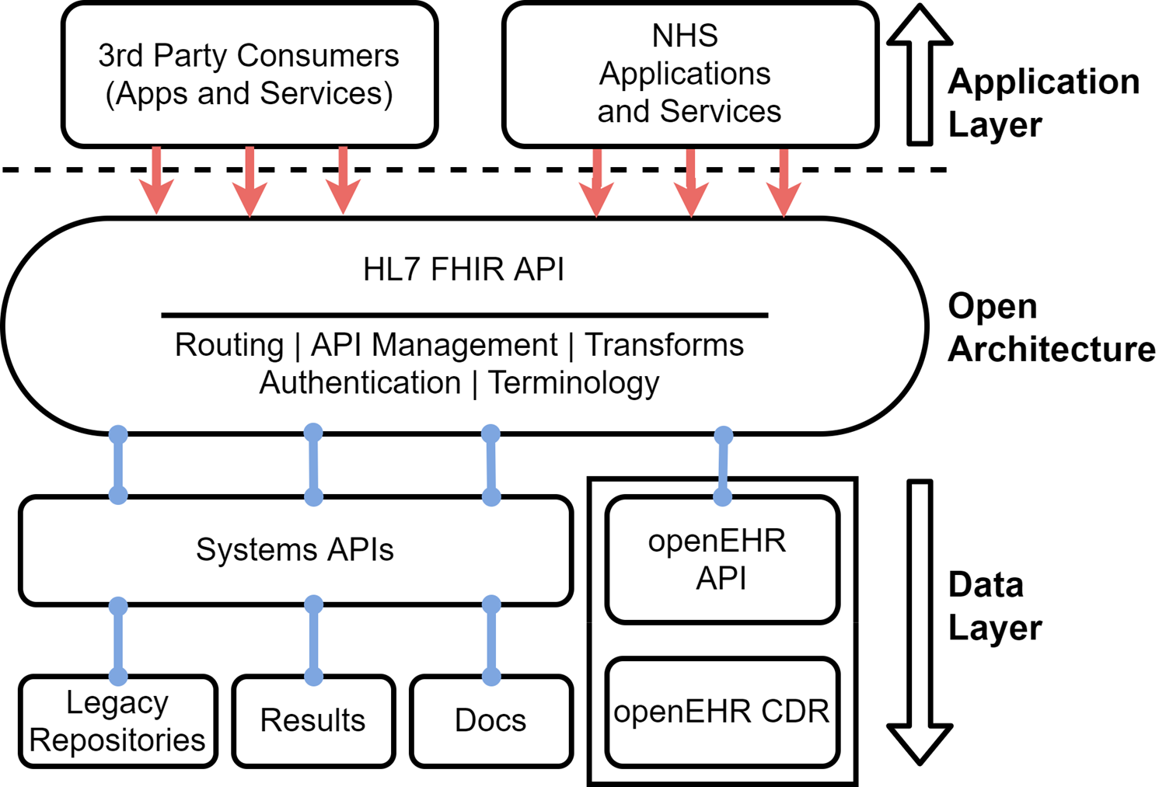
How this fits with the current healthcare ecosystem
Messaging Layer
https://apperta.org
info@apperta.org
https://openoutcomes.apperta.org
Notes:
This slides shows how openOutcomes technology based on openEHR standards fits into the current healthcare data ecosystem
The key aspect of openoutcomes platform is that it separates the data layer from the application layer.
We do this through a semantic rich data persistence data layer based on openEHR open standards architecture.
openEHR then connects to the rest of the ecosystem through the openEHR API and FHIR messaging standards to interoperate with other vendor applications and CDR’s so that IT systems talk to each other seamlessly.
This enables the data to be stored separately in the CDR with all interfaces and queries running directly to and from it so that there is no need to duplicate that data and the data is immediately viewable in all applications.

Slide 21

https://apperta.org
info@apperta.org
https://openoutcomes.apperta.org

Slide 22
Our Approach
Steve Wilkinson
Staircase 13, Project Director
https://apperta.org
info@apperta.org
https://openoutcomes.apperta.org

Slide 23
Key Stakeholders
https://apperta.org
info@apperta.org
https://openoutcomes.apperta.org

Slide 24
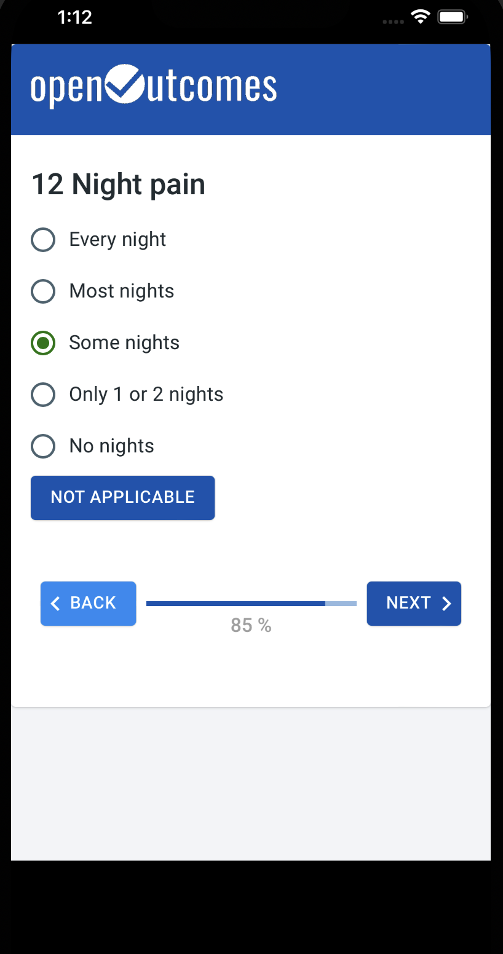
Our Goal
To create a world-class PROMs & PREMs solution in the NHS and UK national interest
  with population level analysis features that can drive improvements in care
  at low cost
  with technical, corporate governance and product governance designed to eliminate or minimise many common pitfalls in healthcare software procurement and implementation
https://apperta.org
info@apperta.org
https://openoutcomes.apperta.org

Slide 25




Common Pitfalls in Healthcare Software
Fragmentation
Data ownership
These issues can all be overcome by correct choices in governance
But unfortunately, important aspects are often not mandated or even considered when it comes to procurement
The Apperta model is designed to solve these issues in conjunction with appropriate technical expertise
Narrow focus
Vendor lock-in
Lack of scalability
Data sharing
Vendor insolvency
Technology bias
https://apperta.org
info@apperta.org
https://openoutcomes.apperta.org

Slide 26
How We Achieved Our Goal
Working closely with clinicians, NHS PROMs experts and other stakeholders at every stage of development
Developing a commercial model where investment by one trust benefits others
Process mapping and analysing current processes
Selecting the best and most appropriate technologies without bias introduced by technical debt
Making extensive use of modularisation and abstraction within the software design to improve flexibility
Using open standards for clinical data storage and interoperability
All of this is difficult! BUT is designed to reduce long term cost
https://apperta.org
info@apperta.org
https://openoutcomes.apperta.org

Slide 27
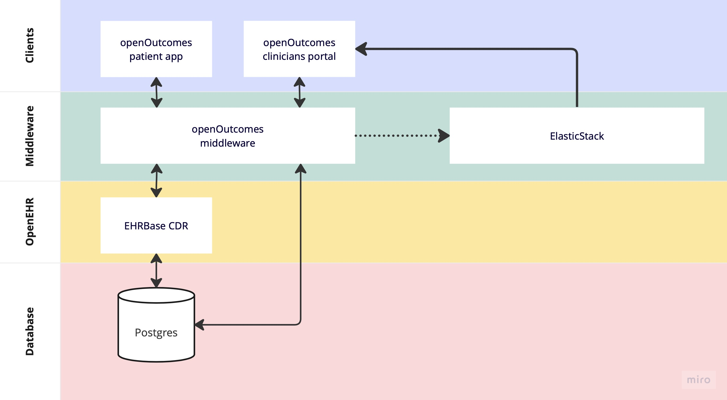
System Overview
https://apperta.org
info@apperta.org
https://openoutcomes.apperta.org

Slide 28
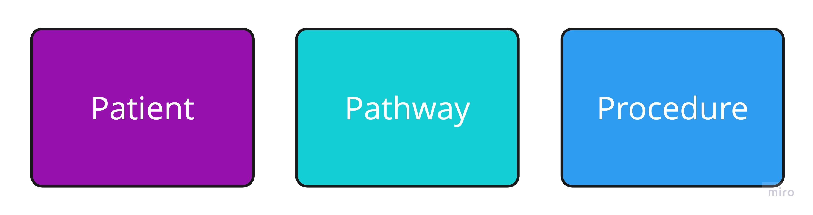
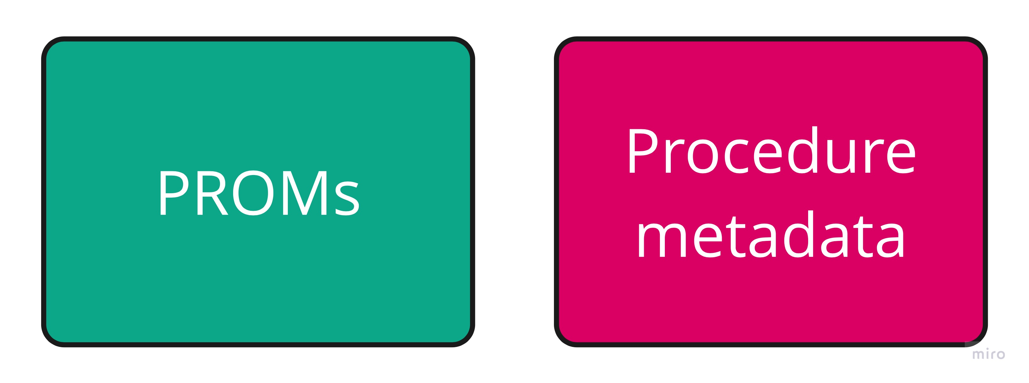
OpenEHR Modelling - Models
Templates constructed using openEHR archetypes, typically by experienced modellers working directly with clinicians
Can be viewed as “plug-ins” whereby new PROMs/PREMs questionnaires and procedure data can be added to openOutcomes without the need for new code
Library of created templates is freely available
https://apperta.org
info@apperta.org
https://openoutcomes.apperta.org

Slide 29
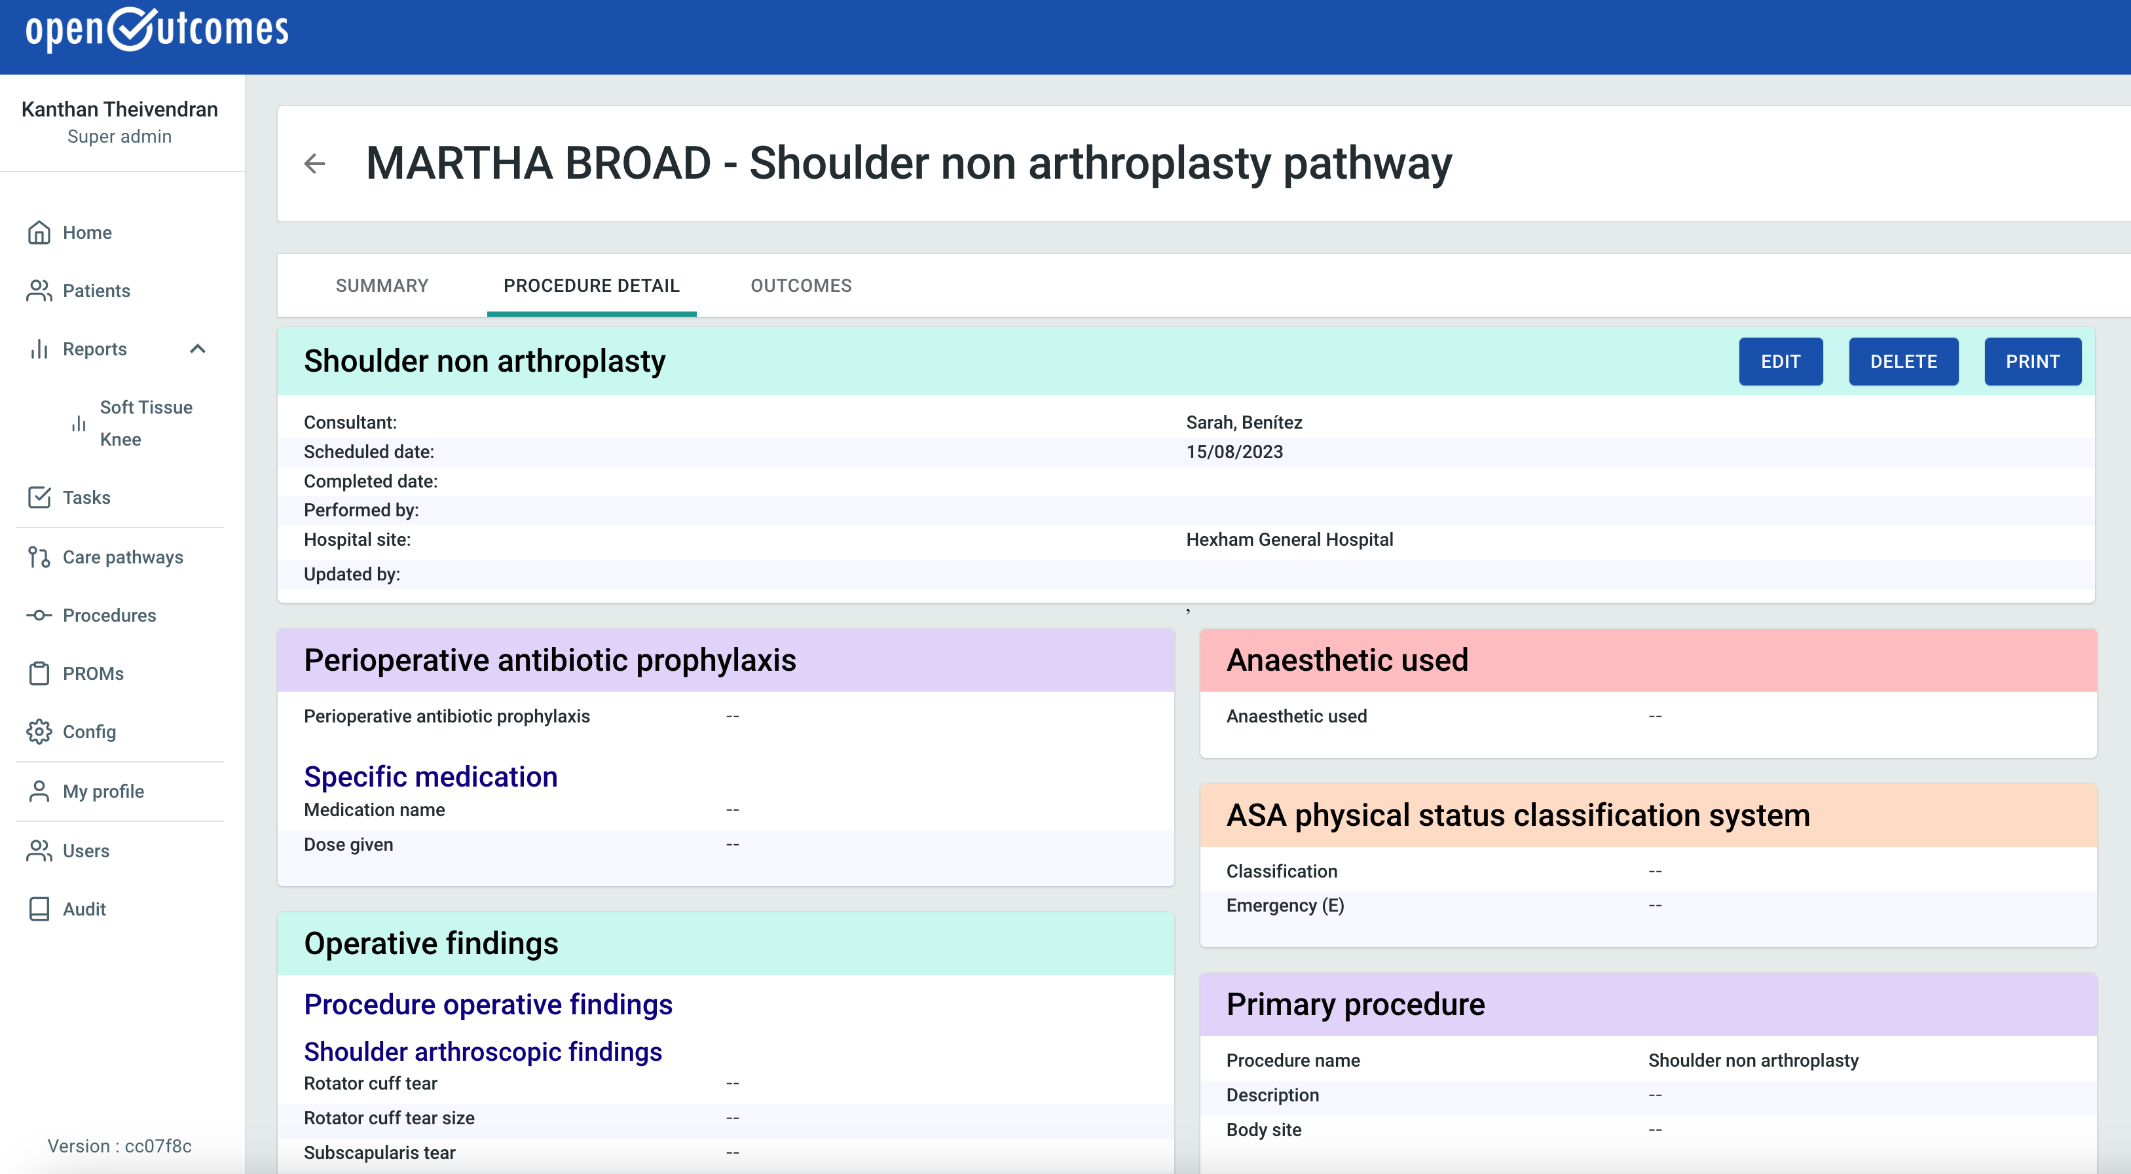
OpenEHR Modelling – Procedure Metadata
OpenEHR templates for procedure metadata are created by clinical modellers with input from clinicians and software engineers
The aim is for expert clinicians within sub-specialities to refine and improve these templates over time, gradually building a consensus for the data that should be recorded
The UI itself is auto-generated, as is the UI for PROMs entry and visualisation
https://apperta.org
info@apperta.org
https://openoutcomes.apperta.org

Slide 30
Integrations
Demographic/patient data can be read from the PAS via an interface usually over HL7/FHIR
Authentication can be delegated to other services, usually Active Directory in UK hospitals. We use Keycloak for this purpose.
Patients are sent messages with links to questionnaires via email and/or SMS
There is an abstract interface for exporting data from the system:
The default plug-in exports to ElasticStack for data visualisation and analysis at a population level
https://apperta.org
info@apperta.org
https://openoutcomes.apperta.org

Slide 31
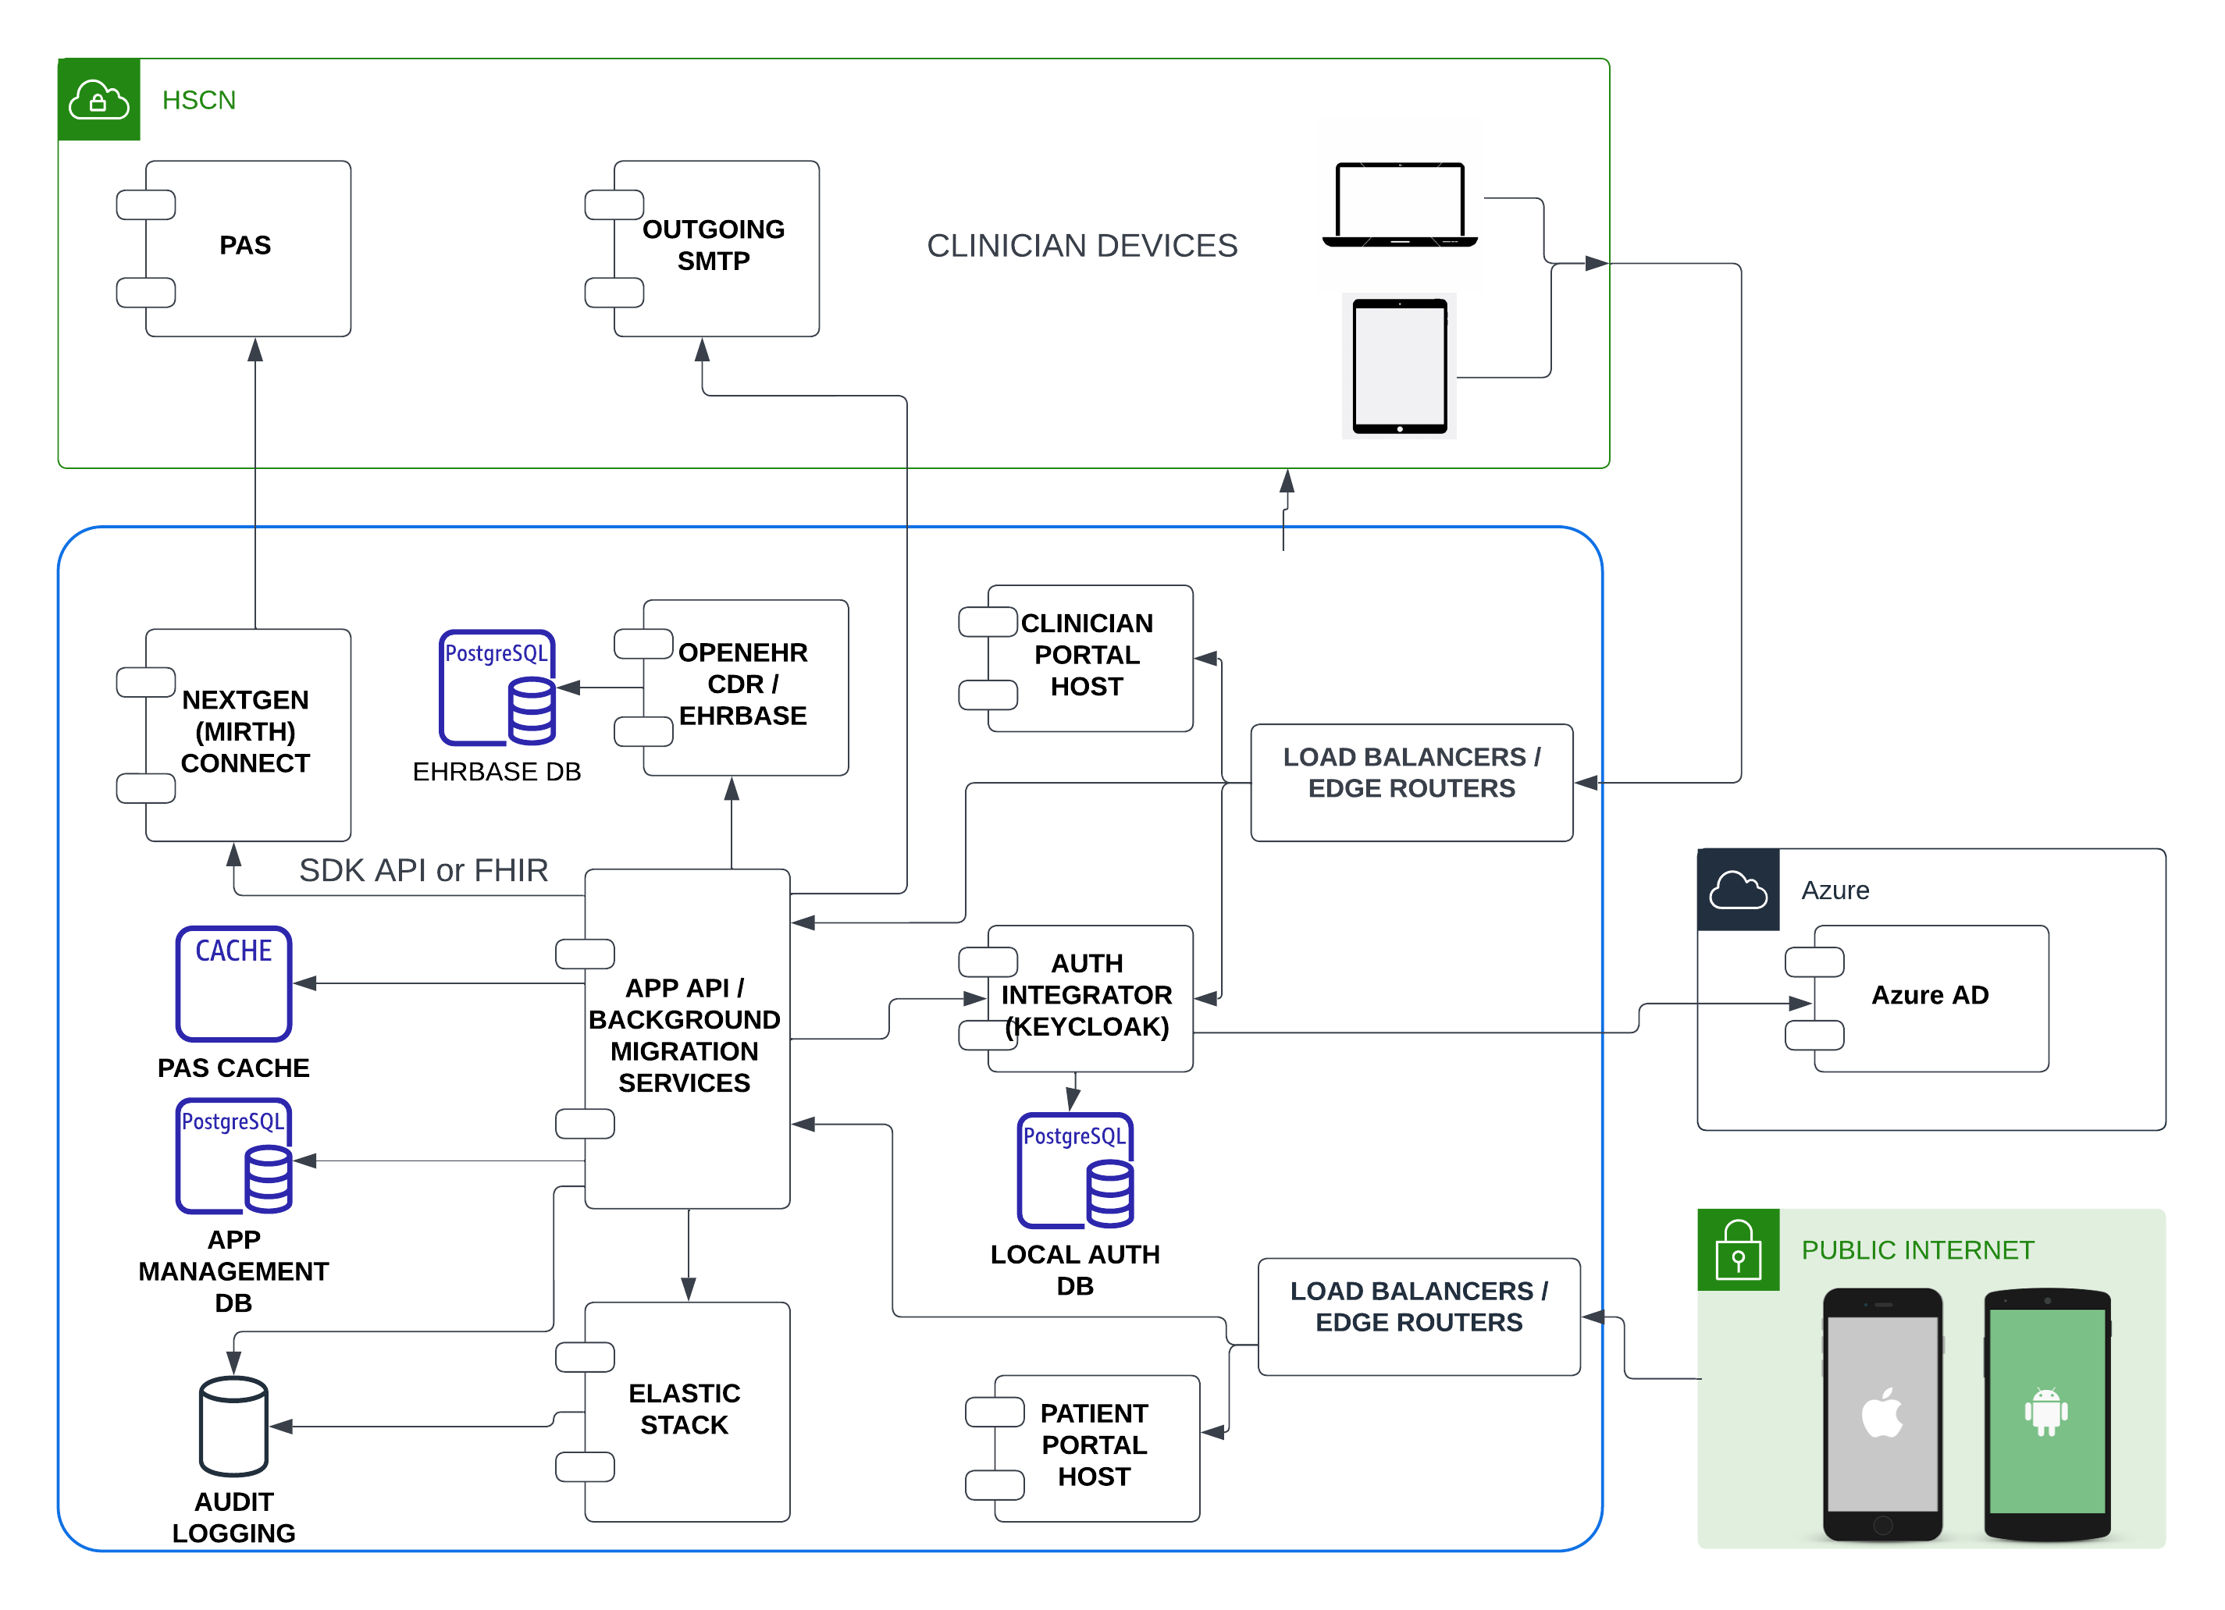
Deployment Architecture
https://apperta.org
info@apperta.org
https://openoutcomes.apperta.org

Slide 32
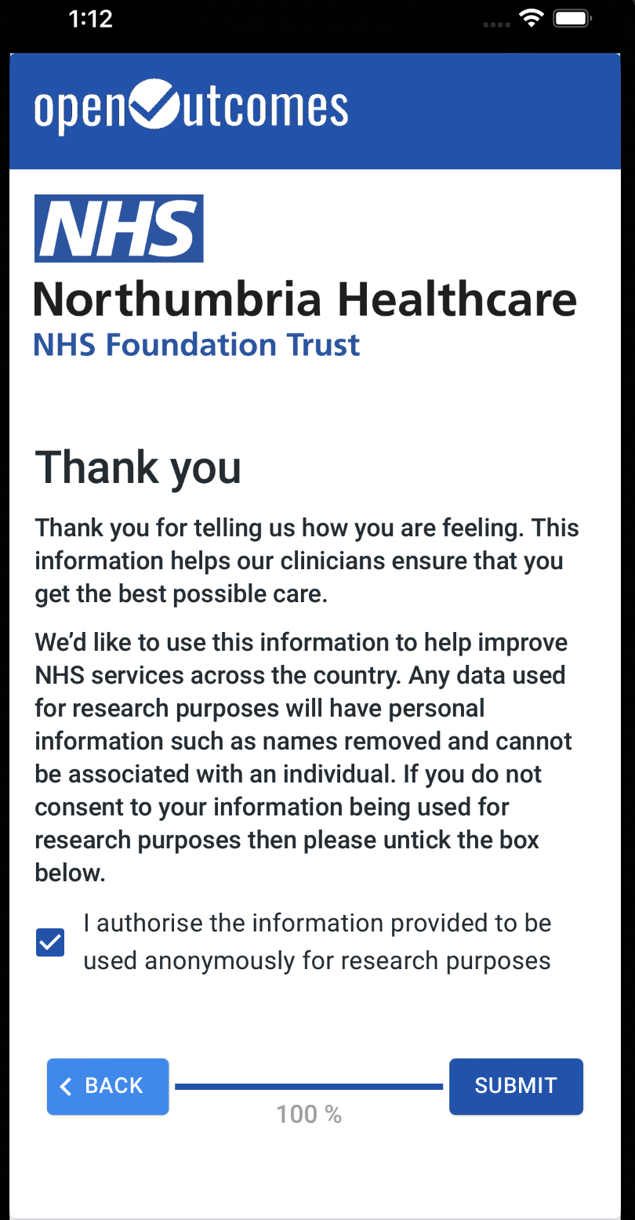
Features – Patient App
Runs in a browser on mobile phone, tablet, laptop or desktop
Look and feel can be branded
Is designed to be very simple to use with one question per page
Is launched via a link in an email or SMS which is automatically sent to the patient at the appropriate time
Uses patient surname and DOB for authentication
https://apperta.org
info@apperta.org
https://openoutcomes.apperta.org

Slide 33
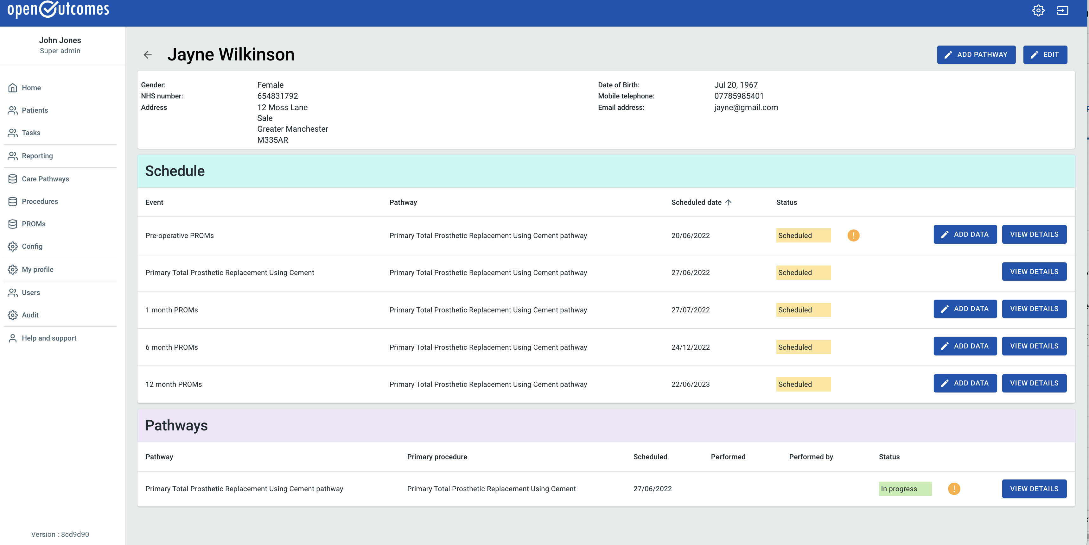
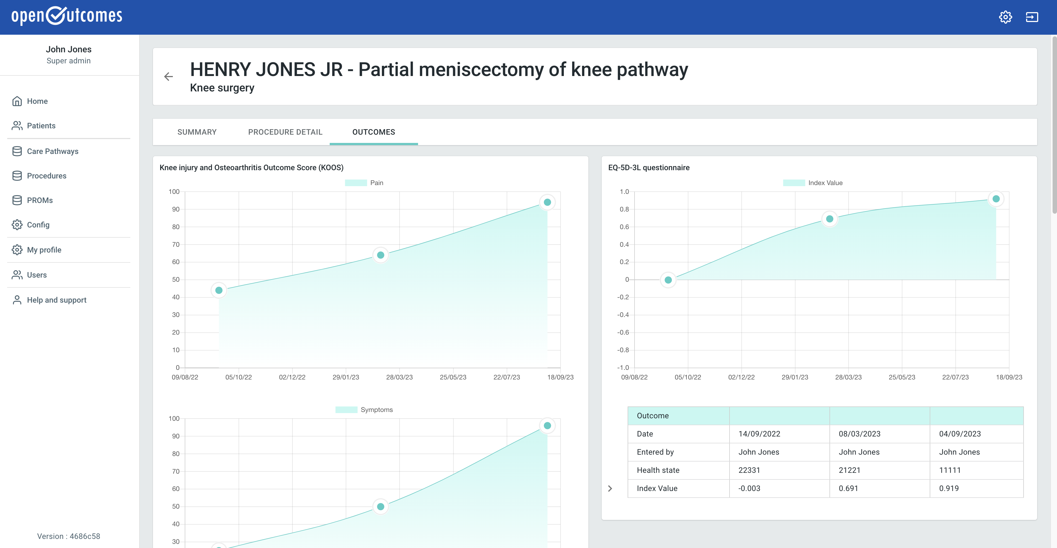
Features – Clinicians Portal
Displays all patient information including status of a pathway, procedure data and PROMs in one straightforward record
PROMs scores are shown on charts which can be shown to the patient in clinic
Allows clinicians and administrators to fill in PROMs questionnaires on the behalf of patients
https://apperta.org
info@apperta.org
https://openoutcomes.apperta.org

Slide 34
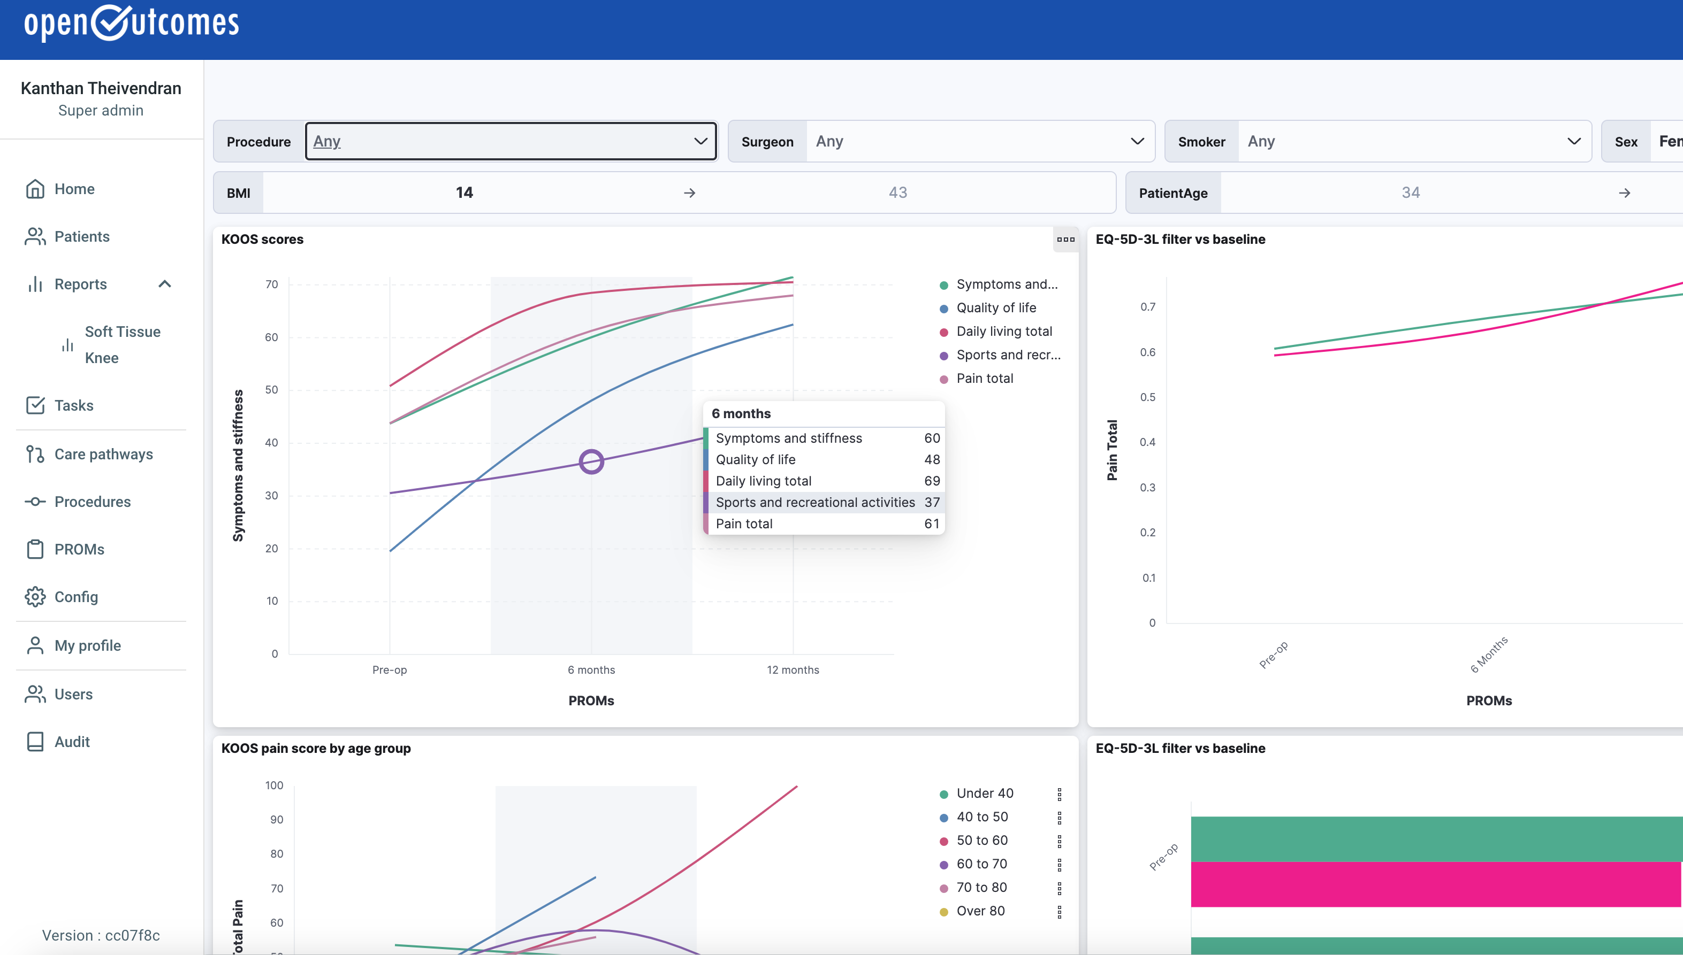
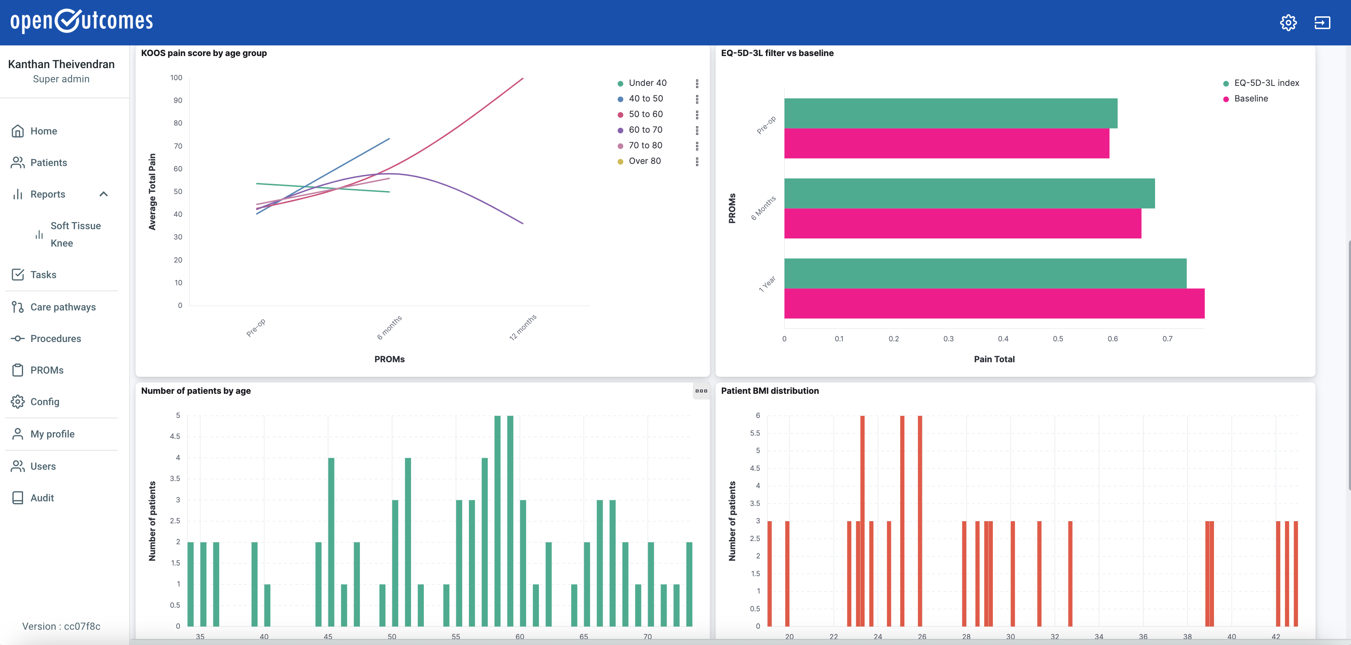
Reporting & Analysis - Population
Custom dashboards can be created in Kibana and embedded in openOutcomes
Visualisations can include a wide variety of styles & filters
Elastic data can be made available to data mining, statistical analysis and AI tools
https://apperta.org
info@apperta.org
https://openoutcomes.apperta.org

Slide 35
Demonstration
Anji Kingman
Northumbria Healthcare NHS Foundation Trust, Clinical Outcomes Manager
https://apperta.org
info@apperta.org
https://openoutcomes.apperta.org

Slide 36
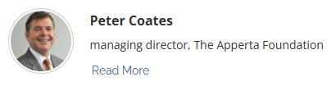

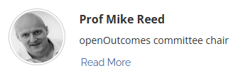
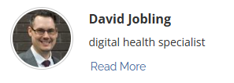
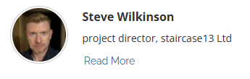
Q&A Session
https://apperta.org
info@apperta.org
https://openoutcomes.apperta.org

Slide 37
Thank you
https://apperta.org
info@apperta.org
https://openoutcomes.apperta.org

