Slide 1

#DHSS24
Overcoming hurdles for rapid EPR adoption Real-life success stories
Chair: Steve Hardy
Maddie Szekely
director of technical services, Altera Digital Health UK
deputy director of digital, Bolton NHS Foundation Trust
Stacey Spence
digital transformation EPR programme manager, Medway NHS Foundation Trust

Slide 2
Overcoming hurdles for rapid EPR adoption: Real-life success stories
How it’s possible for trusts to accelerate their EPR adoption with rapid benefits for both patients and clinicians
Digital Health Summer Schools, Durham University, 18th July

Slide 3

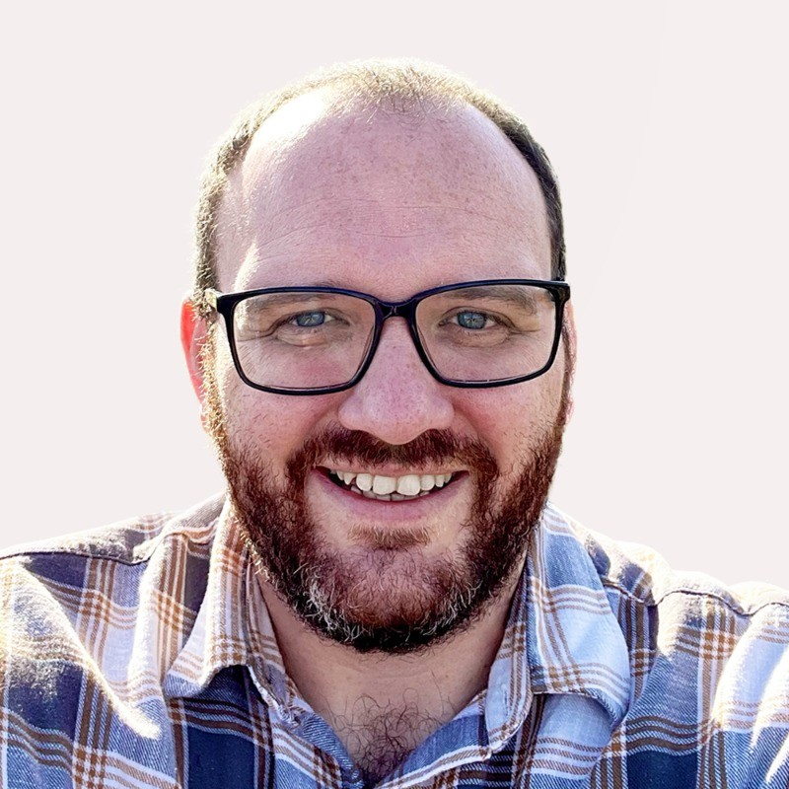
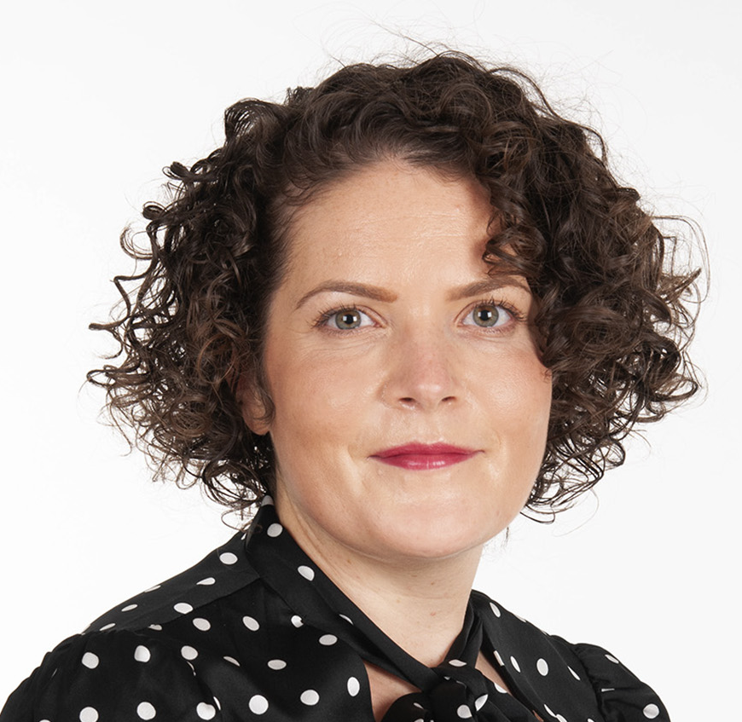
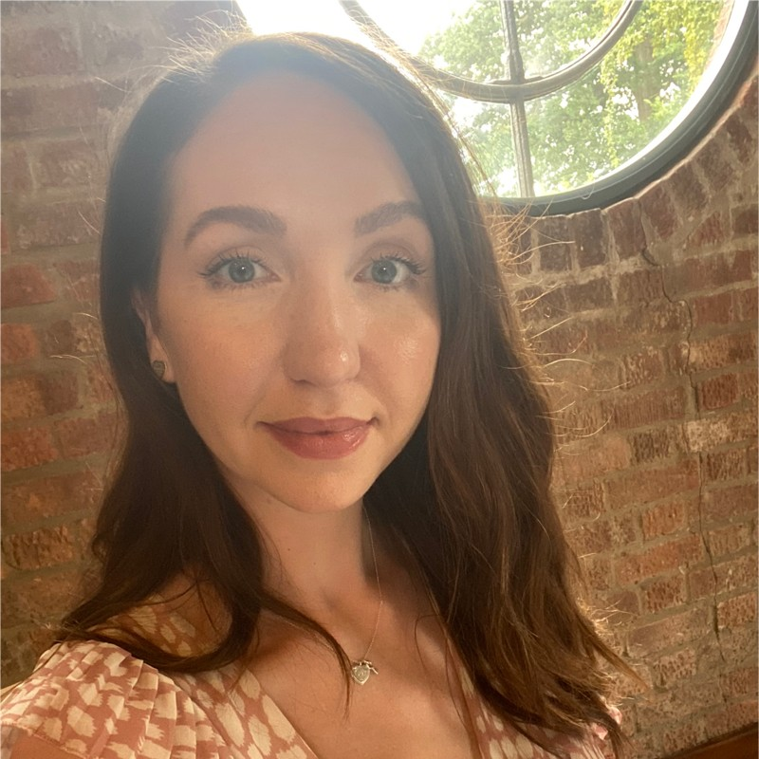
Overcoming hurdles for rapid EPR adoption Real-life success stories
CHAIR
Steven
Hardy
Chief Technology Officer
Altera Digital Health
PANELLIST
Maddie
Szekely
Deputy Director of Digital
Bolton NHS FT
PANELLIST
Stacey
Spence
Digital Transformation EPR Programme Manager
Medway NHS FT

Slide 4
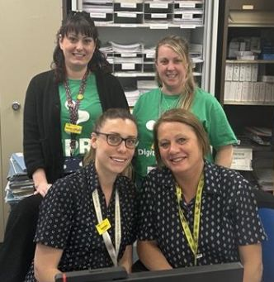
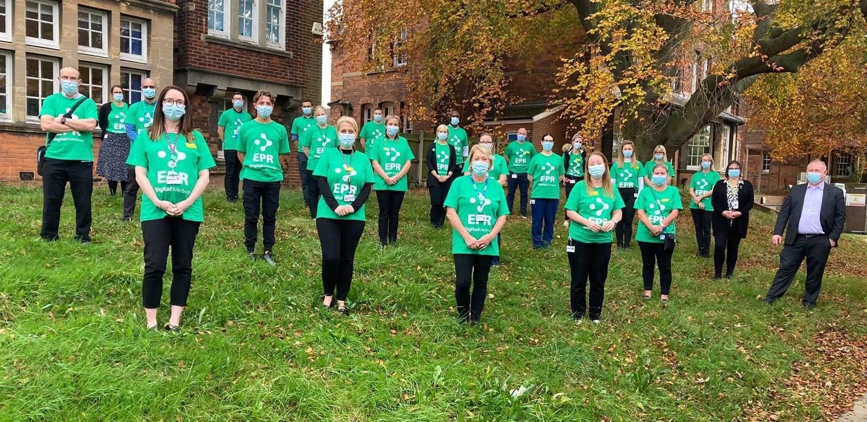

Stacey Spence
Medway NHS Foundation Trust
Consolidating a complex hybrid digital system

Slide 5
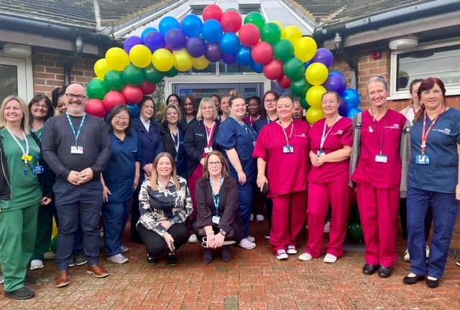

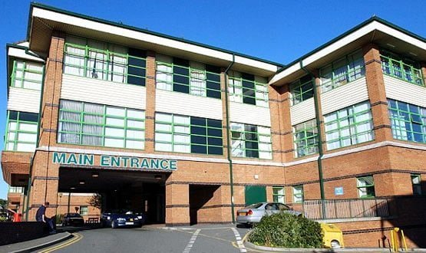
Maddie Szekely
Bolton NHS Foundation Trust
A total transformation from paper to digital

Slide 6





To overcome EPR adoption hurdles, you must…
Overcome budgetary challenges in EPR implementation
Adhere to regulatory standards and compliance requirements
Prioritise strategically amidst other healthcare initiatives
Manage system complexity and integration
Understand more about the crucial role of usability and clinical leadership

Slide 7


OUR KEY LEARNINGS

Slide 8
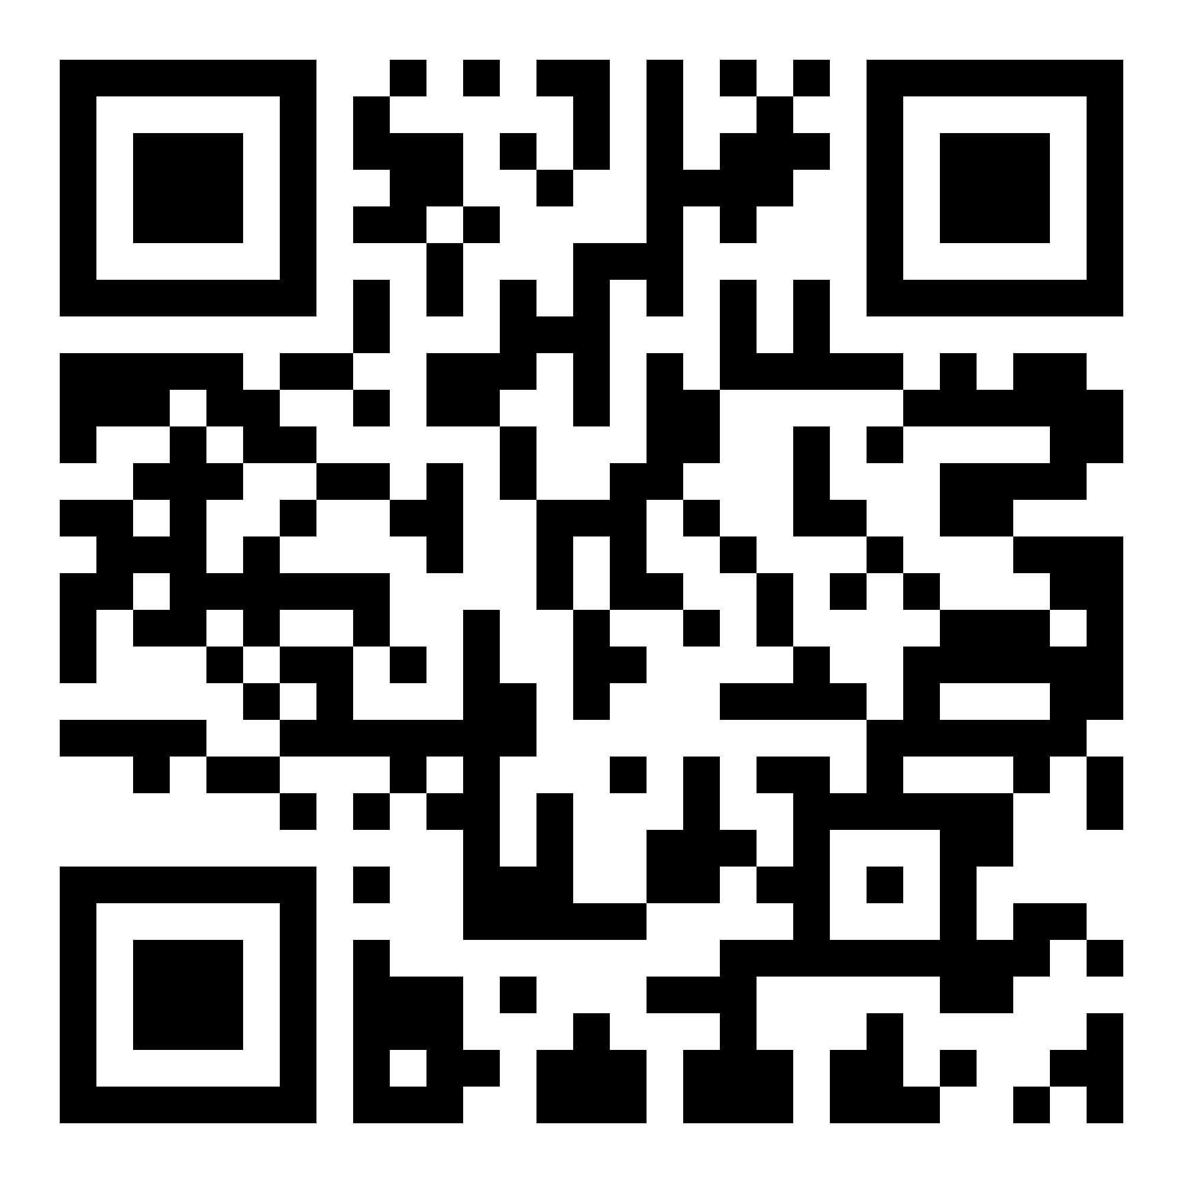
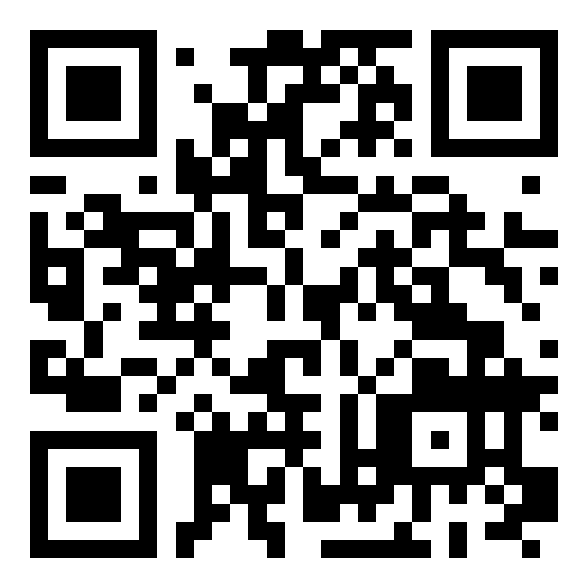
QUESTIONS?

Slide 9
#DHSS24
Maddie Szekely
deputy director of digital, Bolton NHS Foundation Trust

Slide 10
#DHSS24
Stacey Spence
digital transformation EPR programme manager, Medway NHS Foundation Trust

