Slide 1
Frontline Digitisation Support Offer
Collaboration, Knowledge, Expertise
Digital Health Summer Schools
18-19 July 2024

Slide 2

Frontline Digitisation
Programme – in 3 sentences:
1
2
Blueprinting
Funding & Allocations
£2bn Digital Transformation
Programme
Part of the Government's
Major Projects Portfolio
Supporting all Trusts in England to implement and optimise Electronic Patients Records (EPRs)
9
Digital Maturity
3
FD Partnering
Frontline Digitisation Support Offer (FDSO)
Business Case Review
8
4
Market Management
Value Assurance
Strategic Supplier Relationship Management
7
Benefits
5
6

Slide 3
Placeholder for FDSO Video

Slide 4




Service Catalogue
Collaboration
Knowledge
Expertise
Connecting with Each Other
Sharing Best Practice
Upskilling & Actionable Learning
Community of Practice Forum
Open forum on FutureNHS Platform which allows users to connect, ask questions, respond, and discuss.
Webinars, Events and Drop-in Sessions
Topic-based webinars, events and drop-in sessions run by industry experts and Trusts. Previous recording also available.
Subject Matter Expert Support
Upon request, experts from the central team can support and work alongside provider teams on defined work packages.
Supplier-based Peer Network
Networks based on shared EPR supplier to enable Trusts to : connect, share and learn from each other.
Guidance and Documents (Library)
Best practice, guidance, and other key documents available to view and download.
Self-learning Toolkits
Comprehensive self-learning toolkits in areas such as Change Management and Benefits available to view and download.
Procurement Peer Network
A dedicated network for Trusts who are at Procurement Stage to enable sharing of key artefacts and targeted guidance.
Lessons Learnt
Collation and publication of lessons learnt from previous Trust deployments and central SME’s experiences.
Targeted Intervention Support
High Priority Intervention Support on a 1-2-1 basis for Trusts.
Peer-to-Peer Partnerships
We coordinate setting up 1-2-1 partnerships between Trusts on their EPR journey.
Blueprints
Step-by-step guides from other organisations showcasing successful projects on various topic areas.
Learning Labs
Workshop series focused on upskilling and sharing expertise to prepare for data migration and EPR go-live.
Signposting
In Development
Digital Board Programme – NHS Providers
External programme hosted by NHS Providers to upskill Trust Boards.
Useful Links
DCF,WGLL Framework, Digital Nursing Network, Digital Pharmacy.
Convergence
Clinician-Focussed Support
Tiger Teams

Slide 5

















An Overview of the FD Partnership
Frontline Digitisation Support Offer
40+ people
Subject Matter Experts (SMEs)
Supporting
Teams
Delivery
Partner
12 existing Teams within NHSE
Change
Management
Business Case Review Service
Engagement
Teams
PwC
Test Assurance
Team
Clinical
Informatics
Blueprinting
Cloud 21
EPR SMEs from our Delivery Partners
London
Procurement
Partnership (LPP)
Digital System Support (DSS)
Value
Assurance
Nordic
Data Liaison
Service (DLS)
Benefits

Slide 6


The
Challenges
Challenges faced at the start of FDSO
Scope management
New model
Time constraints
Resource constraints
Lack of visibility / knowledge of
who we were
Working with
Consultancies

Slide 7
How we are working together as one team...
Effective planning & control
1
Clear vision & objectives
6
2
Leadership
Trust focused delivery
5
Stakeholder Engagement
3
4
Team collaboration & dynamics, including robust communication
Leveraging
expertise

Slide 8
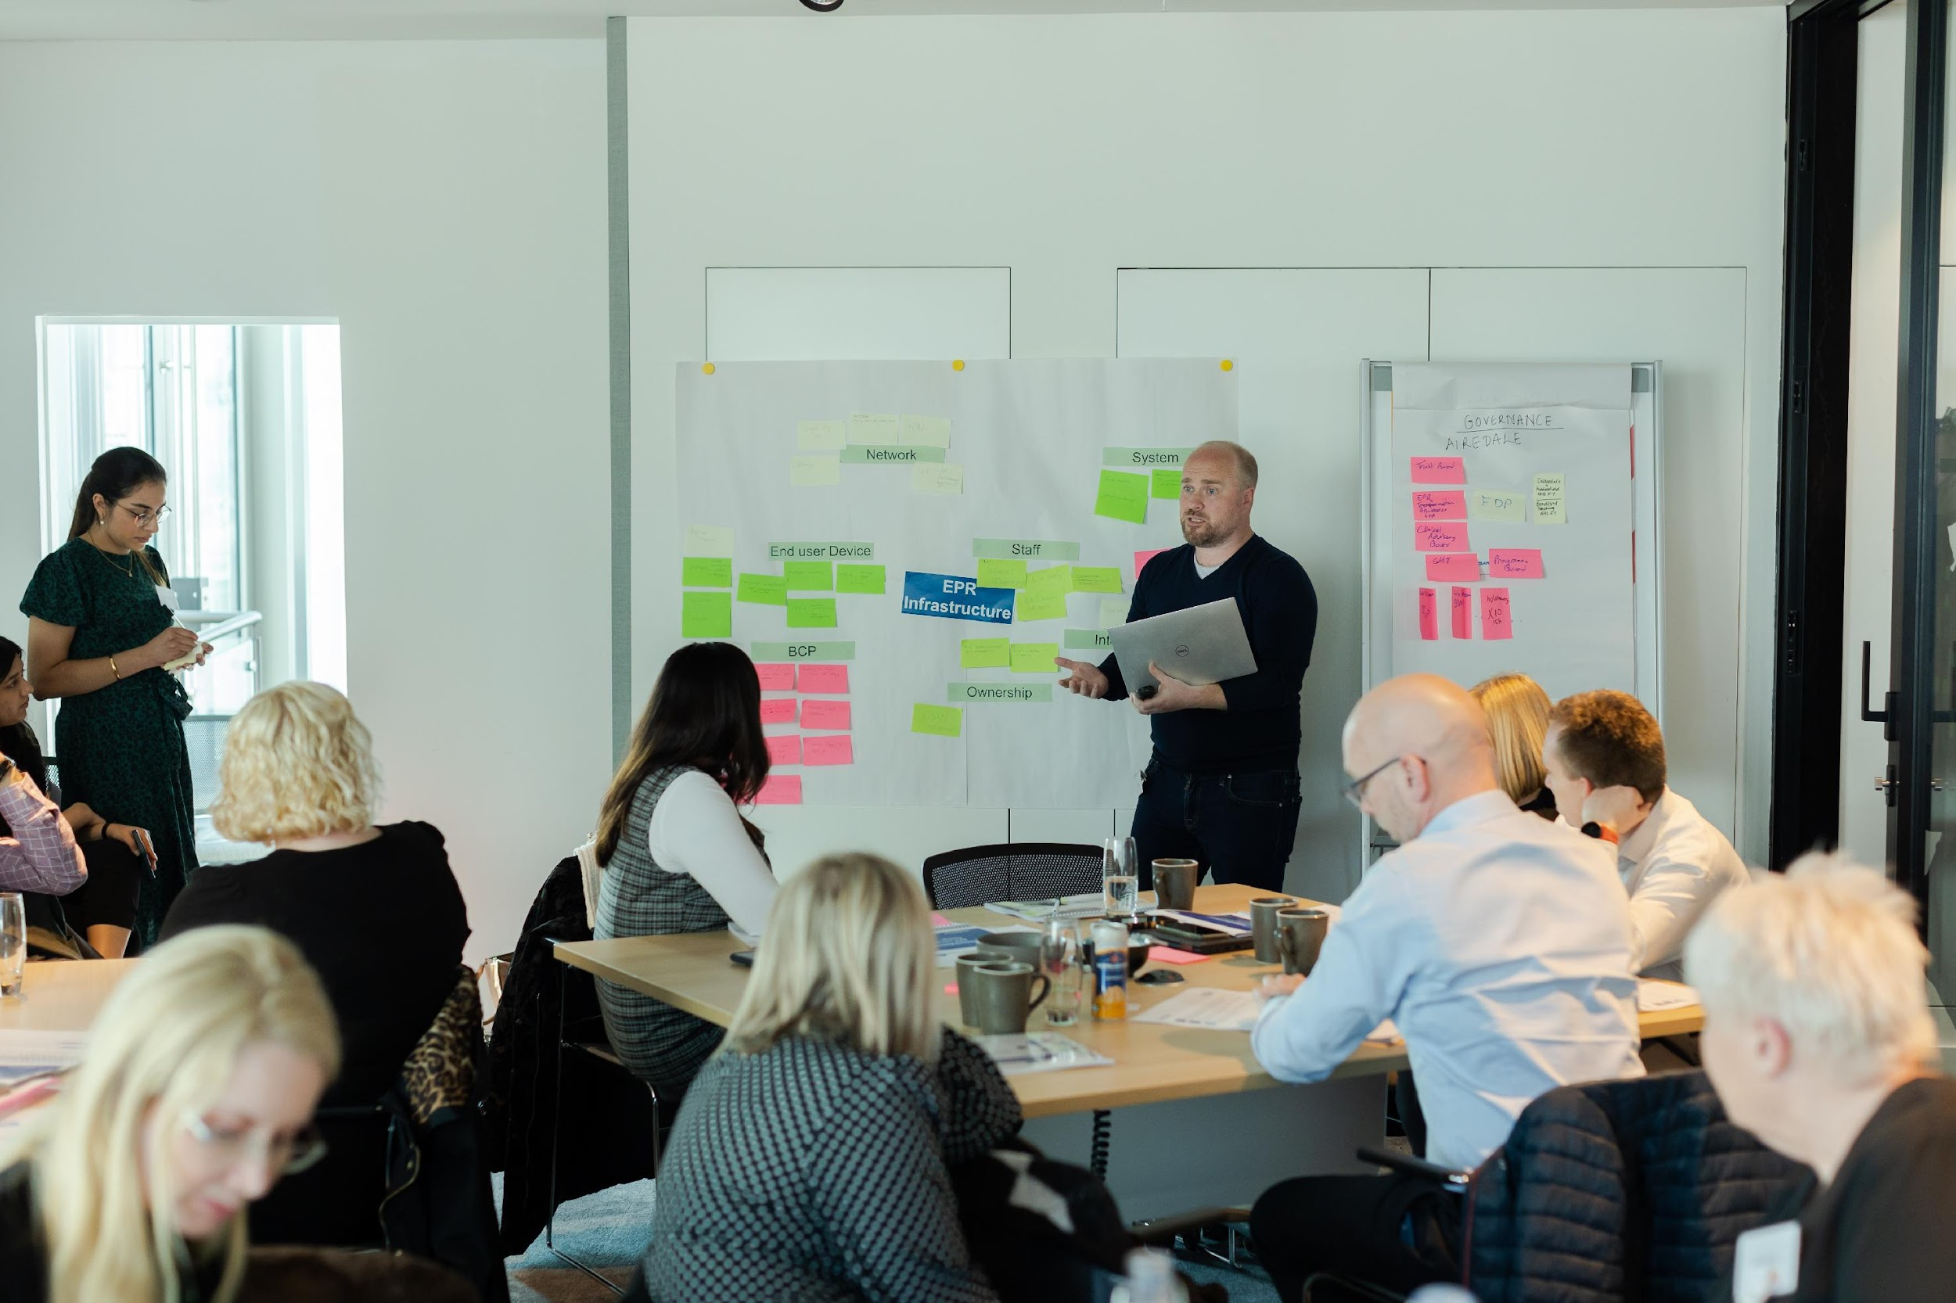
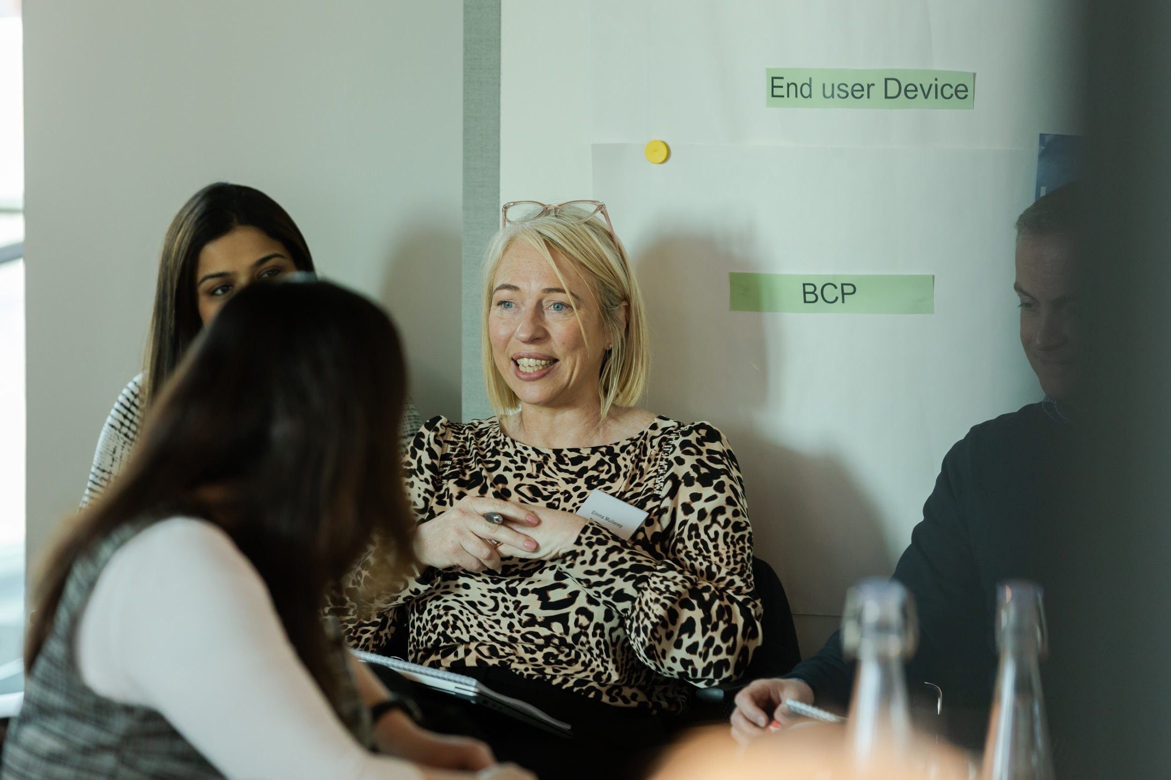
500+
attendees at 48 Learning Labs
Most popular Events were:
The Precision of Practice: The Art of Nursing Documentation [502 attendees]
Mapping the Path to Transformation: The Power of Process Mapping [134 attendees]
2.7k
monthly recipients of FDSO bulletin
70+
Events & Masterclasses delivered
22
Peer Networks
sessions held
770+
members of the Community of Practice
80k
visits to the FutureNHS Support Hub
65+
Trusts have attended the Learning Labs from all seven regions
200+
active & completed resource cell requests provided by SME support
160+
different Trusts engaged with the FDSO
*figures updated on 28/6/2024

Slide 9

Key Takeaways
01
Make sure you sign up to the FDSO newsletter to keep up to date with the Support Offer
02
Encourage your teams and EPR programme leads to attend Learning Labs, Peer Networks, Events and Masterclasses
03
We are always open to feedback; share your thoughts with us!
Contact us: england.fdsupporthubteam@nhs.net
Join: EPR Support Hub
Scan the QR code - to access the EPR Support Hub

