Slide 1

#DHSS24
Clinical engagement a view from Cumbria, Northumberland, Tyne and Wear NHS Foundation Trust
Chair: Lee Rickles
Dr Jonathan Richardson
CIO, programme director and deputy SIRO, Humber Teaching Hospitals NHS FT and Yorkshire and Humber Care Record
CCIO and consultant psychiatrist, Cumbria, Northumberland, Tyne and Wear NHS FT
Andrew Thorn
Dr Charlotte Deasy
Nurse Consultant and Associate CCIO, Cumbria, Northumberland, Tyne and Wear NHS Foundation Trust
Consultant Old Age Psychiatrist, Associate CCIO, CNTW and Regional Clinical Lead for Dementia and Older People’s Mental Health, NHS England

Slide 2

Clinical engagement:
Views from CNTW Digital Health
Dr Charlotte Deasy, Consultant Old Age Psychiatrist & Associate CCIO
Dr Jonathan Richardson, Consultant Old Age Psychiatrist & CCIO
Andrew Thorn, Nurse Consultant & Associate CCIO

Slide 3
Mentimeter

Slide 4
Overview
Online consultation
Rio refresh
Outcomes
Closing statements

Slide 5

Notes:
I work in one of the largest mental health and learning disability trusts in England this covers a population 1.7 million, 9000 staff across a diverse poultion

Slide 6

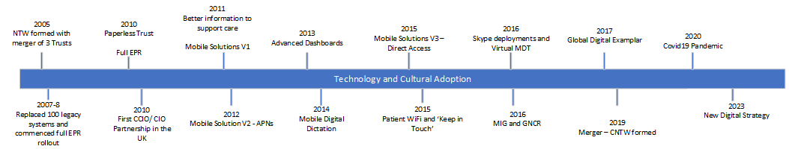

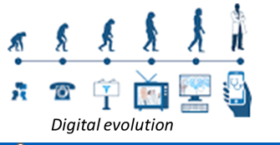


CNTW Journey – Digital Evolution
Level 5
Notes:
For context CNTW has one of the first CCIO/CIO and things have moved on

Slide 7
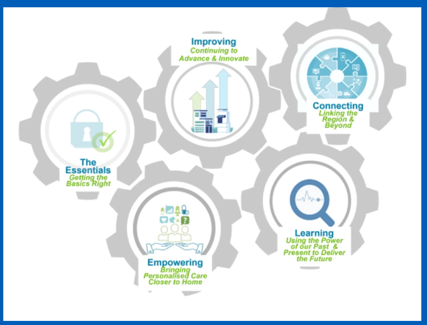
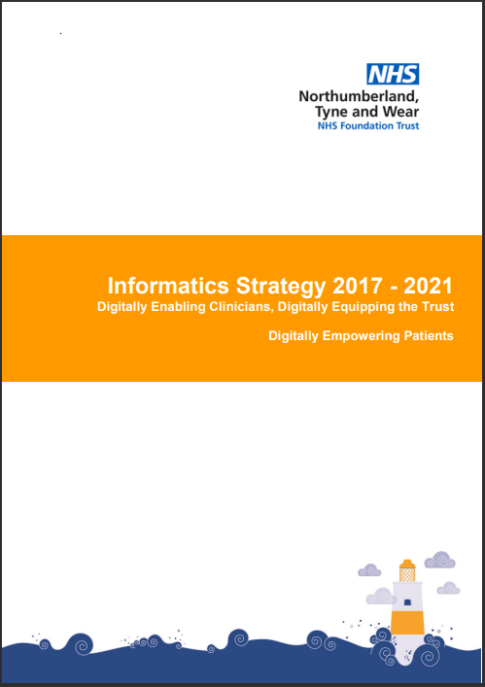
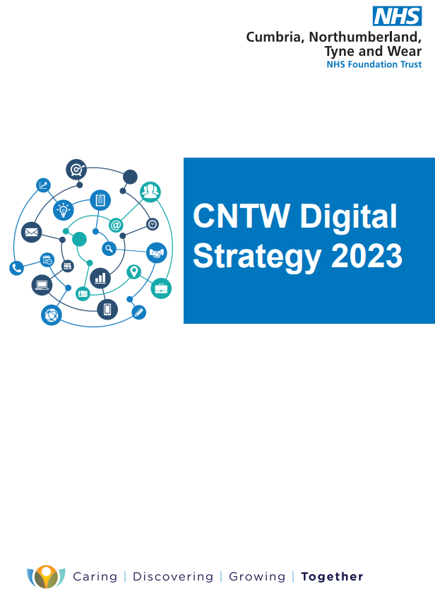
CNTW Digital strategy
NENC Strategic Priorities
9 Key Themes
Cultural Change
Digital Patient
Enhancing the EPR
State of the Art Core Systems
The Work From Anywhere Trust
Open Standards and Systems and Clinical Standards
Cloud First Approach
IG, Security and Assurance
To be a leader in Informatics innovation
Priorities
Improving Core Clinical Systems
Empowering patients
Advancing the use of Information
Seamless System Wide Working
Improving efficiency
Safe, secure and stable systems
Notes:
Move form an informatics to digital strategy and simplifying priorities I feel can help to engage collegeues in theegenda
Priorities
Improving Core Clinical Systems
Empowering patients
Advancing the use of Information
Seamless System Wide Working
Improving efficiency
Safe, secure and stable systems

Slide 8
Engagement– wider than one system
Patient experience
outcomes
Clinical Safety
Online Consultation
My GNCR
ePMA
Rio refresh
Notes:
This is just one component to deliver better outcomes for patients, but also includes
developing the patient facing component of the great north care record (Great North Care Record, 2021)(Great North Care Record, 2021)
all the way through to enabling the electronic patient record to link directly for immediate tests resultsone example is tegration of EHR with laboratory
ICE Click used 12,222 times in May.

Slide 9
Requirement
To provide an online consultation solution to contribute to improving access to services for service users.
Improve service users' choice for treatments by offering online consultations.​
To provide an online consultation solution that enables service users to access care via their domestic or care setting. ​
Slide taken from CNTW NHS playbook presentation at RCPsych The mental health digital playbook webinar – how digital technology can help deliver service improvement and transformation, 02.09.21
Notes:
the trust was tasked with developing and providing an online consultation solution with the aim to improve service users' choice for treatments

Slide 10

Current state
Solution
Benefits
Challenges
Notes:
I feel being honest and open about our current state can help inform and engage

Slide 11
Solution
Used G:Cloud Digital Marketplace to identify Modality OneConsultation as the preferred online consultation solution.
OneConsultation is an online consultation tool that links a clinician to a service user through a video call via the internet. ​
The chosen online consultation solution is implemented across 141 teams with over 3,000 staff having access to the solution within the Trust.
Provides services with one to one consultations or group consultations via a unique link.
End of consultation survey for service users to complete.
Slide taken from CNTW NHS playbook presentation at RCPsych The mental health digital playbook webinar – how digital technology can help deliver service improvement and transformation, 02.09.21
Notes:
As an example online consultation solution was implemented across 141 teams with over 3,000 staff having access to the solution within the Trust.

Slide 12
Benefits
  ​3,834 services users out of 4,701 who have responded to the survey have saved up to 30 minutes or more of travel time.
  From a sample of service users (1547) it was found that 24935.3 miles were travelled, equating to 30p CO2 emissions saved per consultation.
Slide taken from CNTW NHS playbook presentation at RCPsych The mental health digital playbook webinar – how digital technology can help deliver service improvement and transformation, 02.09.21
Notes:
the benefits are numerous including reduction in travel time for service users and a reduction in the carbon footprint

Slide 13
Challenges
An external evaluation from Sheffield University (Painter., et al 2020) found that
‘Concerns centred around the limitations that video calls placed on non-verbal and para-verbal communication and the detrimental effect they feared/perceived to their therapeutic relationships.’
‘Staffs' satisfaction was also heavily affected by audio and video quality. ‘
‘felt video may be problematic for: high risk patients; those with cognitive/communication/sensory difficulties such as learning disabilities, dementia, ASD and ADHD; individuals who have experienced significant trauma; and those experiencing some forms of psychosis and paranoia.’
Notes:
however an external valuation from Sheffield found there were concerns from staff such as that this could be problematic for some patients e.g with cognitive impairment

Slide 14
Challenges
A more recent publication during (Painter., et al 2021) the 2021 pandemic
‘COVID-19 has, in many ways, acted as a catalyst for a change that was both inevitable and already underway. However, from this study, it seems that, if there’s something strange in the neighbourhood, it is important to support staff in deciding who they are gonna call’ (Painter., et al 2021)
Notes:
They also noted that Covid had been a catalyst for change, but emphasise the need for staff support (Greenberg and Tracy, 2020)

Slide 15
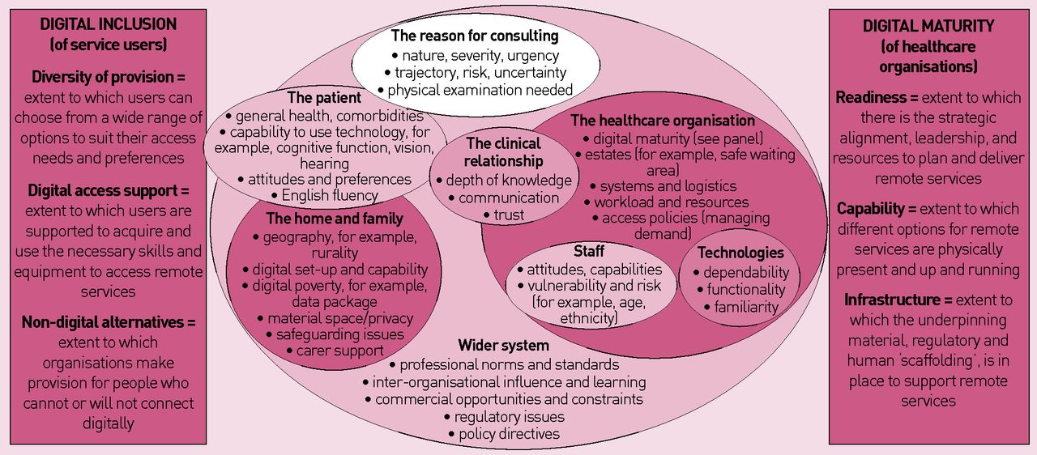

The multiple interacting influences on the choice of consultation modality.
Trisha Greenhalgh, and Rebecca Rosen Br J Gen Pract 2021;71:149-150
©2021 by British Journal of General Practice
Notes:
And we must consider digital inclsion , which this apers highlights

Slide 16
Future State
Framework
Strategy
Notes:
So how do we move from our current to a future state

Slide 17
Mental health and learning disability; digitally enabled for patients and professionals
Quality + Performance + Resource Management = Sustainability
Quality Improvement System
Customer Segments:
•Enabling improvements in quality for patients and families alike
•With improvements in patient experience patient safety and clinical effectiveness
•Ensuring productive relationships with suppliers that are value for money for our patients
Actions to improve outcomes for service users
Customer Relationships:
•Having business to business relationships which are which unique meaningful and customised
• Ensuring focused relationships with other providers within the NENC ICS
Key Activities:
•Assessing, diagnosing and treating patients and families with mental illness and or a learning disability across the NENC ICS
•balancing patient safety, clinical effectiveness, patient experience, finance and performance measures across the NENC ICS
•Working collaboratively with colleagues across health and social care within the NENC ICS
Developing quality and outcomes measures
Value Proposition
Ensuring that the mental health and learning disability needs of patients are enabled via digital channels
enabling patients and professionals to be able to use digital channels effectively
insuring the value based approach to mental health is delivered balancing the outcomes for patients over the resource is available
Key Partners
Cumbria Northumberland Tyne and Wear NHS foundation trust (CNTW)
Acute, primary care and mental health providers
local authorities across North East and north Cumbria integrated care system (NENC ICS)
suppliers of EHRs and the HIE
Ensuring that the organisation is a member of part networks at numerous levels, professionally, locally, regionally and nationally
Partners for innovation for example with the academic Health Science network
potential for consultancy with other integrated care systems
Service users/Carers/Families
Digital
Key Resources:
•Ensuring team members have competencies within Innovation
•Ensuring software solutions have interoperability built in
•competence amongst the project management team
Channels:
•Internally via the CNTW NHS Trust clinical reference group and CNTW NHS Trust corporate decision team - digital
•externally via NENC ICS CIO /CCIO network
Revenue Streams:
Changes to block contract payment for mental health and moving to a blended model with finance held locally at ICS level.
potential to generate income from other ICS
Cost Structure:
•software costs
•additional staff costs e.g. for deputy CIO and associate CCIO
•cost of project management and ongoing support once live
Notes:
I feel we must contextualise the why
and frame change differently for different groups as in the NHS, we operate in a complex adaptive system (Plsek and Greenhalgh, 2001)
a business canvas is a tool which articulates, in this case how we wish to improve mental health and learning disability services by digitally enabling patients and professionals

Slide 18
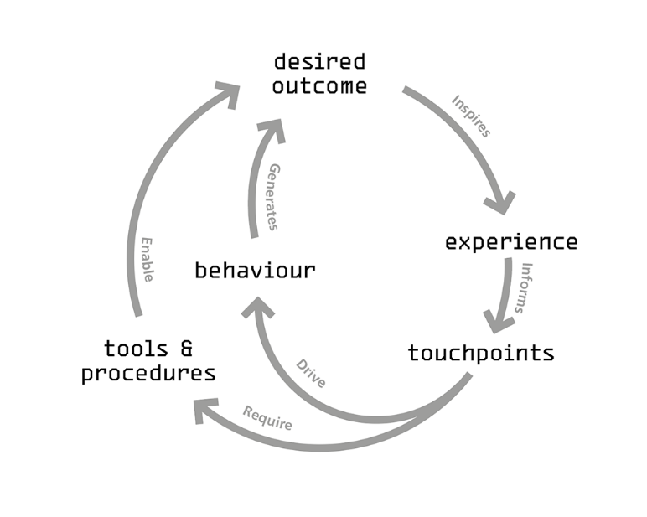
Service Experience framework, Helix Centre, 2021
Notes:
as potential approach to enhance engagement considering the Service Experience framework which highlights
• desired outcome
• experience
• touchpoints
• behaviour tools
• and procedures

Slide 19
Patient experience
Online Consultation
Notes:
So if want to improve patient experience by further improvements to online consultation

Slide 20
Approach
    • Outcome
Notes:
the outcome

Slide 21
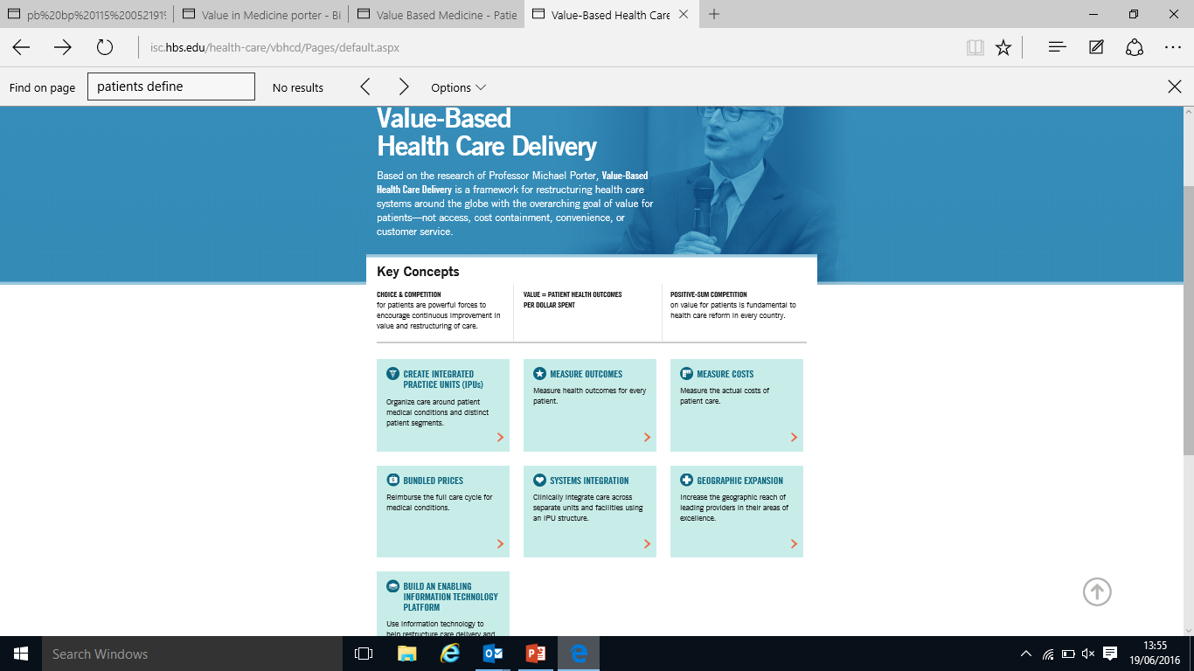
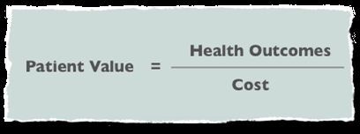
Value Based Healthcare
What Is Value in Health Care? Michael E. Porter, Ph.D. N Engl J Med 2010; 363:2477-2481 December 23, 2010
Notes:
I feel must be around improving value.
We must articulate how this is linked to patient outcomes with the resource we have (Porter, 2010)

Slide 22
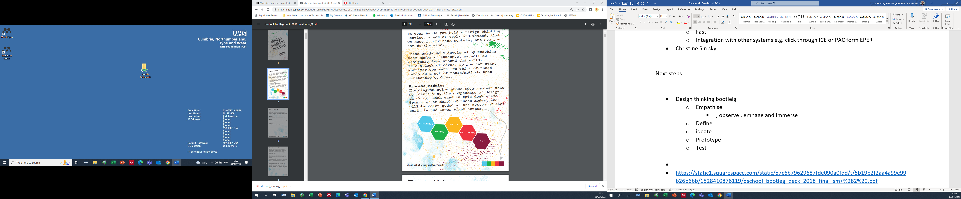
Service Experiene framework, Helix Centre, 2021
  https://static1.squarespace.com/static/57c6b79629687fde090a0fdd/t/5b19b2f2aa4a99e99b26b6bb/1528410876119/dschool_bootleg_deck_2018_final_sm+%282%29.pdf
Notes:
clinical engagement could also be ehnaced by using the approach from Stanford University making sure that we can
empathise with end users
defining why we are using a tool
before prototyping and testing (Doorley et al., 2018)(NHS England, 2019)(University of Cambridge, 2013)

Slide 23
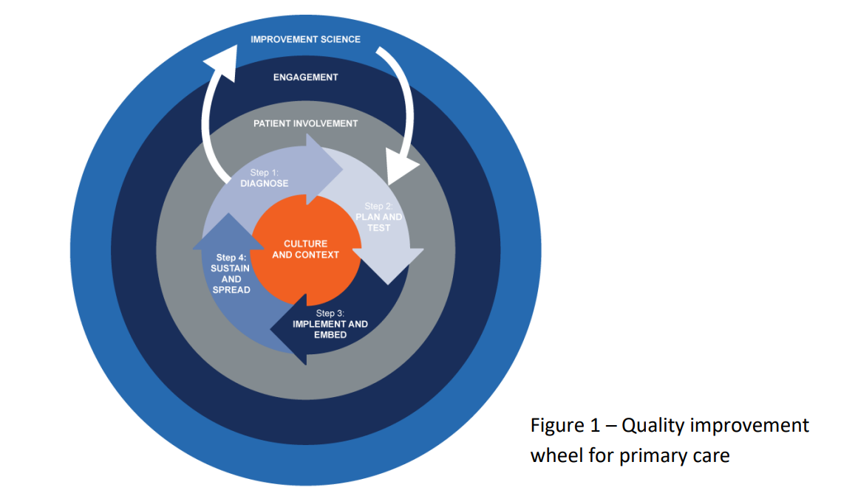
  https://www.england.nhs.uk/wp-content/uploads/2019/03/an-introduction-to-quality-improvement-in-general-practice.pdf
Notes:
I also feel we must underpin any change with a quality improvement approach but also to give staff the tools to continually improve, for example the use of lean

Slide 24
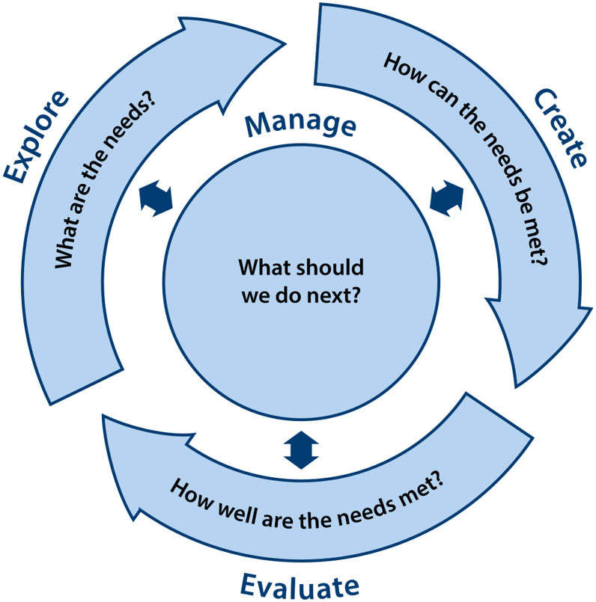
  Taken form Inclusive Design Toolkit
Notes:
this continuous improvement has to be inclusively designed so I have to make sure that we not only explore, create, and manage the issues but also evaluate the change

Slide 25
Approach
    • Outcome
    • Experience
Notes:
This means outcome and experience

Slide 26
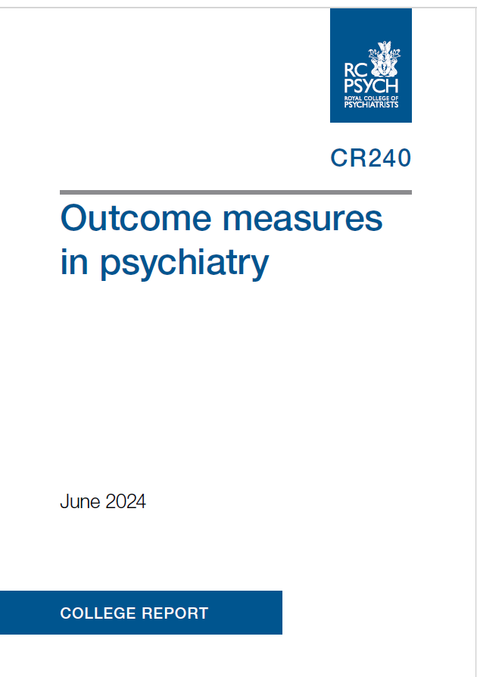
Notes:
Has to be measured
implementing outcome measures,(Improvement, 2016) I believe will enable us to do this

Slide 27
Approach
    • Outcome
    • Experience
    • Touchpoints
Notes:
the key touchpoints

Slide 28
Enhanced Multi Disciplinary Team
Consultant Psychiatrist
SAS Doctors
Junior Doctors
Service users
Carers
Families
Multidisciplinary AC /RC
Nurse Consultant
and
Independent Prescriber
Independent Prescribers
Pharmacist / Nurse
Multidisciplinary AC /RC
Consultant Psychologist
Consultant AHP
Notes:
will be ensuring that the patient at the centre, and any new design has to be coproduced alongside our multidisciplinary teams

Slide 29
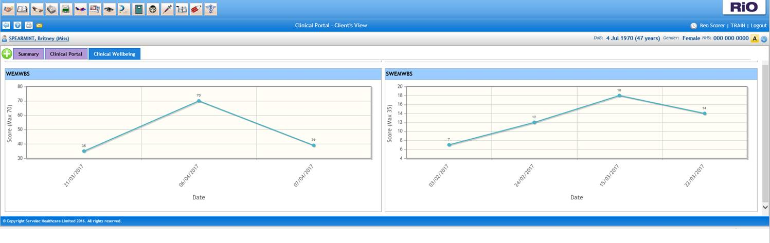
Clinical Wellbeing graph
Short Warwick-Edinburgh Mental Wellbeing Scale or SWEMWBS is a patient-reported outcome measure (PROM)
When a SWEMWBS is completed the total score will be displayed in the graph on the Clinical Wellbeing tab…
Notes:
Visualising any improvement is key

Slide 30
Approach
    • Outcome
    • Experience
    • Touchpoints
    • Behaviour tools
    • Procedures
Notes:
We also have to think about policies, procedures and approaches that we need to adopt such as the approach to recod keeping and clicnal sfety

Slide 31
Engagement– wider than one system
Patient experience
outcomes
Clinical Safety
Online Consultation
My GNCR
ePMA
Rio refresh
Notes:
So for me improving the patient experience is not just about online consultation
This is just one component to deliver better outcomes for patients, but also includes
developing the patient facing component of the great north care record (Great North Care Record, 2021)(Great North Care Record, 2021)
all the way through to enabling the electronic patient record to link directly for immediate tests
However I do think there are challenges going from an initial vision to achieving the desired outcome within the NHS.

Slide 32
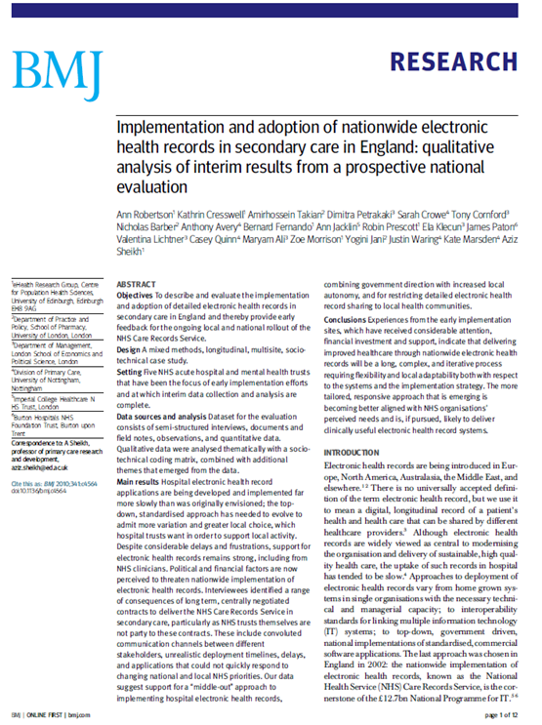
Sociotechnical principles
‘moving away from a too-narrow focus on IT
developing a better balance between national requirements and local flexibility for grassroots adaptability
establishing the capacity and capability to support effective handling of critical human and organisational issues
undertaking systematic reviews and evaluations’
Ref Peltu et al How a Sociotechnical approach can help NPfIT deliver better NHS patient care May 2008
Notes:
These challenges been descried for along time However if we fully adopt a Sociotechnical principles, and I think what still holds true is
Some core features of a Socio technical approach t approach described by Clegg and colleagues or the guiding principles for St change
there is no such thing as 90 project merely business change projects mediated by people in it
improvements require a systems approach
local initiatives work
full beat push every time
focus on benefits
join it all up
monitoring and evaluation
32

Slide 33
Quality + Performance + Resource Management
= Sustainability
Quality
Patient experience
Clinical effectiveness
Patient safety
:
Performance
National requirements
Local requirements of Commissioners and Regulators
Resource Management
Workforce
Finance
Estate
Information
Ref Ken Tooze 2017
Notes:
Thes principles could help balance the resource we have, whilst managing the external performance measures to ensure that patients have a high quality and a sustainable service in the future

Slide 34
Approach to EPR improvements
Kotter’s 8-step model
Create sense of urgency
Build a coalition
Form a strategic vision
Enlist people
Enable action
Generate quick wins
Sustain change
Institute change
Notes:
This is a promise we must all make to each other – to work together to improve the experience of working in the NHS for everyone.
The themes and words that make up Our People Promise have come from those who work in the NHS. People in different healthcare roles and organisations have made it clear what matters most to them, and what would make the greatest difference in improving their experience in the workplace. This is what we should all be able to say about working in the NHS, by 2024.
5 high level impact actions for nursing, nursing and midwifery self assessment tool/Drs Retention Action Plan

Slide 35
Clinical engagement: Trust-wide
Create Climate for Change
Trust-wide Survey
Engage and enable
Build capacity
Listen
Implement and sustain
Evaluate
Engage board
Raise profile
Connect professions
Develop
Embed
Notes:
Less reliance on international recruitment, putting staffing on a sustainable footing.
This is a promise we must all make to each other – to work together to improve the experience of working in the NHS for everyone.
The themes and words that make up Our People Promise have come from those who work in the NHS. People in different healthcare roles and organisations have made it clear what matters most to them, and what would make the greatest difference in improving their experience in the workplace. This is what we should all be able to say about working in the NHS, by 2024.
5 high level impact actions for nursing, nursing and midwifery self assessment tool/Drs Retention Action Plan

Slide 36
Clinical Reference Group
Project support
Clinical interface
Multi-channel communication
Clear priorities and vision
Notes:
Less reliance on international recruitment, putting staffing on a sustainable footing.
This is a promise we must all make to each other – to work together to improve the experience of working in the NHS for everyone.
The themes and words that make up Our People Promise have come from those who work in the NHS. People in different healthcare roles and organisations have made it clear what matters most to them, and what would make the greatest difference in improving their experience in the workplace. This is what we should all be able to say about working in the NHS, by 2024.
5 high level impact actions for nursing, nursing and midwifery self assessment tool/Drs Retention Action Plan

Slide 37
Clinical engagement: ‘Bottom up’
Create Climate for Change
Understand frustrations
Engage and enable
Give permission
Implement and sustain
Innovation culture
Harness energy
Measure outcomes
Communicate success
Notes:
Less reliance on international recruitment, putting staffing on a sustainable footing.
This is a promise we must all make to each other – to work together to improve the experience of working in the NHS for everyone.
The themes and words that make up Our People Promise have come from those who work in the NHS. People in different healthcare roles and organisations have made it clear what matters most to them, and what would make the greatest difference in improving their experience in the workplace. This is what we should all be able to say about working in the NHS, by 2024.
5 high level impact actions for nursing, nursing and midwifery self assessment tool/Drs Retention Action Plan

Slide 38
Autonomy
Meaningful impact
Safety and quality
Clinical leadership
Time and energy
Notes:
Less reliance on international recruitment, putting staffing on a sustainable footing.
This is a promise we must all make to each other – to work together to improve the experience of working in the NHS for everyone.
The themes and words that make up Our People Promise have come from those who work in the NHS. People in different healthcare roles and organisations have made it clear what matters most to them, and what would make the greatest difference in improving their experience in the workplace. This is what we should all be able to say about working in the NHS, by 2024.
5 high level impact actions for nursing, nursing and midwifery self assessment tool/Drs Retention Action Plan

Slide 39
Barriers to engagement
Other priorities
Time
‘Learned helplessness’
(Conflicting view-points)
Notes:
Less reliance on international recruitment, putting staffing on a sustainable footing.
This is a promise we must all make to each other – to work together to improve the experience of working in the NHS for everyone.
The themes and words that make up Our People Promise have come from those who work in the NHS. People in different healthcare roles and organisations have made it clear what matters most to them, and what would make the greatest difference in improving their experience in the workplace. This is what we should all be able to say about working in the NHS, by 2024.
5 high level impact actions for nursing, nursing and midwifery self assessment tool/Drs Retention Action Plan

Slide 40
Levers for engagement
Raise the profile of digital
  Show and Tell
  Newsletter
  Medical Staff Committee
Executive support
  Leadership
  Resource
Select the right priorities
Quick wins
Notes:
Less reliance on international recruitment, putting staffing on a sustainable footing.
This is a promise we must all make to each other – to work together to improve the experience of working in the NHS for everyone.
The themes and words that make up Our People Promise have come from those who work in the NHS. People in different healthcare roles and organisations have made it clear what matters most to them, and what would make the greatest difference in improving their experience in the workplace. This is what we should all be able to say about working in the NHS, by 2024.
5 high level impact actions for nursing, nursing and midwifery self assessment tool/Drs Retention Action Plan

Slide 41
Embracing a culture of engagement

Slide 42
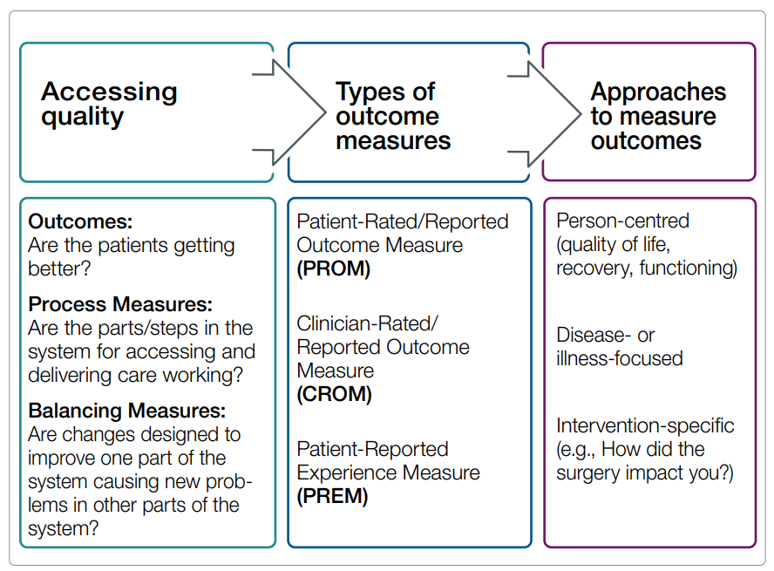
Croms, Proms and Prems
Notes:
Clinicians in Community Services already record Clinician Related Outcome Measures (CROM) via the Mental Health Clustering Tool (MHCT).
However, there is an essential need to gain increased feedback from clients about their outcomes (PROMs) and Experience of services (PREMs).
Gaining feedback from Service Users is important and can be of particular value when integrated into discussions with Service Users and considered at reviews and when treatment planning.
Patient Rated Outcome Measure (PROM):
In line with National guidance, CNTW are using the Short Warwick & Edinburgh Mental Wellbeing Scale (SWEMWBS) as a Patient Rated Outcome Measure (PROM). The PROM should be collected in line with the MHCT, i.e. on completion of initial assessment, at routine review, significant change in presenting needs, e.g., at admission; and at discharge.
This short questionnaire is not anonymous and when returned the response is available in the Patient record, and should be discussed at reviews with service users to inform treatment plans
Patient Rated Experience Measure (PREM):
Unlike SWEMWB feedback, PREM feedback is anonymous.

Slide 43
Principles informing the use of patient and clinician rated outcome measures.
Patient and clinician rated outcome measures should support patient care.
Patient and clinician rated outcome measures need to be clinically meaningful.
Patient and clinician rated outcome measures needs to be clinically valid.
Patient and clinician rated outcome measures are supported by digital enablers.

Slide 44
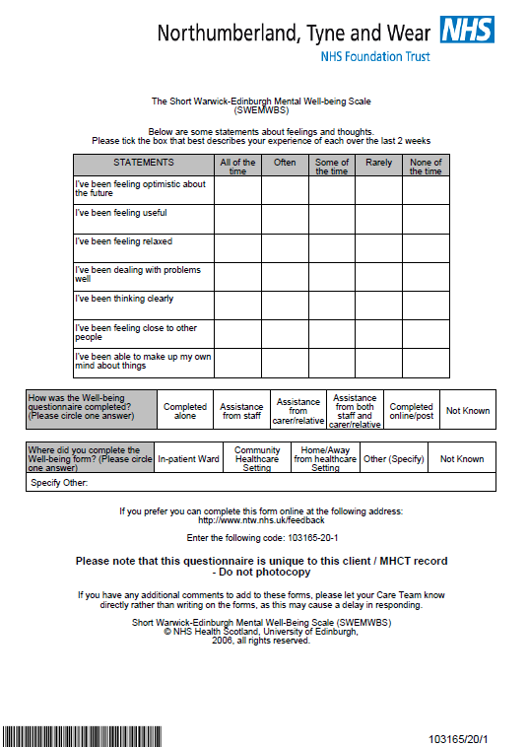
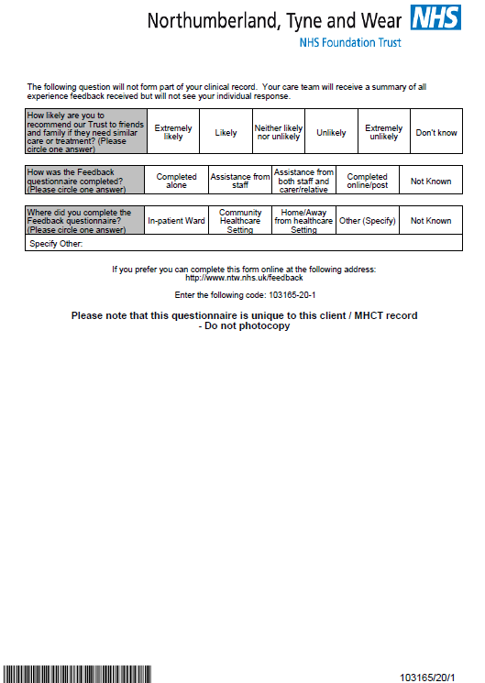
PROMs: What did they look like for service users?
Introduction letter
FFT questionnaire
SWEMWBS sheet. Notice the bar code which makes this unique to the patient

Slide 45
Outcome Measure assumptions
Staff concerns time, intrusion on therapeutic relationship, clients won’t want to complete, time to input onto system, inappropriate at times…
Questionnaires are sent POST review. Not therefore forming part of planning process.
Questionnaires – are they fully validated, not measuring what we want them to, not demonstrating full picture…
Clients not returning forms, not wanting able to fill in, too distressed.
Staff concerns or lack of competence at understanding new approaches.

Slide 46
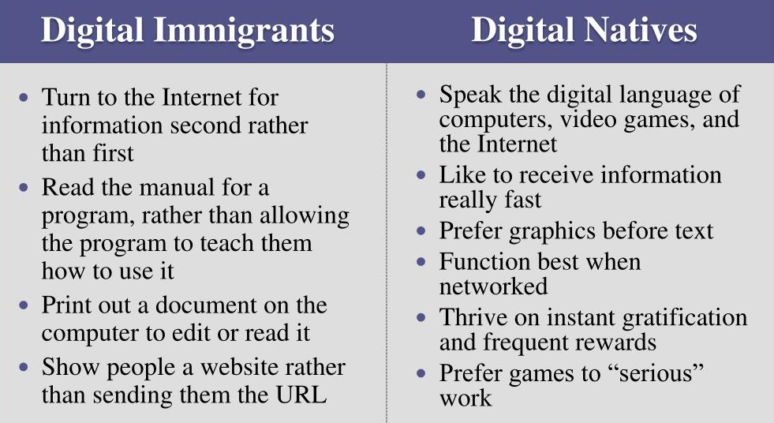
Digital Skills (Prensky 2001)
Notes:
Digital native is a term coined by Marc Prensky in 2001 to describe the generation of people who grew up in the era of ubiquitous technology, including computers and the internet.
On the Horizon. "Digital Natives, Digital Immigrants,"
Digital natives are comfortable with technology and computers at an early age and consider technology to be an integral and necessary part of their lives. Many teenagers and children in developed countries are considered to be digital natives, as they mainly communicate and learn via computers, social networking services, and texting.
The opposites of digital natives are digital immigrants (people who have had to adapt to the new language of technology) and digital refugees (people whose jobs, livelihoods, and lives have been disrupted by the rapid advance of information technology, automation, and artificial intelligence).

Slide 47
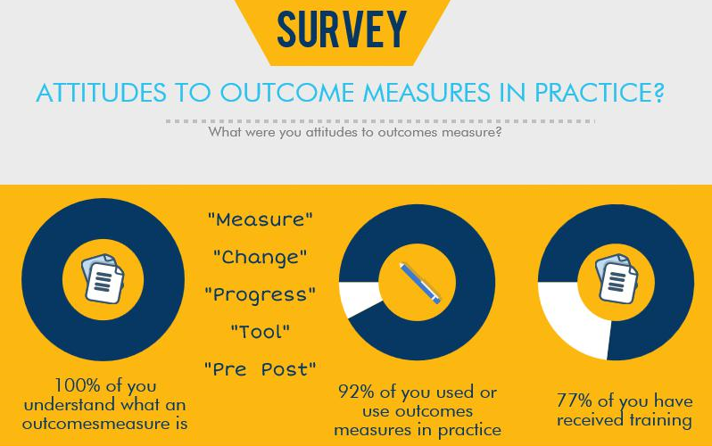
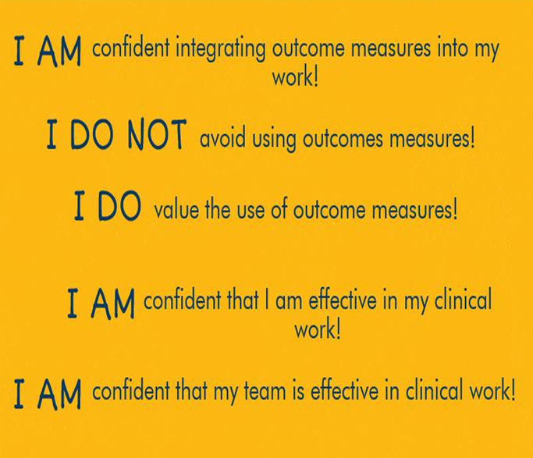
Survey Results
Notes:
What was clear from the initial survey and from the subsequent follow up is that clinicians are well versed in and express positivity to, the use of outcome collection to guide and inform practice as well as ensure collaboration with service users and with carers.
Clinicians in general seem motivated to using outcome measurements; however, what is also clear is the fundamental need to ensure this is driven by an efficient, systematic process. Moreso, the outcome measurement should have clear specificity to the presenting complaint. It is apparent throughout discussions with clinical staff and with service users that the most successfully embedded outcome approaches are those that by virtue of meaningfulness to a clinical agenda, show improvement.

Slide 48
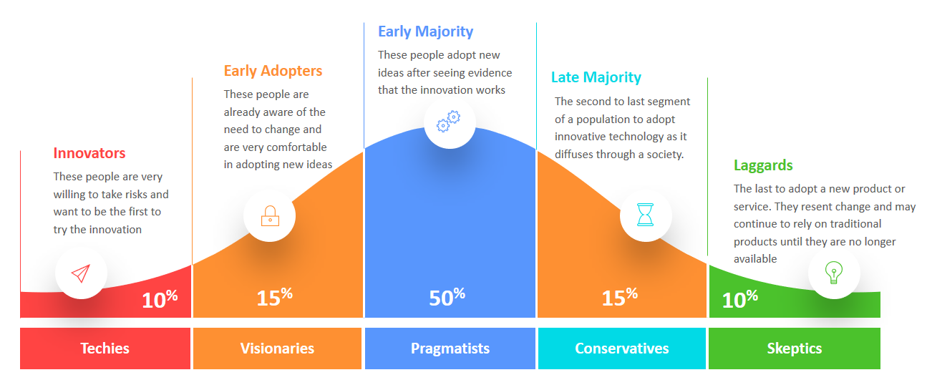
Diffusion of innovation model
Notes:
A better way to leverage change in the clinical environment is perhaps to consider Everet Rogers’ diffusion of innovation model.
Rogers suggests that adopters will typically ask the following types of questions when considering change
Compatibility: How well does this innovation fit with existing values, patterns of behaviour, or tools?
Trialability: Can you try it before you buy it?
Relative advantage: In what way is this innovation better than the alternatives?
Observability: Are its benefits noticeable? If someone else is using the innovation, can I see it being used?
Simplicity / Complexity: The easier it is to learn or grasp, the faster it diffuses.

Slide 49
Common thoughts when implementing change
Compatibility:
Trialability:
Relative advantage:
Observability:
Simplicity / Complexity:
Notes:
Compatibility: How well does this innovation fit with existing values, patterns of behaviour, or tools?
Trialability: Can you try it before you buy it?
Relative advantage: In what way is this innovation better than the alternatives?
Observability: Are its benefits noticeable? If someone else is using the innovation, can I see it being used?
Simplicity / Complexity: The easier it is to learn or grasp, the faster it diffuses.

Slide 50
To this, I would add
Applicability - Is this a tool that enhances care as opposed to simply recording care?
Benefits - How would this impact positively on my clinical practice/ on my care?
For service users: Is this helpful to my recovery?
Notes:
Uniformity
Reliability
Repeatability

Slide 51
Closing statements

Slide 52
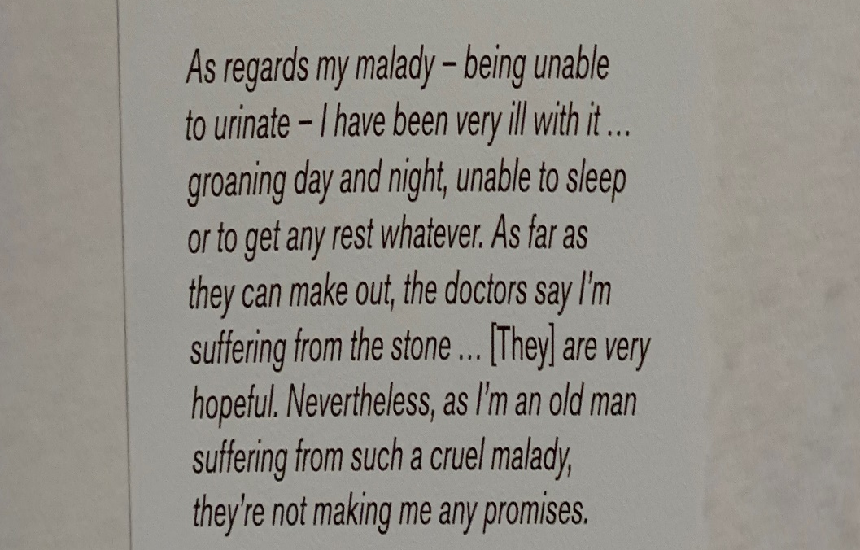
Notes:
Engagement for me is getting back to basics with clinicians, as CCIOs we have a unique insight,
But as CCIO we must remember to ask and reflect on why we’re in the room when implementing any change
As an old age psychiatrist I was touched by this description of the impact of a kidney stone in an elderly gentleman at a recent exhibition

Slide 53
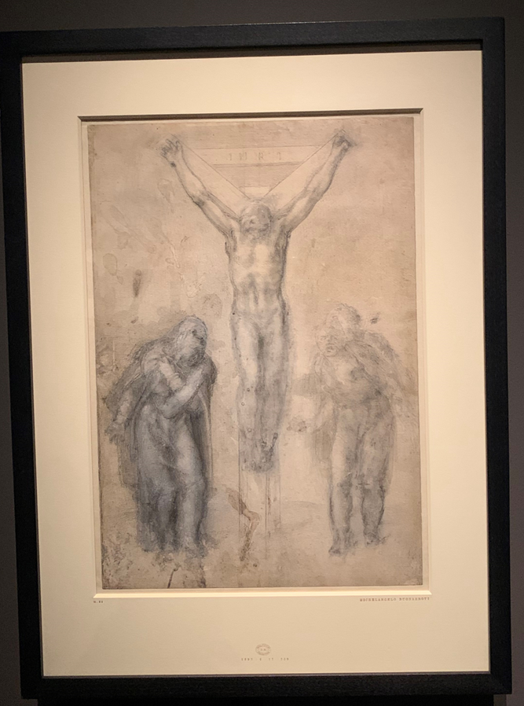
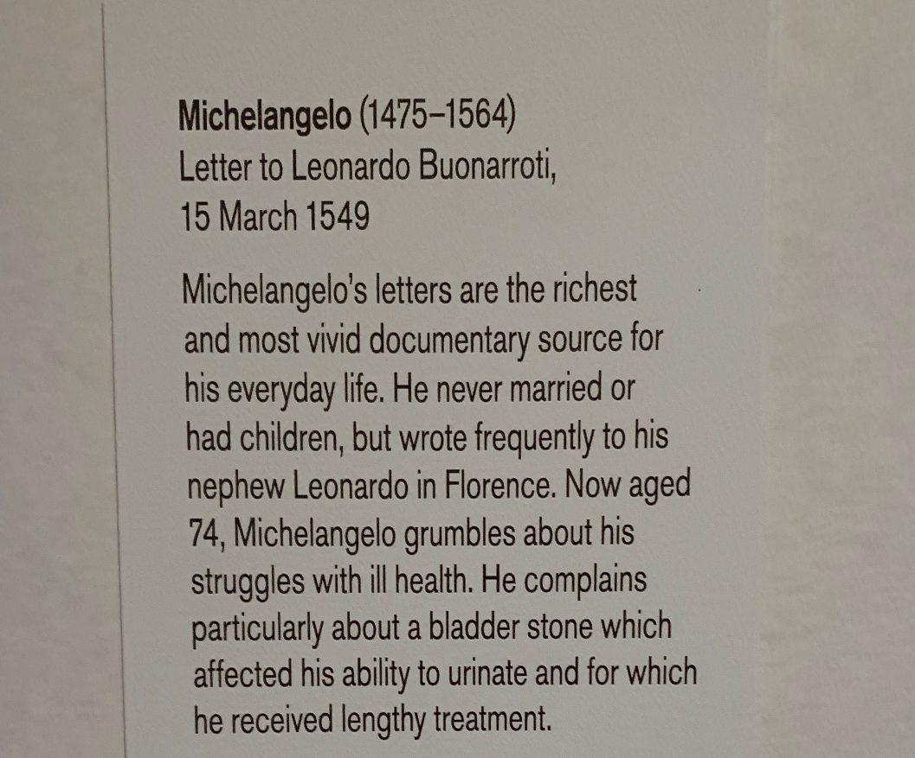
Notes:
This elderly patient – who happened to be Michelangelo – was given hope, and he was still producing drawings like the when he was 80

Slide 54
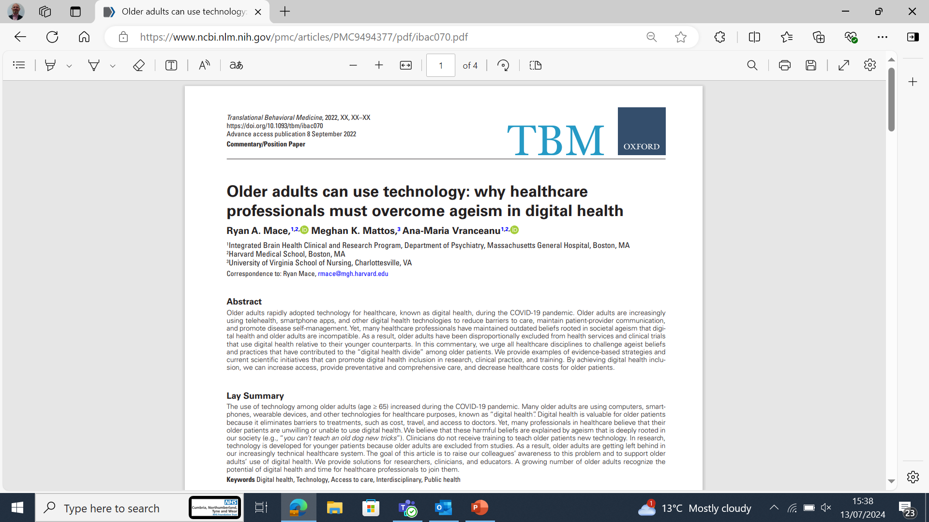
Notes:
Which made me reflect on the technology that we now have and consider could he have produced if he had been born in the 21st century
Having the time to be able implement but also reflect with patients, professionals and provider of services and overcoming our won prejudices, is key to engagement,
As its as much about the psychology of the change as it is the technology

Slide 55
Thank you
Any questions?

