Slide 1
Build vs Buy - Digital Dilemma
David Elliott – CCIO & Executive Director of Child Health and Clinical Support

Slide 2

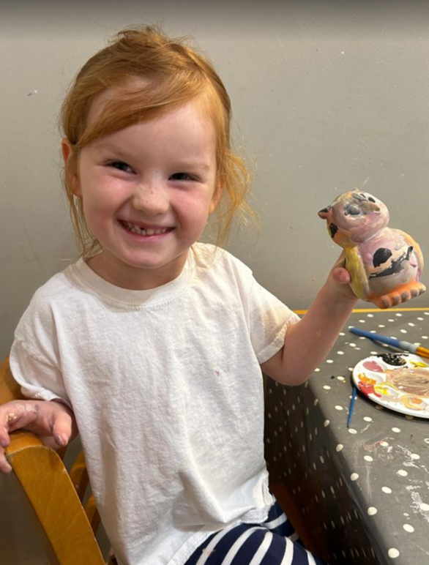
Jack (May 2023)
and Grace………

Slide 3
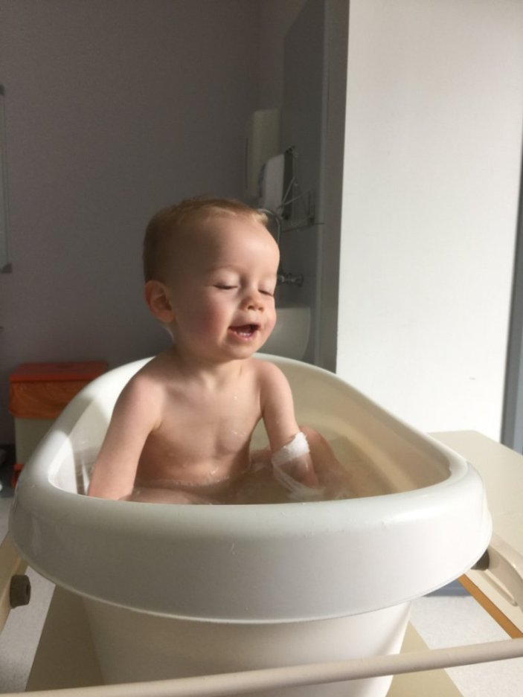
Jack (May 2015)

Slide 4
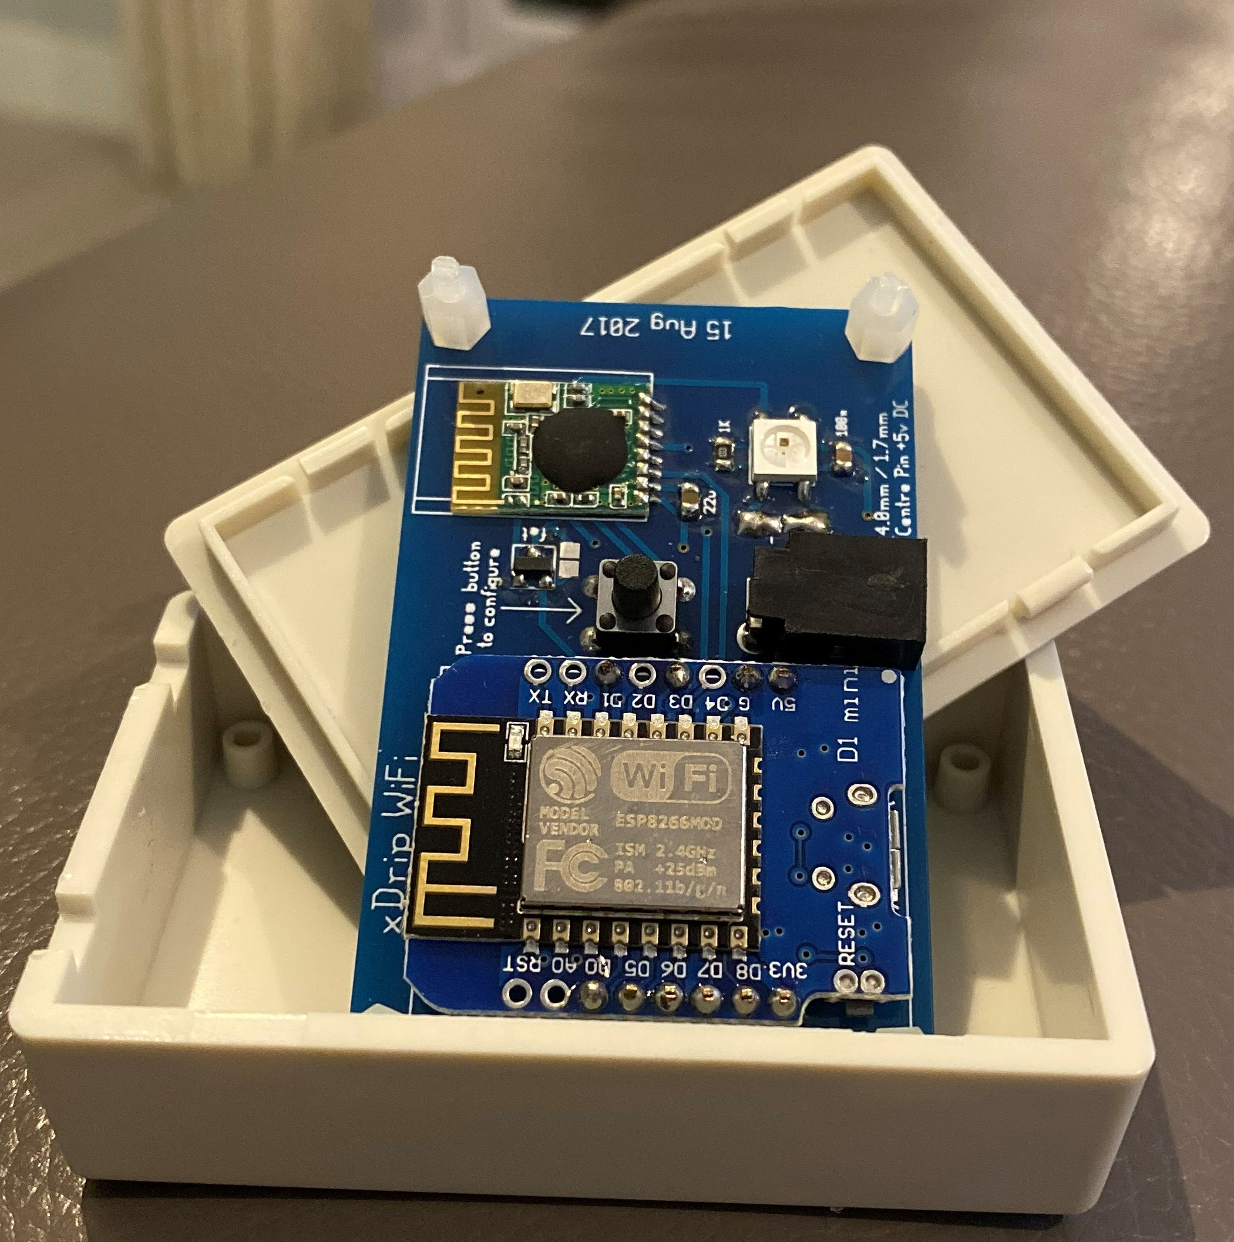
The Elliott Family T1 Tech Roadmap
3rd May 2015 – Jack diagnosed.
August 2015 – Sleep depravation kicks in.
January 2016 – Jacks pump gets delivered.
August 2016 – the Dexcom “sleep angel” arrives
Feb 2017 – Alert fatigue kicks in – the research starts
April 2017 – whole house monitoring
March 2017 – #wearenotwaiting Nightscout Foundation group joined
April 2017 – remote monitoring
December 2018 – Looping breakthrough and testing.
Saturday 9th July 2018 – the Elliott family sleeps through the night. 18 automatic basal adjustments

Slide 5
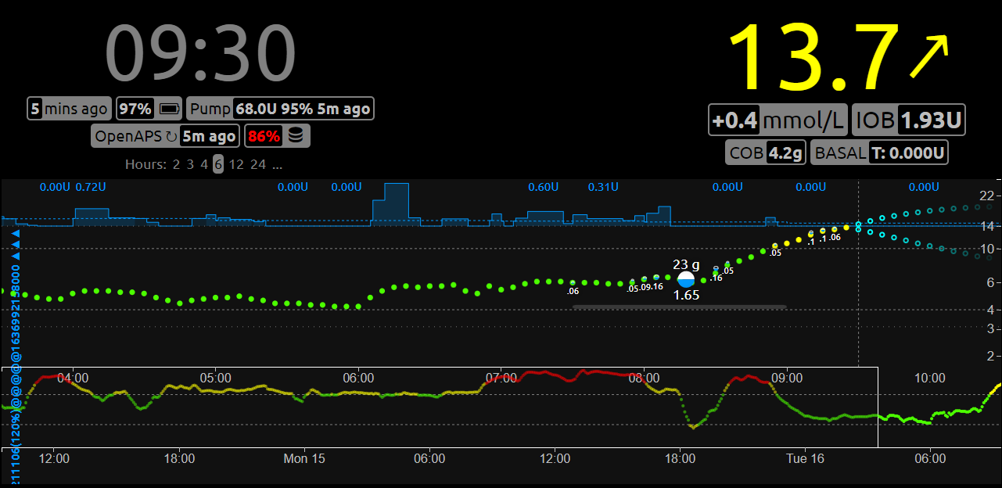

Slide 6
Digital Innovation in Established Healthcare
Its poor and its slow……
#wearenotwaiting
No interest in solving problems for the 1% (i.e not small children with diabetes)
Shareholders and board interests
Healthcare is a sure bet for private equity.
Sales are based on knowing no better.

Slide 7
Risks in Digital and Healthcare
Hidden risks that the technology avoids. (paper risks)
Dual availability of digital and paper – where to look!
Testing, Testing, Testing
Legal issues and build it yourself
Digital is slower…..
Board level Support
Funding

Slide 8
Northumbria Build vs Buy
Sector History
Healthcare = Risky Private Sector = USP
Be Selective
Don’t Build Everything
Don’t introduce Unnecessary Risk
Latest and Greatest
Use the latest and best technologies. Cloud, platform as a service (30% of our current digital teams time is spent reengineering existing system architecture)
Engagement
Work on the ground with the users of the system – real requirement gathering. Not – “this is the new system this is how you use it”.
Investment
Make changes quickly without sizeable cost.
Data
Integrate heavily to make sure data is available when you need it at the point of care. Connectors
Downsides
Risks, Internal recruitment, Skillsets

Slide 9
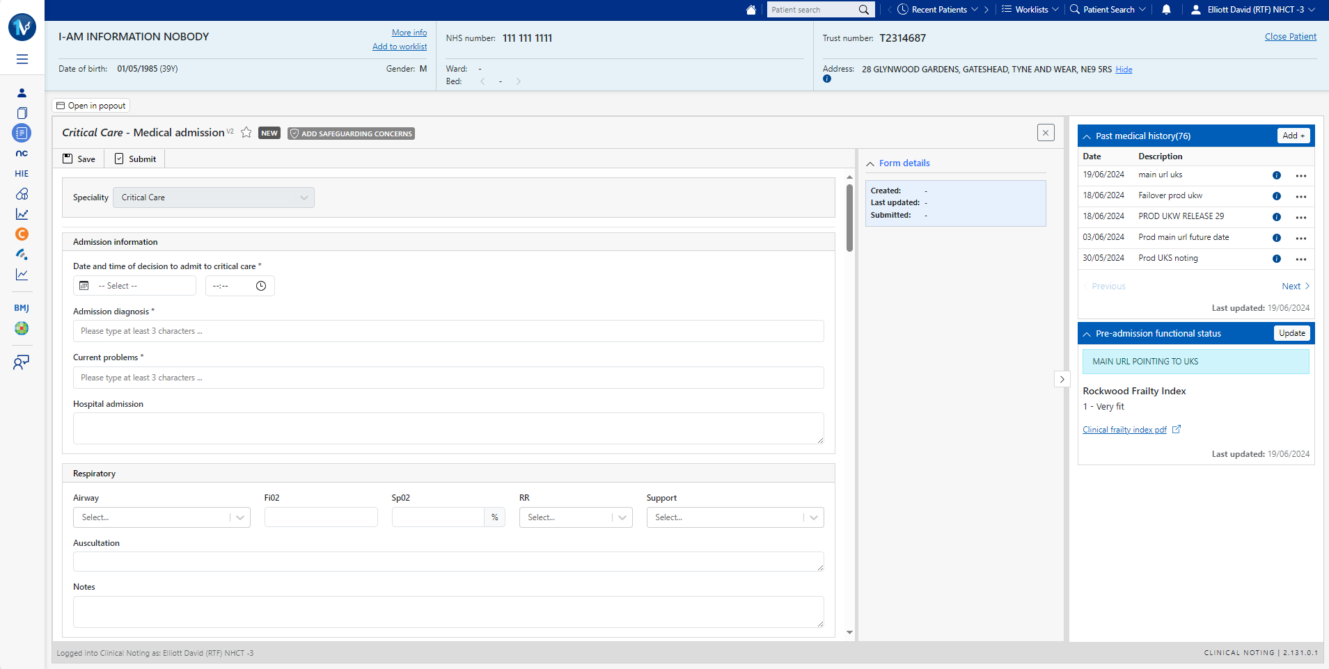
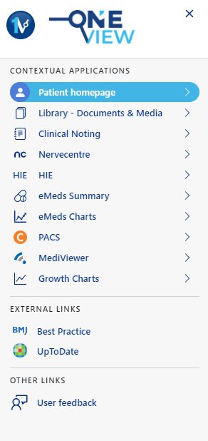
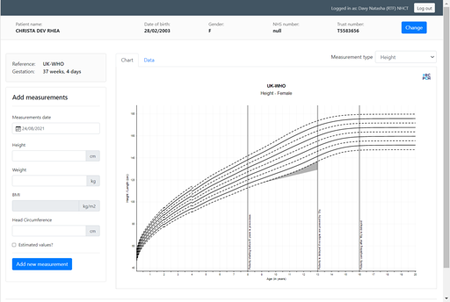
Clinical Noting OneView Development
Launched 4th July 2022
Live – inpatients and outpatients
120,000 notes added per month
Lean towards structured data
Not just replacing paper
Specialty leadership
Time commitment from medical, nursing and managerial.
Iterative process
Total Cost £1.6m

Slide 10
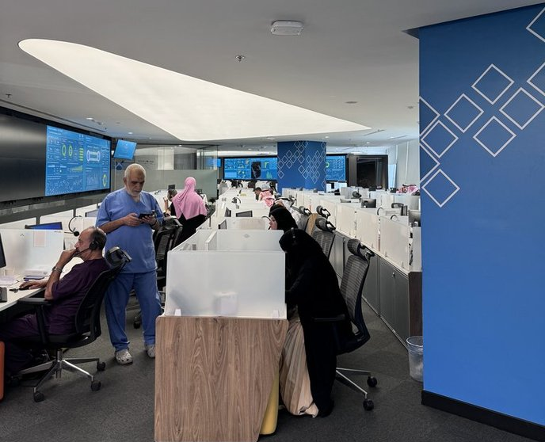
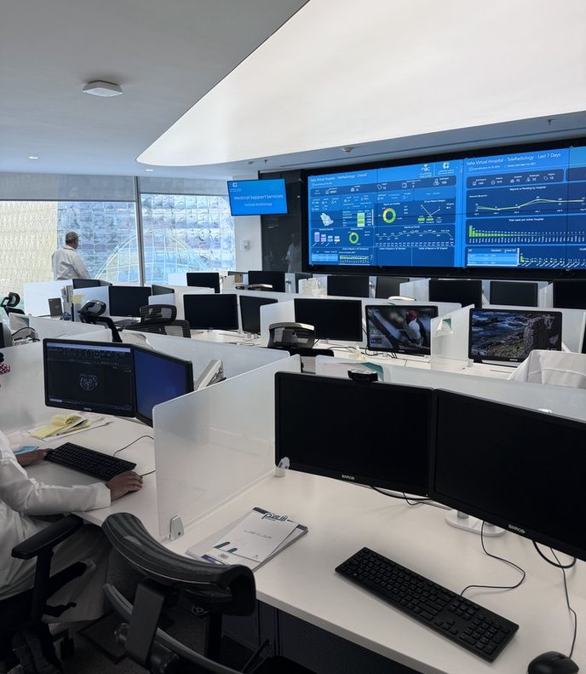
Digital is only part of it…….

Slide 11
Thank you

