Slide 1

#DHSS24
ICS Spotlight Is Digital Working at System Level
Chair: Paul Charnley
John Mitchell
Co-Chair Digital Blueprinting Steering Committee (NHS England)
associate director of digital, NHS Humber and North Yorkshire ICB
Dr Deepa Shanmugasundaram
Linda Vernon
head of digital empowerment, Lancashire and South Cumbria Integrated Care Board
CCIO, Mid and South Essex ICS

Slide 2
ICS Spotlight: Is Digital Working at System Level?
ICS Digital Council / Network Session
Digital Health Summer School
18-19th July
University of Durham

Slide 3
Outline of Session
John Mitchell, associate director of digital, NHS Humber and North Yorkshire ICB
Dr Deepa Shanmugasundaram, CCIO, Mid and South Essex ICS
Linda Vernon, Head of digital empowerment, Lancashire and South Cumbria Integrated Care Board
Discussion
Chairs: Paul Charnley, Bluepritning Programme Chaire and Dr Alec Price-Forbes, consultant rheumatologist and clinical Lead for rheumatology

Slide 4
ICS Digital Council – who are we
New council formed March 2023 – members not voted for but Digita; Health folks asked for volunteers
  myself and Alec Price-Forbes as clinician as co-chairs
  includes CDIO, CCIO, CNIO, CIC, Council , Social Care and Patient reps
Good dialogue with members and NHS England leaders with a bit more space for a two-way discussion
Various topics covered in line with the other networks
  Funding for system wide initiatives (Capital and Revenue) reaching bodies like CICs
  Digital Maturity results and interpretation in year one and year two
  Access to EPR and Shared records for medical examiners
  Pain points – focus of our network session survey (challenge from Sonia Patel)
  Architecture and “One Digital” and helping to shape the case for investment 2025 onwards
  Other sectors of industry (Worshipful Company of Information Technologists)
  System Working action Learning sets
Well into year 2 review looking to ask about whether it is useful and how it might be improved.

Slide 5

National Digital Architecture Programme
Challenges to Overcome
A Digital Health Network Perspective
Presented by the Digital Health
ICS Digital Council
John Mitchell

Slide 6

Summary of Process and Findings

Slide 7

Identifying The Pain Points – Our 3 Stage Methodology
1. Identify
We didn’t want to present the Digital Health Networks with a blank sheet of paper, we wanted to implement a
Supported approach.
Working with a smaller cohort of digital experts from across the Network and NE&Y Region, we captured a list
of known challenges, with supporting additional context, which they would expect the architecture programme
to address.
2. Theme
In order to provide a level of order, and to support discussion the items identified were grouped into 4 themes.
  Interoperability & EPR
  Infrastructure, service and future
  Funding
  Digital Debt
3. Rank
We asked the Digital Health CIO network, and the Digital Health Discourse channel to review the list of pain points, and for each member to select their top 5 issues.
The Process will also be run with the Digital Health CCIO Network in the near future to get a different Perspective.

Slide 8

The 4 key Themes and what They Cover
Interoperability & EPR
Infrastructure, service and future
Funding
Digital Debt
Making Data readily Available:
In the right place
at the right time
To right people
Professional Empowerment
Ensuring that everyone works to the same methods
Ensuring Solutions meet the requirements
Ensuring suppliers delivery as expected
Empowering and ensuring:
System Wide Thinking
A co-production and Sharing mentality
Ensuring cyber-safety for:
Professionals
Our Population
Appropriate Digital skill where they are needed
Standards in Place to support:
Quality
Safety
Delivery
Ensuring that:
Appropriate funding plans are in place
Solutions are sustainable
Funding the right solutions at the right scale
The basics, making sure that everyone has the right technology to do their job to an acceptable level
Making sure that Technology is never a limiting factor
Making sure that replacement planning is in place

Slide 9
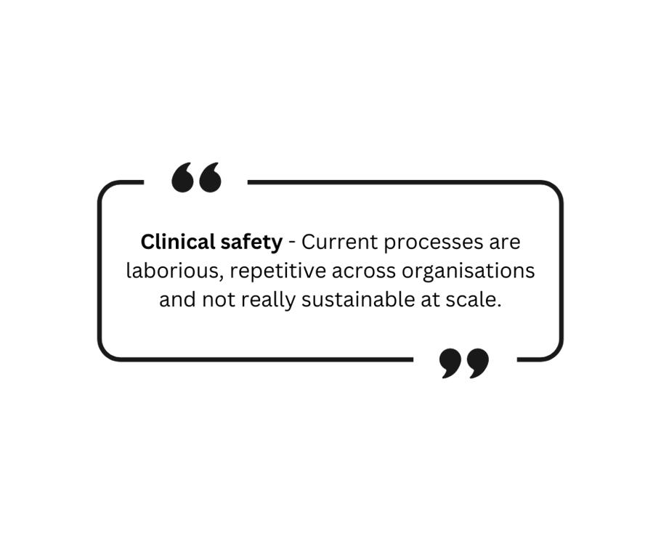
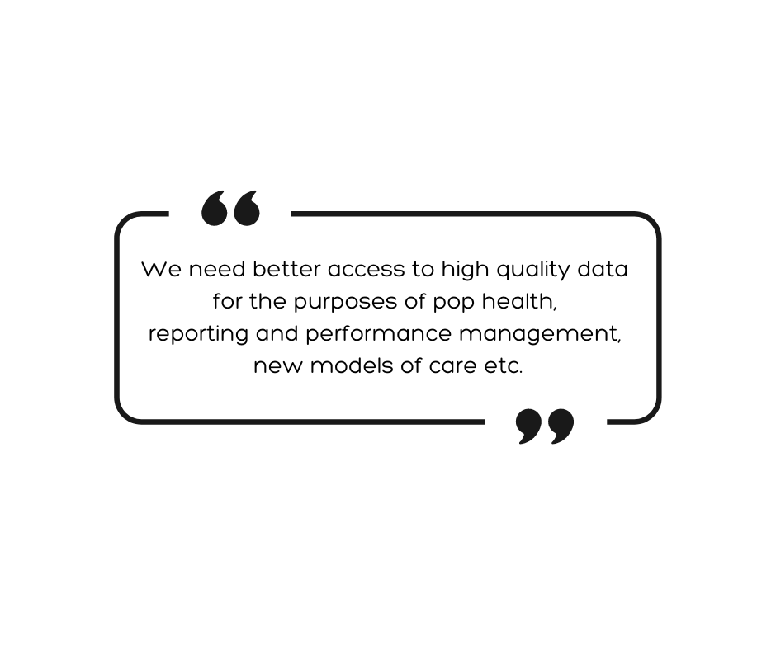
The Pain Points (The Big List)
OpenAPIs not available
Integration \ interoperability standards
EPR standards
Access to records \ Data Silos \ Data standards
Supplier Compliance
Application not service focused
Interoperability & EPR

Slide 10


The Pain Points (The Big List)
Support for truly system wide integrated digital planning and delivery covering all aspects of care
Cyber response & resilience
Lack of Centres of excellence
Improved NHS App Infrastructure
Lack of architecture standards\plan
Re-use, sharing, and rationalisation of systems (not possible)
Standardised Connectivity
Lack of architecture standards\plan
National Services not delivered by the front line
Skills among our workforce
Digital health literacy in populations\communities
Infrastructure, service and future

Slide 11
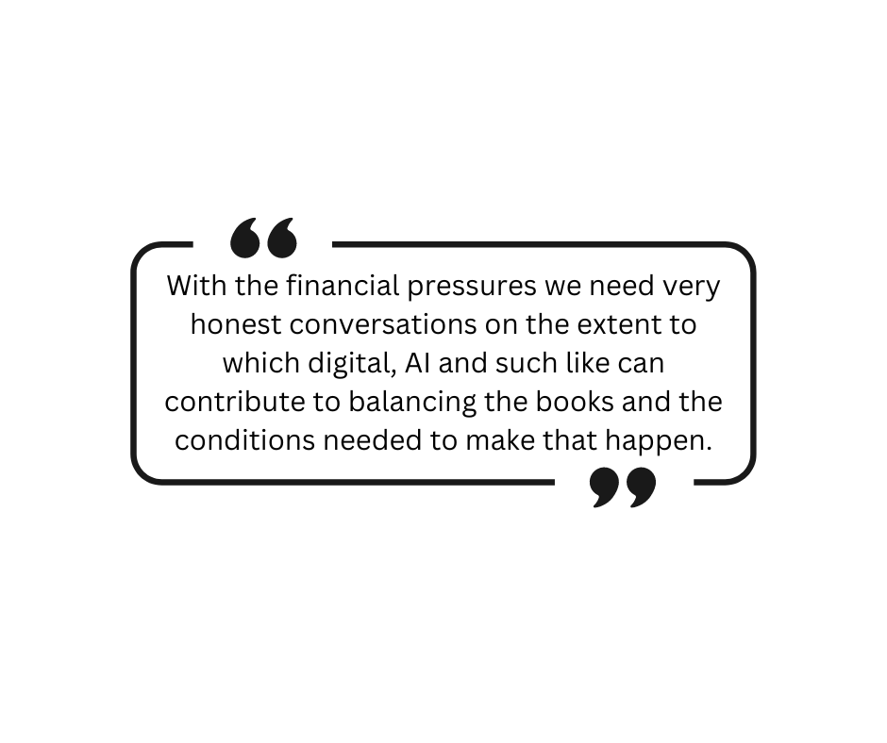
The Pain Points (The Big List)
Managing funding allocations from capital into revenue
Escalating Costs
Funding

Slide 12


The Pain Points (The Big List)
Outdated Infrastructure
Dependency on Legacy systems
Ageing national systems
Digital Debt

Slide 13
The Outcome – The CIO View
The top 5 pain points, in order, selected by CIO Members of the networks (as of 21/06/24) are:
  Managing funding allocations from capital to revenue
  Support for a truly system-wide integrated digital planning and delivery covering all aspects of care
  Outdated Infrastructure
  Lack of architecture standards / plan
  Skills amongst our workforce

Slide 14
The Outcome – The CXIO View
The top 5 pain points, in order, selected by CXIO Members of the networks (as of 21/06/24) are:
  Integration / interoperability standards
  Outdated Infrastructure
  Support for a truly system-wide integrated digital planning and delivery covering all aspects of care
  Skills amongst our workforce
  Supplier Compliance

Slide 15
Dr Deepa Shanmugasundaram, CCIO, Mid and South Essex ICS

Slide 16


DR DEEPA SHANMUGASUNDARAM MBBS MRCP MRCGP DIP.DIABETES DFSRH
    SYSTEM CLINICAL LEAD DIABETES - MSE ICB
    CHIEF CLINICAL INFORMATION OFFICER (CCIO) PRIMARY CARE - MSE ICB
    DIABETES & STROKE STEWARD - MSE ICB
    GP APPRAISER & GP MENTOR

Slide 17
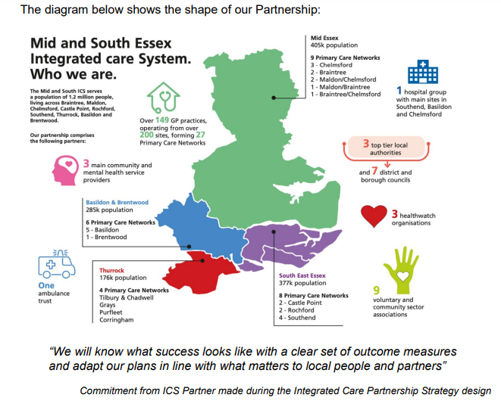

Slide 18
DIGITAL IN NHS
NHS LONG TERM PLAN PUBLISHED IN 2019 HIGHLIGHTED THE IMPORTANCE OF TECHNOLOGY FOR THE FUTURE NHS
PEOPLE, DATA AND TECHNOLOGY CONSIDERED CRUCIAL FOR THE ONGOING EVOLUTION OF NHS
DIGITALLY EQUIPPED SYSTEM FOR BETTER CARE - TO IMPROVE EFFICIENCY, DIAGNOSIS & TREATMENT & SERVICES

Slide 19
PLAN FOR DIGITAL HEALTH & SOCIAL CARE
LONG TERM SUSTAINABILITY OF NHS IS DEPENDANT ON SUCCESSFUL DIGITAL TRANSFORMATION
KEY GOALS OF DIGITAL TRANSFORMATION
  1.PREVENT PEOPLE’S HEALTH & SOCIAL CARE NEEDS FROM ESCALATING
  2.PERSONALISED CARE & REDUCTION IN HEALTH INEQUALITIES
  3.IMPROVE EXPERIENCE & IMPACT OF PEOPLE PROVIDING SERVICES
  4.TRANSFORM PERFORMANCE

Slide 20
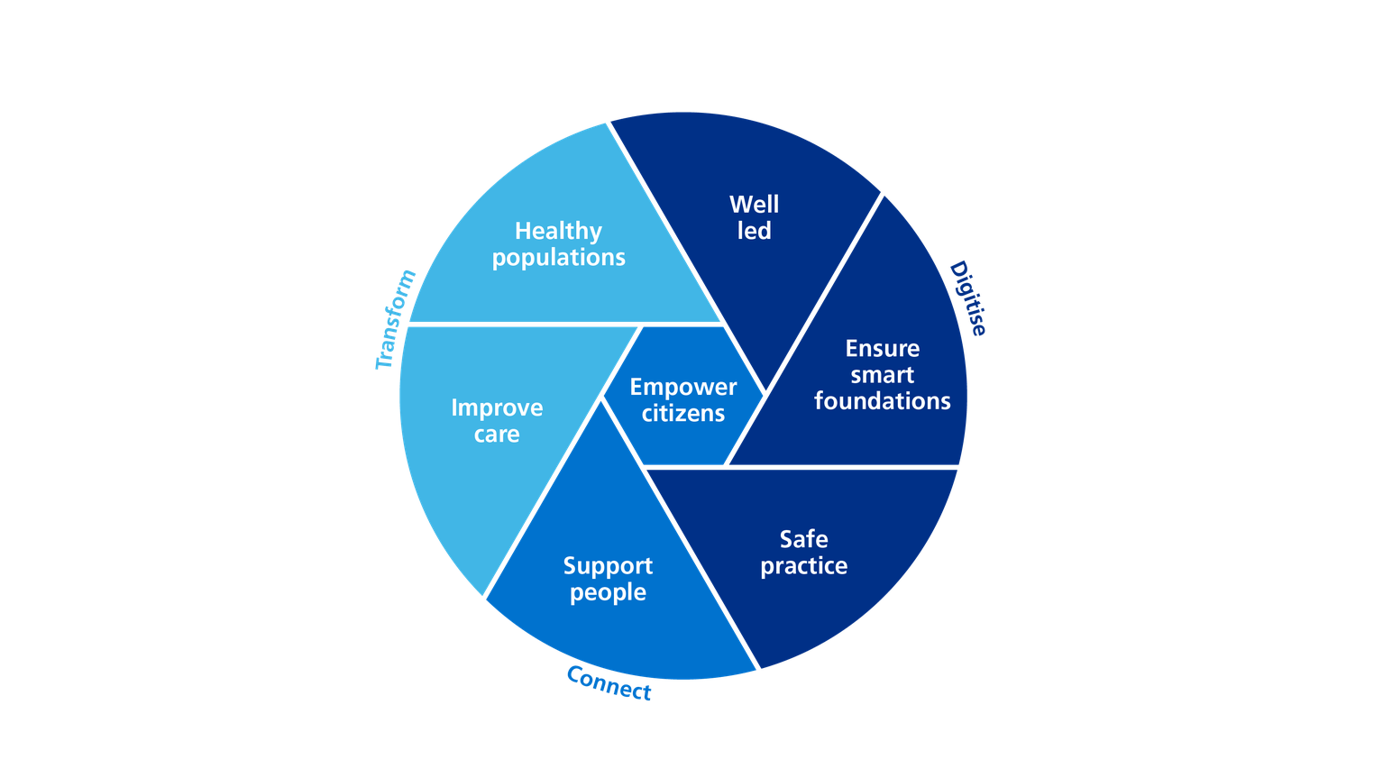
WHAT GOOD LOOKS LIKE
Notes:
How to assess digital maturity at system level ?

Slide 21
IS DIGITAL WORKING AT SYSTEM LEVEL
HAS DIGITAL IMPROVED
PATIENT ACCESS
PATIENT EXPERIENCE
PATIENT OUTCOMES

Slide 22
DIGITAL TRANSFORMATION
NATIONAL PROGRESS ON DIGITAL TRANSFORMATION WAS RATED INADEQUATE IN 2023
COMMON CHALLENGES
LACK OF REVENUE FUNDING
LACK OF ALIGNED STRATEGIC VIEW AND SHORT TERM THINKING AROUND TECH INFRASTRUCTURE
INSUFFICENT PROJECT MANAGEMENT SUPPORT
DIGITAL EXCLUSION
CULTURAL RESISTANCE TO NEW WAYS OF WORKING (BUSY SYSTEMS AND ORGANISATIONAL SILOES)

Slide 23
PAIN POINTS - CCIO VIEW
FUNDING, WORKFORCE, WORKLOAD
ORGANISATIONAL & DATA SILOES
SUSTAINIBILITY OF PROGRAMMES
MATURITY OF DIGITAL CLINICAL SAFETY VARIES BETWEEN ICBs AND WITHIN ICB
CYBER SECURITY
SPEED OF CHANGE AND READINESS TO CHANGE
COPRODUCTION WITH RESIDENTS & ADDRESSING DIGITAL EXCLUSION

Slide 24
WHAT DO SYSTEMS WANT FROM NHSE
MULTIYEAR FUNDING COMMITMENT RATHER THAN SHORT TERM FUNDING .
FUNDING SUPPORT FOR ENHANCING DIGITAL SKILLS OF WORKFORCE
& CITIZENS

Slide 25
Linda Vernon
Head of digital empowerment, Lancashire and South Cumbria Integrated Care Board

Slide 26



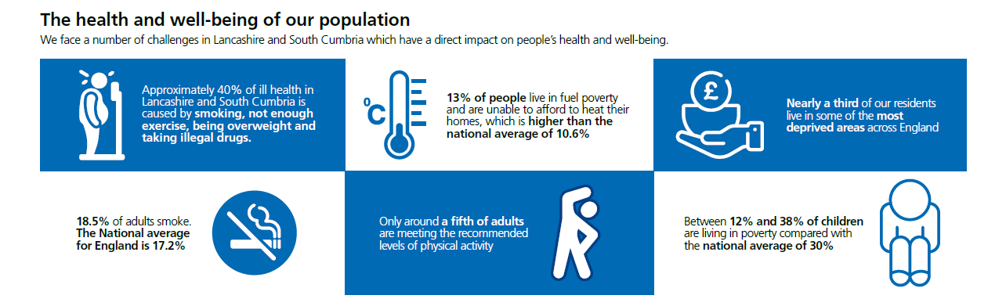




Slide 27


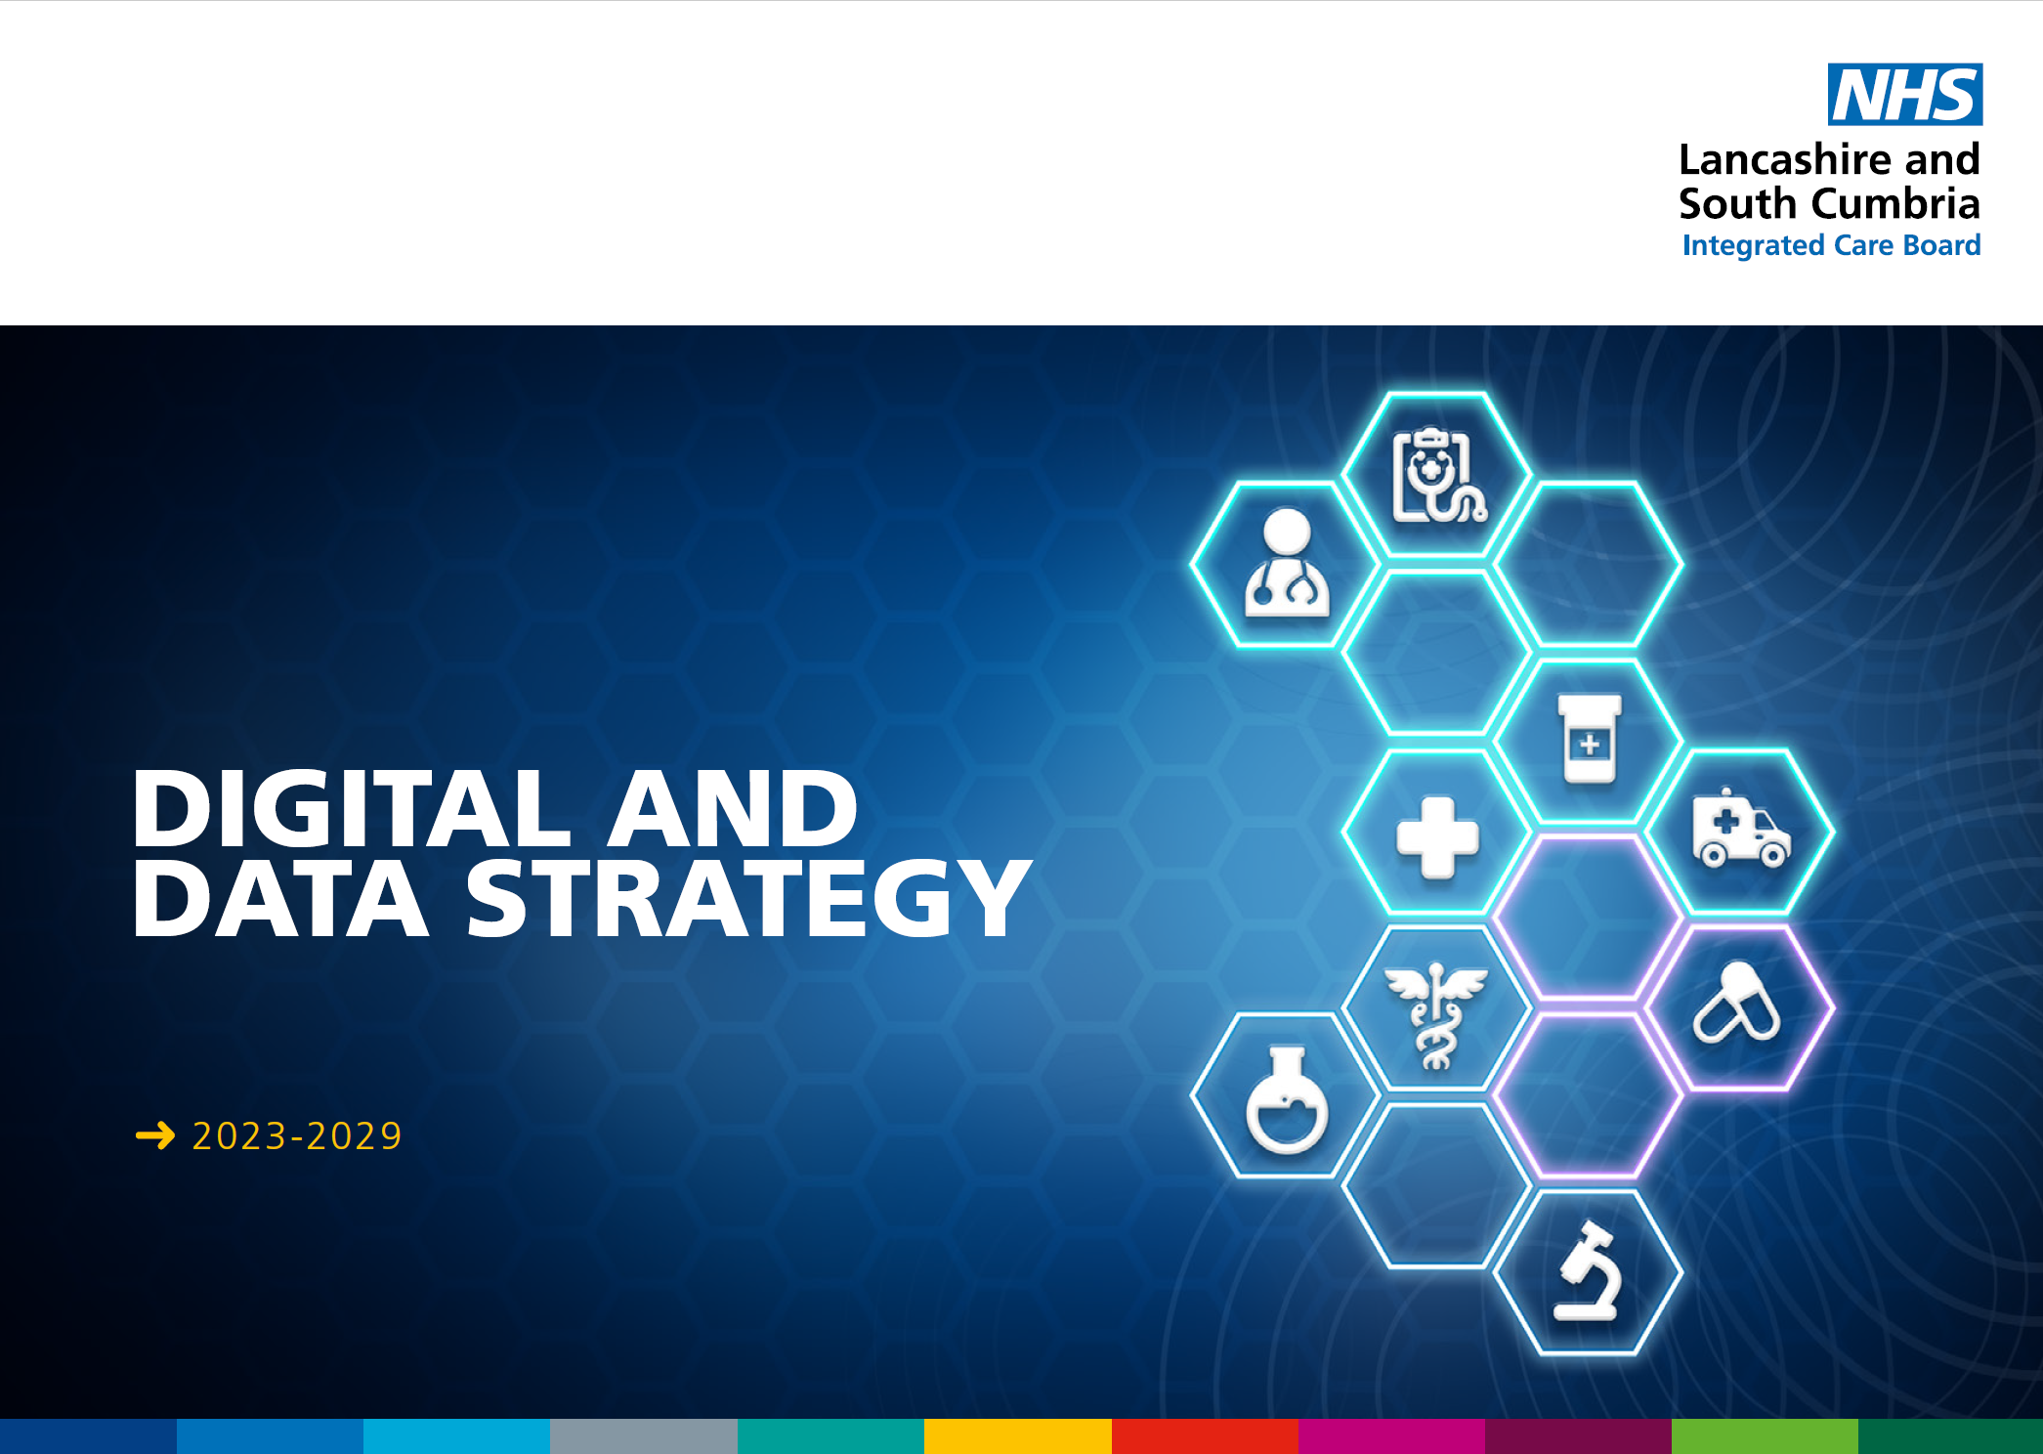
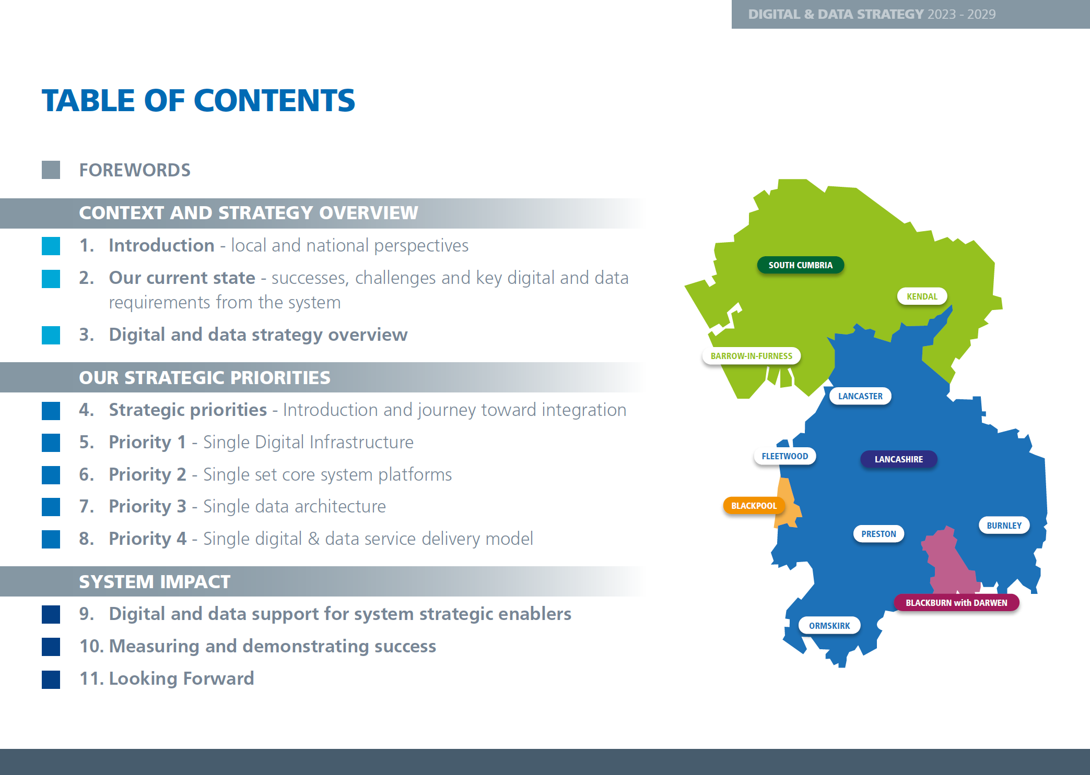

Slide 28
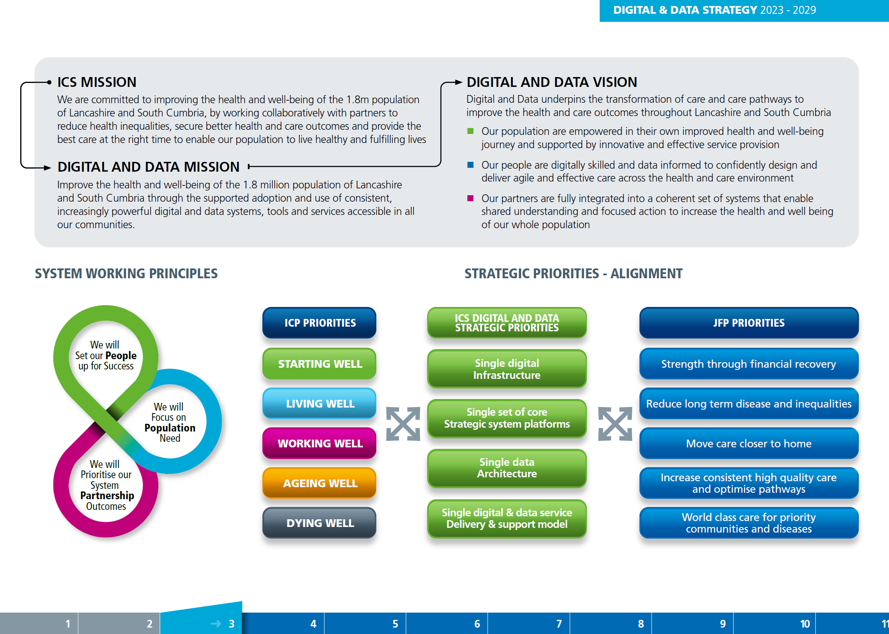

Slide 29
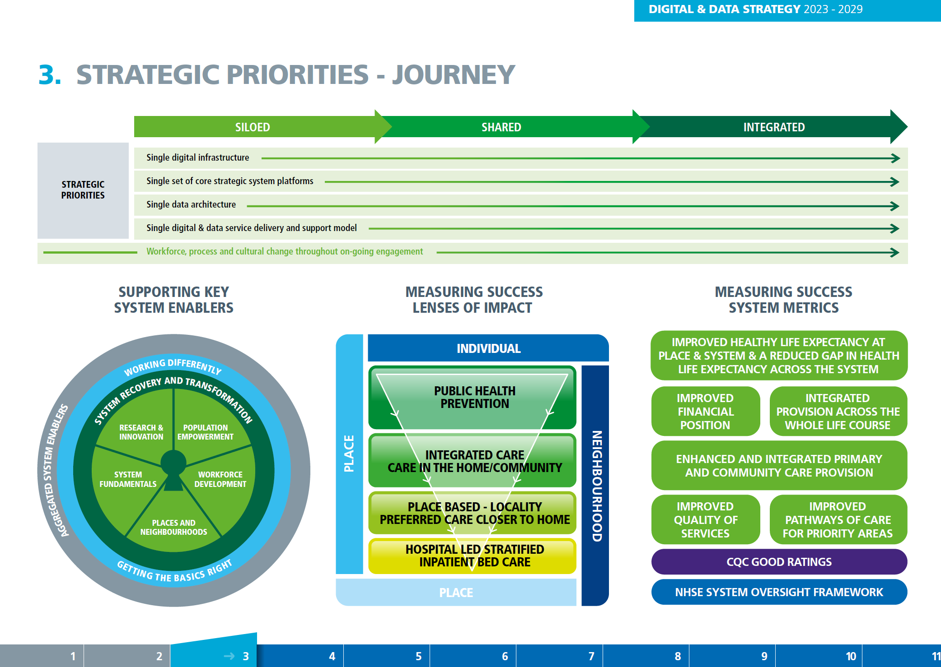

Slide 30
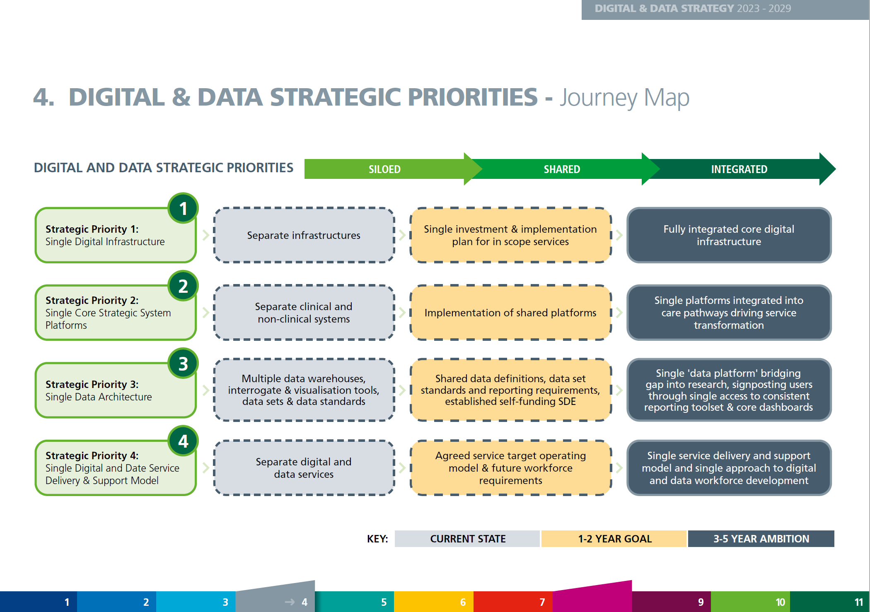

Slide 31
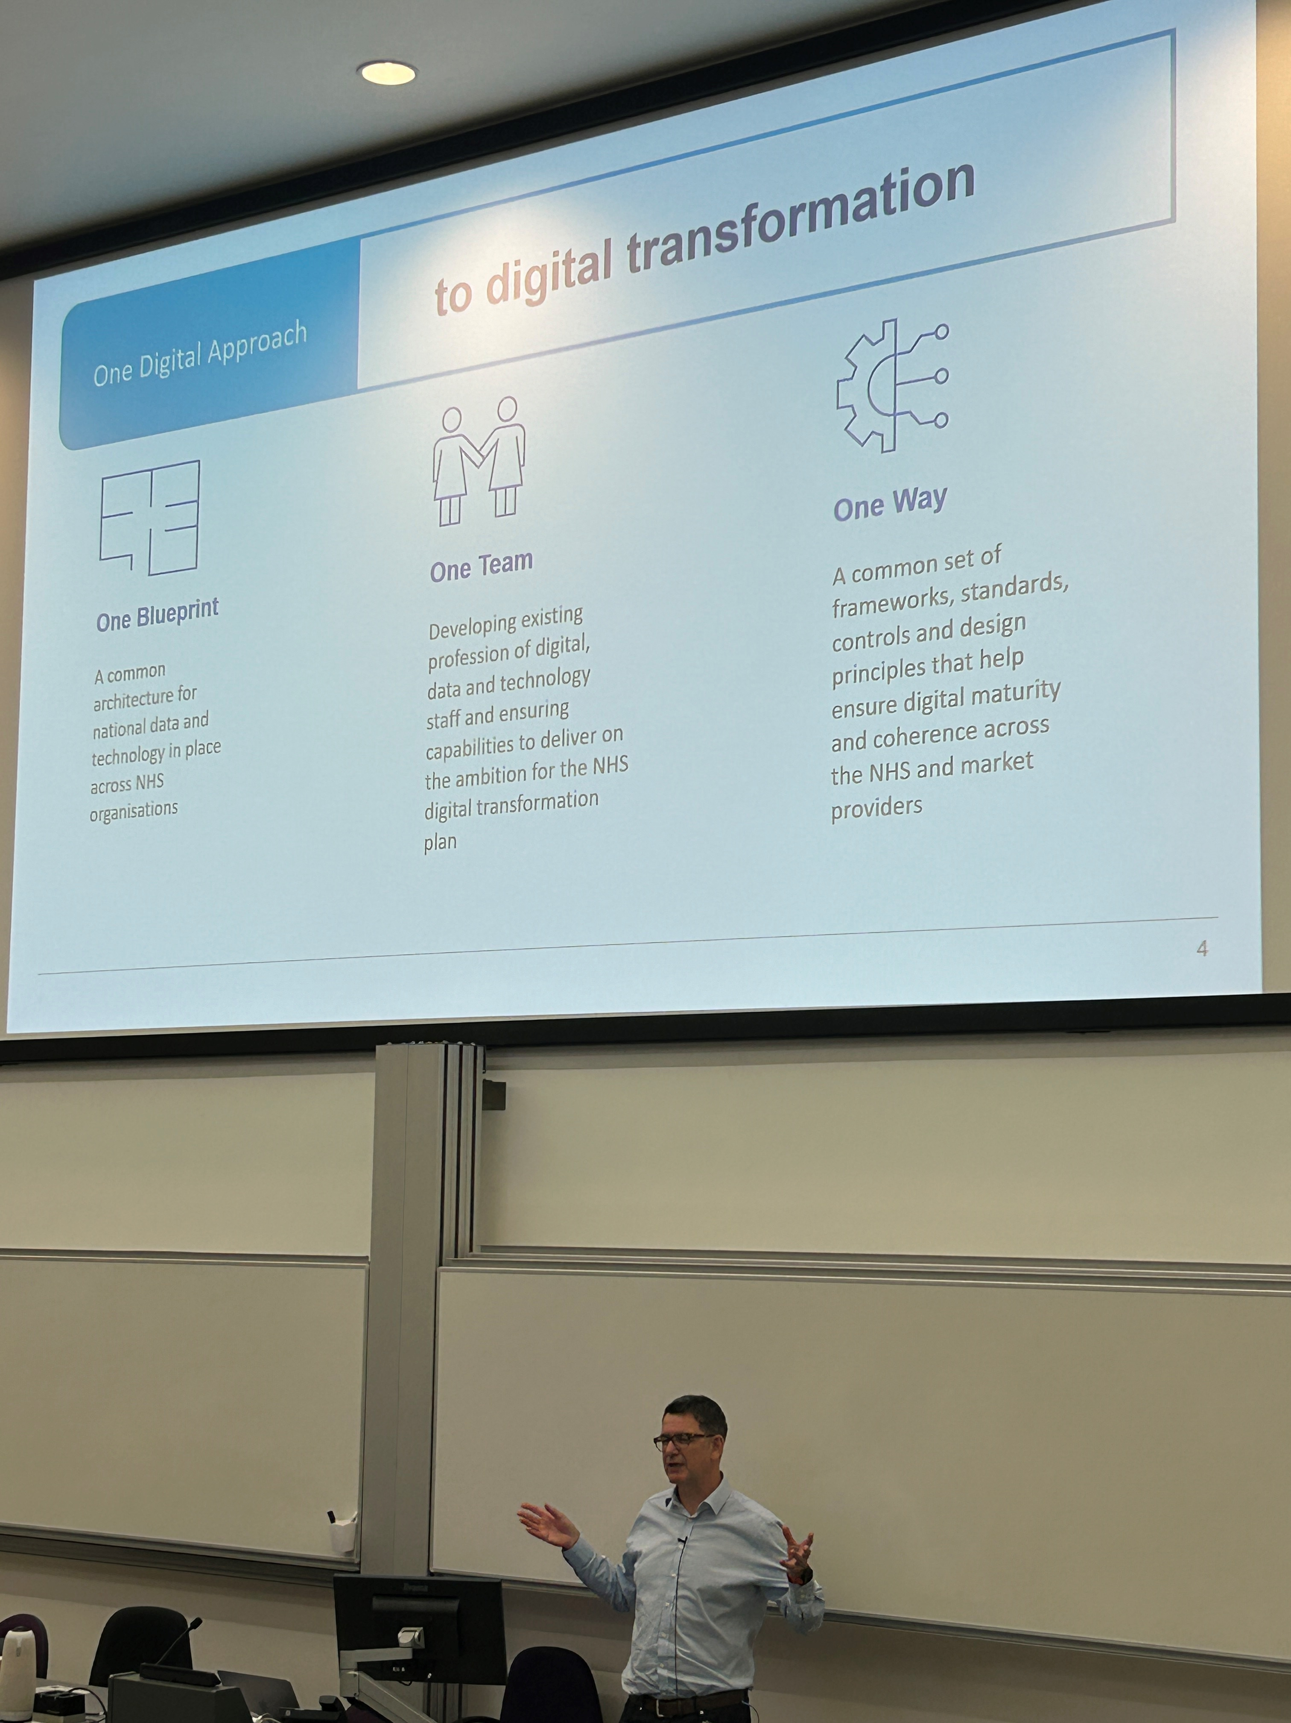
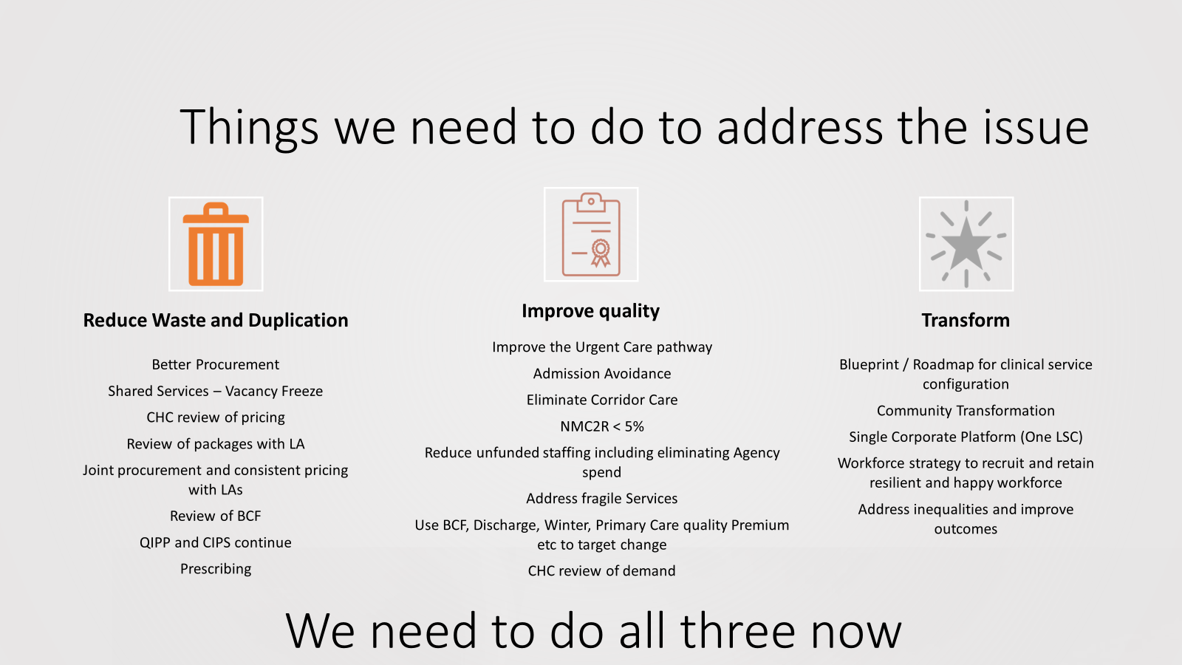
Lancashire & South Cumbria Pain Points
One Blueprint
One Team
One Way
Truly integrated, holistic, preventative care
Recovery & Transformation

Slide 32
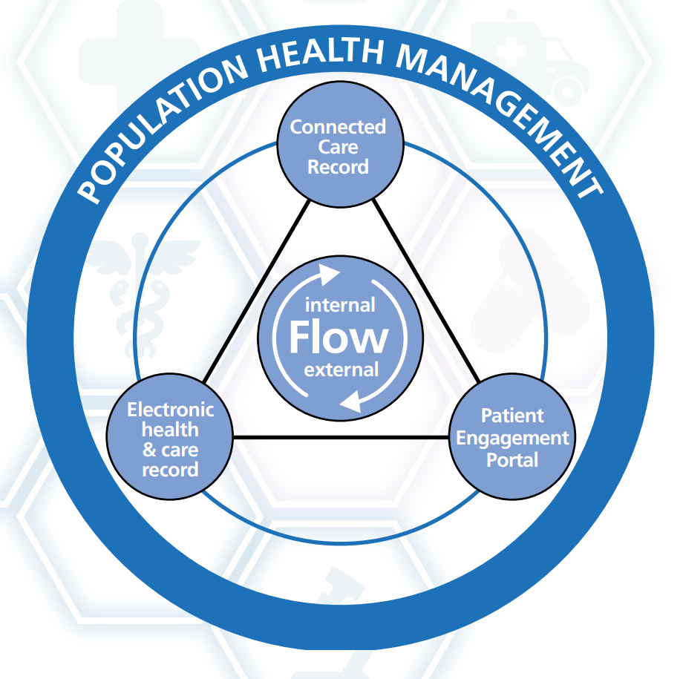
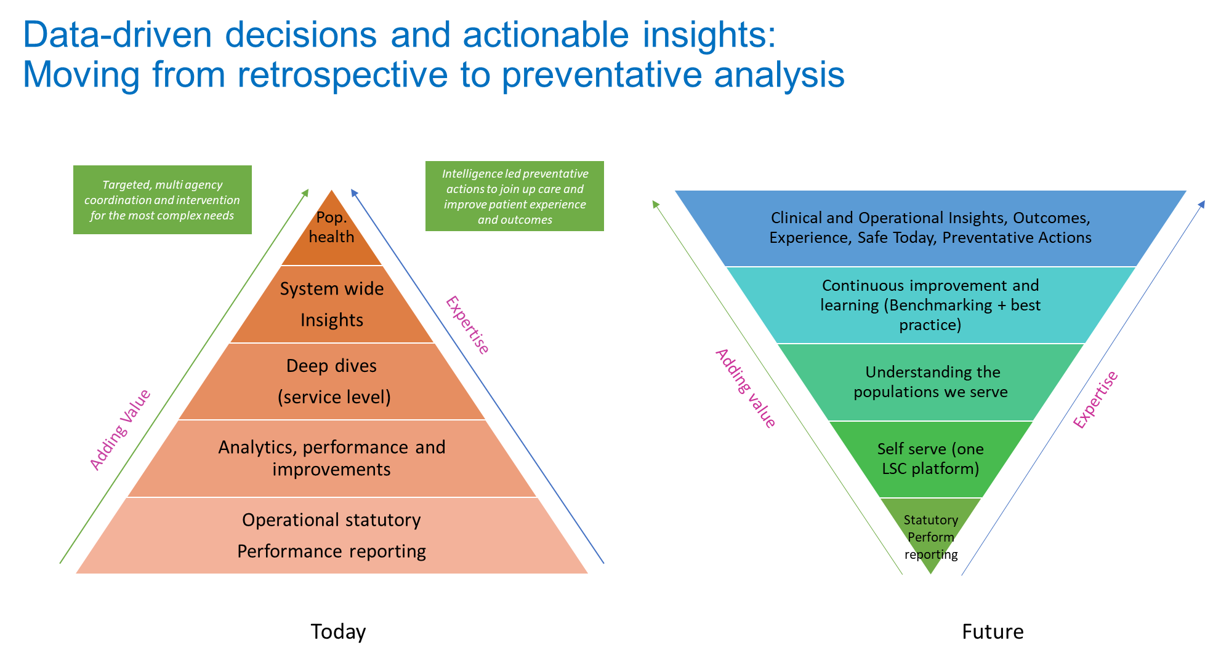
Lancashire & South Cumbria Pain Points
EPR & Connected Care Record
Patient-facing tools aligned to a seamless user journey - PEP, NHS App, choice, self-management, virtual monitoring and care, prevention and lifestyle behaviour
WHOLE SYSTEM FLOW
WORKFORCE & PUBLIC SKILLS – DDaT reorganisation, skills and retention; frontline digital & data/intelligence literacy; public digital activation
INNOVATION, SPREAD & ADOPTION – engagement, user-centred design and change management (funding & support offer)
Data architecture – SDE, FDP, local PHM solutions – high quality data available for care, planning, AI analytics
Procurement, funding … AUTHENTIC INTEGRATION

Slide 33
Next Steps (Calls to Action)
Continue the Discussion
  Seek Views of:
    CICs
    Voluntary Sector
    Members of the public
Work with the Representatives of the Networks to Further Understand the Implications and Benefits of solving these issues – the “So What?” for the Top 5 issues
Use this information as a discussion point at Summer School.

Slide 34

Additional Feedback and Supportive Information to Inform Discussion collected from our Community

Slide 35
Highlighted Principles from SME
Provide services, rather than applications to solve real-world, known NHS Problems.
Provide more viable access to the NHS app so that interfaces and integration is not bespoke.
Streamline the assurance processes so that access to national services is more straightforward.
Provide a transparent architectural plan and roadmap for the future,
aligned to an architectural strategy.
Delegate the delivery of national services or capabilities to the front-line
so that we can progress at pace.

Slide 36
Further Discussion Points
We need to get the basics right, this requires continued investment
Some of the business impacts that resonate include:
  Unwarranted variation
  Complexity leads to cost and inhibits ability to change
  Productivity (… people serve multiple applications, not other way round).
Reduce local duplication for clinical safety & cyber supplier assurance
Community provision of Digital:
  Infrastructure
  lack of EPR options
  Off-line solutions
  kit
  Connectivity
  Interoperability ( all of which increase risk to patients/citizens and staff)

Slide 37
Further Discussion Points
The biggest step forward for our system would be to have a target enterprise architecture for the system (based on patient flow across settings) and a mechanism to ensure funding and investment decisions align to that blueprint.
We need a cloud migration strategy it's a key one
We need different programmes to use consistent patterns to make it easier for 3rd party systems to work with NHS programmes
Better use of AI at scale
Business architecture not just technical architecture needs to be considered
EPR supplier:
  Firmer/stronger control required around OBC process and beyond, the knowledge providers have of what’s needed for a go live, in order to hold EPR’s to consequence
The speed to deploy systems and the pace and scale of innovation is hampered by not having and enterprise architecture approach.
Clinically data silos are the single biggest issue - having to make clinical decisions without all of the information to underpin it being available
We need a single source of Truth for patient records that is accessible by all who undertake care, and by the patient
Use of SnomedCT consistently for diagnosis, symptoms and pathways.

Slide 38
The Complete Results (CIO)
Challenge | % of vote
Managing funding allocations from capital into revenue | 10.7
Support for truly system wide integrated digital planning and delivery covering all aspects of care | 7.4
Outdated infrastructure | 7.0
Lack of architecture standards / plan | 7.0
Skills among our workforce | 7.0
Integration / interoperability standards | 6.6
Cyber response & resilience | 6.6
Access to records / Data silos / Data standards | 6.6
Escalating costs | 6.3
Dependency on legacy systems | 5.9
Supplier compliance | 5.2
Digital health literacy in populations / communities | 4.4
EPR standards | 4.1
Standardised connectivity | 3.0
Re-use, sharing and rationalisation of systems (not possible) | 2.6
OpenAPIs not available | 2.6
Aging national systems | 2.2
Improved NHS App infrastructure | 2.2
Application not service focus | 1.8
Lack of Centres of Excellence | 0.7

Slide 39
The Complete Results (CXIO)
Challenge | % of vote
Integration / interoperability standards | 11.3
Outdated infrastructure | 9.0
Support for truly system wide integrated digital planning and delivery covering all aspects of care | 8.5
Skills among our workforce | 7.3
Supplier compliance | 7.3
Dependency on legacy systems | 6.8
Managing funding allocations from capital into revenue | 5.6
Standardised connectivity | 5.6
EPR standards | 5.6
Escalating costs | 5.1
Access to records / Data silos / Data standards | 5.1
Digital health literacy in populations / communities | 4.5
OpenAPIs not available | 2.8
Aging national systems | 2.8
Lack of architecture standards / plan | 2.3
Re-use, sharing and rationalisation of systems (not possible) | 2.3
Application not service focus | 2.3
Lack of Centres of Excellence | 1.7
Improved NHS App infrastructure | 1.7
Cyber response & resilience | 1.1

Slide 40

Thank You

Slide 41
Where are your priorities?
What solutions can we forward?
What is in our control?
  CDIOs
  Managing funding allocations from capital to revenue
  Support for a truly system-wide integrated digital planning and delivery covering all aspects of care
  Outdated Infrastructure
  Lack of architecture standards / plan
  Skills amongst our workforce
  CxIOs
  Integration / interoperability standards
  Outdated Infrastructure
  Support for a truly system-wide integrated digital planning and delivery covering all aspects of care
  Skills amongst our workforce
  Supplier Compliance

Slide 42
Finding the balance
Too much centralization vs too much variation
Storing and archiving data in the most efficient way
Too much cloud (central costs) or not enough (local costs and fragility of support)
Avoiding Monopolistic solutions
Agreed framework (TOGAF) ?
Bureaucracy/Compliance vs agility and flexibility

Slide 43
Next Steps
Work picked up via NHS England – now working with Enterprise architecture team to define the definitive priority problem areas
Part of the One Digital preparations for the cases for new funding
Ongoing discussion between ICS leaders and NHS England to continue to develop solutions in a single ICS digital council one of the means of communication

Slide 44

Thoughts from Another Sector
Ted.Rees@member.wcit.org.uk
Central Contracting and Licencing
One way Banking drove towards standardisation was in the contracting and licencing agreements with suppliers. By centralising and creating single global contracts, it also helped to drive the supplier behaviour and help to enforce movement towards more open connectivity.
This also led to cost savings at a global level. It caused plenty of challenges too. Local IT directors had budget and spending taken from their control. Local supplier salesmen had challenges getting paid under global arrangements. Allocations and billing needed to be handled by a central team. But overall it led to greater standardisation and central control and adoption of strategic aims
Technical Debt / Standardisation – Cost benefit Analyses
A key challenge in my roles was always generating cost benefit analyses for infrastructure and standardisation. This generally required a fair degree of creativity. This was also a challenge for digital/technical debt – If only pure running costs are considered then it is tempting to keep old systems limping along. If the wider implications are considered (lack of integration, risk of errors, patient experience) then the business case can be made more compelling.

Slide 45
Thoughts from Another Sector
Ted.Rees@member.wcit.org.uk
Capital Vs Revenue
Your point about having budgets in the wrong places (capital vs revenue) was also a common problem in my time in banking. I personally hated large projects being funded by capital which then become amortised over many years – basically creating cost headaches for future IT directors, often without the expected benefits. On the other hand, if you are working across many silos, a large multi-year capital budget commitment is probably essential, especially if you want the outcome to be patient- or user-focussed rather than system component driven. One idea is
Piggy Backing “mandatory” projects
It was always difficult to get cash for this type of project. A useful catalyst was often other mandatory programs such as regulations making old systems too expensive to change or things like cyber security. In other words, pots of cash became available to do real work, but the messaging needed careful finessing – “the only way to ensure this system is compliant is to rewrite these parts”…

Slide 46
Thoughts from Another Sector
Ted.Rees@member.wcit.org.uk
Multi-Entity Support
Ensuring that all systems supported multi entity processing was essential and a key factor in the system having life beyond its original purpose. Choosing which system to use post-merger was always a contentious issue, but excessive time could be wasted choosing the best one when the benefits of speed of integration were more important. We found it helpful to publish a short list of key architecture principles/policies to include things like this
Summary
In reality the move towards standardised platforms is a never-ending quest. A common issue was that large organisations were formed by mergers of smaller organisations with overlapping systems coverage. I expect this will become more common in your world going forward as the laggards get swallowed up by organisations who are more scalable and able to support multiple entities.
In reality in the banking world “system landscape simplification” took MANY years and was driven by mergers, regulations and business viability. If you think this took so long in a world with a relative abundance of cash then health suppliers need to be realistic and not be over ambitious by selecting a limited number of priorities for standardising or reduction of technical debt.
Pooled Cloud Audits
One other initiative I thought it might be helpful to know about is our work in the City of London Resilience. One area I learnt about the other day was the work we are doing in “Pooled Cloud Audits” for companies in the City of London. In simple terms cloud providers have become very big and powerful and many firms have regulatory obligations for things like security which are totally dependent on the cloud providers, who don’t like to change their offerings for individual requests.
The WCIT have acted as facilitators to groups of banks or exchanges to carry out audits of their cloud providers. This allows anonymity for individual cloud clients but helps to drive the providers in the way the clients want to go, without breaching confidentiality or reputation exposure.
When I heard about this, I thought it might be helpful for Health Provider IT organisations. Although you may not yet be big cloud users it could be something to bear in mind. It may also be useful in the Cyber Security space where no individual trust wants to expose their weaknesses on an individual basis but may collectively have a better vehicle to help to drive improvements. I guess this may be topical also…
This started as something small but appears to have built some momentum with regulators and banks becoming more supportive.

Slide 47
Thoughts from Another Sector
Ted.Rees@member.wcit.org.uk
Pooled Cloud Audits
One other initiative I thought it might be helpful to know about is our work in the City of London Resilience. One area I learnt about the other day was the work we are doing in “Pooled Cloud Audits” for companies in the City of London. In simple terms cloud providers have become very big and powerful and many firms have regulatory obligations for things like security which are totally dependent on the cloud providers, who don’t like to change their offerings for individual requests.
The WCIT have acted as facilitators to groups of banks or exchanges to carry out audits of their cloud providers. This allows anonymity for individual cloud clients but helps to drive the providers in the way the clients want to go, without breaching confidentiality or reputation exposure.
When I heard about this, I thought it might be helpful for Health Provider IT organisations. Although you may not yet be big cloud users it could be something to bear in mind. It may also be useful in the Cyber Security space where no individual trust wants to expose their weaknesses on an individual basis but may collectively have a better vehicle to help to drive improvements. I guess this may be topical also…
This started as something small but appears to have built some momentum with regulators and banks becoming more supportive.

Slide 48
Mentoring/Action Learning Set
17th September 12:30-14:00
We say “system first” but behaviour, culture, and resources (both people and money) are still very much “provider first”. How have others overcome this?
Pilot discussion, Paul C, Nick O(BSOL) and Jaqui C (Manchester HIN)
Start with a check in and recap 10 minutes
2 problems to explore per session – 30 minutes each
  This is my challenge with system working 5 minutes
  Time to ask questions, delve deeper 10 minutes
  Time to make suggestions 10 minutes
  Pick some to take away 5 minutes
Group reflection and group lessons 20 minutes
Let us know if you want to take part
Paul.charnley@nhs.net

Slide 49

Thanks to the panel ……………and to you for attending

