Slide 1
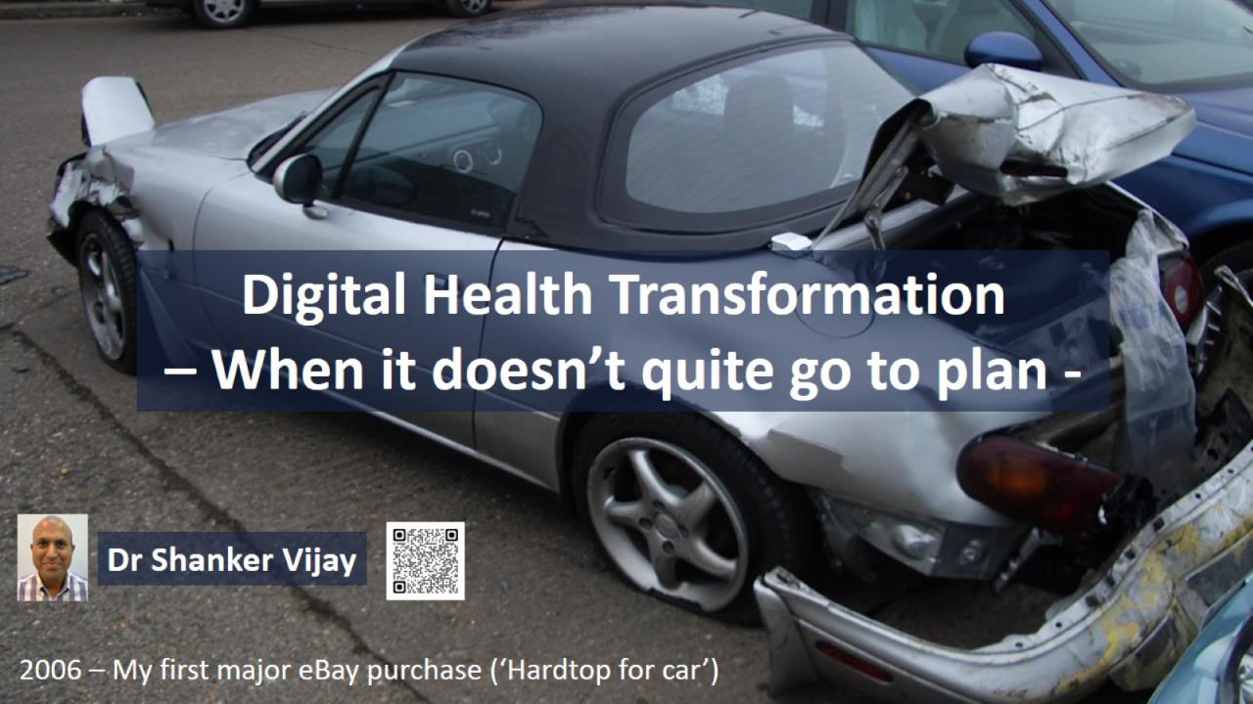

Slide 2
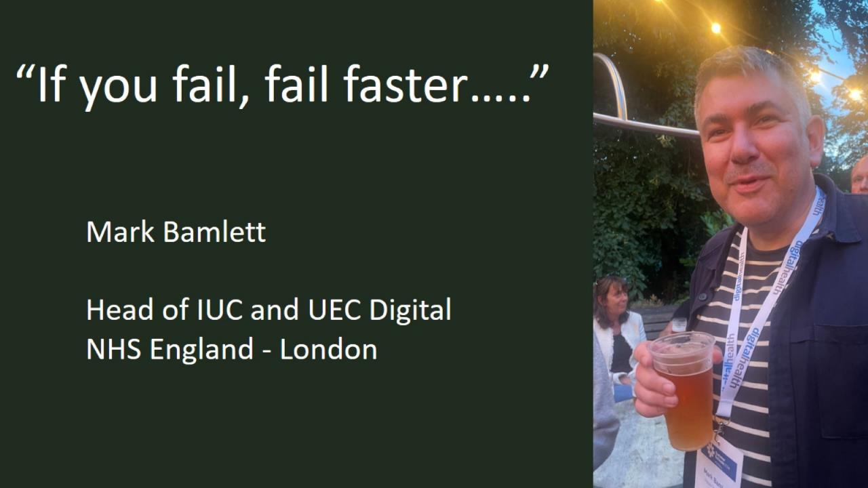

Slide 3

2009
Performance manager
Dr Foster, General Practitioner
E85000 SOME SURGERY
My account
Log out
Home
Performance manager
Latest data, 15/01/2009
?
12/08
01/09
02/09
03/09
04/09
05/09
06/09
07/09
08/09
09/09
265 days to go!
Analysis
Download
Print
Incorrect CVD Risk score calculation:
- External software overestimated CVD risk when combined Ethnicity & FH risk factors, leading incorrect coding in patients’ records.
Lack of testing before roll out
Lack of Change Log / Version control by supplier
Later: Same underlying issues in QRISK2 incident in SystmOne / Reluctance for IT providers to build in clinical risk tools
Actual position on 15/01/2009
Patients
Attainment
Points
Show £
H&F
rank
Eligible
Qualifying
Excepted
Current
Predicted
Aspiration
Target
Current
Predicted
Aspiration
Max
QOF+ 2008/09
129.92
205
639
639
3 / 30

Cardiovascular disease prevention
47.36
64
76
76
1 / 30
ü
+ CVD PREVENT 1
436
391
6
91%
95%
90%
90%
12.02
45
45
45
5 / 30
+ CVD PREVENT 2
436
342
2
78%
90%
90%
90%
11.62
30
30
30
3 / 30
ü
+ CVD PREVENT 3
436
386
36
90%
85%
90%
90%
6.53
8
8
8
4 / 30
ü
+ CVD PREVENT 4
436
377
22
91%
82%
90%
90%
7.00
13
13
13
9 / 30
+ CVD PREVENT 5
436
364
4
84%
100%
90%
90%
28.39
50
50
50
2 / 30
+ CVD PREVENT 6
436
364
7
84%
90%
90%
90%
0.00
105
105
105
-
+ CVD PREVENT 7
436
122
1
28%
90%
90%
90%
5.00
5
5
5
7 / 30
+ CVD PREVENT 8
436
242
0
56%
90%
90%
90%
7.00
13
13
13
1 / 30

Alcohol
12.02
35
115
115
-

Smoking
11.62
25
38
38
-
Ready

Slide 4


Slide 5
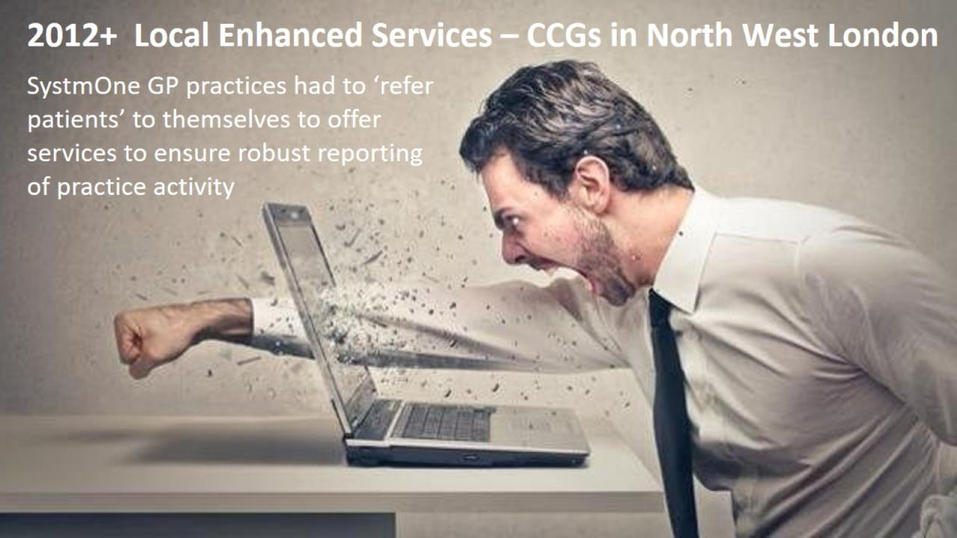

Slide 6


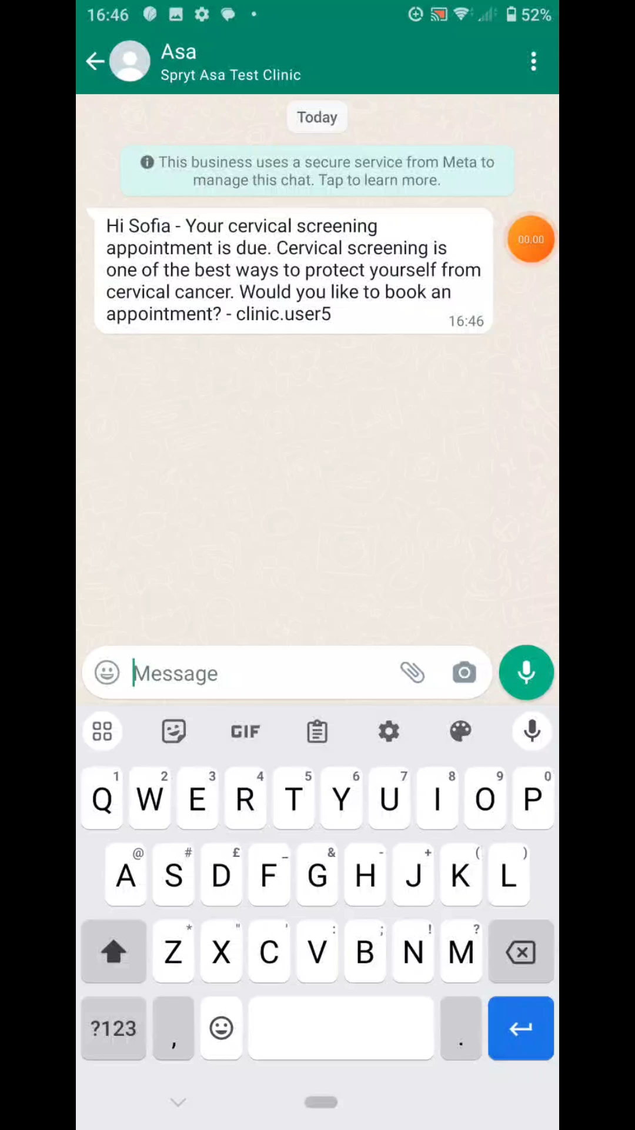
2023 RPA/Automation/AI in Primary Care
RA Smartcard role for ‘robots’
Barriers to requesting SNOMED codes for patient communication preferences (e.g. Instant messaging via WhatsApp)
Move to increased
MHRA regulation as
Medical Devices
Notes:
https://youtu.be/wBDj4RyfxZs
Asa is an AI receptionist that streamlines the appointment management process for patients and clinic staff. Asa allows patients to book, cancel and pay for appointments via instant message or voice at any time, without requiring any new app or website. Convenience is key to this solution. Asa is omnichannel capable but in this demonstration we are showcasing how simple the patient booking experience is for a cervical cancer screening appointment using WhatsApp.
Asa leverages AI to predict and reduce no-shows, providing clinic staff with actionable insights on which patients are likely to miss their appointments. Additionally, Asa incorporates behavioral science and generative AI to tailor language and messaging to different patient groups, improving communication and engagement with patients and optimizing their attendance rate.
25% of healthcare spending stems from administrative activities such as billing and scheduling. Automating scheduling will reduce organizational pressures and enable the medical admin to focus on under served patients as well as freeing up time to focus on other tasks.
Patients interact with Asa as they would with a human receptionist. Asa leverages an advanced AI framework that operates by retrieving information from a meticulously curated knowledge base, composed of content that is rigorously vetted and validated for accuracy by healthcare professionals.
Consequently, Asa’s responses are sourced from this tailored and trustworthy repository, ensuring precision and appropriateness. This approach significantly reduces reliance on generic training data or unverified web sources. Asa adeptly addresses non-diagnostic patient inquiries regarding appointments and general questions (for example directions), whilst firmly abstaining from offering medical advice. Moreover, the model integrates a fact-checking protocol, further reinforcing the consistency and reliability of the information provided.
If the patient would like to speak with the medical admin or if there is an emergency situation, Asa will send an alert to the dashboard which is connected to the clinics PAS system. The medical admin can pause Asa at any time and engage with the patient directly, ensuring there is always a human in the loop.
Asa can also communicate with patients in their native language (not in current NHS production release) In this example Asa responds empathetically to the patient's questions in Spanish, alleviating the patient's concerns, reducing uncertainty and increasing motivation to attend their appointment. To assist visually impaired patients or patients with low literacy, Asa can send appointment invitations as a recorded voice note in their native language

Slide 7
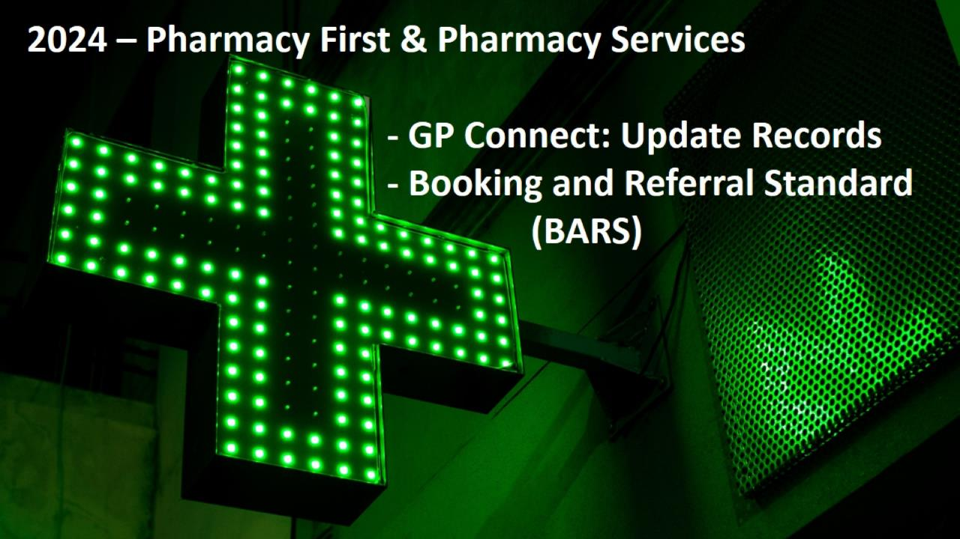

Slide 8

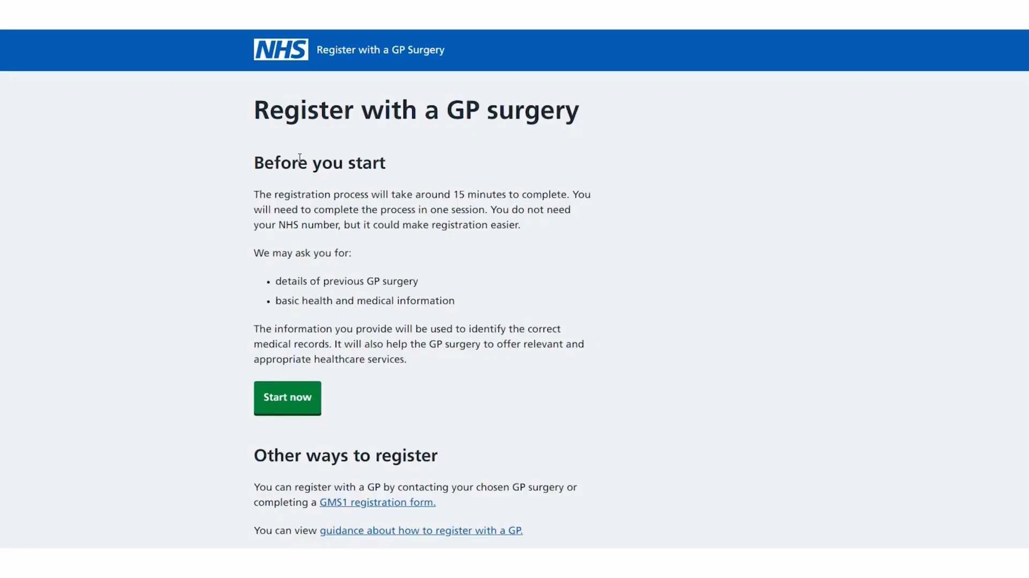

Present - NHSE ‘Register with a GP Surgery’ Online GP Registration
Notes:
https://youtu.be/rDIr5xDkaDc

Slide 9
