Slide 1

#DHSS24
The Seven Barriers to Digital Transformation in HealthCare
David Sims
John Payne
Clinical Solutions Executive, InterSystems
Physician Executive, InterSystems and Consultant Transplant Cardiologist

Slide 2
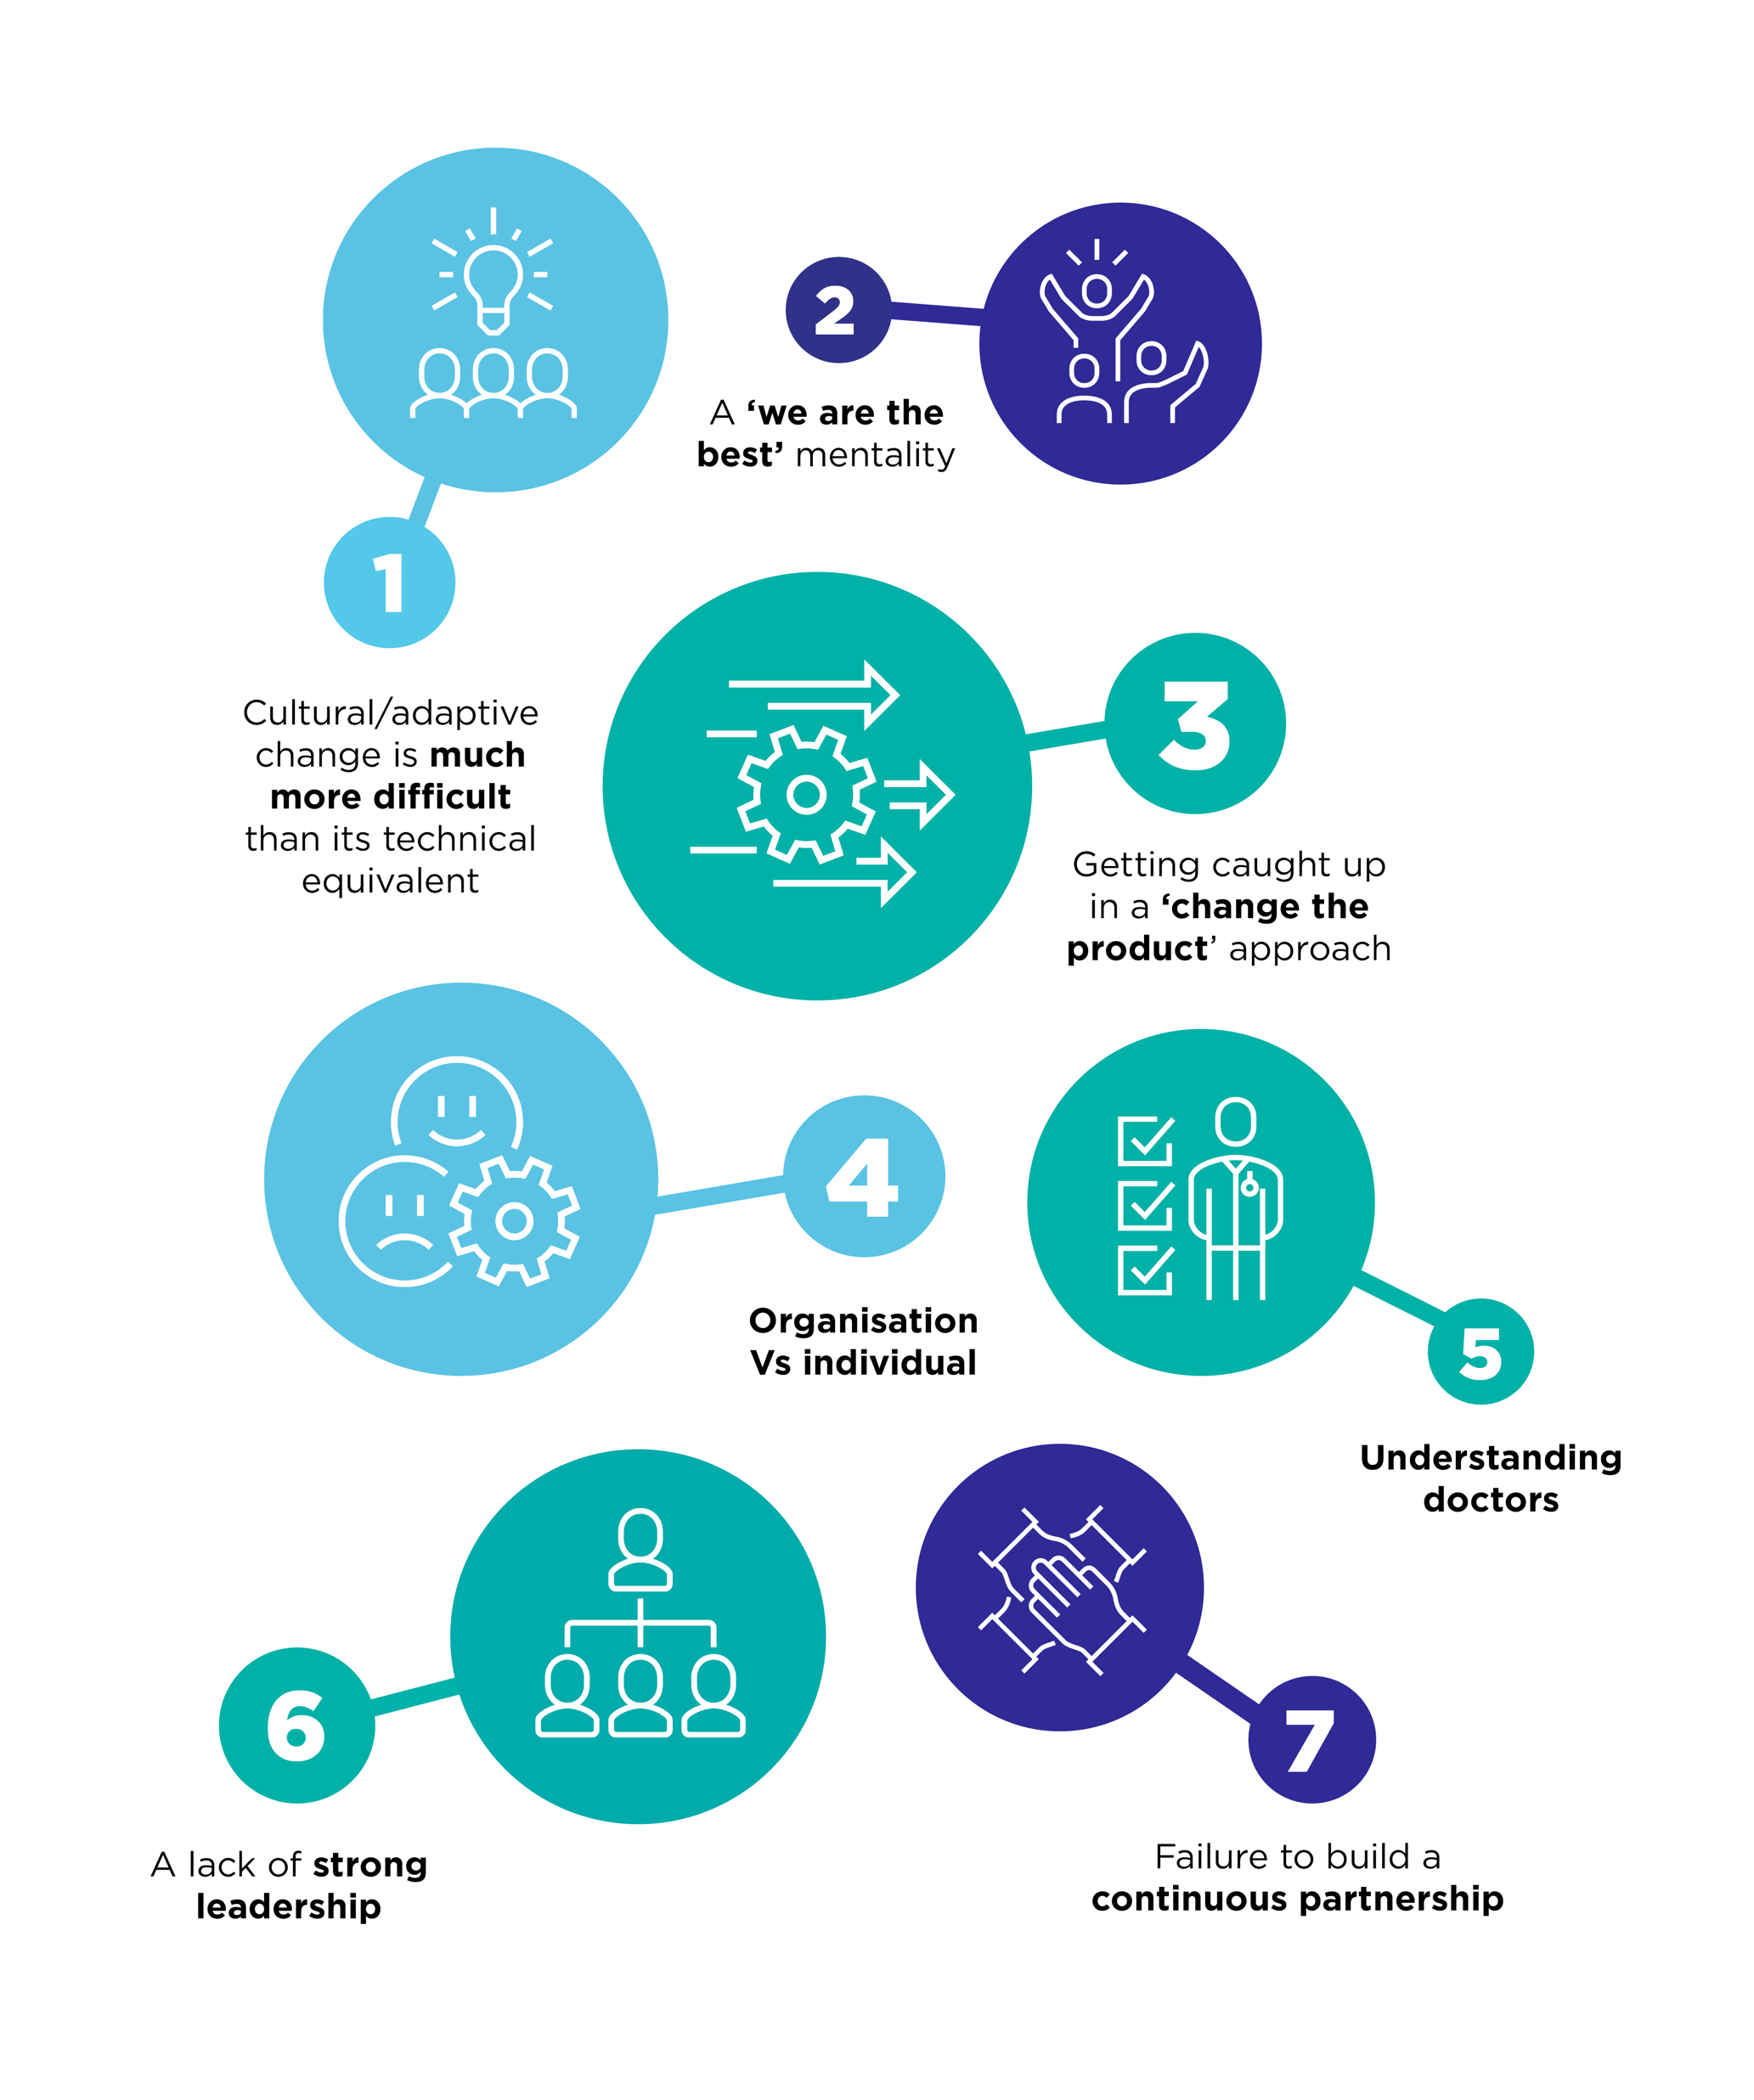
The 7 Barriers to Digital Transformation in HealthCare
Dave Sims, Clinical Solutions Executive, InterSystems
John Payne, Physician Executive InterSystems and Consultant Transplant Cardiologist
Notes:
Good afternoon

Slide 3

Computers, Software
(and Functionality)

Slide 4
Become familiar with adaptive vs technical change and share with customer
Digital teams should be experts!

Slide 5
Challenge!

Slide 6
Develop a ‘work with what you have’ mindset!

Slide 7
Priority is patient and organisation!
Not doctor, nurse, or specialist team or ward!

Slide 8
Become familiar with why doctors in particular resist change!

Slide 9
Who is the executive sponsor?
Is the nurse or medical director aligned?

Slide 10
Create a culture of proactivity, rather than reactive crisis management!

Slide 11
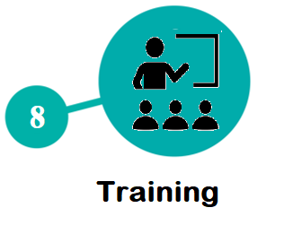

Summary
But …… There is more!

Slide 12
Ensure users know how to use and get best use of the solution!

Slide 13
Summary
Ignoring the human side to digitization will result in failure
Digital teams need to be experts in these areas to be successful

Slide 14
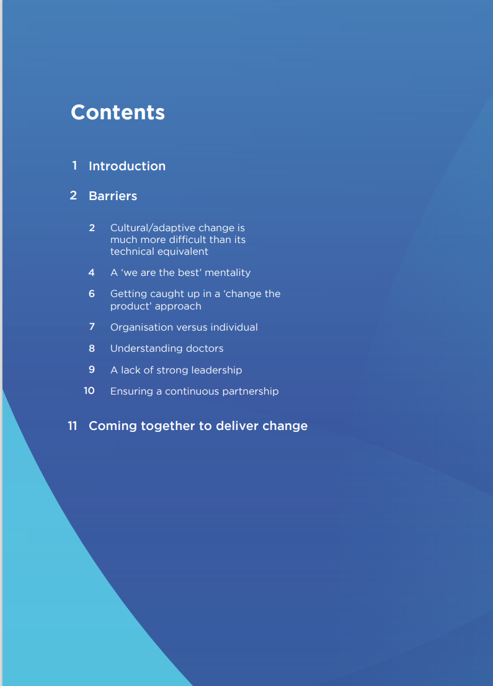


Collateral

