Slide 1




The Digital Health Strategy for Catalonia
A person-centred, data-driven information system
19th of July 2024
NHS Summer Schools 2024 (Durham, United Kingdom)
1

Slide 2
Once upon a time…
“… fundamental changes in health delivery with the main objective to improve the quality of care focusing on six qualities of care: Safe, Effective, Patient-centred, Timely, Efficient and Equitable”.
“… to achieve the main objective, the care processes need to be redesigned and a strong investment in health information technology is required. The focus of this investment has to be on supporting care processes in the context of the Internet revolution to foster access of health information by all stakeholders…”.
Source: Crossing the Quality Chasm (Institute of Medicine, 2001).

Slide 3
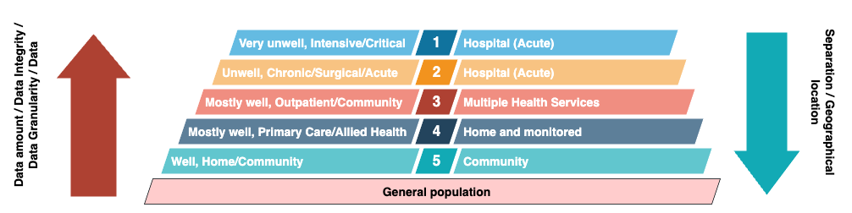
Which are the data we collect? Where are data produced?
Source: NIH Grant application (Isaac Cano, Jordi Piera-Jiménez et al, 2021)

Slide 4
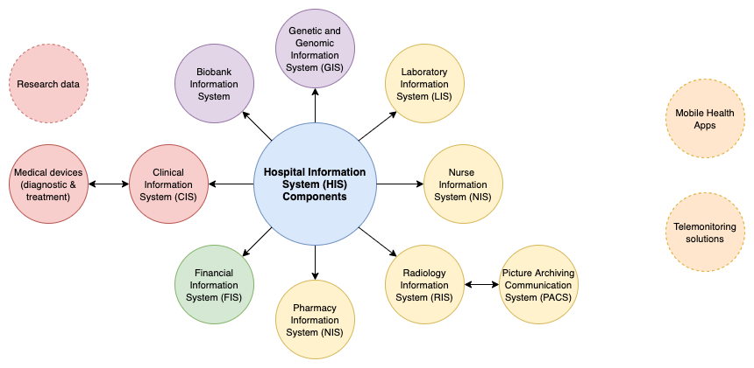
EMRs continue to be the main source of health-related information

Slide 5
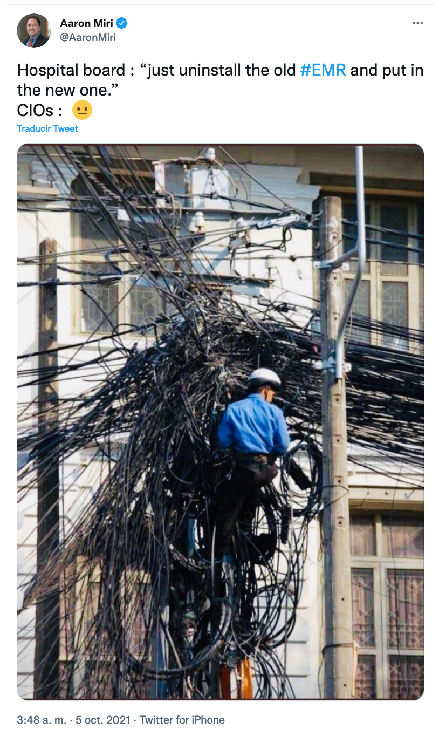
EMRs seen from the inside

Slide 6






Some highlights on the Catalan Health System
8.000.249
940
Population in Catalonia in 2023.
Facilities that range from primary health care centers to hospitals and intermediate care centers.
1
Universal coverage
EMR for primary care
> 29
29
Free healthcare for all Catalonian citizens.
EMR products in specialized care
EMRs for specialised
care
69
> 10
Hospitals across the region (12 high complex – third level).
Different systems for social care records.

Slide 7
The Catalan Digital Health platform
Hospitals and intermediate care
29 products
Electronic Prescribing (SIRE)
150 M prescriptions / year
37,000 health professionals as users
5.5 M users
Personal Health Portal (LMS)
> 6.1 M citizens
Central PACS System (SIMDCAT)
> 6,200 M images
Unique therapeutic plan
Genomics platform
Late 80's Early 90'
2000
2006
2023
2009
2022
2014
2007
2018
2020
Primary care EMR
1 product
National Patient Index (RCA)
Shared Electronic Health Record (HC3)
>1,100 M documents
> 70% structured information
Care Process Management (IS3)
> 80.6 M referrals / year
Remote consultations
> 80 M
Open platform
openEHR CDR
CKM
New apps
PROMs
Medications
Immunizations

Slide 8
A huge fragmentation of health information technologies
69 hospitals and 29 different EMR products (best of breed)
Each tertiary hospital has around 800 silos of information
Each secondary hospital has around 400 silos of information
Our prospections indicate us we have more than 16k silos of patient-related information
Huge heterogeneity of proprietary data models

Slide 9
From the EMR to the EHR and to the PHR
PHR
EHR
EMR
Electronic Medical Record (EMR)
Digital clinical data of a patient
from a single provider
Electronic Health Record (EHR)
Digital clinical data of a patient
from multiple providers
Personal Health Record (PHR)
Digital clinical data of a patient
from multiple sources including
data collected by patients

Slide 10
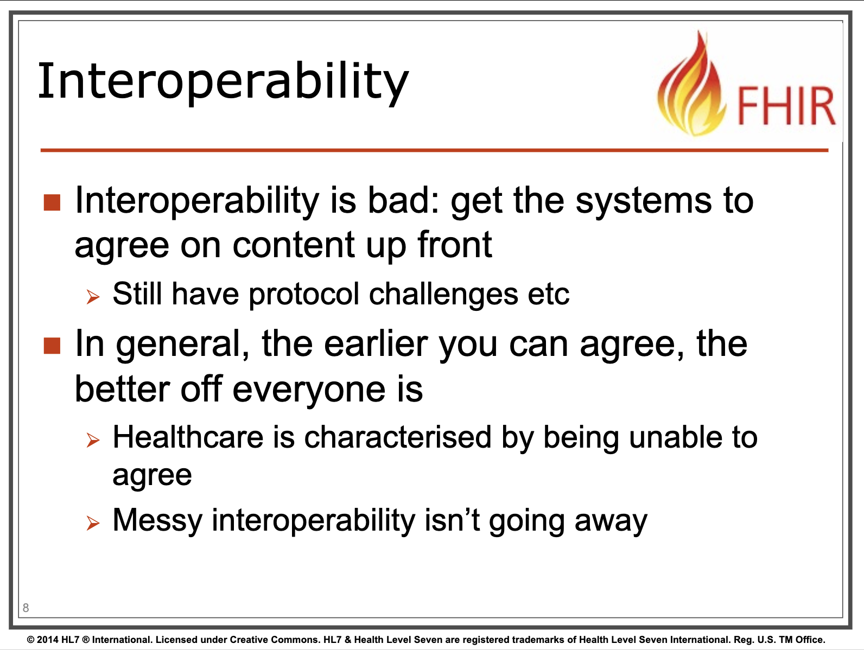
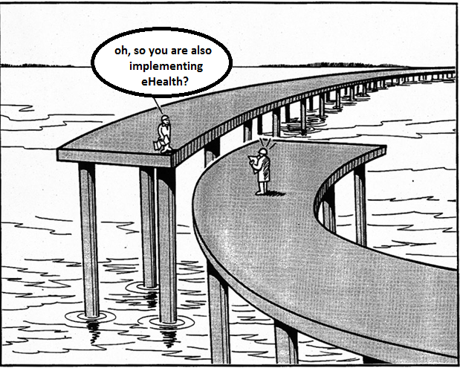
When building the EHR/PHR, the main issue is interoperability
Source: Graham Grieve (HL7-FHIR) podcast with Sidharth Ramesh 2024.
Source: Ed Simons (Nijmegen University), David Baker (CASRAI) and Josh Brown at euroCRIS meeting in Amsterdam 2014.

Slide 11
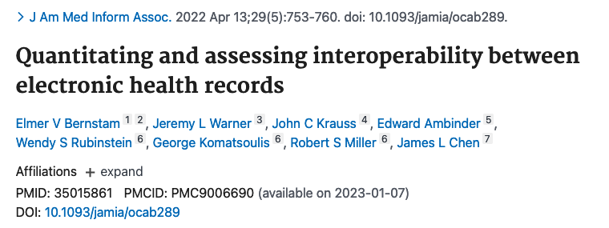
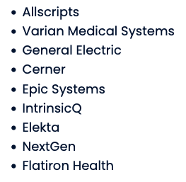
Data is not understood even when connecting the same vendor system…
Discussion: “In contrast to data elements required for successful billing, clinically relevant data elements are rarely standardized, even though applicable standards exist.”

Slide 12
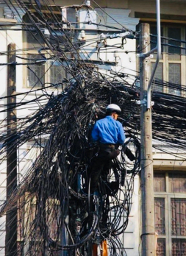
Building a comprehensive longitudinal EHR/PHR is a dream
…

Slide 13

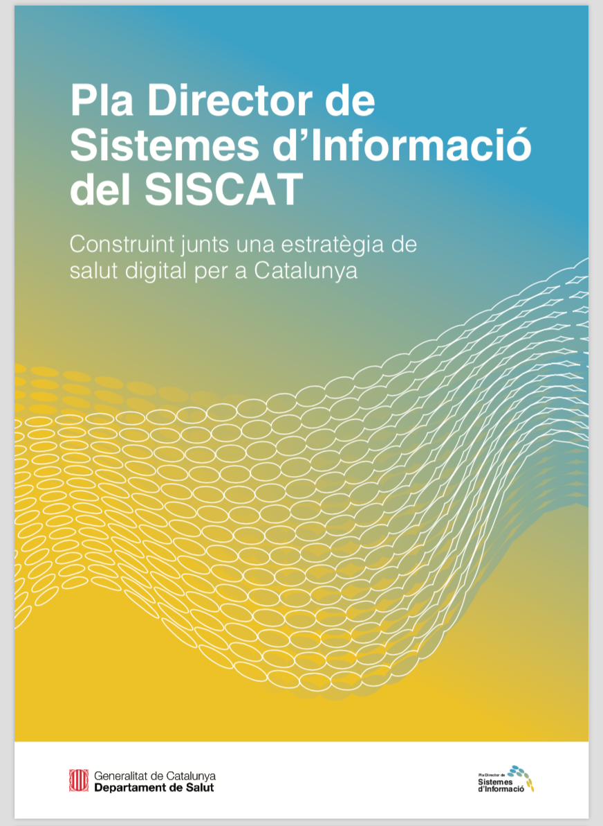

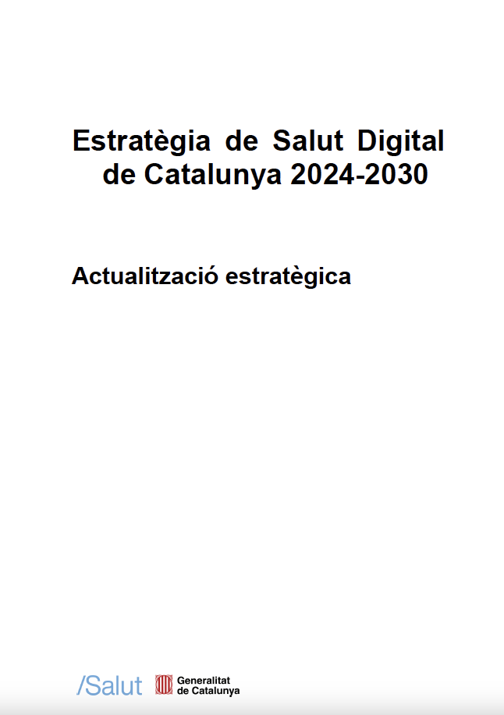
Catching up the time:
Digital Health Strategy for Catalonia
2016
2017
2021
2024

Slide 14
The main objective of the Digital Health Strategy for Catalonia
Integrated and person-centred care, supported by an information systems model that systematically leverages health data to build value-added services, that fosters innovation and that is built on a collaborative model based on open standards

Slide 15
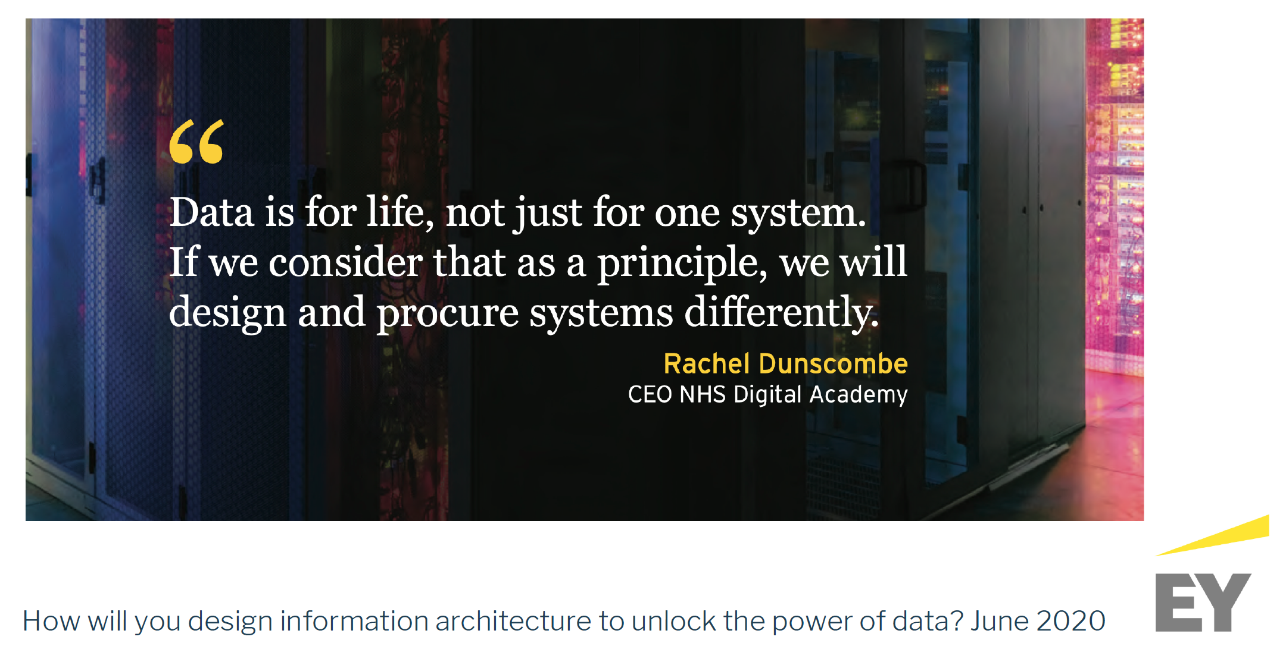
What is this all about?

Slide 16

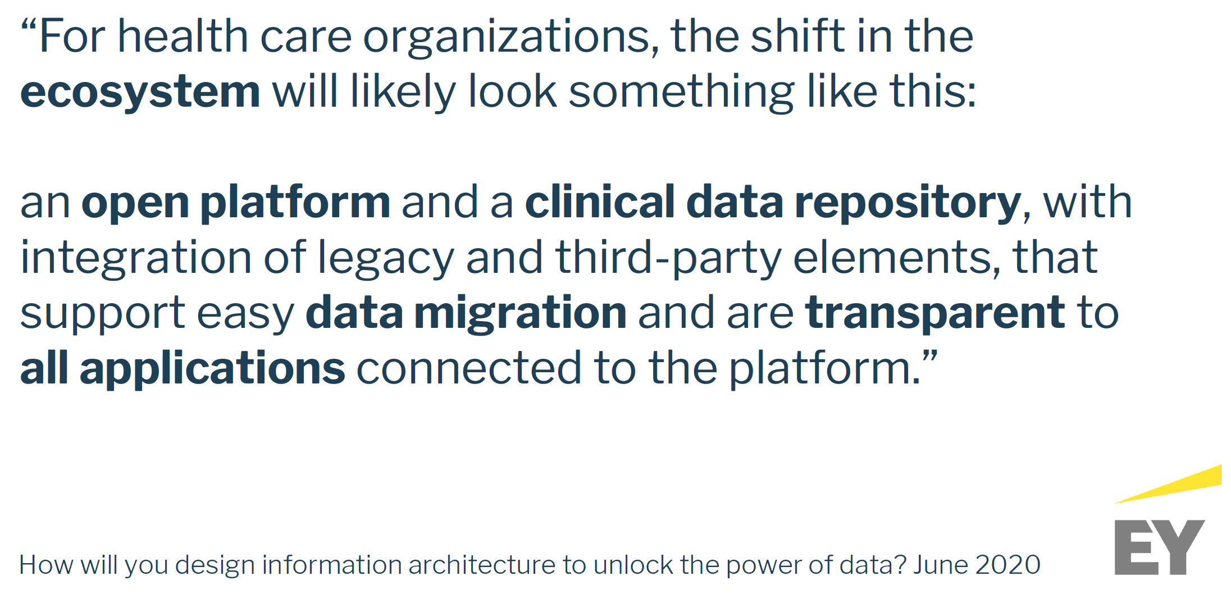
The open platform paradigm
Source: The Apperta Foundation 2017.

Slide 17
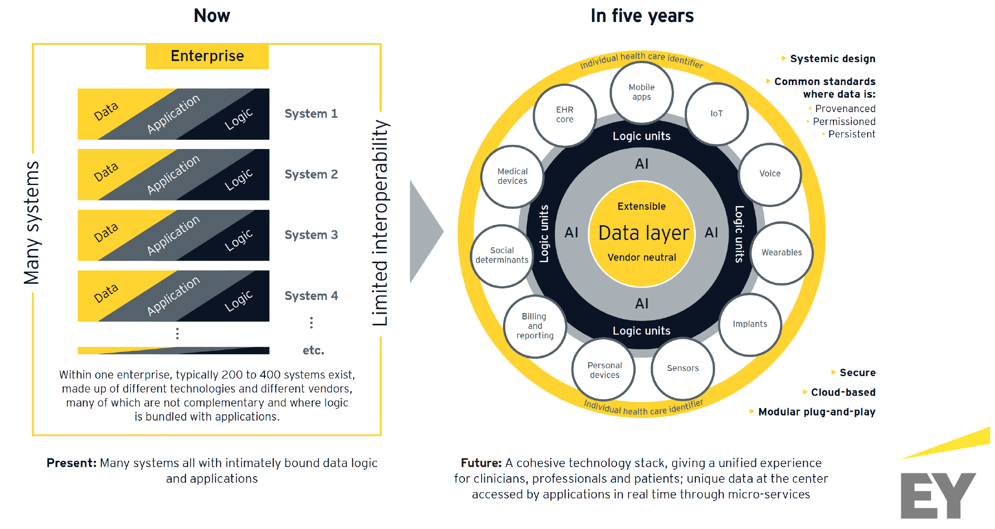

Current vs future view

Slide 18
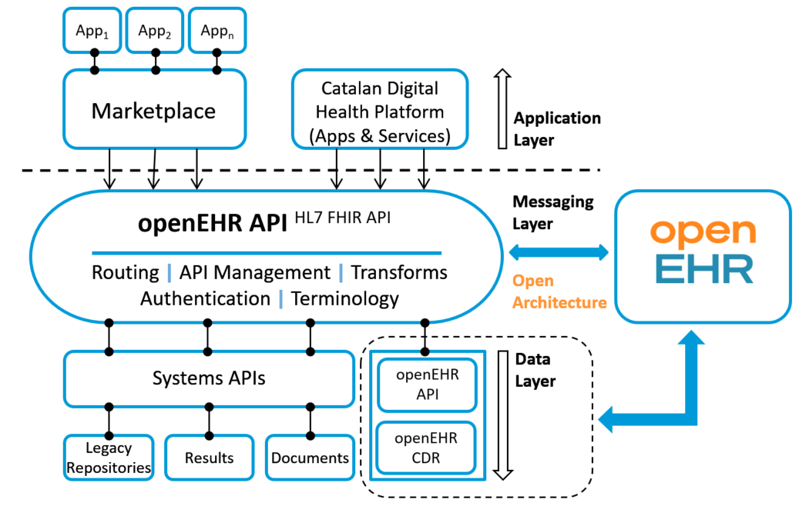
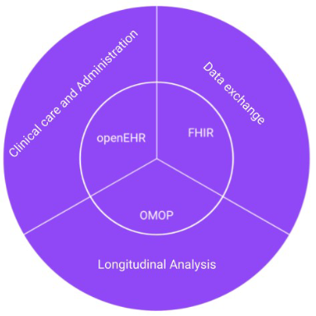
Towards the third generation EHR
Source: Tsafnat G, Dunscombe R, Gabriel D, Grieve G, Reich C. Converge or collide? Making sense of a plethora of open data standards in healthcare: an editorial. Journal of Medical Internet Research.
Source: New architecture model for Catalonia based on the open platform (adapted from the Apperta Foundation – United Kingdom)

Slide 19
Our view for a different and open future
We are building an INFOSTRUCTURE on the paradigm of open platforms
We have purchased a Clinical Data Repository and are migrating our solutions
We are decoupling data from applications, storing data in an open format
We are now procuring the technologies and services to build a market place
This enables data to follow the patient
This is fostering better integration and collaboration
It is helping scaling-up innovations

Slide 20


Thank you!
Dr Jordi Piera-Jiménez, PhD, MBA, FHIMSS
Director of the Digital Health Strategy for Catalonia at Catalan Health Service
Director at the openEHR Foundation
Associate Professor of Informatics, Multimedia and Telecommunications at the Open University of Catalonia jpiera@catsalut.cat
@jpieraj

