Slide 1
Serving Communities Through Digital Services
Thinking About
Digital Inclusion
Katie Heard
Head of Research and Data Insights

Slide 2
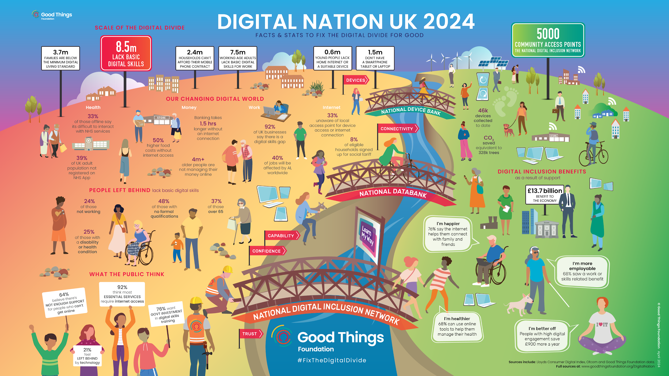

Slide 3
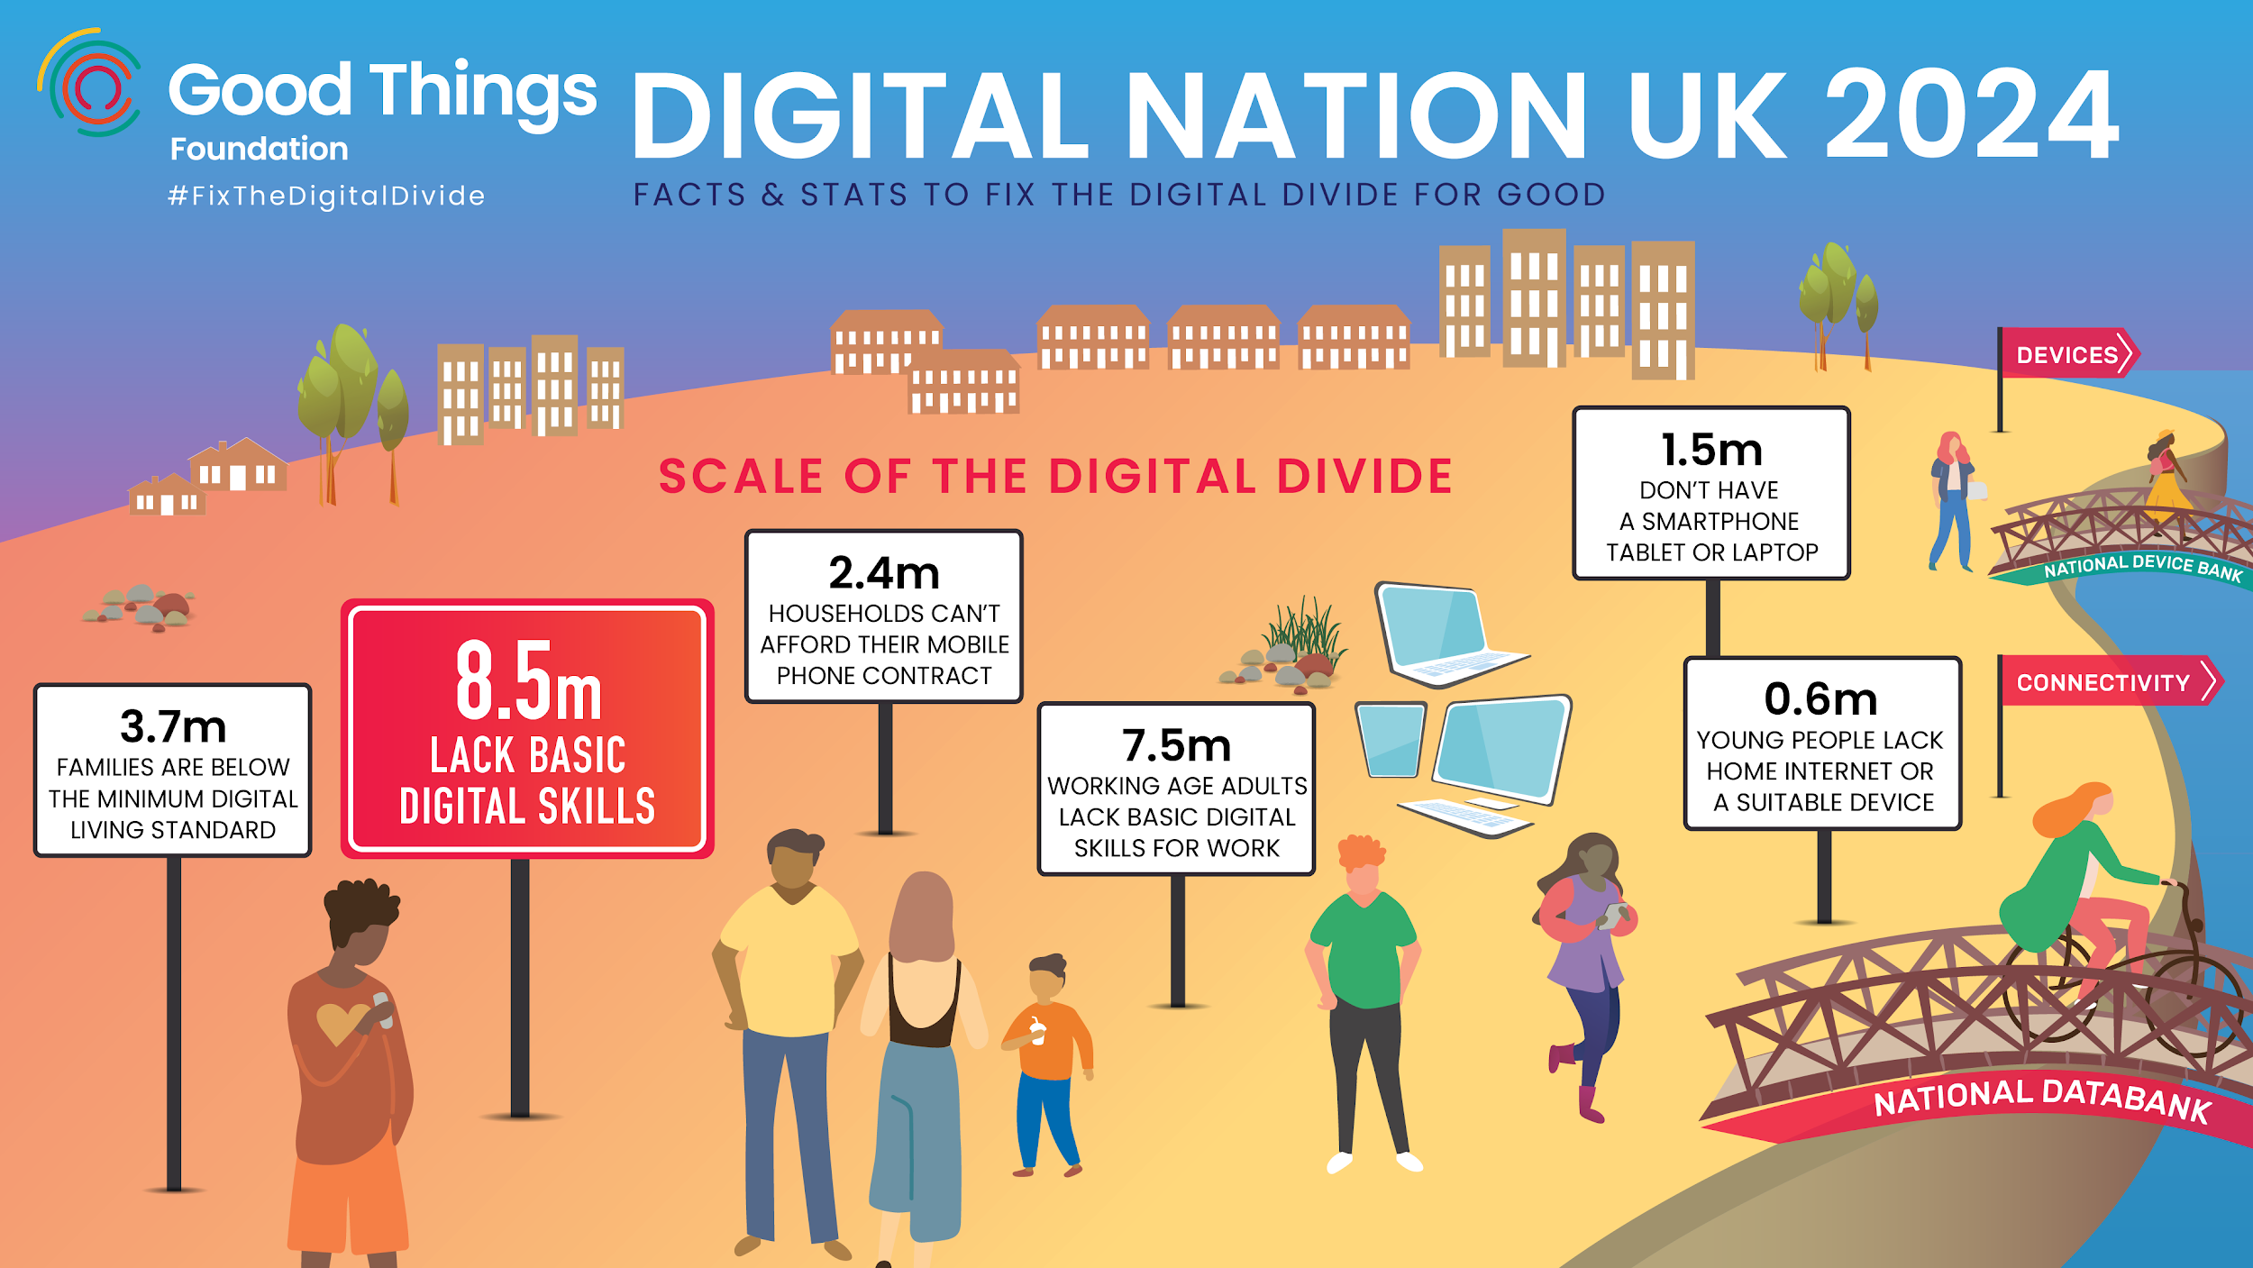

Slide 4
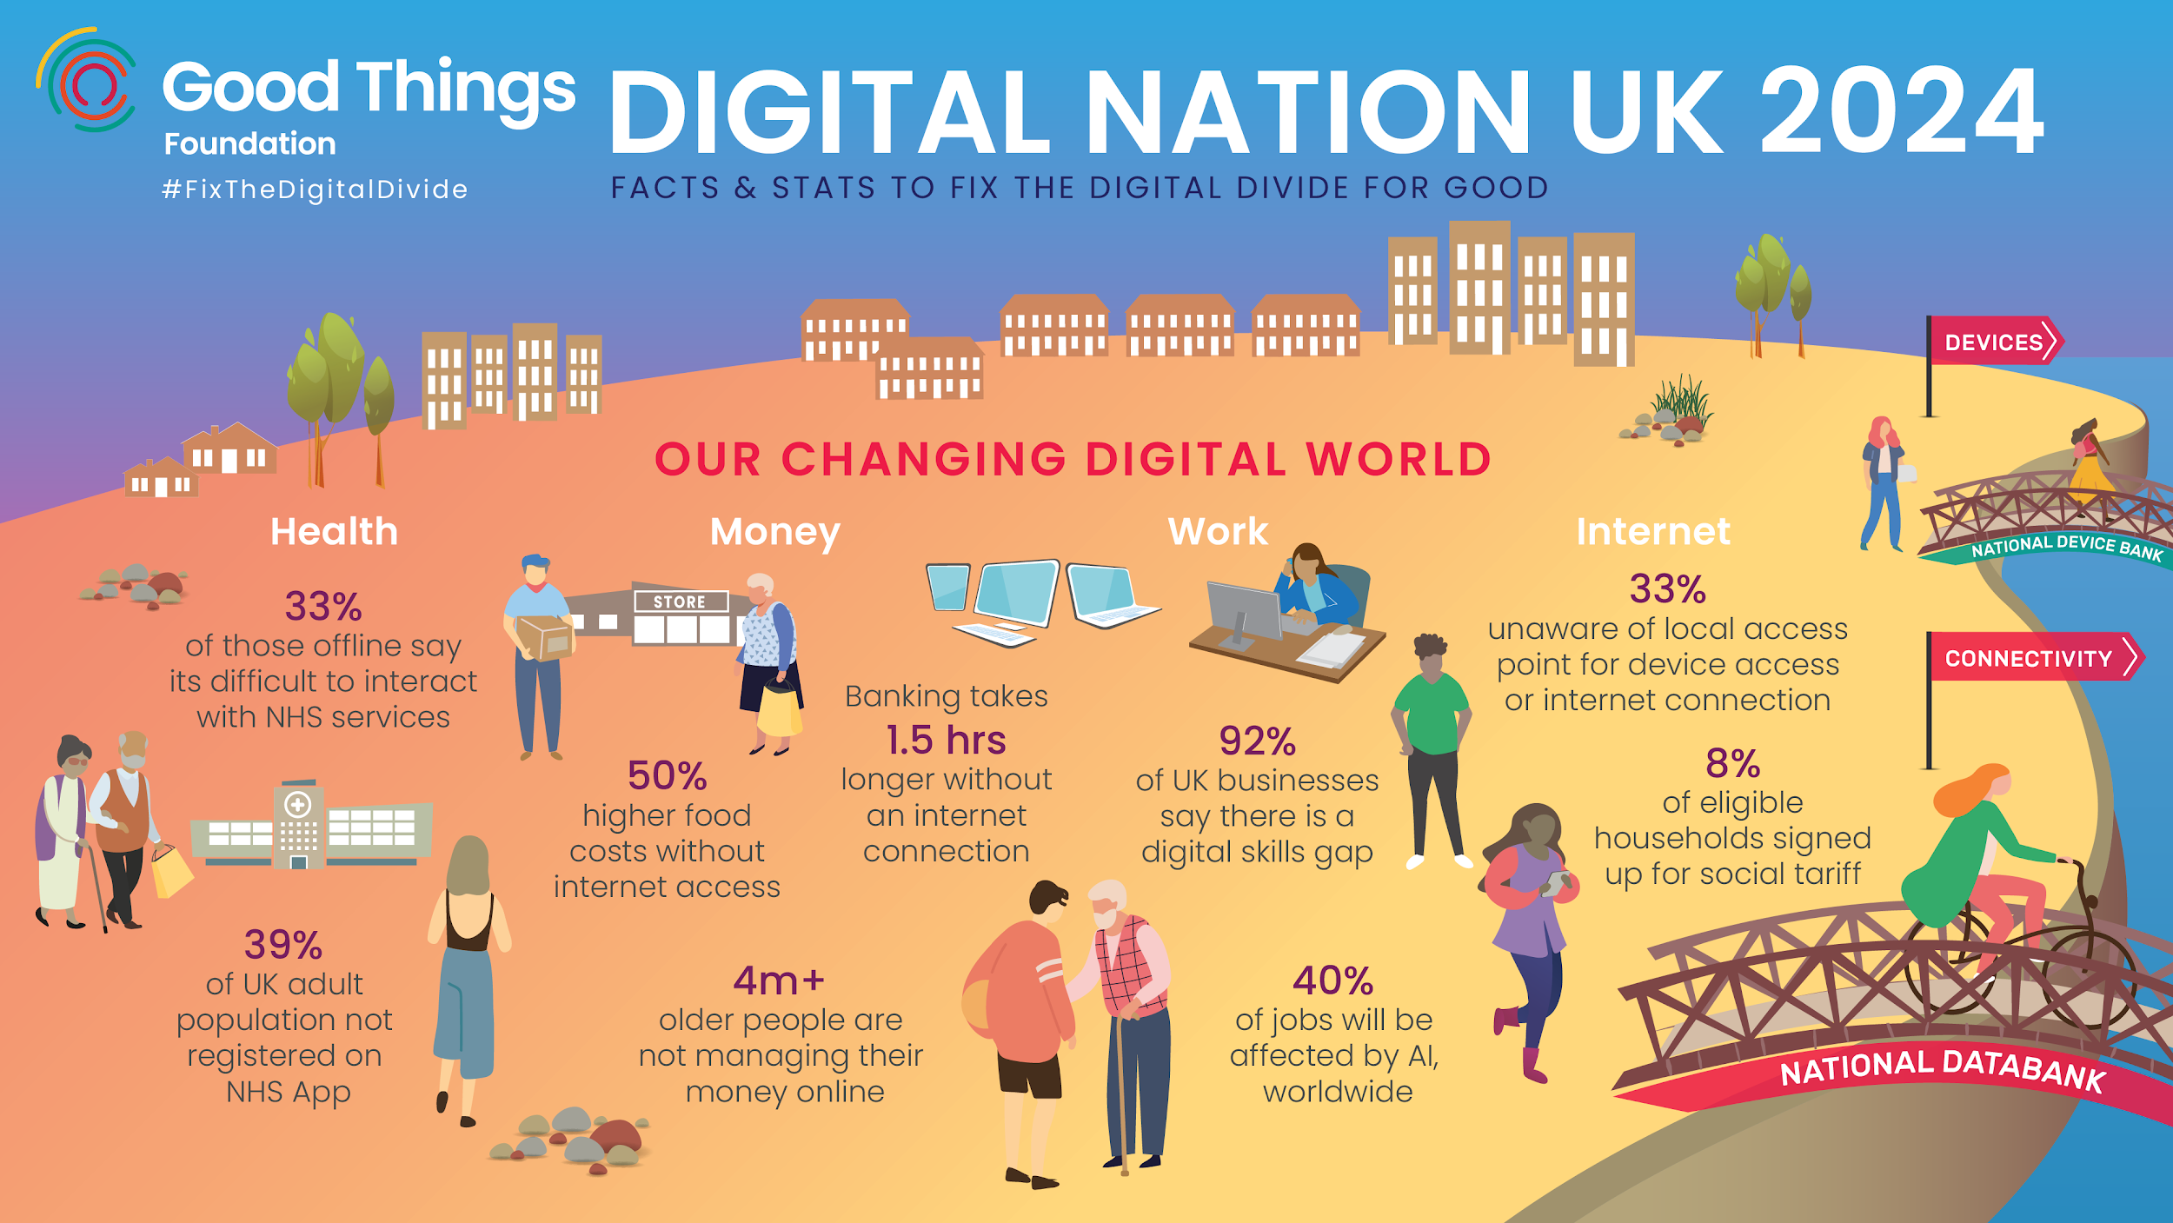

Slide 5
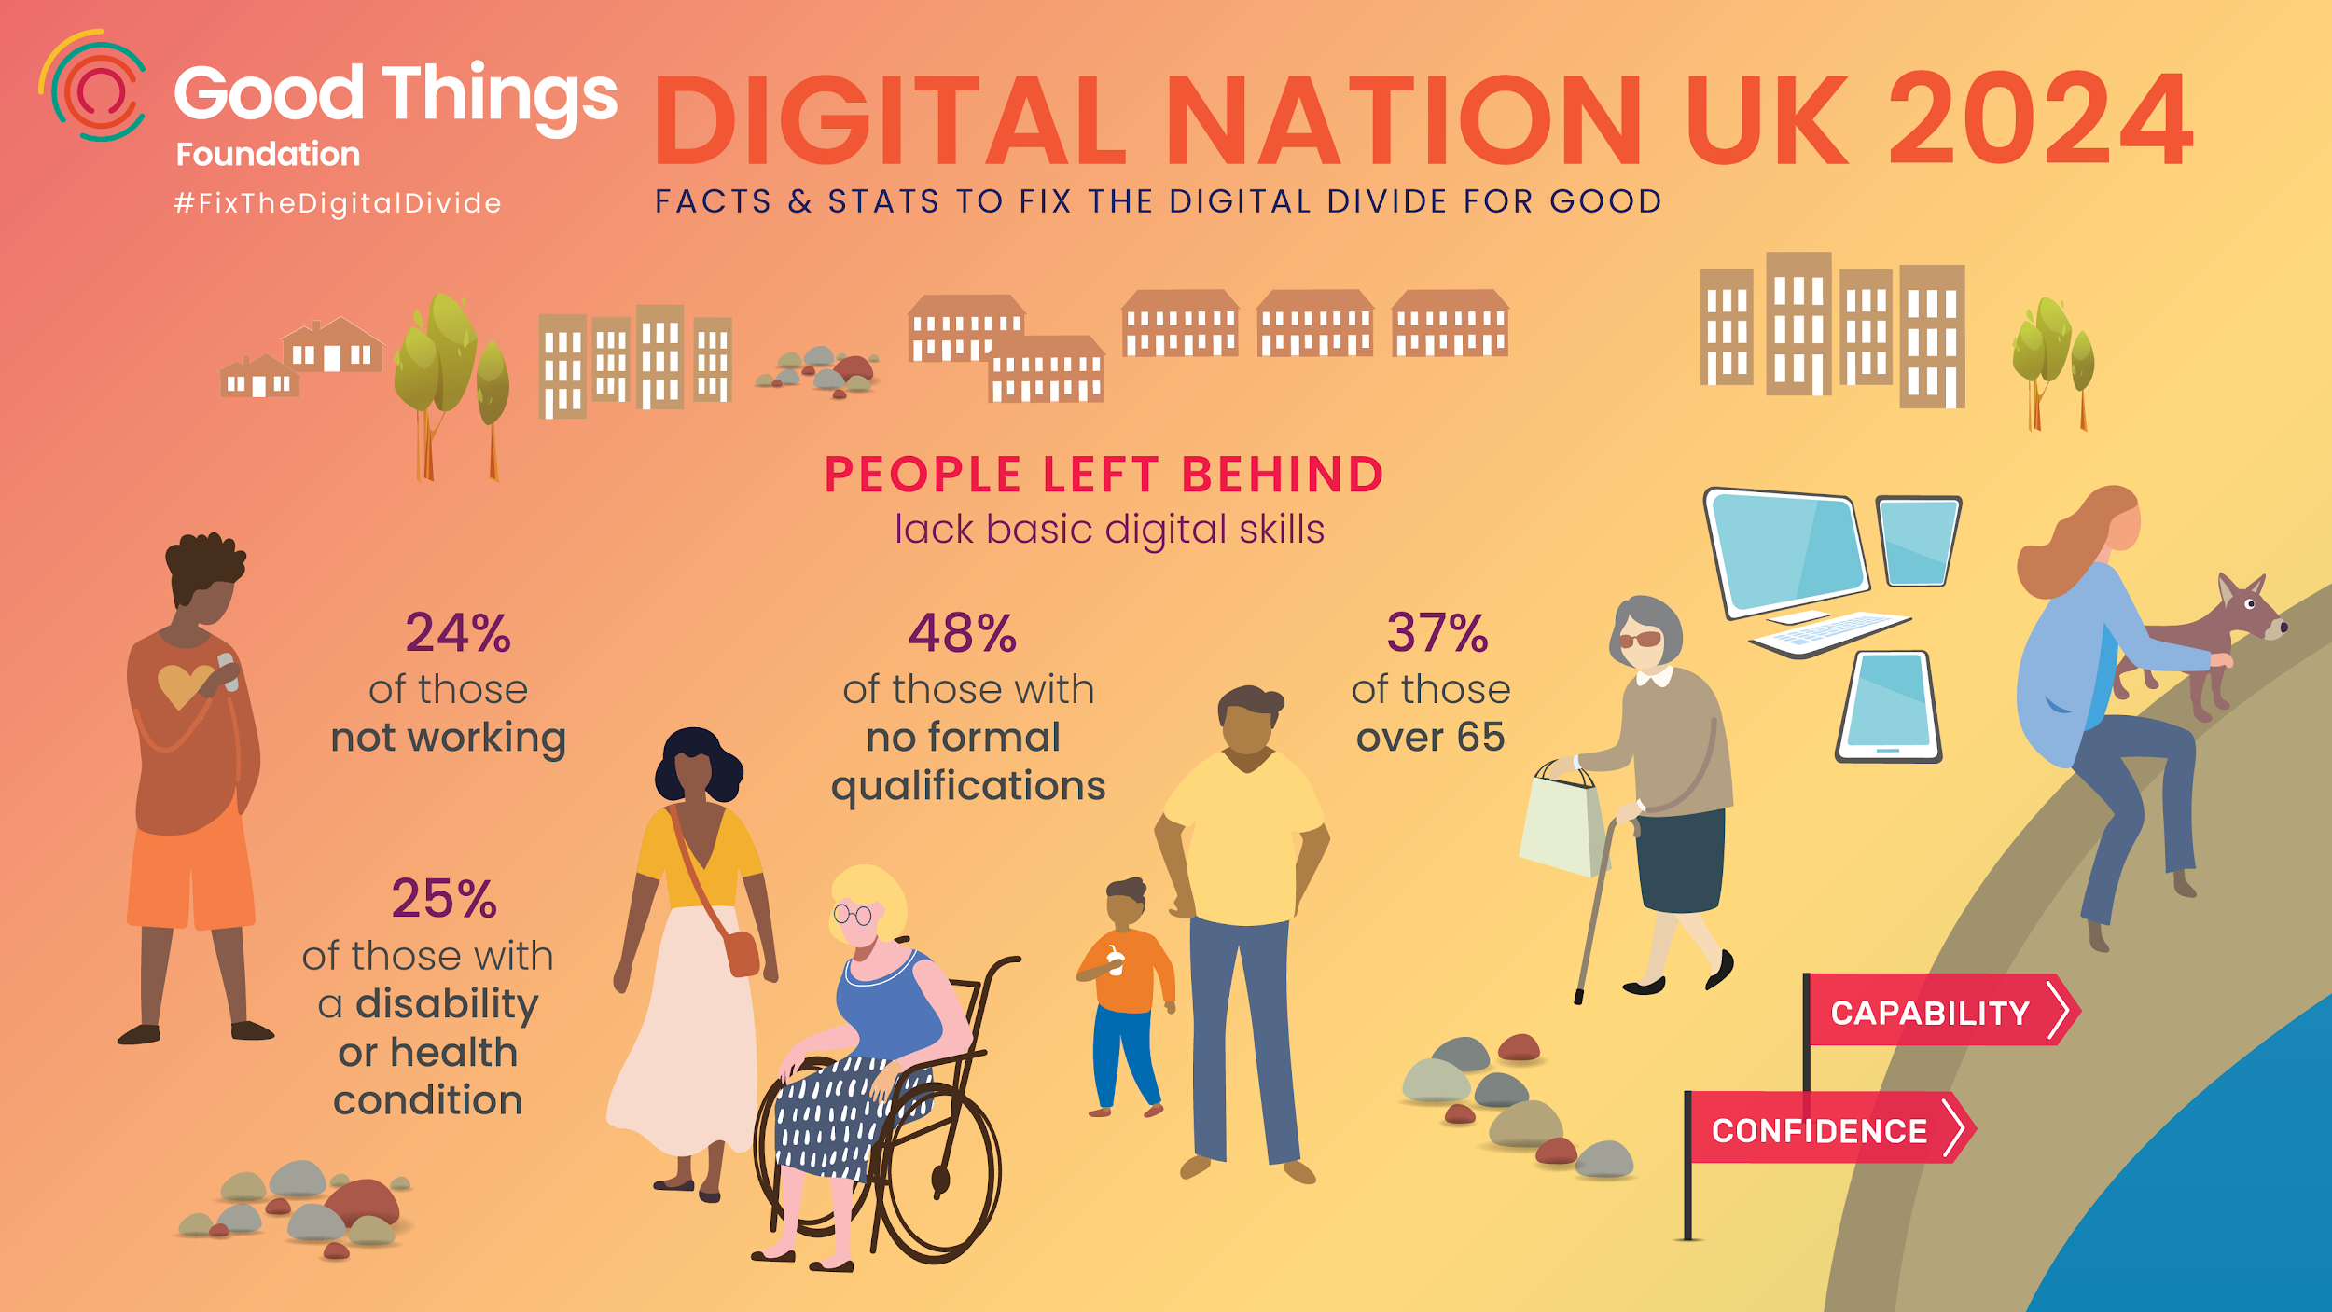

Slide 6
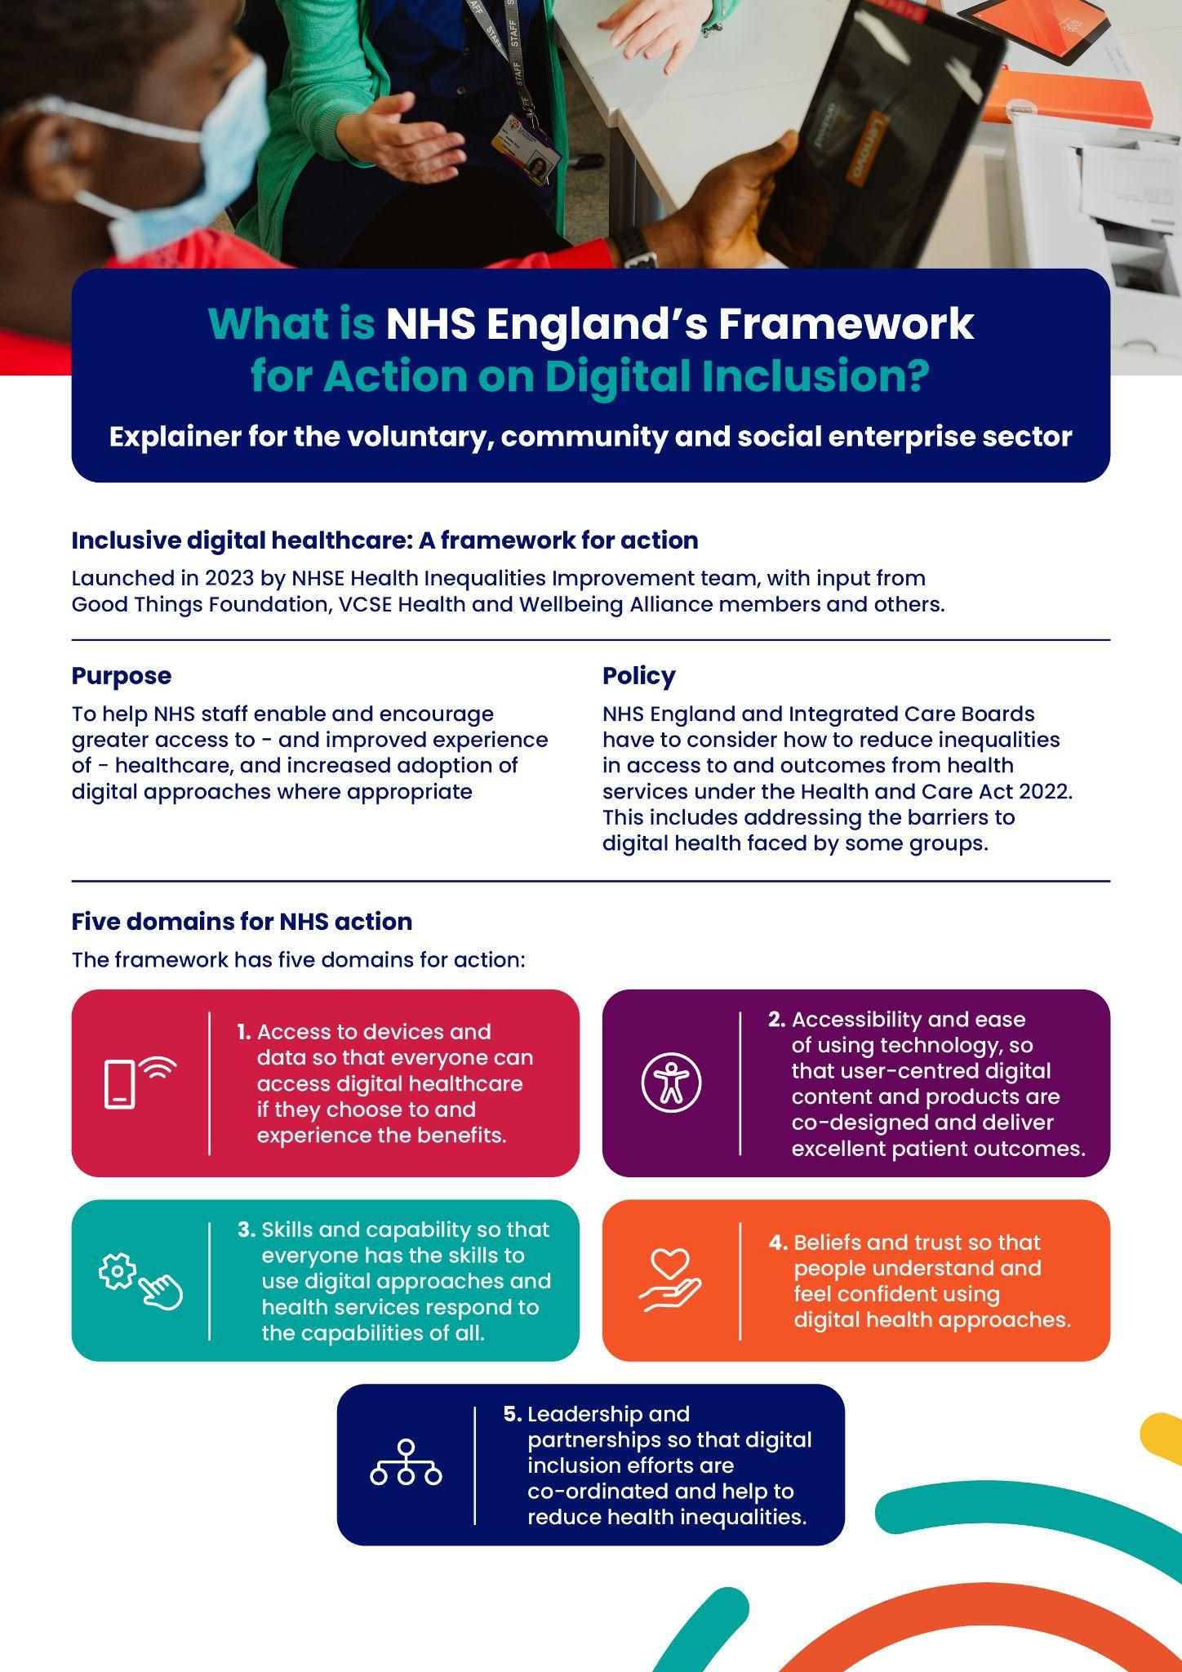
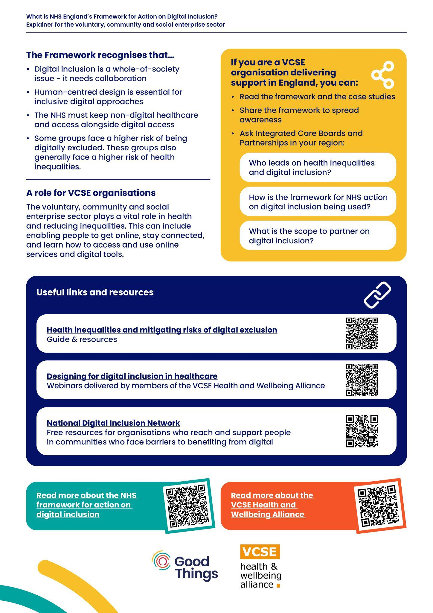
Digital Inclusion - An NHS priority
NHS Operational planning guidance identifies digital exclusion as a priority:
Priority 2: Mitigating against digital exclusion
The Framework for action on digital inclusion is a tool to help NHS staff enable and encourage greater access to and improved experience of healthcare, and increased adoption of digital approaches where appropriate

Slide 7

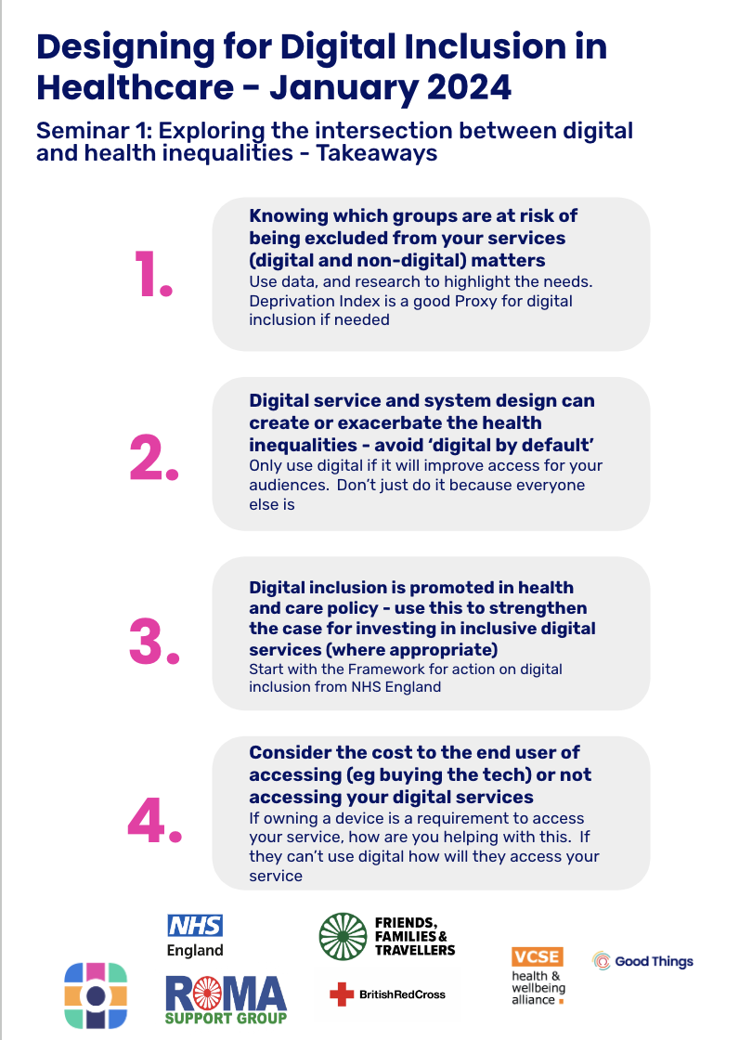
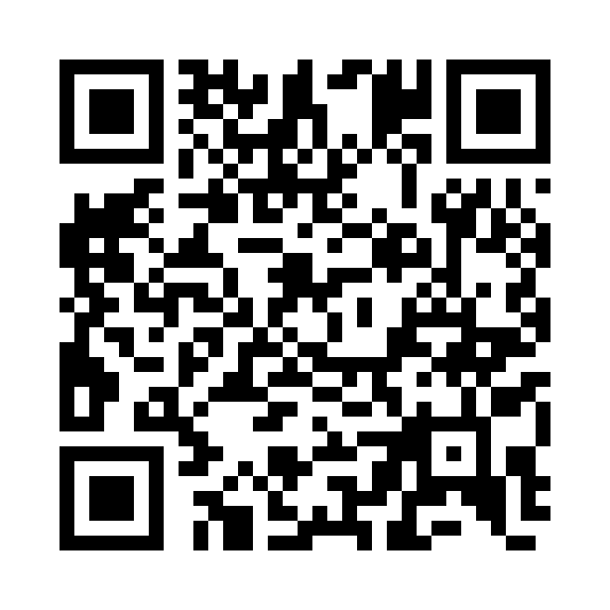

Designing for digital inclusion in healthcare
A seminar series to help you consider populations, barriers and solutions:
Seminar 1 ‘Exploring the intersection between digital and health inequalities’
Seminar 2 ‘Exploring the barriers that exclude people from digital health services, and how to remove them’
Seminar 3 ‘Designing inclusive digital healthcare services
Including lots of examples and case studies

Slide 8


See examples of good practice in primary care
Find out more: https://www.goodthingsfoundation.org/insights/supporting-digital-inclusion-in-general-practice-top-tips/
The challenge
Admin staff based at busy GP practices across the Beeston and Middleton area in Leeds were unsure where to signpost vulnerable patients who required digital and non-digital support around their health needs and had limited time to offer direct support.
The approach
100% Digital Leeds developed a place-based approach to digital inclusion to improve health participation, working with Beeston and Middleton Local Care Partnership to develop a Digital Health Hub Network. Each Digital Health Hub offers accessible spaces for patients at the heart of the local community.
Bevan Health and Wellbeing successfully recruited and trained peer volunteers to increase digital literacy and online use of healthcare for volunteers and patients who were asylum seekers, refugees or who had been affected by homelessness. Of 77 patients who participated in an evaluation, 29% started using online consultation systems or similar website forms to request help from their GP; 26% requested repeat prescriptions online; and a quarter used a video app for GP consultations.

Slide 9
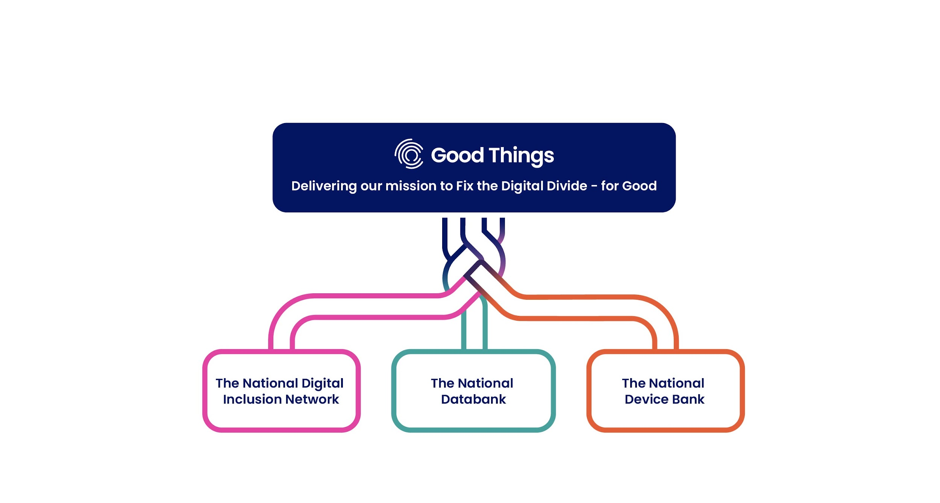
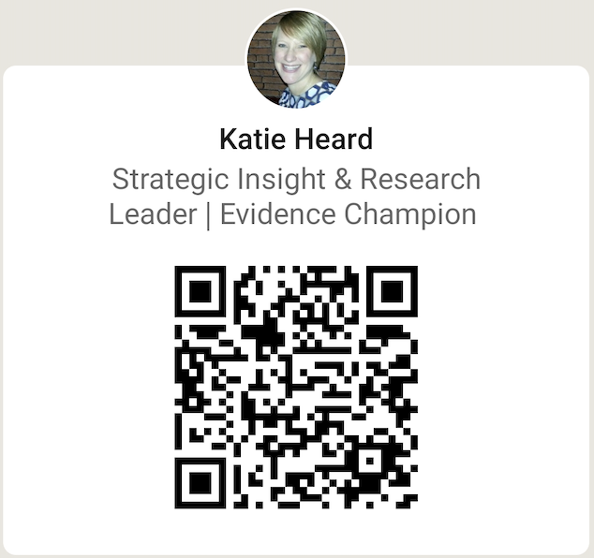
Get in Touch!
Katie Heard, Head of Research and Data Insights
katie.heard@goodthingsfoundation.org

