Slide 1

Integration of cancer services: The role and importance of regional multidisciplinary team meetings (MTDs)
Prof. J.J.M. (Koos) van der Hoeven, medical oncologist
Chair regional cancer network Oncomid
Summer Schools, Durham, 18 July 2024

Slide 2
Disclosures
Emeritus professor of medical oncology at the Radboud University and Leiden University Medical Center
Medical director Hartwig Medical Foundation 2020-2023
Member supervisory board Dutch Institute of Clinical Auditing
Member advisory board “ Vereniging Innovatieve Geneesmiddelen”
Chair regional cancer network Oncomid

Slide 3
Agenda
What makes cancer different from other diseases?
Organization of cancer care in the Netherlands
(Regional) multidisciplinary team meetings, why?
Burden of MDTMs
Requirements for optimal MDTM
Technical facilities for MDTM
How to reach the top 3 in Europe regarding outcome of cancer treatments?

Slide 4
The approach to cancer patients needs to be multidisciplinary
Tissue is the issue, importance of molecular diagnostics is increasing
Staging procedures need to be carried out carefully
Treatment advice depends upon the input from a multidisciplinary team including specialists in surgery, medical oncology, radiotherapy, nuclear medicine, pathology, radiology and others
Patients play an important role in shared decision making

Slide 5


Slide 6
Netherlands is a small, densely populated country
17 million inhabitants
Largest distance east-west 100 km, north-south 300 km
71 hospitals, all these hospitals are involved in cancer treatments
7 university hospitals
Prinses Maxima Centrum: hospital for child cancer
Netherlands Cancer Institute Amsterdam
Annually 120.000 new cancer patients

Slide 7
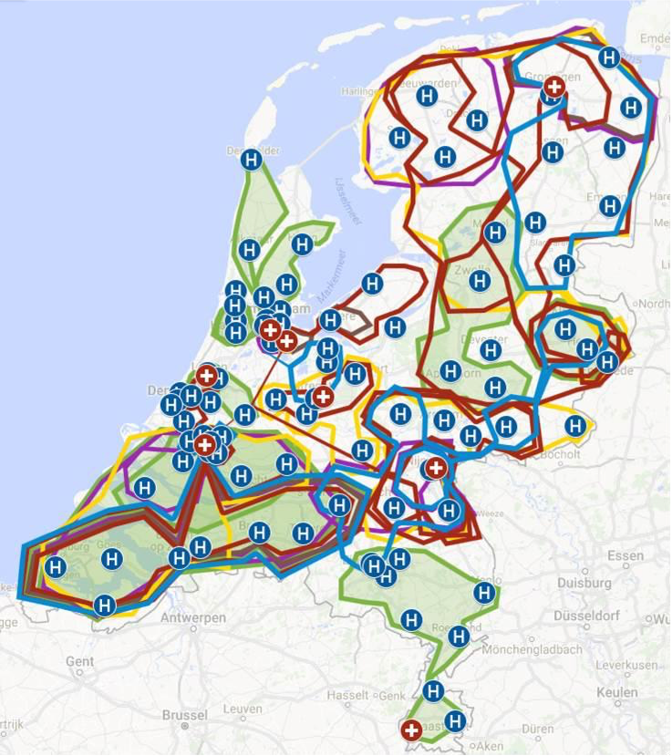
Multiple regional cancer networks

Slide 8
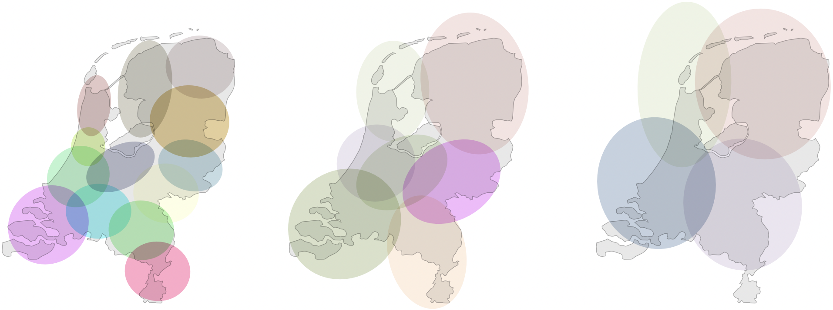
Towards regional cancer networks in the Netherlands

Slide 9
Since 2012 multidisciplinary norm document for cancer treatments
Requirements for infrastructure, out-patient clinic, day-care, emergency department, number of dedicated specialists and nurses
Norms for turnaround time: 1 week first presentation, 3 weeks discussion at the MDTM, 3 weeks for start initial treatment
Volume norms for complex surgical procedures and some systemic treatments
Each patient should be discussed at an MDTM before initial treatment
.
.

Slide 10
How to ensure equal access and optimal treatment for every cancer patient in the Netherlands
Not every suspicion of cancer leads to a cancer diagnosis
Rapid referral for further diagnosis if cancer is suspected, within a week
Once the cancer diagnosis is confirmed, standardized examinations are carried out to further stage the disease
Discussion at a multidisciplinary team meeting within three weeks after referral, treatment proposal is formulated
The location of treatment depends on the type of cancer, extent of the disease, comorbidity and wishes of the patient
.
.

Slide 11
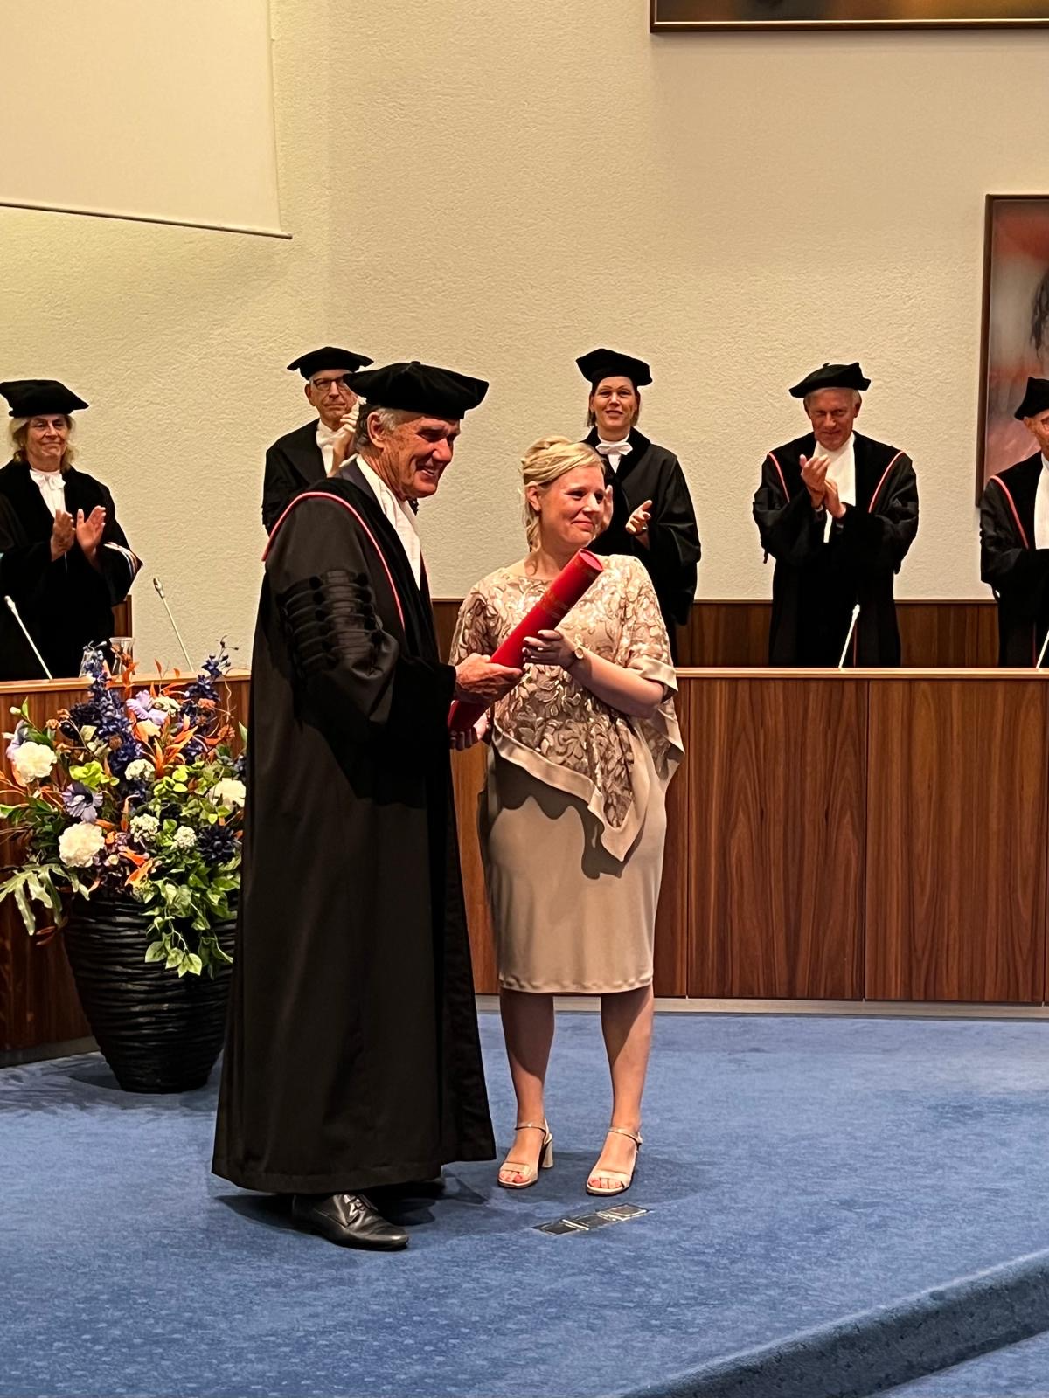
Thesis Dr Janneke Walraven ‘Towards sustainable multidisciplinary team meetings in oncology

Slide 12
MDTM: a heavy burden
Analysis of 105.000 patients with cancer: A nationwide population-based study in the Netherlands. Walraven J et al, EJC 2019
Have all these patients really been discussed in the MDTM?

Slide 13
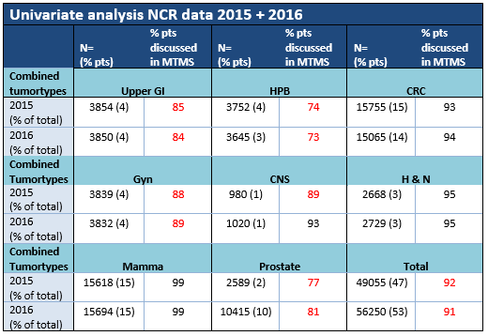


Slide 14
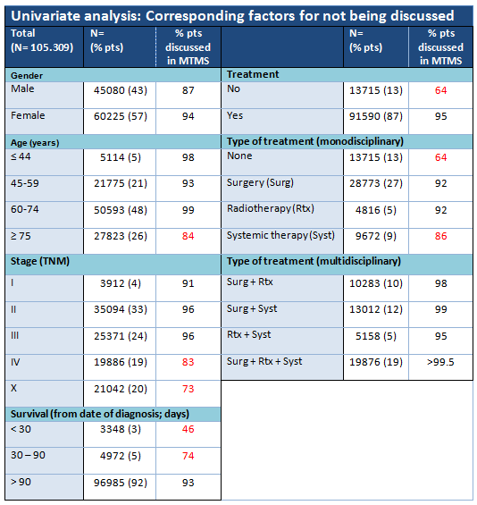

Slide 15
It matters who is present at the MDTM!
For patients with MIBC, the probability of being discussed in a MDTM was associated with age, performance status and receiving treatment with curative intent, especially if a representative of a hospital in which patients can be operated on for bladder cancer was present. Future studies should focus on the impact of MDTM advice on survival data. Walraven J et al. BJU Int 2023;
Some patients need to be referred to specialized centres for low volume/high complex procedures. Selection procedures are crucial

Slide 16
Regional MDTMs in the past
Images sent on CD-roms
Clinical information came by fax
Information was frequently incomplete or not available
Patients had to be referred in person to achieve a good advice
Expert teams visited the hospitals in person

Slide 17
Requirements for an optimal regional MDTM
well scheduled
prepared by all core members
guided by a qualified chairperson
supported by administrators
AND
facilitated by an excellent exchange of data and images between the hospitals

Slide 18



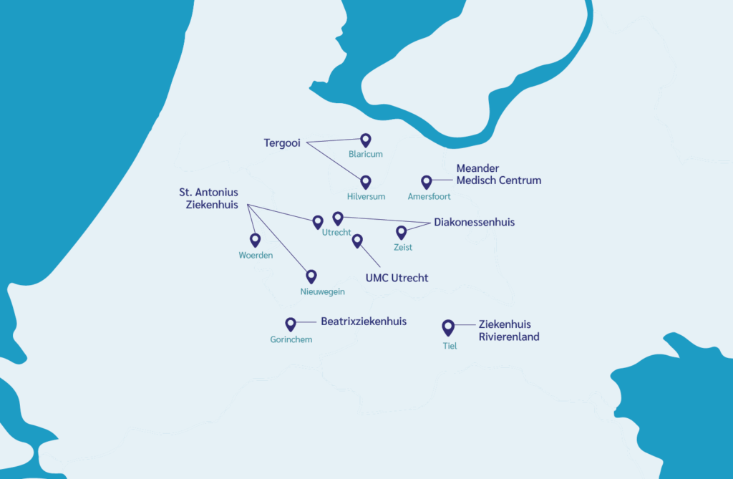







Regional cancer network Oncomid

Slide 19
Guiding principle for Oncomid: It does not matter in which hospitals a patient presents with first complaints
Common care pathways
Regional Multidisciplinary Team Meetings
Regional surgery teams
Starting point: “far away if necessary, nearby home if possible”
Agreements about rapid referral
Diagnostic process and follow-up in the original hospital
Transparency of process and outcome indicators

Slide 20
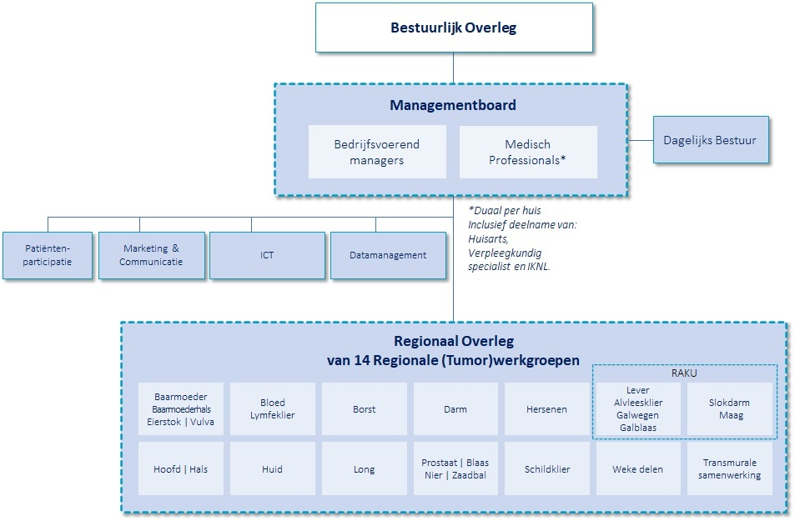
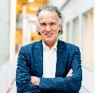
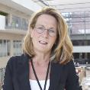
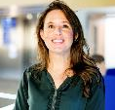

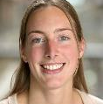
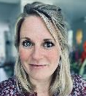

Executive committee
Koos van der Hoeven
Chair
Gera de Jong
Manager Meander MC
Camilla Basart
Programm manager
Floor Bakker
Programm manager
Jorine van der Heeden
Datamanager
Marije Veenboer
Communication advisor
Jaarverslag Oncomid | 4

Slide 21
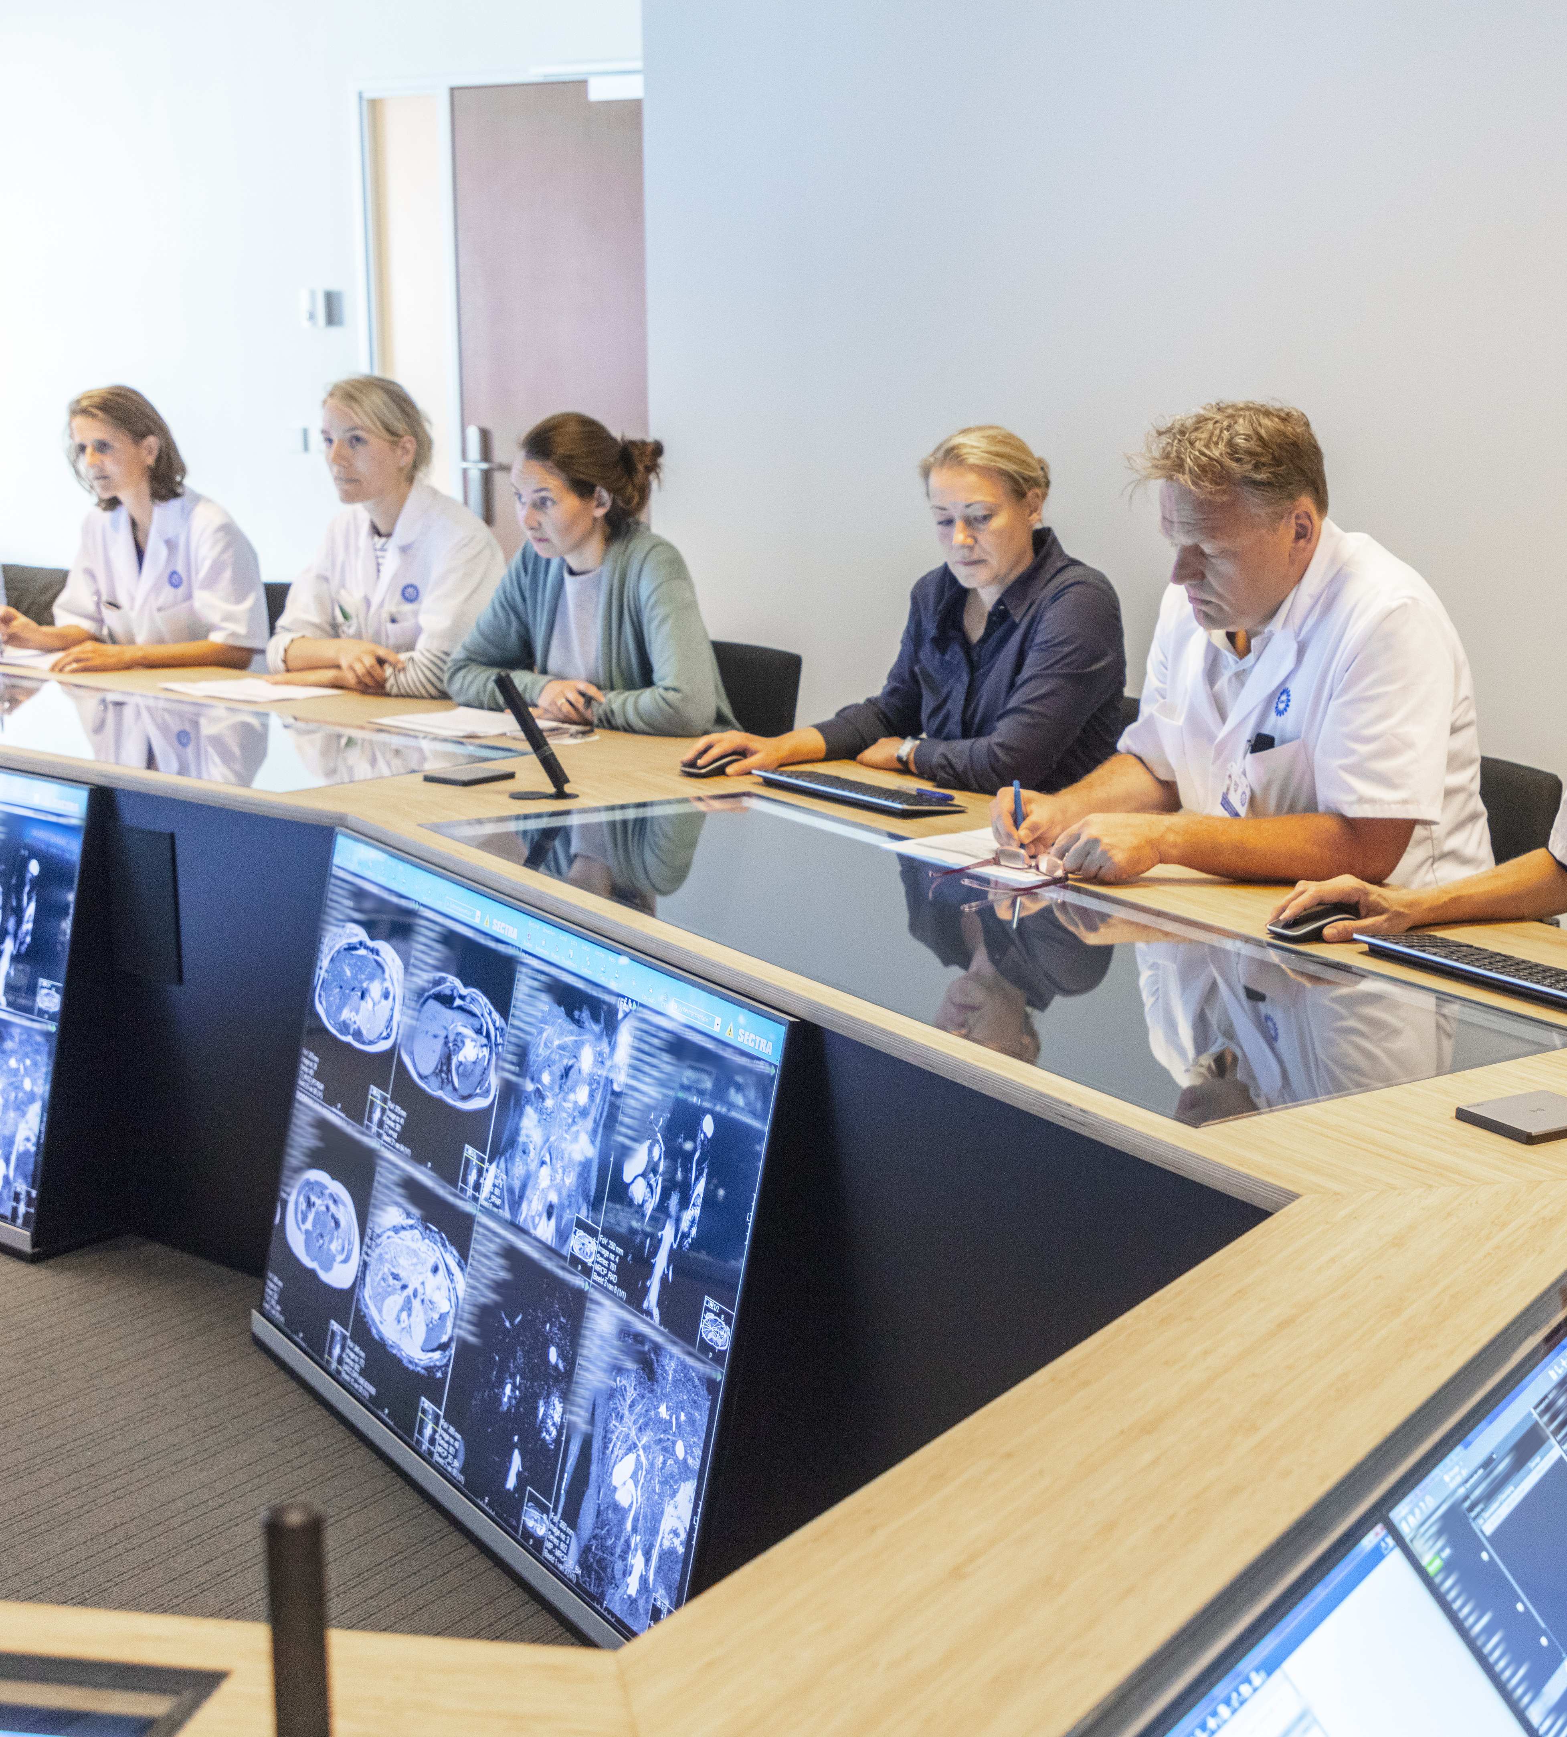
Facilitating regional MDTMs in oncology in Oncomid
Support in all participating hospitals
Advice and project management
ICT plays a crucial role
It has to meet high technical and privacy standards

Slide 22
Project Data Delen Midden Nederland: towards a safe digital platform for MDTM
Participants: all hospitals in Oncomid
Parsek/Open line for Vitaly
Financial support by Zilveren Kruis, largest health insurer in the Netherlands
Start 2020

Slide 23
Aims of the project
The practitioner himself can refer a patient for a regional MTD
Essential information can be easily extracted from the health records
An agenda for the MDTM can be centrally planned
Meeting can be prepared by the chair, radiologists, pathologists
All participants can be present at the MDTM in a virtual surrounding
Radiological images have diagnostic quality
Conclusions and advice will be visible for the treating specialists and GP immediately after the meeting

Slide 24
The project had many challenges
Streamlining and a good understanding of the process
Three different systems of electronic patient files ( EPIC, HIX, EasyCare)
Privacy issues
Different regional tumour working groups have various wishes. Different format for each tumour type
Determining who have access to the platform
Getting everyone involved
Technical and administrative support

Slide 25

Many sources had to be connected
Hospital | Source | Connected on XDS affinity domain
Antonius | Epic EPD | Epic Care Everywere
 | Radiology PACS … | Philips
Diakonessenhuis | HiX EPD | CS Zorgplatform
 | Radiology PACS Oldelft | Philips
In ontwikkeling | Cardiologiy PACS IntelliSpace | Philips
In ontwikkeling | Endoscopy viewer via Clinical Assistent | Philips
Meander MC | EasyCare EPD | Enovation
 | Radiology PACS AGFA | Enovation
Rivierenland | HiX EPD ? | To be determined
Tergooi | HiX EPD + PACs Sectra | To be determined
UMC Utrecht | HiX EPD | CS Zorgplatform
 | Radiology PACS Sectra | Philips
In development | Cardiology PACS IntelliSpace | Philips
 | Radiotherapy PACS | Philips
 | Endoscopy viewer via Sectra | Philips
Elk ziekenhuis is zelf verantwoordelijk voor het aansluiten van de bronsystemen op het eigen XDS affinity domain. Als een koppeling met een bronsysteem nog niet aanwezig is, moeten de documenten uit dat systeem vooralsnog handmatig naar Vitaly ge-upload worden. Hier wordt een overzicht gegeven van deze bronsystemen voor zover nu bekend.

Slide 26




How Vitaly works in practice
Preoperative
work-up
Adjuvant
therapy and en follow-up
Surgery
Upper-GI MDTM
&
post-MDO pol
HPB MDTM
&
post-MDO poli
‘SHARED CARE’ and ‘REGIONAL TEAMBUILDING’

Slide 27
Current status
Vitaly has been implemented for three regional MDTM’s in Oncomid, several others will follow soon
Health insurer Zilveren Kruis has offered to implement the system at their expense in all regions in the Netherlands
The condition is that all regions use the same system, to prevent having different systems as there are in electronic patient files
The system will also be used for cardiology, obstetrics and other indications

Slide 28
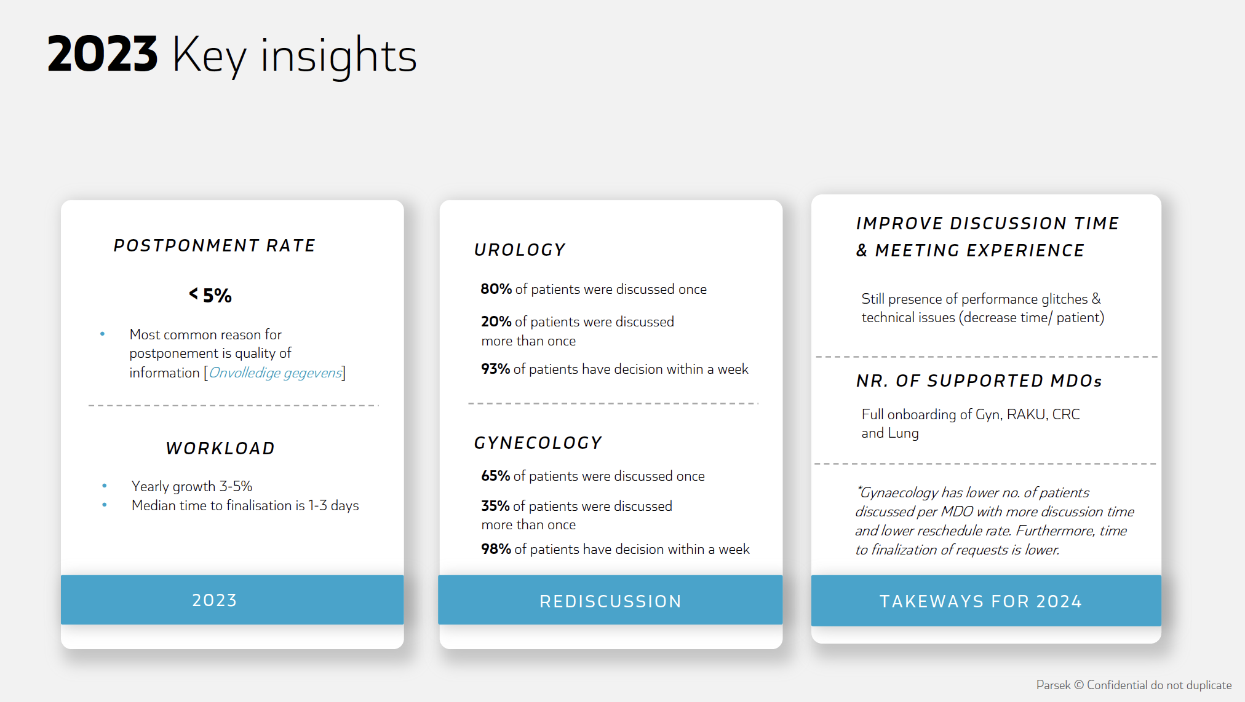
Vitaly has a good performance

Slide 29
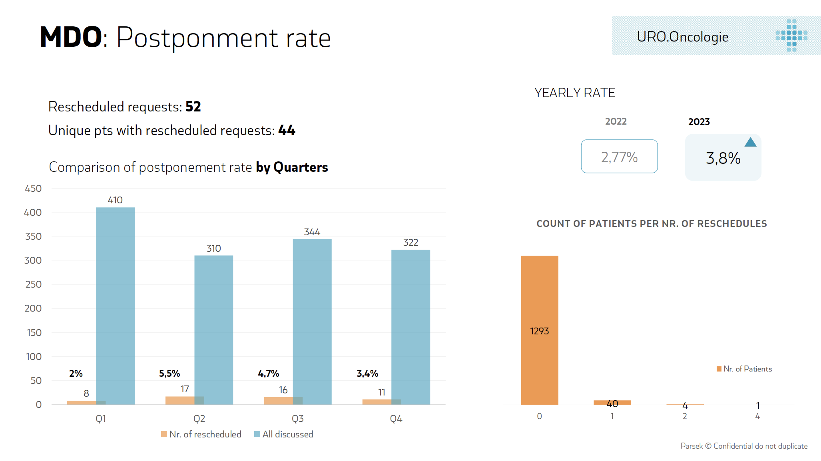
Postponment rate is low

Slide 30

IZA sets new rules
Volume norms for complex surgery/treatments: 50—100
Regional planning
Regional MDTM become more important
Focus on efficacy

Slide 31
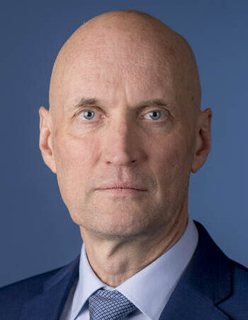
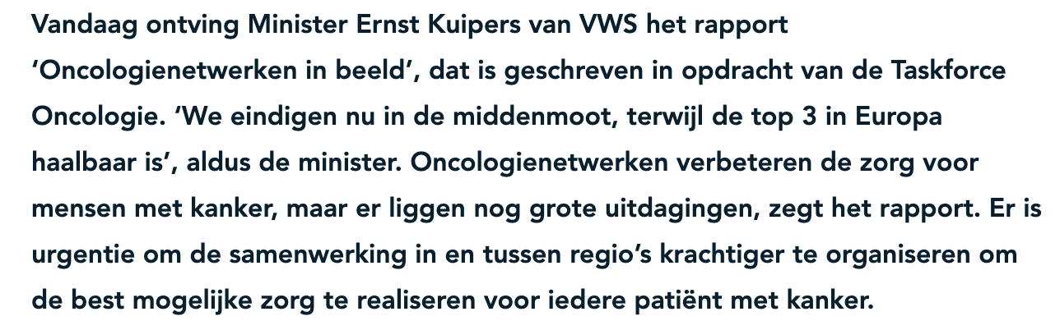
There are plenty of other challenges
How to reach the top 3 in Europe in cancer care

Slide 32
Performance has to be transparent
For each cancer type there are different indicators
Results give insight in the performance of doctors’ own hospital in comparison with others
It may be used to improve outcome

Slide 33
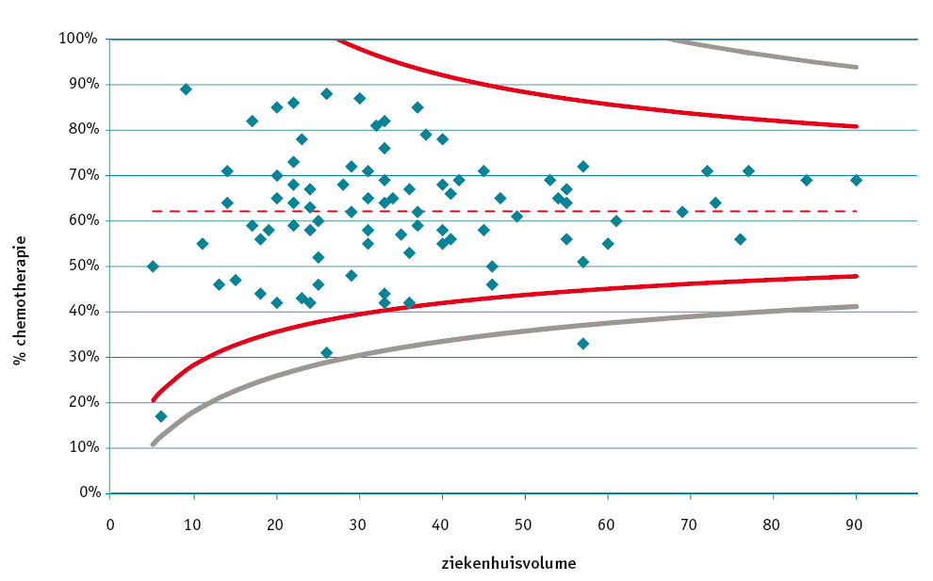
Hospital variation stage III colon cancer, adjuvant chemotherapy

Slide 34
CONCLUSIONS
Shared care in oncology is possible without compromising patient outcome
Good collaboration between local hospitals and university/ specialized hospitals is mandatory to guarantee high quality and innovation
All patients need to be discussed in a MDTM, for complicated cases in a regional MDTM
This is only feasible with optimal technical and administrative support
For complex surgery and systemic treatments patients should be referred to a specialized centre
Monitoring of outcome measures mandatory to ensure the highest quality of care for our patients

