Slide 1
Time for an upgrade?
Digital & data workforce deliberations: Bradford & West Yorkshire
Professor Liz Breen
Director of the Digital Health Enterprise Zone

Slide 2
The Background
Concerns about the sustainability of service provision, organisational functioning, cyber security and much more.
Informed by HEE report Data Driven Healthcare in 2030: Transformation Requirements of the NHS Digital Technology and Health Informatics Workforce (HEE, 2021).
1) Digital and Data Skills pipeline in Bradford place
2) ‘Top Up’ programme for West Yorkshire graduates.
Notes:
https://www.hee.nhs.uk/our-work/building-our-future-digital-workforce/data-driven-healthcare-2030

Slide 3
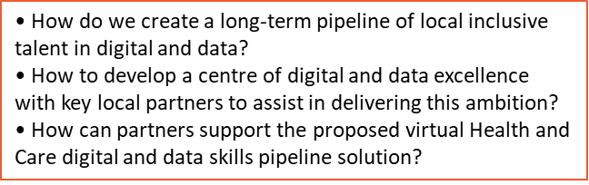
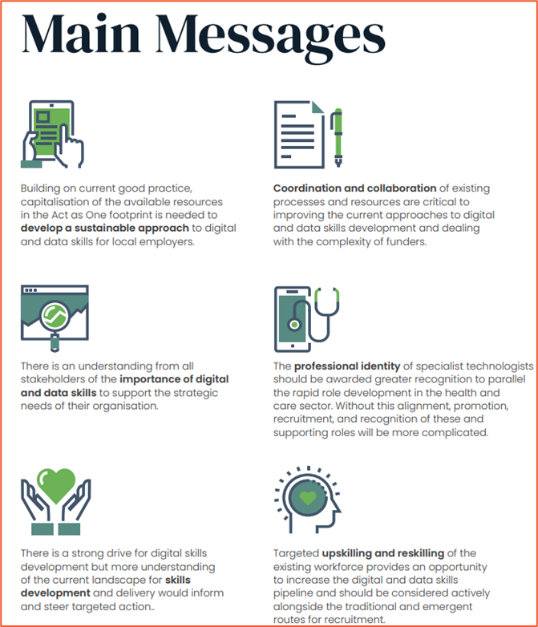

Notes:
NHS Business Services Authority (2023) Prescription Cost Analysis – England – 2022-23. Accessed: 23rd March 2023. https://www.nhsbsa.nhs.uk/statistical-collections/prescription-cost-analysis-england/prescription-cost-analysis-england-2022-23#:~:text=Key%20findings,while%20costs%20increased%20by%208%25.

Slide 4


Graduate Career Boost Programme
West Yorkshire

Slide 5
NHS challenges/policy
Equality, Diversity & Inclusion
NHS expert insights
Reflective Practice &
NHS Applications/
Mock interviews
Professional Identity
Research & Management
Digital/Simulation
Programme Content
Service Improvement
Project Management
Change Management
Notes:
NG80 Patient decision aid on asthma inhalers and climate change (nice.org.uk)

Slide 6
The future of our healthcare services…..
Lies in the hands of our workforce
People and automation not people v automation
Services are dynamic and so are people
Non-technical skills should be sought and nurtured
Value-based, inclusive and transparent recruitment should be the norm
Talent comes in many forms and from many quarters – diversity should be embraced – change it up!
Securing a sustainable digital workforce is challenging – embrace it!

Slide 7
So, is it time for an upgrade of your digital & data workforce?
Thank you

