Slide 1






County Durham and Darlington NHS Foundation Trust
Initiatives and Experience
Sue Jacques
Chief Executive
www.cddft.nhs.uk

Slide 2

October 2024
www.cddft.nhs.uk

Slide 3

www.cddft.nhs.uk

Slide 4





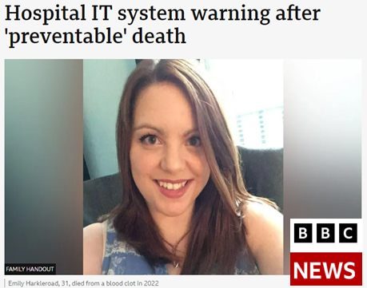
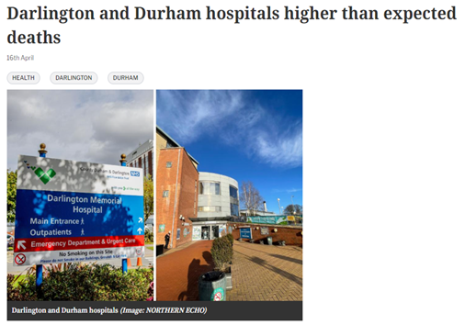

Trust ‘long way off’ EPR benefits a year after launch
Promoting communication and collaboration among teams
Enhancing patient safety
A trust is a “long way” from achieving the expected benefits of an electronic patient record system 15 months after launch, and it is still disrupting mortality data, its leaders have admitted.
Darlington and Durham hospitals higher than expected deaths
Improving
access to comprehensive and up-to-date medical information
Eliminating the need for paper-based records, and releasing more time to care
Supporting faster and more accurate decision-making
Culture Change
Training
Patient perception & confidence
Benefitting patients and healthcare professionals
www.cddft.nhs.uk

Slide 5
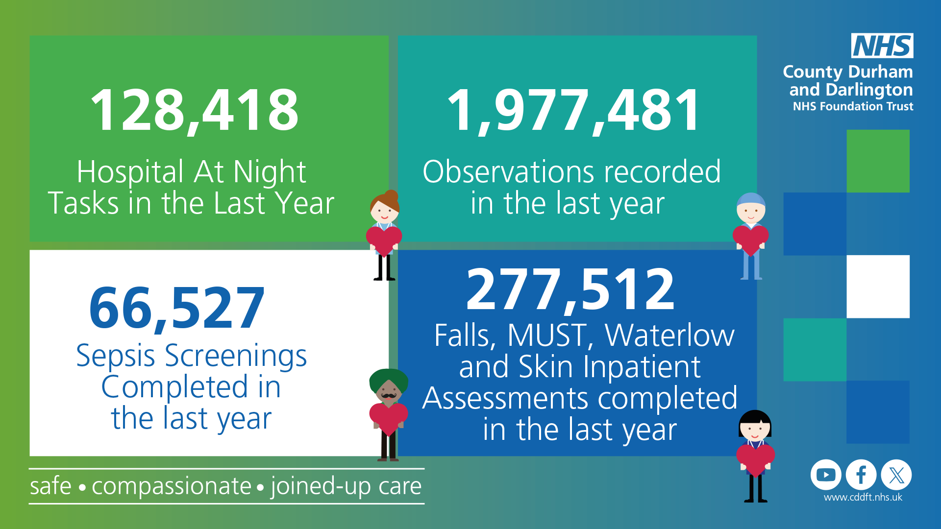
Over the last year…..
www.cddft.nhs.uk

Slide 6
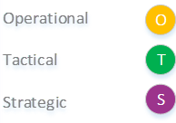
Digital Health Governance: A Path to Transformation
Good governance foundations drive digital transformation, enhance patient care, and support healthcare professionals
Governance Tiers
Benefits
S
Strategic Alignment
Effective Decision-Making
Resource Optimization
Enhanced Patient Care
Support for Healthcare Professionals
Addressing Challenges
Strategic Change and Investment Board
Digital Strategy Sub Committee
S
Digital Health Governance
Digital Clinical and Operational Advisory Group
S
T
Weekly Priorities Meeting
O
Scoping Review Meeting
O

Slide 7
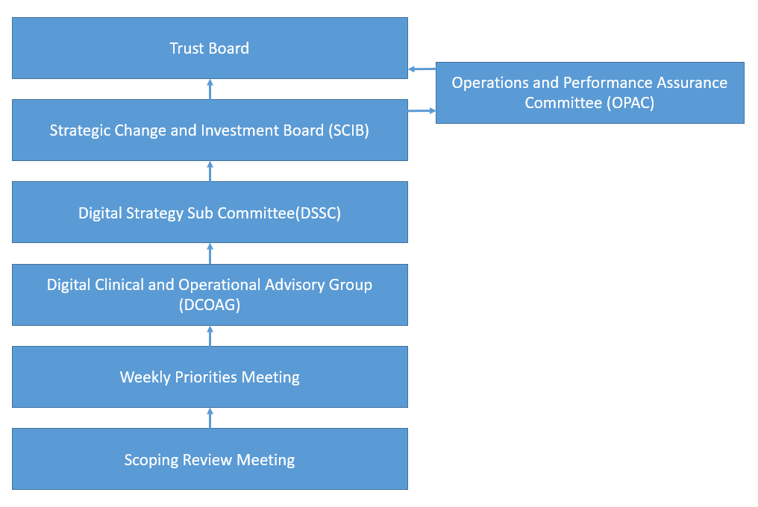
www.cddft.nhs.uk

Slide 8

Digital Journey and Future Strategy:
"Our journey doesn't end with EPR implementation; it's the beginning of an ongoing expedition. With each step forward, we navigate new territories of digital health, discovering better ways to serve our patients and improve our systems."
Future Strategy Roadmap
Assess and Improve Digital Maturity
Develop and Implement Roadmap
Enhance Patient Engagement
Ensure Scalability and Flexibility
Provide Training and Support
Foster Innovation and Partnerships
Continuous Improvement and Feedback

Slide 9


Support
Cooperate
Contribute
Collaborate
Harmonise
Teamwork
Help
Trust
www.cddft.nhs.uk

